Slide 1
NORP LLM CHATBOT EVALUATION
Notes:
Good afternoon everyone. We are here to present our project on "NORP LLM Chatbot Evaluation." This project aims to simplify SQL query generation for non-technical researcher scientists using Large Language Models, or LLMs. Let’s dive in.

Slide 2
Introduction and Motivation
Challenges:
Researchers struggle to extract insights from databases without SQL expertise.
Existing tools aren’t user-friendly for non-technical users.
Our Approach:
Simplify the process by translating natural language into SQL using LLMs.
Outcome:
Enhance accessibility for researchers while maintaining SQL query correctness.
Notes:
Social scientists and researchers often struggle with SQL queries due to a lack of technical expertise. However, SQL is crucial for extracting meaningful data and visual insights from databases. Existing tools lack user-friendly interfaces, which creates a barrier for these researchers. Our approach focuses on addressing this gap by translating natural language queries into SQL commands seamlessly. This enables researchers to access data insights without requiring SQL expertise.

Slide 3
Research Objective
Develop a chatbot system to convert user's english language queries into SQL commands.
Relevance to NORP Researchers:
Empowers researchers by simplifying access to database insights.
Bridges the gap between technical SQL tasks and intuitive data exploration.
Notes:
Our project focuses on developing a chatbot system that converts user natural language queries into SQL commands.
This system is particularly relevant to NORP researchers as it:
Empowers researchers by simplifying access to database insights, allowing them to focus on their analysis instead of writing complex SQL queries.
Bridges the gap between technical SQL tasks and intuitive data exploration, making data analysis accessible even for non-technical users.
This seamless integration ensures researchers can efficiently gain insights from their data without the technical hurdles.

Slide 4
Methodology
Action Plan
Utilize LLMs to transform natural language into SQL queries using annotated datasets.
Apply prompt engineering to enrich user inputs with schema and example rows for better context.
Establish a feedback mechanism for improving query quality and resolving errors iteratively.
Assess the SQL generation process using both NLP-based evaluation metrics and by running the generated queries on Metabase.
Goal
Attain precision and usability in SQL query generation tailored for non-technical research scientists.
Notes:
The goal of our project is to achieve precision and usability in SQL query generation tailored for non-technical users. We started by leveraging LLMs to transform natural language into SQL queries using annotated datasets. To improve context understanding, we applied advanced prompt engineering techniques. An iterative feedback mechanism was established to refine query quality and correct errors. We evaluated the SQL generation process using NLP-based metrics and by executing queries on Metabase.

Slide 5


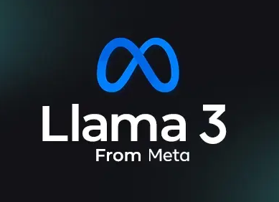


Tools and Technologies
LLMs:
Gemma1 7B, Gemma2 9B, Mistral 7B, LFM 40B MoE, LLaMA3 8b, Phi-3 3.8B
Infrastructure:
Public faced APIs and deployed open-source models on the PACE cluster.
Frameworks and Tools:
- Hosted LLMs through open-source APIs (compute resources on PACE cluster are insufficient to train a large LLM, limiting our ability to fine-tune them effectively)
- Tested the generated SQL queried on Metabase for performance evaluation and visualization.
- SQL parsers & frameworks to validate database.
Notes:
For this project, we used a range of tools and technologies:
LLMs such as Gemma1, Gemma2, Mistral, LLAMA, PHI, LMF
Infrastructure on the PACE cluster, although its computational limits prevented us from fine-tuning large models.
Tools like Metabase for executing and validating SQL queries. These tools helped us address various challenges while maintaining a focus on usability.

Slide 6
Prompt Engineering – An overview
What is it? Crafting inputs that guide the LLM to produce better outputs.
Approaches
Zero-Shot: Minimal context, basic results.
One-Shot: Incorporates a single example or hint to guide the output generation
Few-Shot: Uses multiple examples to provide a broader understanding and context of the task
Resource Used : www.promptinguide.ai
Notes:
Prompt engineering is the practice of designing and refining input prompts to effectively guide AI models, such as large language models (LLMs), to generate desired outputs.

Slide 7
Zero-Shot vs One-Shot vs Few-Shot
Zero-Shot Prompting
Prompting: Provides only the user's natural language query to the LLM.
Example: "Show total shootings by month."
Challenges: Limited context leads to incomplete or generic SQL outputs.
One-Shot Prompting
Prompting: Adds schema details to the prompt for structural guidance.
Example: "Show total shootings by month. Schema: Sales (month, total)."
Outcome: Improves query structure but struggles with handling logic and edge cases effectively.
Few-Shot Prompting
Prompting: Enriches the prompt with schema and sample data rows for context.
Example: "Show total shootings by month. Schema: Sales (month, total). Example rows: ('Jan', 1000), ('Feb', 2000)."
Outcome: Best performance for handling query generation by offering richer context.
Performance
Zero-Shot: Quick but lacks accuracy.
One-Shot: Schema guidance improves structure of the generated query.
Few-Shot: Best results for accurate SQL queries generation.

Slide 8
Evaluation Metrics
NLP Metrics
BLEU: Measures the degree of overlap between the generated and reference SQL queries. Useful for identifying word-level matches but limited in assessing SQL correctness.
ROUGE: Evaluates the recall of sequences in the generated queries compared to the reference queries. Effective for identifying structural similarities. (rouge-1, 2, l)
Levenshtein Distance: Measures the number of single-character edits (insertions, deletions, or substitutions) needed to transform one string into another.
Jaccard Similarity: Calculates the similarity between two sets by dividing the size of their intersection by the size of their union. Useful for assessing overlap.
Cosine Similarity: Measures the cosine of the angle between two vectors, capturing their similarity based on orientation rather than magnitude. Commonly used for text embeddings.
Semantic Parsers
Utilized to check the structure and logical validity of the generated SQL queries.
Focuses on whether the query aligns with the database schema and intended logic.
Challenges: Struggles with complex queries due to incomplete or missing explicit values.
Metabase Evaluation
Process: Execute the generated SQL queries on the database using Metabase.
Comparison: Matches the results of generated queries against annotated (desired) outputs.
Significance: Provides direct feedback on query accuracy and practical usability.
Notes:
Bleu – contiguous sequence of words from generated output to reference
Rouge – opposite

Slide 9
Performance Evaluation
Model | levenshtein_similarity | jaccard_similarity | cosine_similarity | bleu_score | rouge_1 | rouge_2 | rouge_l
LFM MoE | 0.217 | 0.165 | 0.129 | 0.026 | 0.518 | 0.305 | 0.462
Gemma | 0.251 | 0.166 | 0.122 | 0.016 | 0.515 | 0.291 | 0.46
Phi-3 | 0.112 | 0.076 | 0.07 | 0.008 | 0.319 | 0.176 | 0.259
Gemma 2 | 0.097 | 0.067 | 0.076 | 0.006 | 0.296 | 0.156 | 0.244
Mistral 8x7B | 0.102 | 0.07 | 0.057 | 0.004 | 0.304 | 0.164 | 0.244
Llama 3.2 | 0.12 | 0.02 | 0.021 | 0.001 | 0.147 | 0.054 | 0.123
SIMPLE QUERIES
Model | levenshtein_similarity | jaccard_similarity | cosine_similarity | bleu_score | rouge_1 | rouge_2 | rouge_l
LFM MoE | 0.094 | 0.117 | 0.179 | 0.008 | 0.451 | 0.217 | 0.332
Gemma | 0.122 | 0.112 | 0.143 | 0.006 | 0.427 | 0.203 | 0.328
Phi-3 | 0.071 | 0.069 | 0.126 | 0.005 | 0.357 | 0.153 | 0.237
Gemma 2 | 0.061 | 0.076 | 0.109 | 0.007 | 0.366 | 0.162 | 0.238
Mistral 8x7B | 0.066 | 0.071 | 0.093 | 0.006 | 0.346 | 0.161 | 0.229
Llama 3.2 | 0.094 | 0.021 | 0.033 | 0.001 | 0.128 | 0.045 | 0.096
COMPLEX QUERIES
Model | LFM MoE | Gemma | Phi-3 | Gemma 2 | Mistral 8x7B | Llama 3.2
Zero Shot | Worse | Worse | Worse | Worse | Worse | Worse
One Shot - Schema | Average | Average | Poor | Poor | Poor | Worse
Few Shot – Schema, Sample Data Rows | Good | Good | Average | Average | Poor | Poor
PROMPT ENGINEERING
Notes:
LFM n Gemma are the best
LFM better on manual evaluation
Gemma 2 worse than Gemma 1
LLama significantly worse than every other model
Bleu scores nearly same in complex

Slide 10
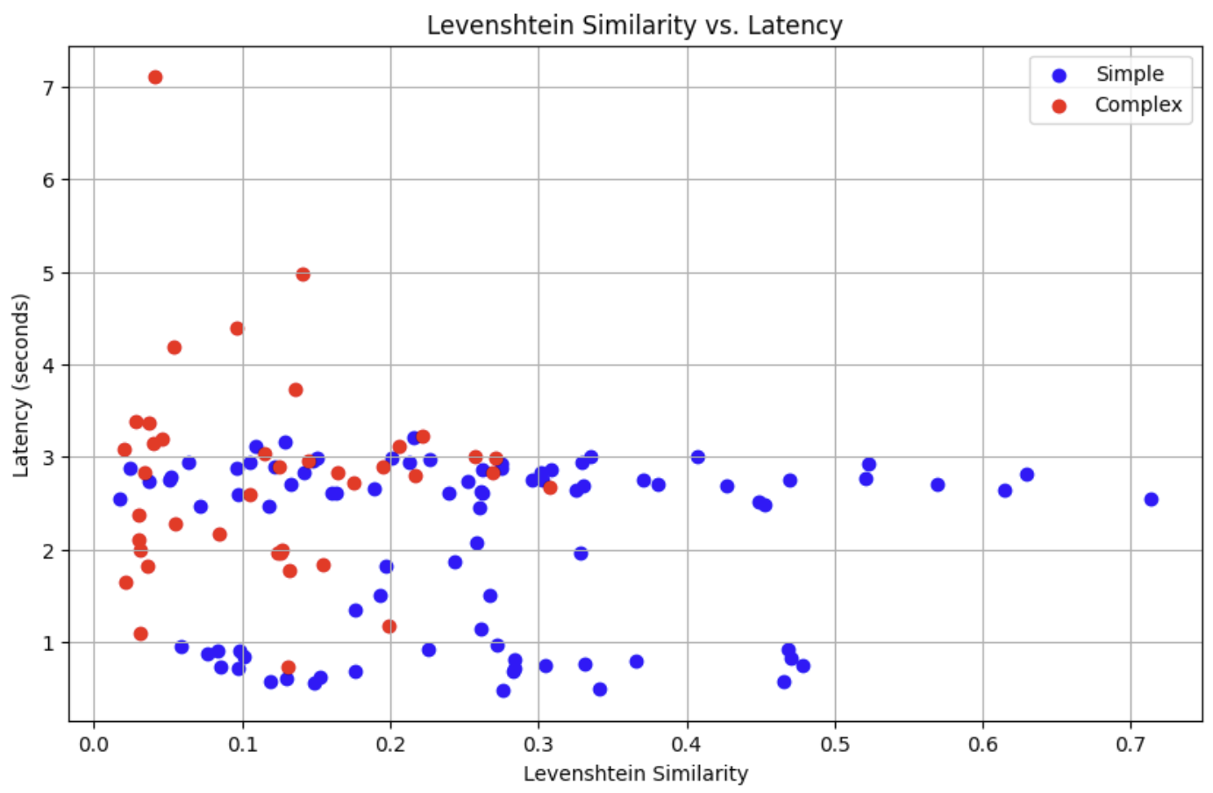
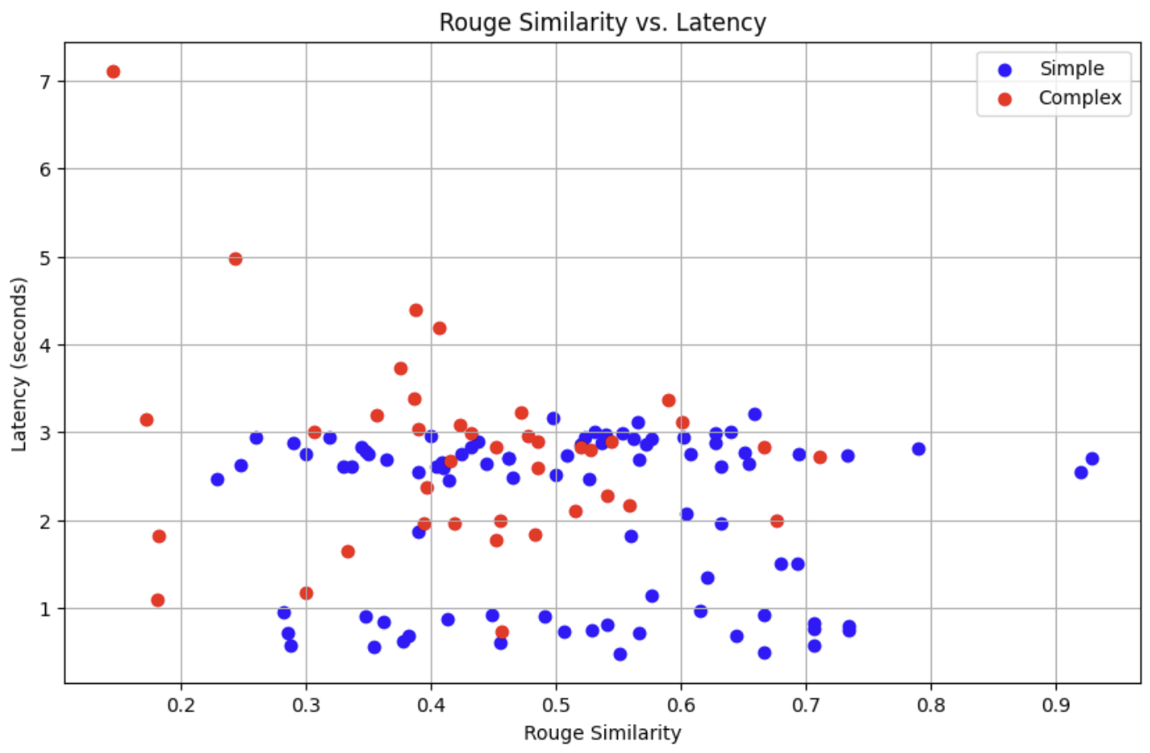
Simple vs Complex Latency analysis
Notes:
Low performace of complex
Good range of latency for complex with few taking very long.
Simple queries take less than 3 sec and with significant amount less than one sec
We can see that some sample queries have significantly high levenshtien similarity
From the rouge metric, the similarity scores are similar with the outliers of simple being better and outliers of complex being worse

Slide 11
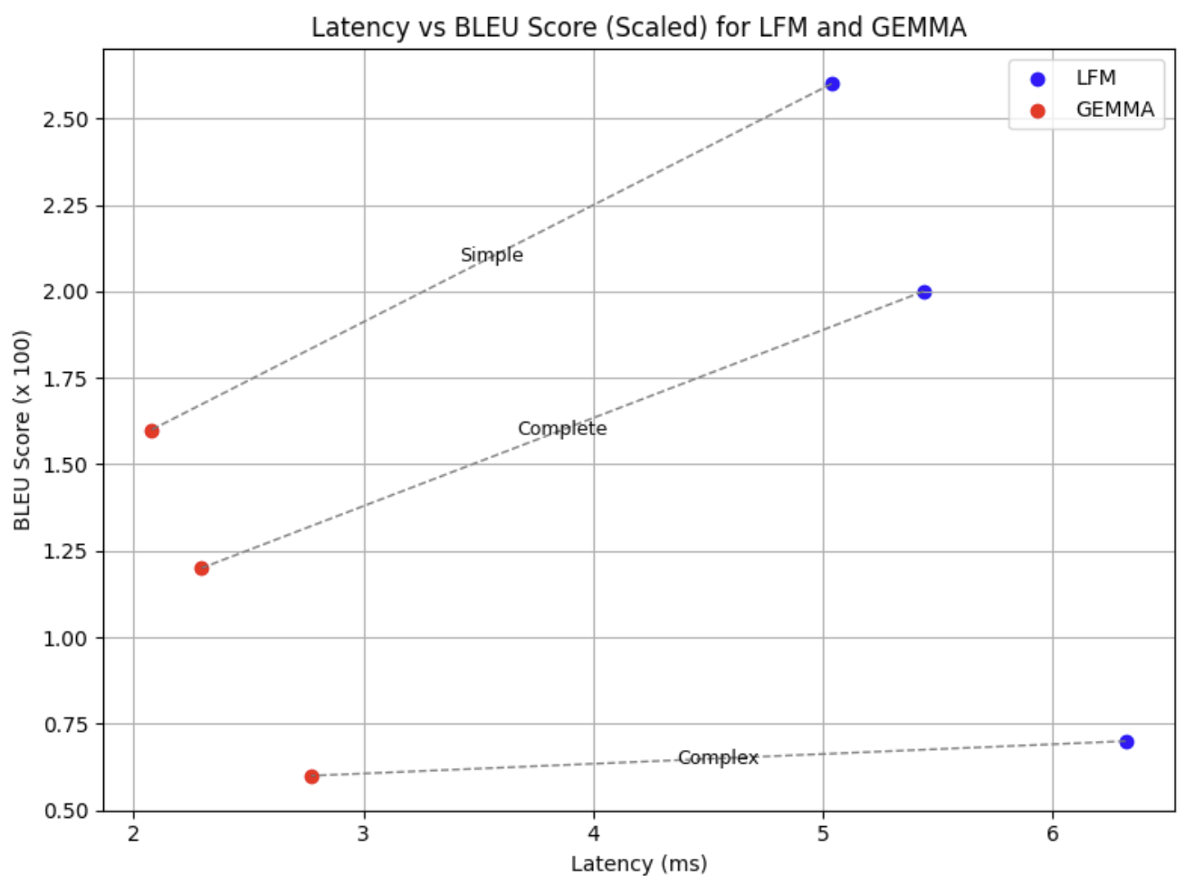
Gemma1 vs LFM Model Insights
The LFM model on average takes longer to provide a response for SQL generation and the effective ratio is roughly the same for simple and complex queries.
However, it is important to note the difference in bleu scores for simple and complex. It is seen that LFM barely performs better on complex and vastly performs better on simple queries

Slide 12
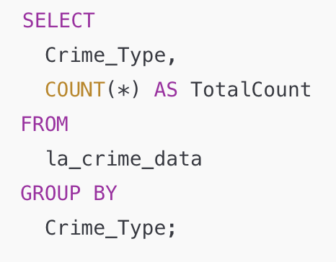
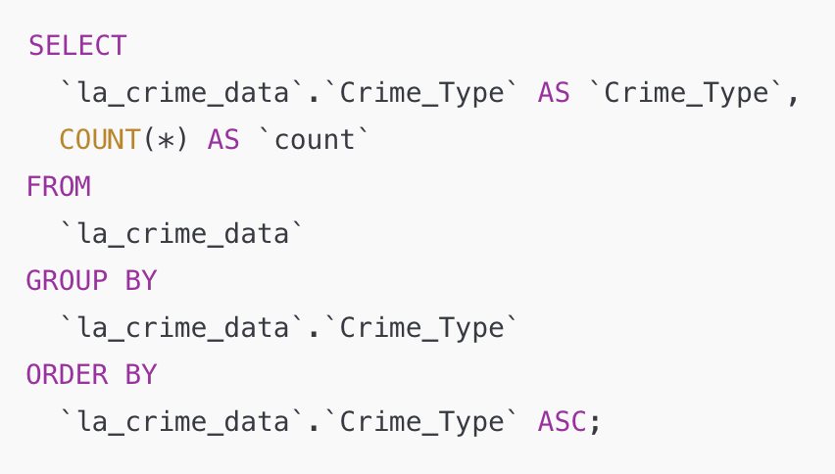
LLM-GENERATED VS IDEAL SQL QUERY (SIMPLE QUERY)
Prompt : Give the total count of each crime in LA.
Notes:
Here’s an example of a simple query on the crime dataset where the LLM-generated SQL matches the ideal SQL output efficiently.
The generated query avoids unnecessary complexity while delivering the desired results.
This demonstrates how LLMs perform well with straightforward queries, particularly when schema details and structure are less complex.

Slide 13
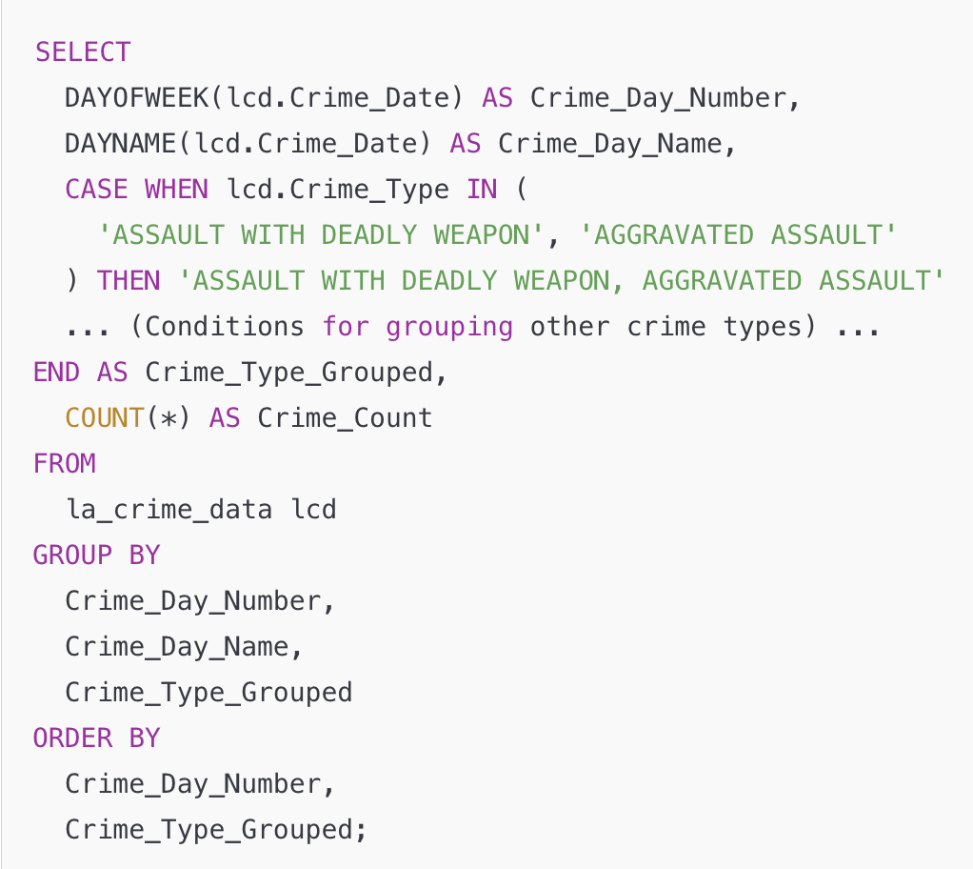
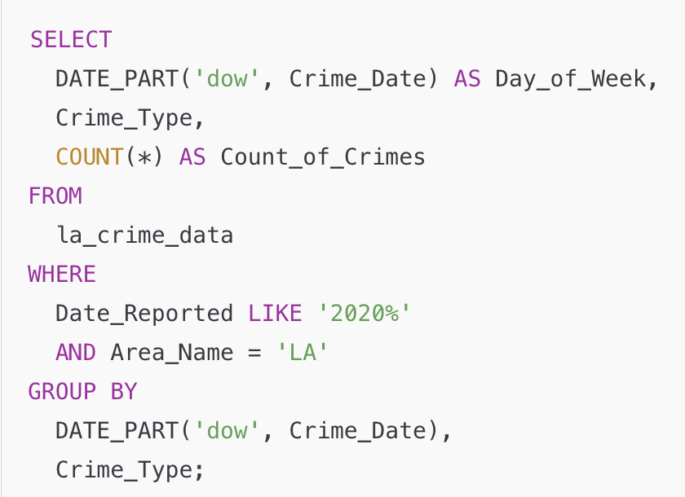
LLM-GENERATED VS IDEAL SQL QUERY (COMPLEX QUERY)
Prompt : Give count of each crime type for each day of the week in LA.
Notes:
In contrast, here’s an example of a complex query where LLM-generated SQL falls short.
The limitations of LLMs become apparent when handling operations like joins, CASE statements, or queries requiring knowledge of the data itself.
Without understanding the underlying data values or schema relationships, the LLM cannot accurately generate queries for such scenarios.
This highlights a critical gap in LLM capabilities: while they excel in generating syntactically correct queries, they struggle with deeper semantic understanding and data-specific logic.

Slide 14
Challenges and Learnings
Challenges:
Generic Metrics: Metrics like BLEU and ROUGE are insufficient for evaluating SQL correctness, as they focus on text overlap rather than execution accuracy.
Learnings:
Impact of Prompt Design: Clear, context-rich prompts (e.g., few-shot prompting) significantly improve query accuracy and reduce iterations.
Limited Dataset Context: LLMs are not that great at writing complex queries because their ability is restricted by the lack of prior knowledge about the dataset entries.
Iterative Refinement Needed: Complex queries require multiple iterations to achieve desired outputs, increasing time and effort.
Coding-Optimized LLMs: LLMs shown to perform well in coding tasks (like LFM) also demonstrate better performance in writing SQL queries compared to general-purpose models.
Feedback Loop Effectiveness: Iterative feedback allows the system to refine errors in real-time, enhancing both usability and output quality.
Notes:
We discuss about the challenges and learnings from our project.
Under Challenges, we faced:
Generic Metrics like BLEU and ROUGE, which aren’t suitable for SQL correctness.
Limited Dataset Context, as LLMs lack prior knowledge of data entries.
The need for Iterative Refinement to achieve accurate outputs.
For Learnings, we observed:
The Impact of Prompt Design, where clear, structured prompts improved accuracy.
Coding-Optimized LLMs performed better in SQL generation compared to general-purpose models.
Feedback Loop Effectiveness, where iterative refinement enhanced accuracy and usability in real-time.
These insights guided our approach and future directions.

Slide 15
LLM Usage
We used LLMs such as GPT-4 for simple coding tasks such as:
Code for better plots and visualization
Sample code generation for understanding the OpenAI python library and its functions
We also used LLMs to improve our understanding of the metrics used in the analysis

Slide 16
Understanding Performance Limitations and Future Scope
Why Does Performance Fall Short?
General-Purpose Constraints: Gemma is not specialized for SQL generation, and the limited annotated dataset prevents us from fine-tuning it to schema-specific tasks, resulting in suboptimal outputs for complex queries.
Evaluation and Query Complexity: Metrics like BLEU and ROUGE only assess textual overlap, overlooking execution correctness, while complex SQL queries require detailed schema knowledge that Gemma lacks by default.
Future Directions
Advanced Prompting: Using improved prompting methods like incremental and schema-specific examples, can significantly enhance query accuracy and reduce iteration cycles.
Specialized Models: Explore SQL-focused LLM models that can better generate queries and host them on PACE cluster. Fine-tuning them on a larger annotated dataset will improve the performace.
Notes:
We need specialized models, current gen performance models don’t suffice
Need to fine-tune models on much larger annotated datasets
Better evaluation metrics
We need to implement better prompt engineering techniques along with hosting a SQL focused LLM on PACE cluster

Slide 17
CONCLUSION
The use of large language models (LLMs) such as Gemma, LFM and Llama for SQL query generation demonstrates potential but faces challenges due to limited context and dataset size.
Prompt engineering, combined with feedback loops, enables iterative improvement but cannot fully address the complexity of generating precise SQL queries without database-specific knowledge.
Current models like Gemma are general-purpose and not fine-tuned for SQL tasks, leading to suboptimal performance for complex queries.
While LLMs have shown promise in assisting researchers, evaluation metrics such as BLEU and ROUGE are insufficient for assessing SQL correctness, needing Metabase execution-based validations.
Future advancements in dataset size, specialized models and improved prompting techniques are the key to overcoming these limitations and achieving better SQL generation capabilities.

Slide 18
L1 Skills
General Skills
Reading and Writing:
Interpreting project documentation and articulating SQL queries clearly.
Fact vs. Opinion:
Analyse performance on real data to check assumptions on model performance
Technical Skills
Programming Techniques:
Automating LLM integration and SQL validation using Python
Tool Familiarity:
Using open-source APIs and Metabase for query generation and evaluation.
SQL Basics:
Debugging and validating SQL queries generated by the models using parsers.
Logical Reasoning:
Understanding how natural language maps to SQL structures effectively.
Notes:
Going over Metabase documentation
Talk about assumption on Gemma vs Gemma 2
Tools:
Using Open-Source API
Using Metabase for query evaluation
SQL validation in python in along with SQL parsing
Automating the LLM integration and SQL generation and evaluation

Slide 19
L2 Skills
General Skills
Validating Assumptions:
Running the generated SQL queries against Metabase helped in understanding BLEU limitations.
Innovative Synergy:
Advanced Prompt Engineering combined with automation and feedback loops to generate better SQL queries
Technical Skills
Advanced Prompt Engineering:
Experimenting with zero-shot, one-shot, and few-shot prompting techniques.
Innovative Synergy:
Advanced Prompt Engineering combined with automation and feedback loops to generate better SQL queries.
Framework Integration:
Integrating LLMs, Metabase, evaluation frameworks to help social scientists.
Applying Theory in Practice:
Utilizing LLMs like LLAMA, Gemma for real-world SQL query generation.
Notes:
For L2 Skills, we focused on:
General Skills: Applying theory in practice by utilizing LLMs like Llama and Gemma for SQL query generation, and validating assumptions through Metabase to understand BLEU's limitations.
Technical Skills: Advanced prompt engineering with techniques like zero-shot and few-shot prompting, combined with frameworks and automation to enhance query accuracy and usability.

Slide 20
L3 Skills
General Skills
Generalization/Specialization:
Recognizing the limits of general-purpose LLMs and the value of fine-tuned models.
Systems Thinking:
Technical Skills
Advanced AI/ML Understanding:
Leveraging insights from model performance trends (e.g., Gemma vs. LFM).
LLM Deployment:
Deploying and fine-tuning LLMs on platforms like the PACE cluster for optimal performance.
Trend Recognition:
Understanding the application pull for LLMs in domains like NORP.
Evaluating centralized cloud systems vs. decentralized local deployments for LLMs.
Notes:
For L3 Skills, we focused on:
General Skills: Recognizing trends in LLM application for specific domains like NORP and understanding the value of fine-tuned models for specialized tasks like SQL generation.
Technical Skills: Leveraging insights from advanced AI/ML techniques, deploying LLMson PACE clusters, and exploring the balance between centralized and decentralized systems for LLMs. Since pace takes too long, cloud based apis were the way to go

Slide 21

THANK YOU
Chetan Reddy Bojja
chetanreddy.b@gatech.edu
Chathurvedhi Talapaneni
ctalapaneni3@gatech.edu

