Slide 1
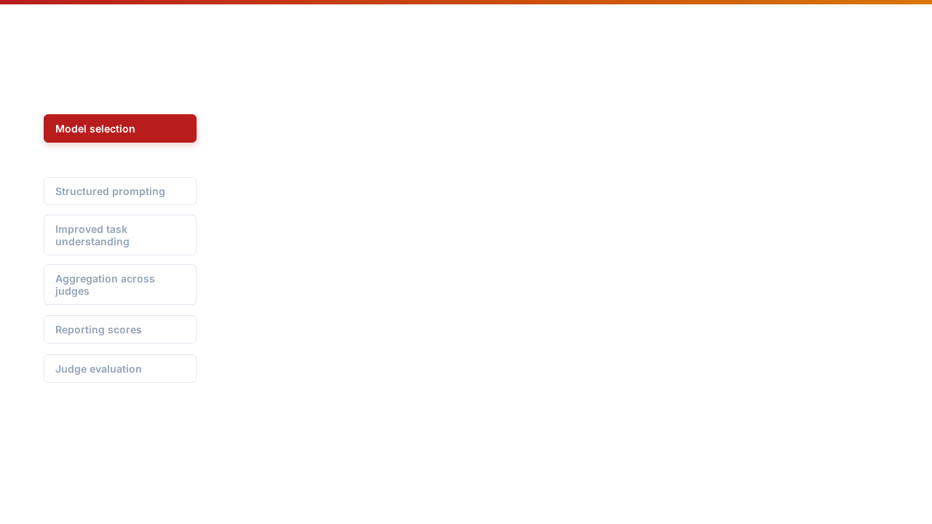













01. MODEL SELECTION BEST PRACTICES
Frontier LLM / LLM Scale
S T R A T E G Y
R E S E A R C H
Utilize frontier LLMs (GPT-4/5, Claude Opus). The judge should be at least as capable as the generator (preferably stronger).
Supports high human agreement. G-Eval p=0.514; MT-Bench >80% agreement.
Smaller LLMs
S T R A T E G Y
R E S E A R C H
Use fine-tuned SLMs for narrow tasks or in jury setups. Task-specific judges often outperform general models for hallucinations.
PandaLM-7B reaches 93.75% of GPT-3.5 ability. PoLL (Haiku/Command R) is than GPT-4.
STRATEGIC ALIGNMENT FRAMEWORK
SLIDE 01 / 04

Slide 2
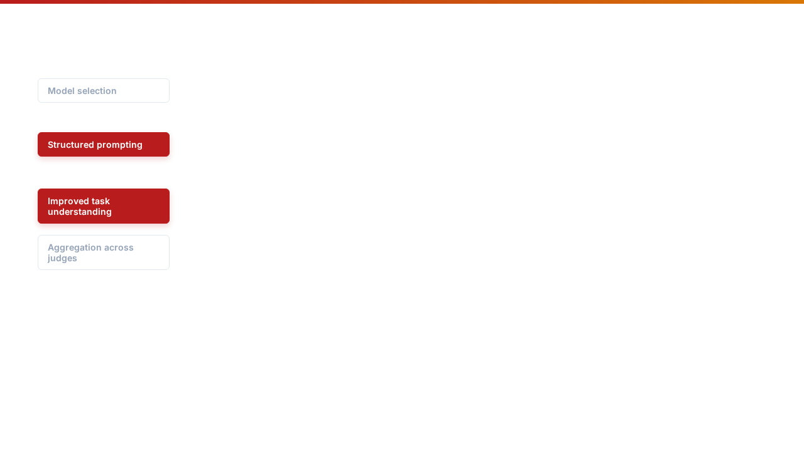




02. PROMPTING & TASK UNDERSTANDING
Prompt Architecture
S T R A T E G Y
R E S E A R C H
Define task, role, and metric explicitly. Use JSON schemas to control formatting and style/verbosity bias.
leads to more consistent judgments. RAGAS separates dimensions like faithfulness for clearer metrics.
Task Understanding
S T R A T E G Y
R E S E A R C H
Decompose evaluation into claim extraction & verification stages. Require evidence attribution for all verdicts.
Few-shot examples anchor task interpretation. are reliable when split into sub-tasks.
STRATEGIC ALIGNMENT FRAMEWORK
SLIDE 02 / 04

Slide 3
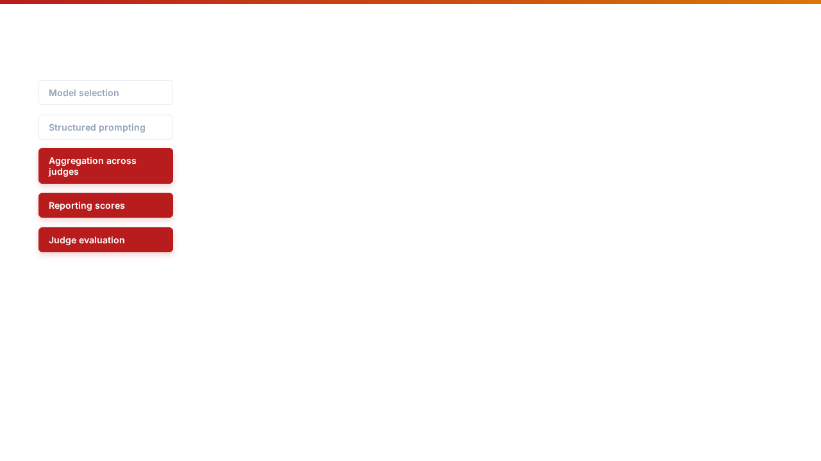












03. AGGREGATION, REPORTING & EVAL
Consensus & Aggregation
S T R A T E G Y
R E S E A R C H
Use heterogeneous panels (PoLL) to reduce model-specific bias. Approaches include majority voting and reliability weighting.
methods assign influence to stronger judges. Diverse panels outperform single large models.
Continuous Scoring
M E T R I C S
R E S E A R C H
RAGAS-style source-grounded scoring captures and provides transparent evidence.
STRATEGIC ALIGNMENT FRAMEWORK
SLIDE 03 / 04

Slide 4
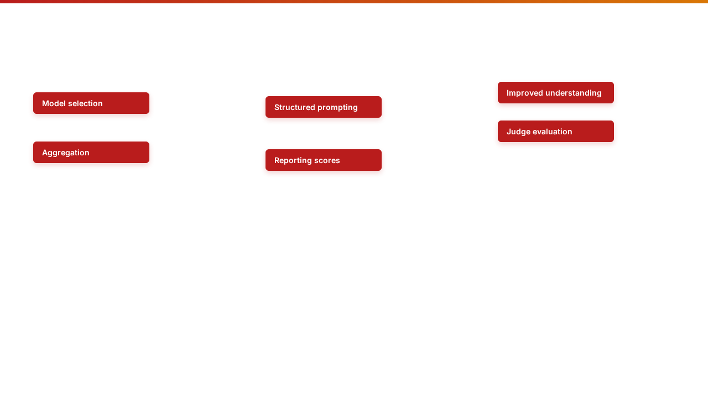





SYSTEM FRAMEWORK OVERVIEW
STRATEGIC ALIGNMENT FRAMEWORK
SLIDE 04 / 04

