Slide 1

STACK OVERFLOW
DEVELOPER SURVEY 2019
AMMANABROLUCHETANSHANKAR
JAN 8TH 2024
https://www.linkedin.com/in/ammanabroluchetanshankar/

Slide 2

OUTLINE
Executive Summary
Introduction
Methodology
Results
Visualization – Charts
Dashboard
Discussion
Findings & Implications
Conclusion
Appendix

Slide 3

EXECUTIVE SUMMARY
Data contextualization and analysis goal.
Methodology description.
Data gathering.
Data analysis.
Data visualizations.
Results presentation supported with graphs and trends.
Discussion of overall findings and implications regarding
the results previously exposed.
Final conclusions of the carried out research.

Slide 4

INTRODUCTION
Stack Overflow’s annual Developer Survey is the largest and most comprehensive survey of people who code around the world.
Results don’t represent everyone in the developer
community evenly.
Nearly 90,000 developers.
Trends to predict where the developers are going.
Characterization of developers around the globe.

Slide 5

METHODOLOGY
Collect survey data & explore its content
Web Scraping
APIs.
Request library.
Data Wrangling
Exploratory data analysis
Analyzing data distribution.
Handling outliers.
Correlations.
Data Visualization
Highlight distribution of data, relationships, the composition and comparison of data.
Dashboards

Slide 6

RESULTS

Slide 7
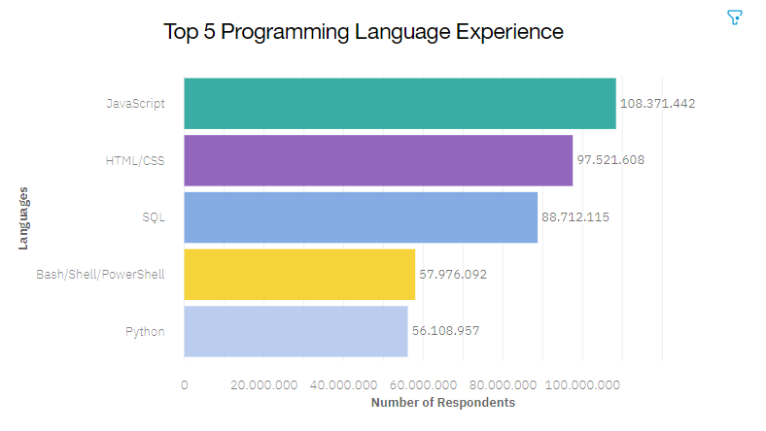
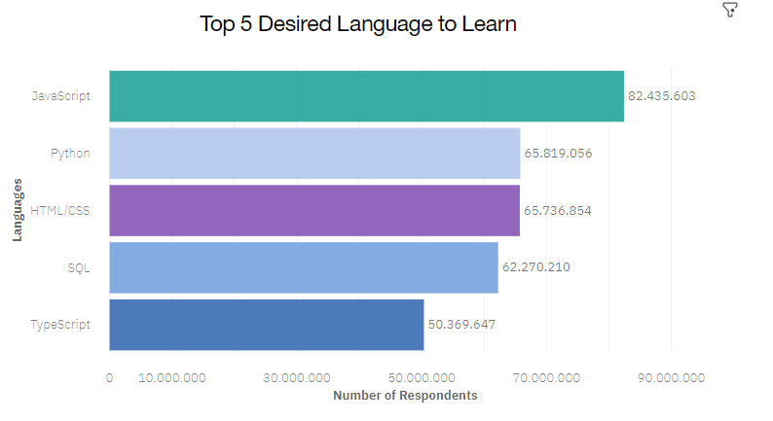
PROGRAMMING LANGUAGE TRENDS
Current Year Next Year

Slide 8
PROGRAMMING LANGUAGE TRENDS - FINDINGS & IMPLICATIONS
Findings Implications
JavaScript seems to keep as leading language.
Python fastest-growing.
Great interest in TypeScript
Possible developers migration from JavaScript to TypeScript.

Slide 9
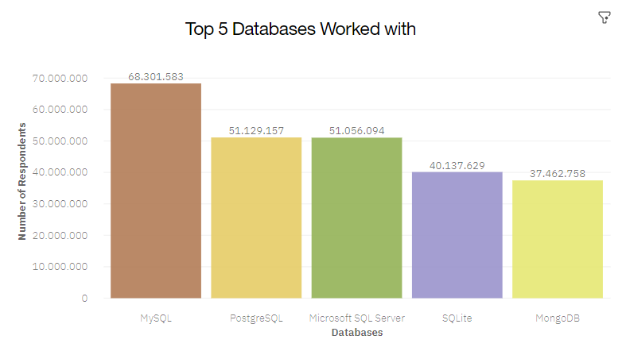
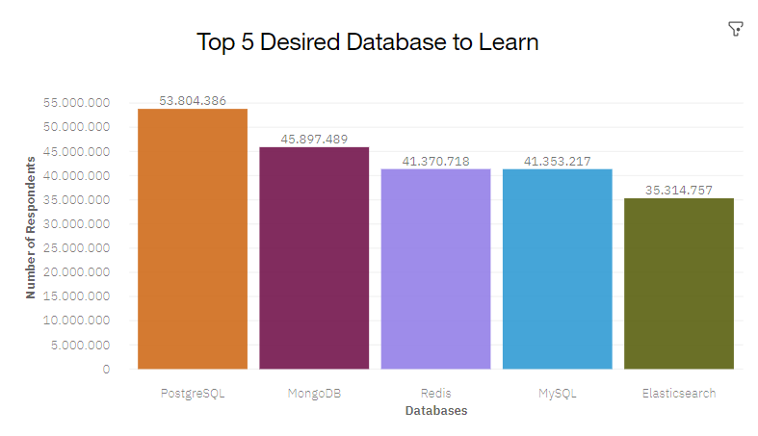
DATABASE TRENDS
Current Year
Next Year

Slide 10
DATABASE TRENDS - FINDINGS & IMPLICATIONS
Findings Implications
MySQL as most used database.
Lack of interest in Microsoft SQL Server and SQLite.
Increasing interest in PostgreSQL and MongoDB.
Microsoft SQL Server and SQLite losing ground in the market.
PostgreSQL and MongoDB establishment in the market.

Slide 11
DASHBOARD
https://dataplatform.cloud.ibm.com/da shboards/380a93e5-f4a1-4e4d-9841- 4966b65d676b/view/4c21e17d12b36af 74bfcc0e407cf7a0f7d35250fbabb8456d 6d77b490a327397f33b1590c87c1d5b8
9130561a5bf110acc

Slide 12
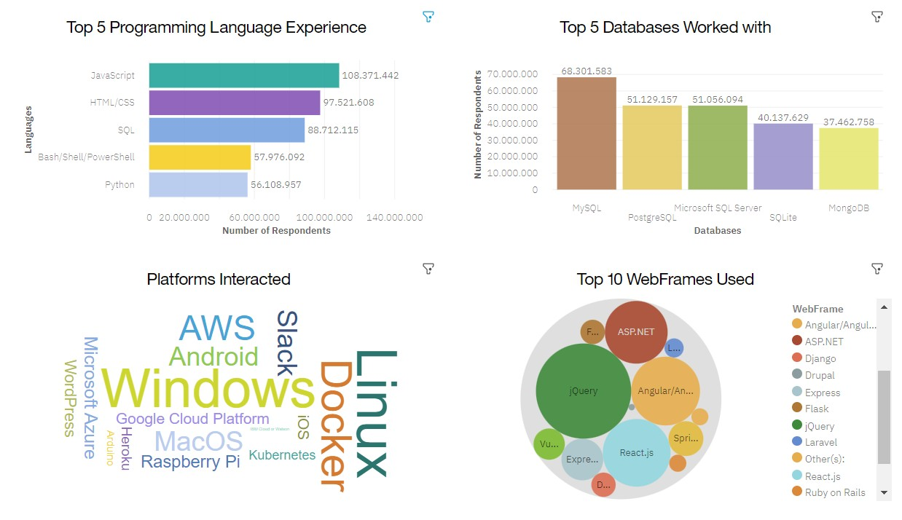
CURRENT TECHNOLOGY USAGE

Slide 13
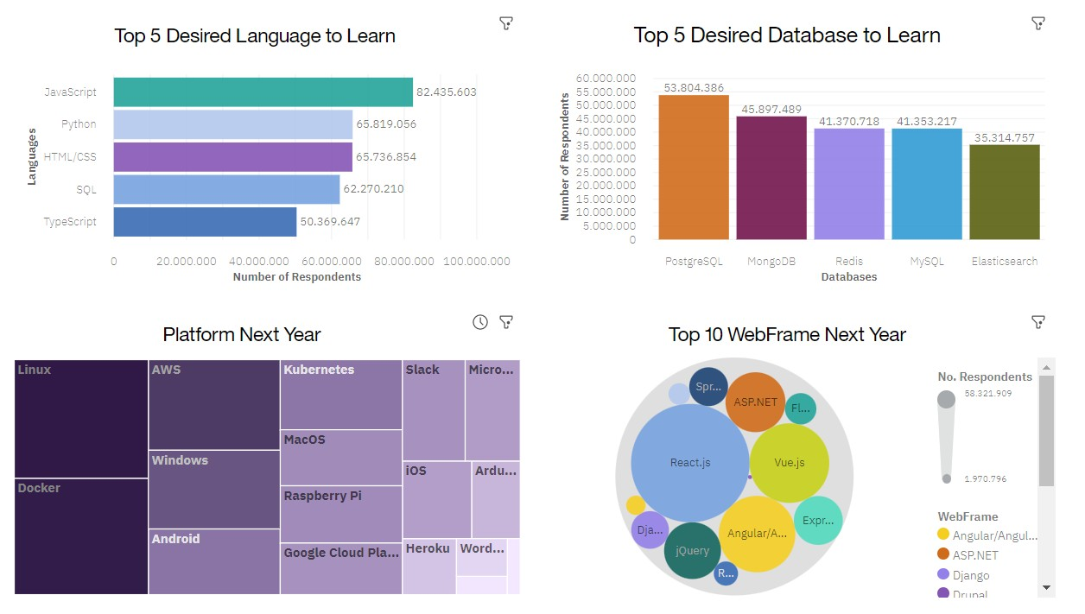
FUTURE TECHNOLOGY TREND

Slide 14
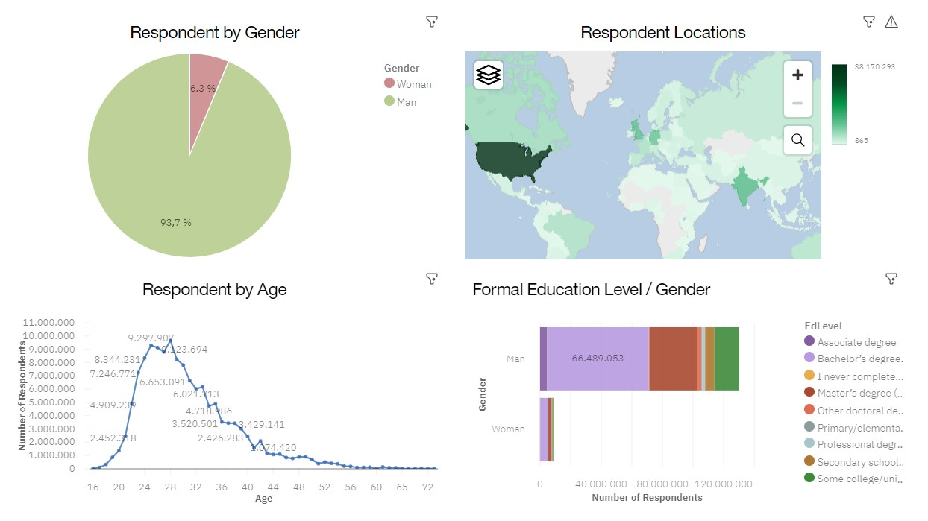
DEMOGRAPHICS

Slide 15
DISCUSSION

Slide 16
OVERALL FINDINGS & IMPLICATIONS
Findings Implications
JavaScript widely used and TypeScript getting popular.
Over 90% young male developers.
Developers mostly located in developed countries.
JavaScript and TypeScript web frames gaining followers.
Global polarization of developers location and gender.
Young developers without postgrad studies on its majority.

Slide 17




CONCLUSION
Developers are people with very marked characteristics.
A good idea of popularity trends of different tools, platforms and languages can be obtained.
There is a job to be done to spread accessibility of this labor market to countries in development.

Slide 18

APPENDIX

Slide 19
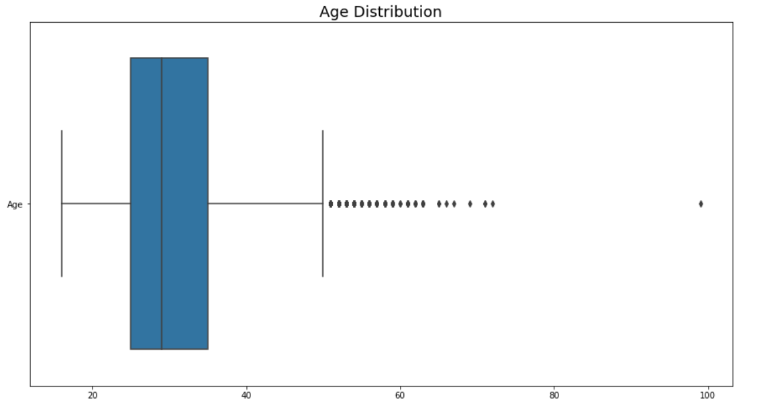
AGE DISTRIBUTION BOXPLOT

Slide 20
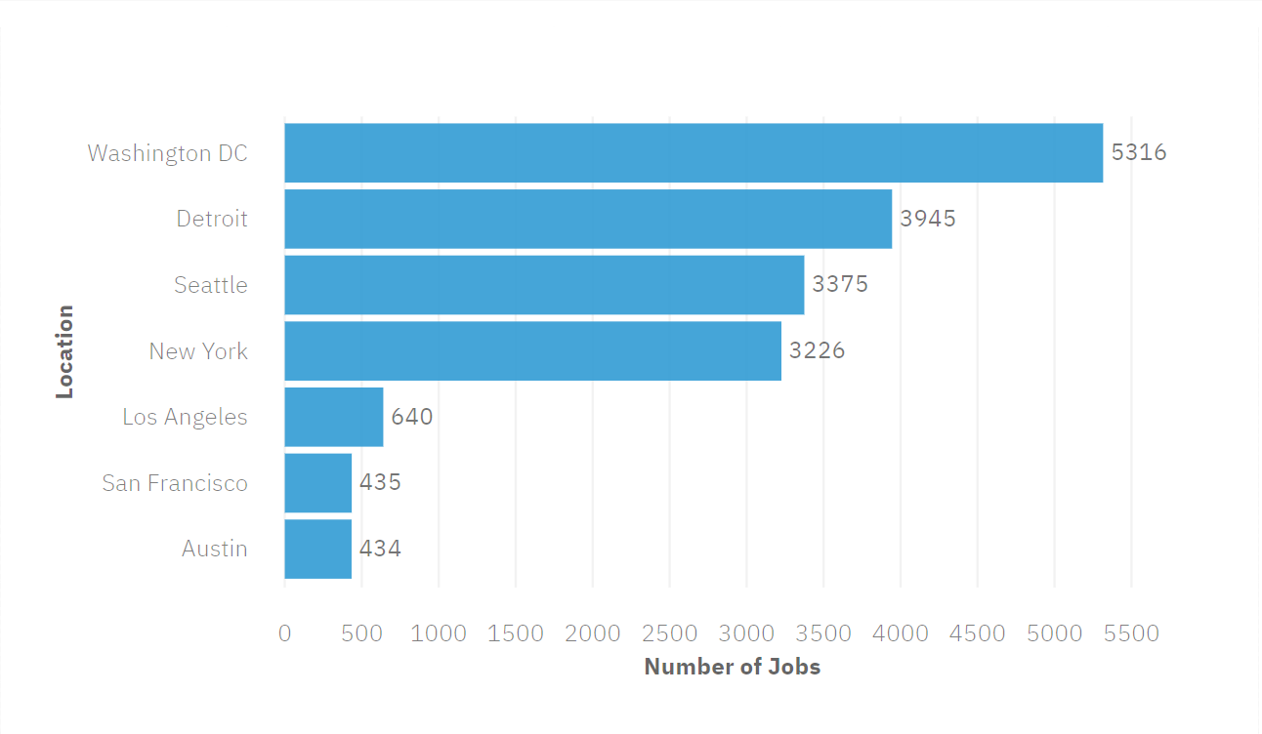
JOB POSTINGS

Slide 21
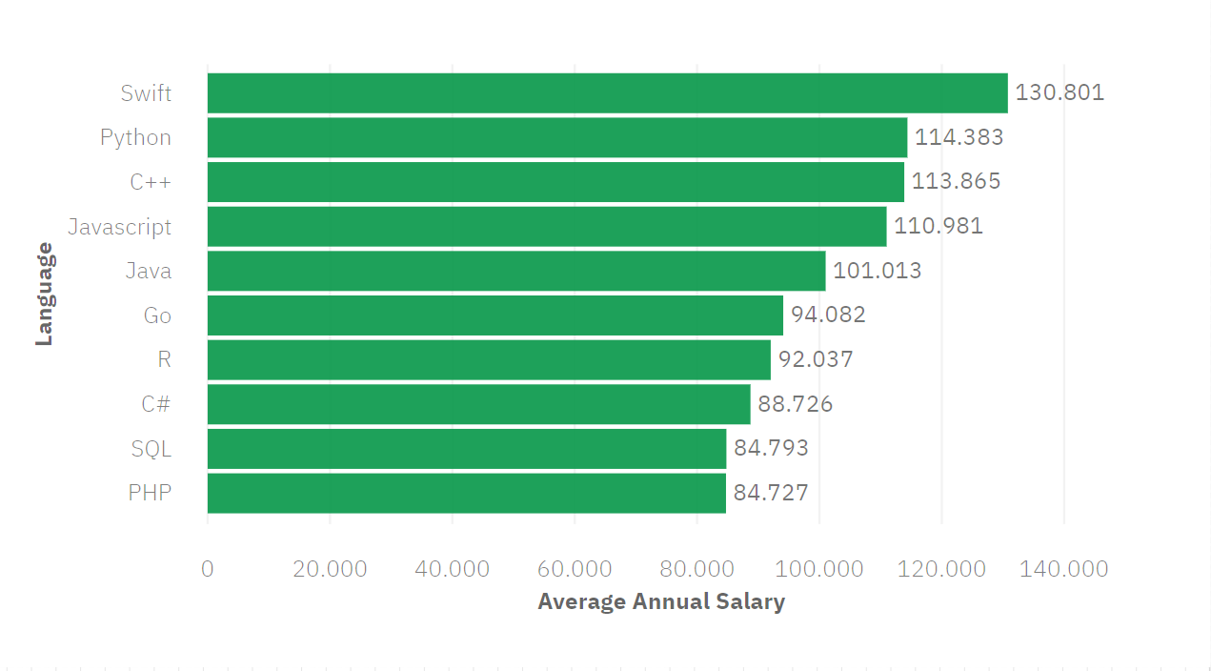
POPULAR LANGUAGES

