Slide 1
CLUSTER ANALYSIS ON THE NEIGHBOURHOODS OF WEST HYDERABAD

Slide 2
Introduction
There are more than 2000 restaurants in Greater Hyderabad region. Hence, to open any kind of restaurant in the city will be a challenging task for the investor.
For the past 5 years we have seen a significant increase in the business related to canteens and restaurants. So, we will have a better insight if we can answer the following.
What type of restaurant would it be?
What would be the best place for it?

Slide 3
Source of the Data and its properties
Initially we have to go through the selection of the neighbourhoods in west Hyderabad. Collection of the information for the selected neighbourhoods can be done by using Geopy and Foursquare API. To visualize the information, we use Folium library.
Using Foursquare API, collect the top 100 restaurants maximum and their categories for each neighbourhood within a radius 1500 meters.
Neighbourhood, Neighbourhood latitude, Neighbourhood longitude, Venue, Venue latitude, Venue longitude and Venue category are the features we work to do clustering.

Slide 4
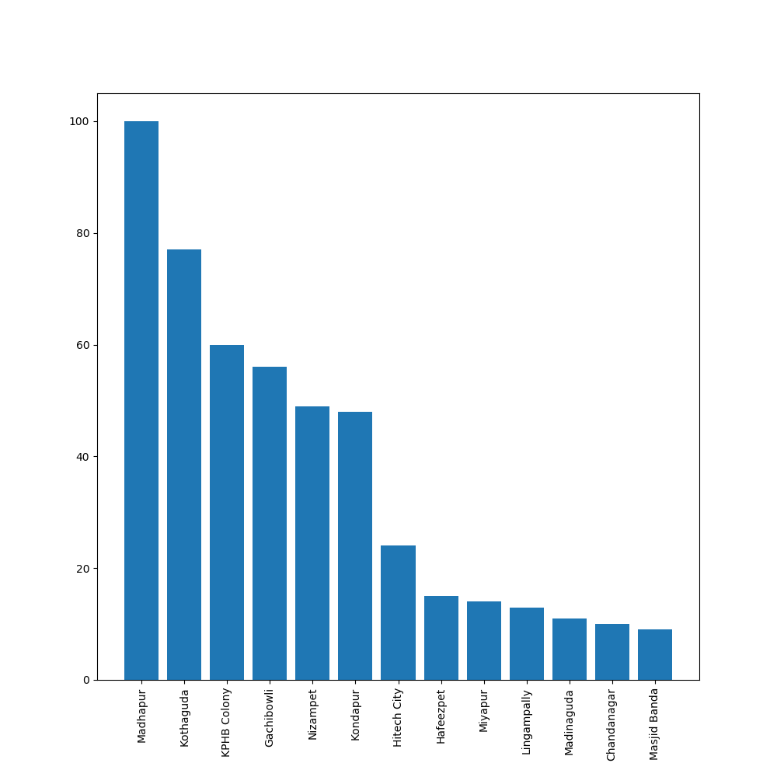
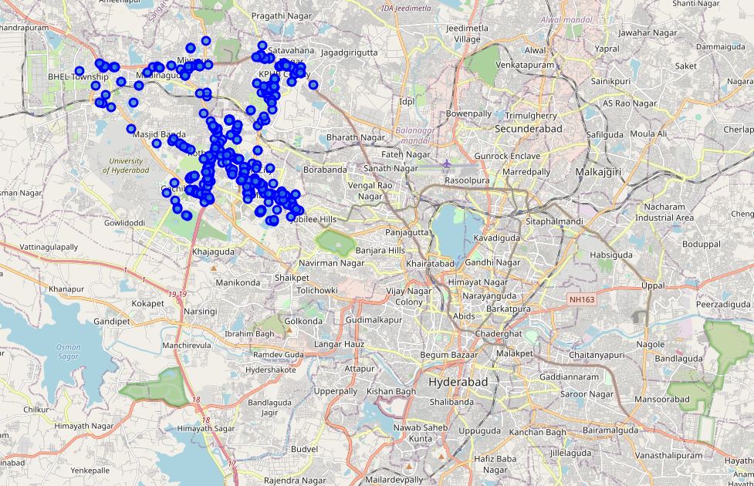
Exploratory Data Analysis
Frequency of Venues at each Neighbourhood
Visualization of the Venues

Slide 5




Modelling
We have to do one-hot encoding. In this, we will calculate the frequency of venue category with each neighbourhood by grouping with neighbourhood feature and also identify the top 10 common venues in each neighbourhood.
The cluster categories are allocated to each neighbourhood.
Frequency of venues in each cluster
Cluster 0
Or Shopping
Cluster 1
or Recreational
Cluster 2
or Residential

Slide 6
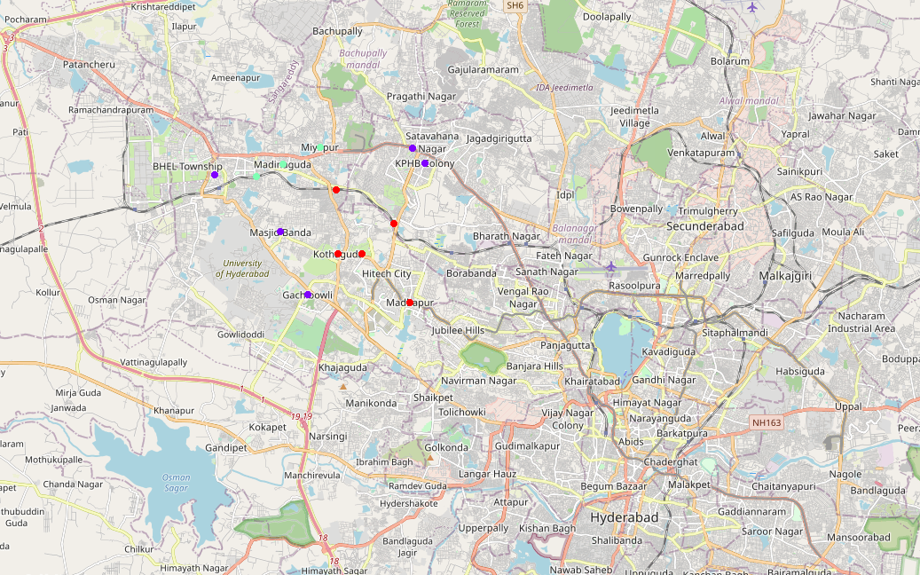
Visualization of the Clusters
Red – Cluster 0
Blue – Cluster 1
Sea Green - Cluster 2

Slide 7
Conclusion
Analysing the most popular restaurants in each cluster, the investor should prefer the least popular types as a safe choice. There is no sense in opening same type of business in the same street as competitor.
The cluster wise recommendations can help the investors to watch the analysis and take a decision. Recommendations, based on description of each cluster are as follows.
Cluster 0 or shopping: Madhapur and Kondapur
Cluster 1 or Recreational: Gachibowli and Nizampet
Cluster 2 or Residential: Miyapur and Chandanagar

