Slide 1

Omnichannel Analysis Project Report
Uncovering insights in retail sales performance, customer behavior, regional trends, and operational efficiency — powered by Python, SQL, and Power BI.

Slide 2

Project Objectives
Sales Performance
Regional Distribution
Customer Segmentation
Analyze overall sales and top-performing categories
Evaluate sales across geographic regions
Understand who drives the most revenue
Shipping Efficiency
Interactive Dashboard
Assess delivery performance across regions
Visualize insights via Power BI

Slide 3


Dataset Overview
What Each Row Contains
Order & ship dates
Customer segment
Product category & sub-category
Region, state, city
Revenue per order
Transaction-level granularity spanning multiple years — enabling sales, customer, product, and logistics analysis.

Slide 4
Dataset Variables
Categorical
Numerical
Date
Category & Sub-category
Region, State, City
Customer Segment
Sales (revenue)
Shipping Days (derived)
Order Date
Ship Date
Together, these variables support trend analysis, product evaluation, segmentation, regional comparison, and delivery performance assessment.

Slide 5
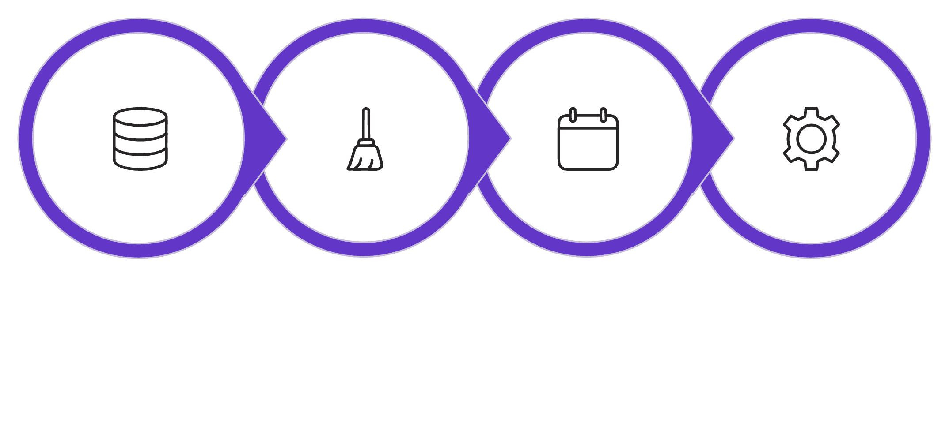
Data Cleaning & Feature Engineering
Key Engineered Features
Year & Month from order date
Day of Week for ordering patterns
Shipping Days = Ship Date − Order Date
Load & Standardize
Handle & Deduplicate
Convert Dates
Engineer Features
These steps ensured a clean, analysis-ready dataset with deeper time-based and operational insights.

Slide 6

Exploratory Data Analysis
Category Analysis
Certain categories contributed significantly more revenue — strong demand concentration in specific product groups.
Sub-category Analysis
A few product groups drove the majority of revenue share.
Time-Based Trends
Seasonal fluctuations identified across months and years, revealing peak business periods.

Slide 7
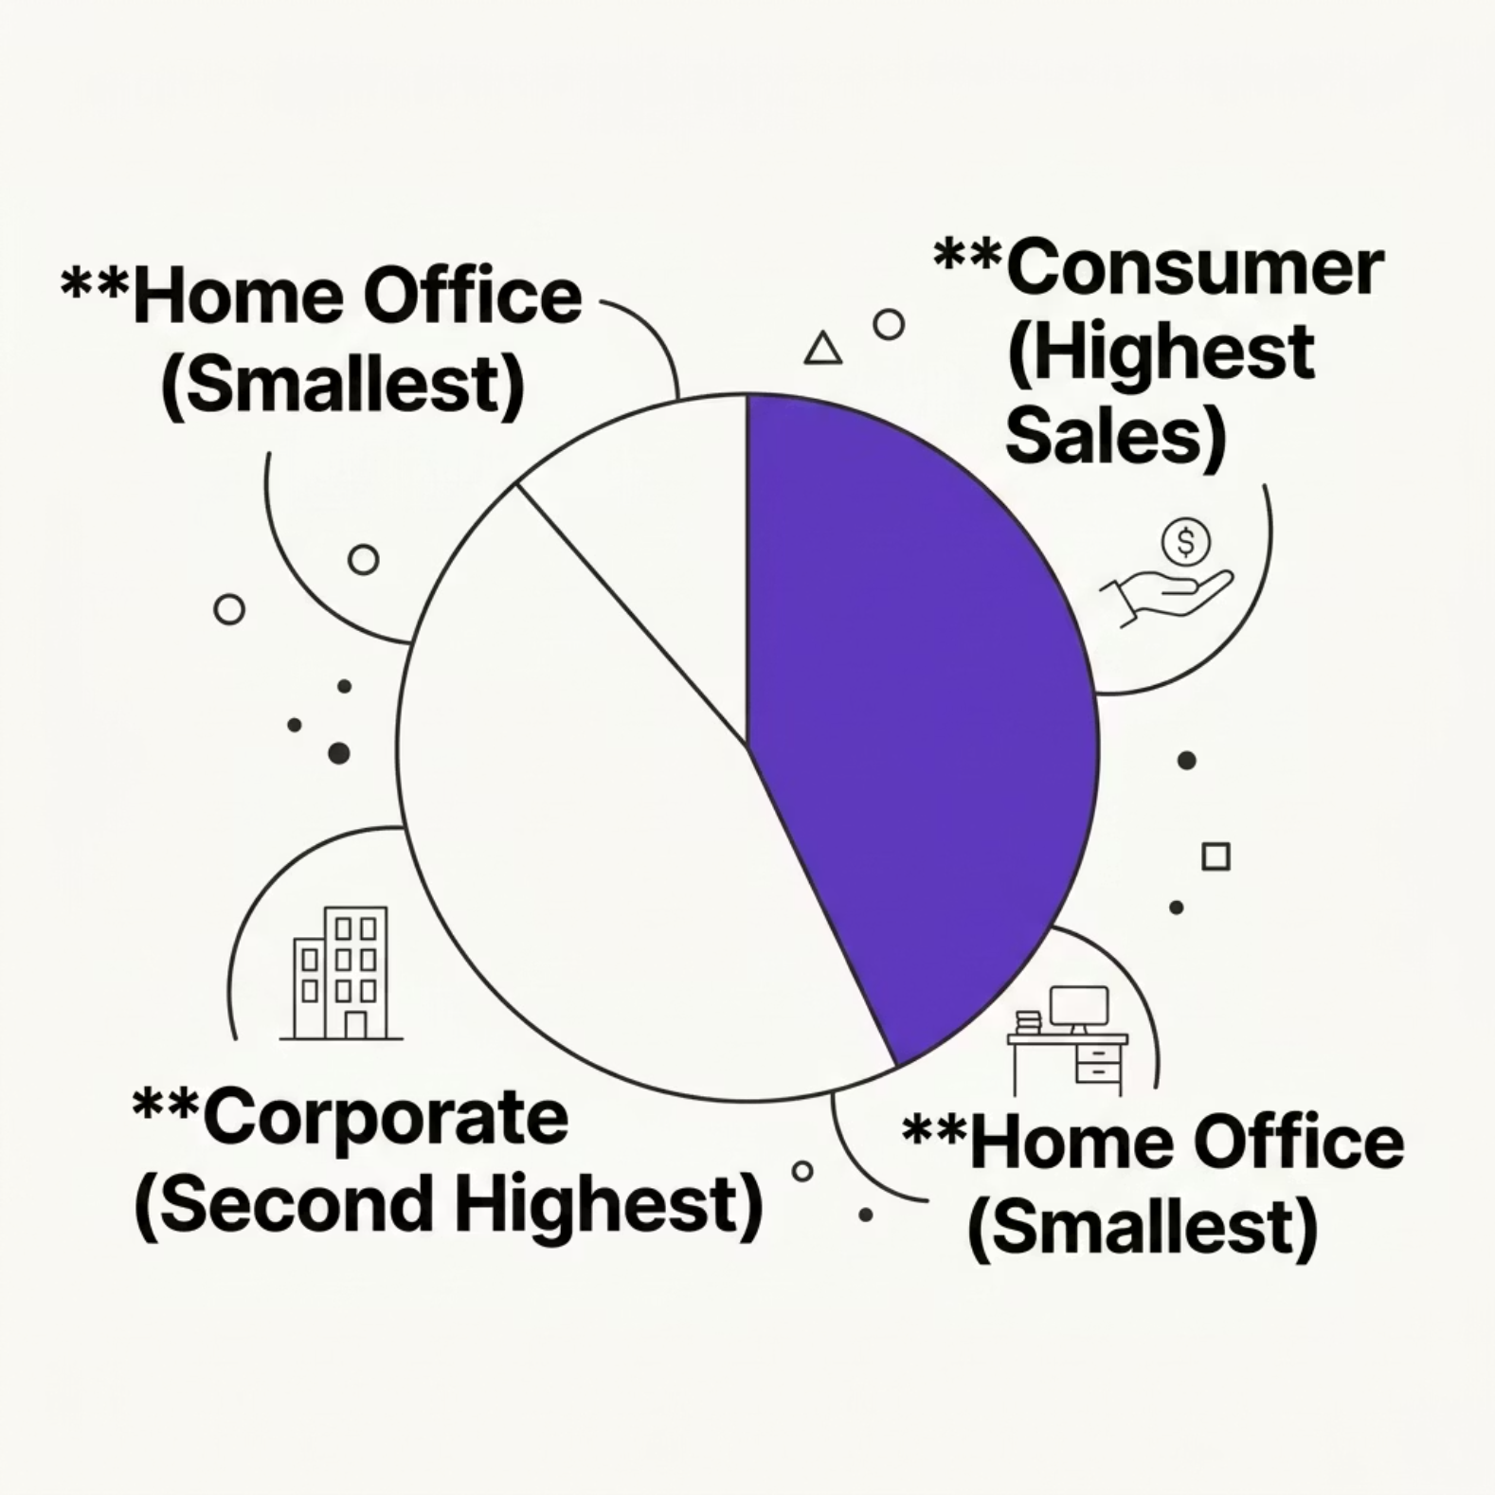

Customer & Shipping Insights
Customer Segments
The Consumer segment is the largest revenue contributor — individual customers are the primary sales driver.
Shipping Performance
Average shipping time: ~4 days
East region: fastest delivery
Central region: slightly higher shipping time
Performance is otherwise consistent across regions

Slide 8
SQL & Power BI Analysis
SQL Validation
Power BI Dashboard Features
Key operations used to confirm Python findings:
KPI cards: Total & Average Sales
Sales by Category & Region
Monthly Sales Trend (line chart)
Customer Segment distribution
Shipping performance by region
Interactive slicers: Region, Category, Year
Aggregation: SUM, AVG
Grouping: GROUP BY
Time extraction: month, year
Ranking & sorting by category/region

Slide 9

Key Insights & Recommendations
Focus on Top Categories
A few categories drive most revenue — prioritize marketing and inventory here.
Regional Strategy
Improve sales in underperforming regions; optimize Central region logistics.
Target Consumers
Personalized campaigns for the Consumer segment — the largest revenue driver.
Seasonal Planning
Leverage seasonal sales trends for promotional and inventory planning.

Slide 10



Conclusion
Structured data analysis transforms raw transactions into actionable business intelligence.
Python
SQL
Power BI
Data cleaning, EDA & feature engineering
Query-based validation of findings
Interactive dashboard for decision-making
Together, these tools help businesses improve decisions, optimize operations, and enhance overall performance.

