Slide 1
✦ AI CAREER COPILOT
JobPilot
AI-Powered Career Navigation, ATS Optimization & Mock Interview Platform
Unified 1:1 Architecture: Native Android APK (Kotlin / Compose) & Windows Desktop (Edge WebView2) • Live PostgreSQL Backend
📱 Android Mobile App
Jetpack Compose + ML Kit Face Detection
💻 Windows Desktop App
Standalone .exe + Edge WebView2 Host
⚡ Live Production Backend
FastAPI + PostgreSQL + Brevo OTP on Render

Slide 2
1. Project Objective & Problem Statement
Solving modern technical hiring friction through automation, real-time feedback, and dynamic curriculum
⚠️ The Modern Candidate Challenges
• Black-Box ATS Screening: Over 75% of resumes are discarded by Applicant Tracking Systems due to formatting errors and semantic skill mismatches.
• No Realistic Interview Simulator: Candidates lack structured practice with real-time video eye-contact telemetry, voice dialogue, and STAR methodology grading.
• Fragmented Learning Paths: Generic online courses lack day-by-day accountability, quizzes, and automated synchronization with real hiring requirements.
• Cold Outreach Inefficiency: Job seekers struggle to write personalized, high-converting recruiter messages and cover letters tailored to job descriptions.
🚀 The JobPilot AI Solution
✓ AI Mock Interview Simulator: 5-stage structured technical interview room with on-device face presence tracking, audio synthesis, voice dictation, and 4-D report.
✓ Automated ATS Resume Tailor: NLP extraction of candidate resumes (PDF/DOCX), audit of missing fields, and instant 1-click tailoring against any job title.
✓ Personalized 6-Month Roadmaps: Custom curriculum generated for any tech role with day-by-day learning topics, daily quizzes, and code notes.
✓ Semantic Vector Job Match & Gap Analysis: Calculates exact match percentage, missing required skills, and generates customized cold outreach messages.

Slide 3
2. System Architecture & Cross-Platform Tech Stack
Single production backend powering 1:1 parity between Android APK and Windows Desktop
📱 Android Mobile Client
Language / UI: Kotlin 2.0 • Jetpack Compose • Material 3 Design
ML & Vision: Google ML Kit Face Detection • CameraX Live Stream
Voice & Audio: Android SpeechRecognizer • TextToSpeech (TTS) Engine
Networking & State: Retrofit 2 • OkHttp • Kotlin Coroutines & StateFlow
Packaging: Android APK (`com.jobpilot.app`) Release Build
💻 Windows Desktop Client
Runtime / Window: Microsoft Edge Chromium WebView2 Native Window
Embedded Host: Python 3.13 Local SPA & Reverse Proxy Server (`main.py`)
Frontend UI: React 19 • Vite • Lucide Icons • Canvas Vision Telemetry
Audio & Voice: Web Speech API (SpeechRecognition) • SpeechSynthesis
Distribution: PyInstaller Standalone Executable + Inno Setup 6 Installer
⚡ Production Cloud Backend
Framework: FastAPI (AsyncIO Python 3.13) • High-throughput REST API
Database: PostgreSQL running on Render Cloud (Single Source of Truth)
ORM & Schemas: SQLAlchemy 2.0 • Pydantic V2 Validation Models
Security & Auth: JWT Bearer Tokens • Passlib Bcrypt Hashing
Email Delivery: Brevo SMTP Transactional Email API for 6-digit OTP verification

Slide 4
3. Core Features & Capabilities Matrix
Comprehensive breakdown of the 6 integrated career acceleration modules
🎙️ AI Mock Interview Simulator
5-stage structured interview room with on-device camera face presence detection, question audio playback, voice dictation, and instant 4-D scorecard report.
🗺️ 6-Month Dynamic Roadmaps
Customized day-by-day learning milestones with interactive daily quizzes, bookmarking, code notes, and automatic resume skill synchronization.
📄 ATS Resume Builder & Tailor
NLP extraction of candidate resumes (PDF/DOCX), automated missing fields audit, ATS score calculation, and 1-click semantic tailoring to job descriptions.
💼 Semantic Job Match & Outreach
Calculates exact semantic compatibility %, analyzes skill gaps, and generates tailored LinkedIn outreach messages & cold emails.
📊 Application Kanban Tracker
Full lifecycle pipeline tracker organizing applications into Saved, Applied, Interviewing, Offered, and Rejected stages with date tracking.
🤖 24/7 AI Career Coach
Conversational AI assistant with full persistent chat history, answering questions regarding career transitions, salary negotiation, and system design.

Slide 5
4. NLP & Artificial Intelligence Models: Where & How Used
Detailed mapping of Machine Learning, Natural Language Processing, and Computer Vision models in JobPilot
1. Transformer Vector Embeddings (BERT / RoBERTa) • Purpose: Semantic Job Matching & Resume Relevance
Generates high-dimensional dense vector embeddings of job descriptions and candidate profile skills. Computes cosine similarity to generate accurate Match Percentage and identify missing required technical skills.
2. Document Information Extraction (Spacy NLP & PDF Engine) • Purpose: Resume Parsing & ATS Scoring Pipeline
Extracts entities (Work Experience, Education, Skills, Certifications) from uploaded PDF and DOCX files. Performs keyword density analysis and structural formatting checks to calculate ATS compatibility score.
3. Generative Language Model (LLM Inference) • Purpose: Career Coach, Roadmap Synthesis & Interview Feedback
Generates customized 6-month day-by-day learning curricula, multi-turn conversational coaching responses, dynamic interview questions tailored to candidates' projects, and detailed evaluator feedback with ideal model answers.
4. Computer Vision Face Detection (Google ML Kit & Canvas Telemetry) • Purpose: Live Interview Face Alignment & Presence Score
Executes real-time face detection at 30 FPS. Analyzes face orientation, bounding box centering, eye-contact estimation, and posture attentiveness to produce an objective Video Presence Score (0-100%).
5. Voice Transcription & Speech Synthesis (ASR & TTS Engine) • Purpose: Voice-Driven Hands-Free Mock Interview
Web Speech API and Android SpeechRecognizer convert spoken candidate audio into text transcriptions in real time. SpeechSynthesis generates natural spoken audio for the AI interviewer.

Slide 6
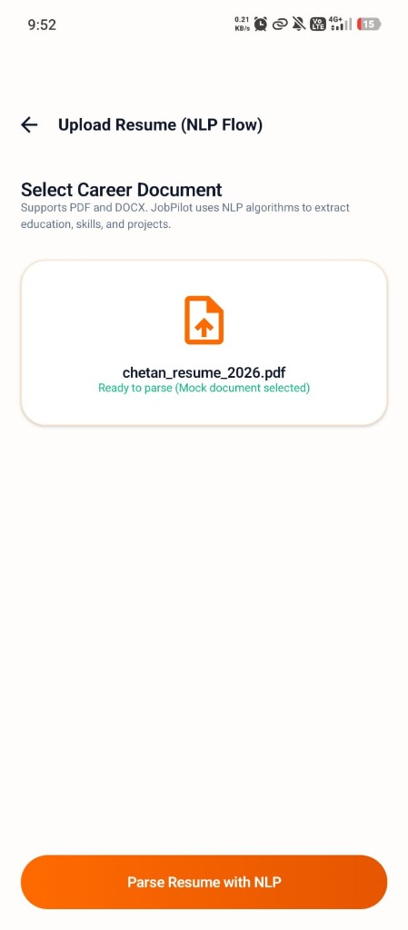
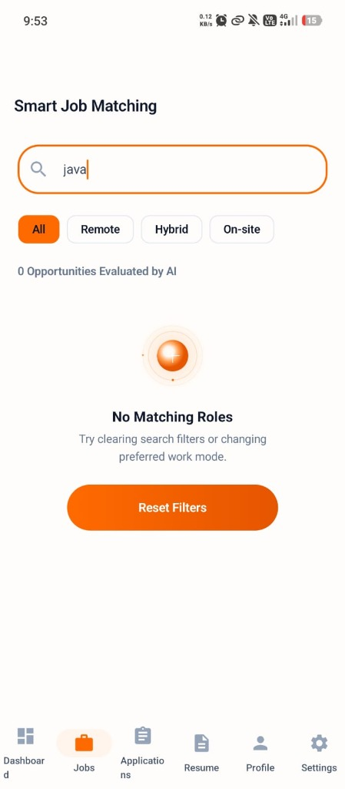
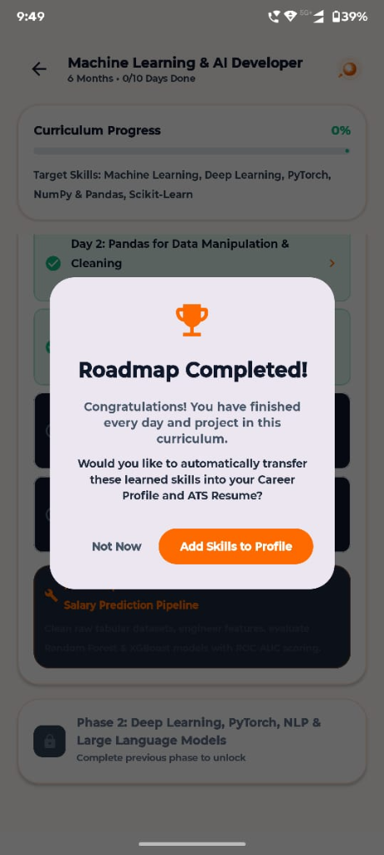
5. Android APK Application Showcase (Mobile Screens)
Jetpack Compose Material 3 UI with Live ML Kit Camera, Roadmap Quizzes, and ATS Resume Hub
Mobile Dashboard & Metrics
AI Mock Interview Setup
6-Month Career Roadmap
ATS Resume Hub & Tailor

Slide 7
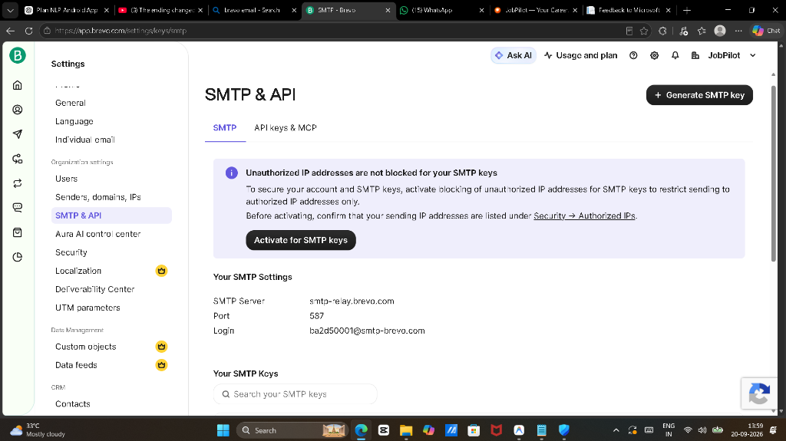
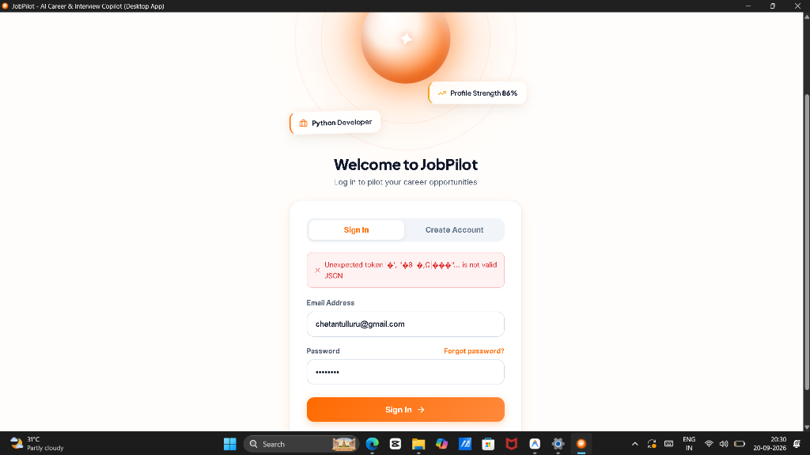
6. Windows Desktop Application Showcase (Desktop Screens)
Edge WebView2 Native Window Host with 1:1 Material 3 Navigation & Embedded Reverse Proxy
Windows Desktop Dashboard & Top Navigation Bar
Windows Authentication & OTP Verification Screen

Slide 8
7. Database Schema & Backend Data Persistence
Single source of truth on PostgreSQL with zero mock bypasses across Android and Windows
👤 Users & Auth
Stores encrypted credentials (bcrypt), Brevo email OTP timestamps, verification states, streak counters, and target roles.
🗺️ Roadmaps & Milestones
Stores generated curricula, total days (e.g. 180), active day index, progress %, completion timestamps, and phase resources.
📝 Daily Quizzes & Notes
Stores daily 3-question quizzes, selected candidate answers, pass/fail status, and user markdown code notes per day.
📄 Resumes & ATS Audits
Stores extracted personal info, education, skills, projects, work experience, missing field audits, and tailored resume variations.
💼 Jobs & Applications
Stores job postings, required skills, semantic vector match scores, and application status stages (Saved $\rightarrow$ Offered).
🎙️ Interview Sessions & Reports
Stores question sets, candidate answer transcripts, camera eye contact & presence telemetry, and 4-D evaluator reports.

Slide 9
8. Project Summary & Future Enhancements
Transforming technical recruitment with seamless multi-platform AI copiloting
🏆 Key Accomplishments Delivered
✓ 1:1 Multi-Platform Parity: Delivered complete feature, navigation, and visual parity across native Android APK and standalone Windows Desktop .exe.
✓ Live AI Mock Interview Room: Interactive video simulator with real-time face tracking, audio synthesis, speech-to-text dictation, and comprehensive model answers.
✓ End-to-End ATS Pipeline: Instant extraction, missing field audit, and 1-click tailoring with PDF export.
✓ Enterprise-Grade Cloud Backend: FastAPI + PostgreSQL with Brevo OTP transactional email delivery and JWT authentication.
🔮 Future Roadmap & Enhancements
✦ Autonomous Job Application Agent: Automated form filling and portfolio submission across major job portals with user approval gates.
✦ Multilingual Voice & Accent Adaptation: Expanded speech synthesis supporting international tech interview accents and regional languages.
✦ Live Coding Sandbox Integration: Embedded Monaco / WebAssembly code editor with unit test execution during technical interview stages.
✦ Enterprise Recruiter Portal: Dedicated portal for recruiters to review candidates' verified AI interview scorecards and roadmap credentials.

