Slide 1
KPMG-Internship
Sprocket Central Pty Ltd
Data analytics approach
Chetan Tewari

Slide 2
Agenda
Introduction
Data Exploration & Model Development
Final Dashboard

Slide 3
Introduction
Goal: Customer Insights for Optimal Resource Allocation
Dataset
Transactions Data(Year-2017) (20k Transactions)
Customer Demographic Data (4000)
Customer Address Data(4000)
New Customer Data (1000)

Slide 4
Data Exploration & Model Development
Exploratory Data Analysis
Missing Values
All The Numerical Variables
Distribution of the Numerical Variables
Categorical Variables
Cardinality of Categorical Variables
Outliers
Feature Engineering
Dropping unnecessary feature
Filling in Missing Values
Categorical features
Standardization of values, and
Model Selection

Slide 5
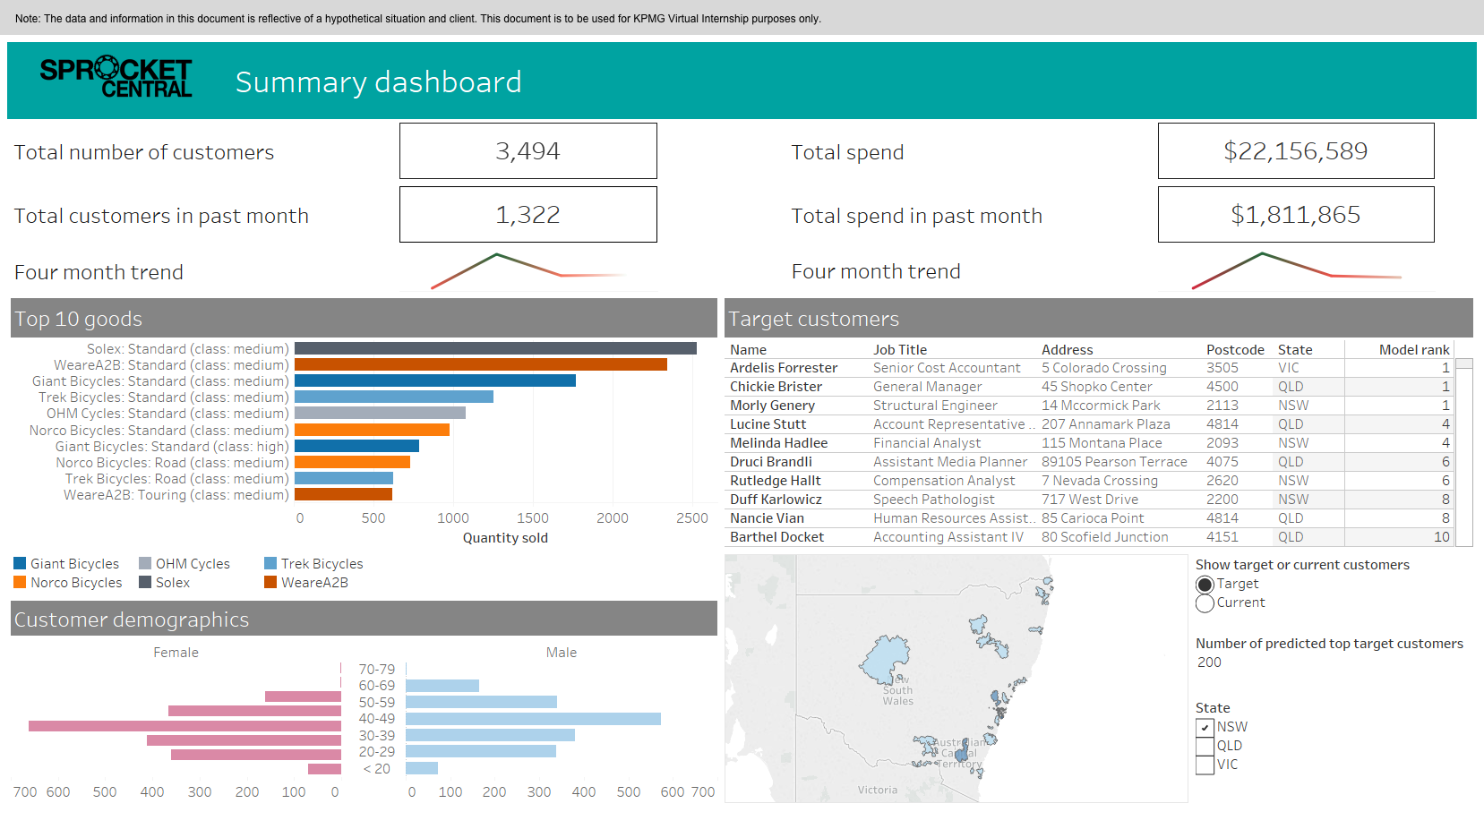
Final Dashboard

