Slide 1

Movie Award Data Analysis
GIC_OND21_PYSPARK_1
By Team-C
Pragya Sharma
Chetanya Saini
G Balaji

Slide 2
Table of Content
Data Analysis
Data Flow
Why are we using PySpark?
Spark Architecture
PySpark Features
Problem Statement
Use Cases Performed

Slide 3



Data +
Analysis

Slide 4
Loading data into system
Analyzing the data
Valuable Information
External data
Importing data into Pyspark
Performing transformation & Action
How Data is flowing:-

Slide 5
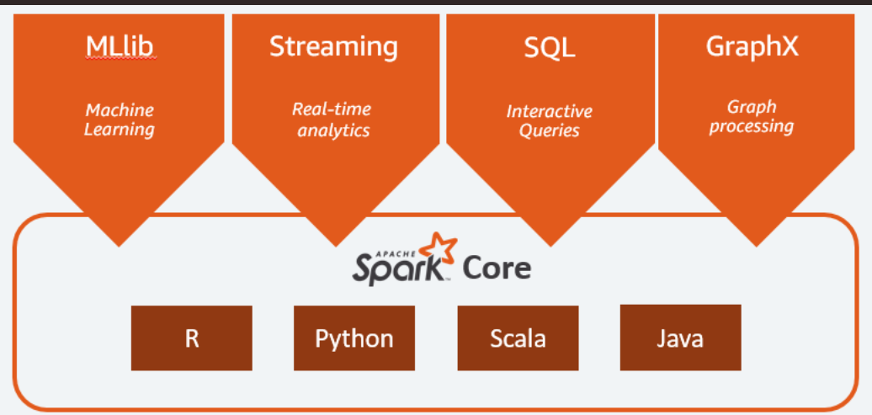
Why are we using PySpark ?

Slide 6
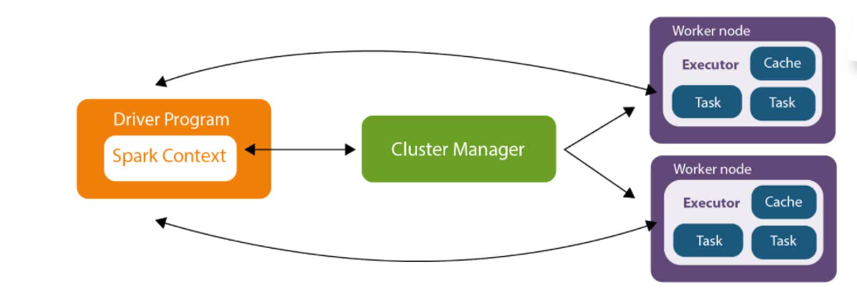
Spark Architecture

Slide 7
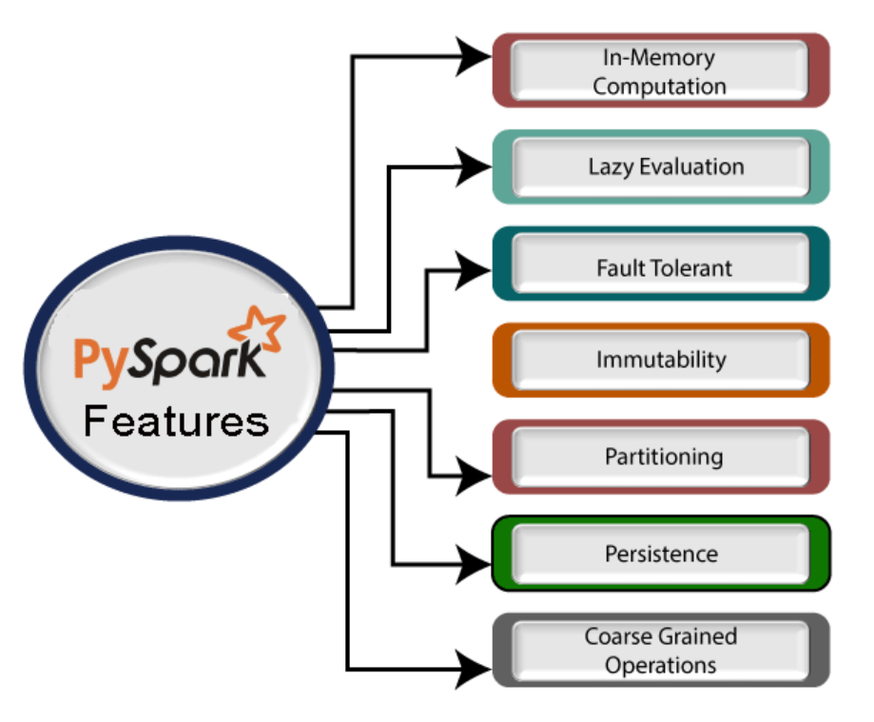

Slide 8
Problem Statement-
Everybody loves movies. Nowadays, movie releases per year has increased compared to earlier days because of an increase in the number of production houses. A few giants, like Netflix and Amazon, have started creating their content as well.
Hollywood is spreading its wings in most countries because of its graphics, story, and actors. In Hollywood, few directors have made a great impact among audiences. Among these, few of them have received nominations and won awards.
Before watching a movie, people tend to validate the director’s credentials like, what kind of movies he has made in the past and if he has won any awards. The given data set has details about the movie directors and whether they have received nominations and won awards.
The dataset contains the following fields:
Director name
Ceremony
Year
Category
Outcome
Original language

Slide 9
Use Cases
Directors who were nominated and have won awards in the year 2011
Award categories available in the Berlin International Film Festival
Directors who won awards for making movies in French
4. Directors who have won awards more than 10 times.
Extra Use Cases:-
Top 20 Directors awarded as per the records.
Oldest and Newest movie as per the Records.

Slide 10
Data file Source:-
https://www.kaggle.com/
Total number of records in Movie award data analysis is 225676.

Slide 11
References:-
https://www.javatpoint.com/pyspark
https://sparkbyexamples.com/
https://soumendrak.medium.com/why-should-i-use-pyspark-81d783e65e01
https://intellipaat.com/blog/tutorial/spark-tutorial/spark-architecture/
https://spark.apache.org/

Slide 12
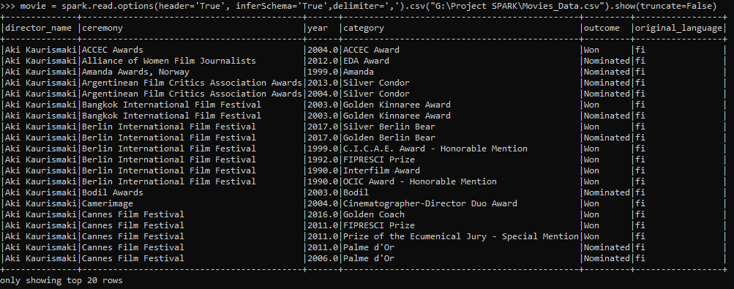
Importing Data Into PySpark
movie = spark.read.options(header='True', inferSchema='True',delimiter=',').csv("G:\Project SPARK\Movies_Data.csv")
Importing Packages in PySpark
import pyspark
from pyspark.sql import SparkSession

Slide 13
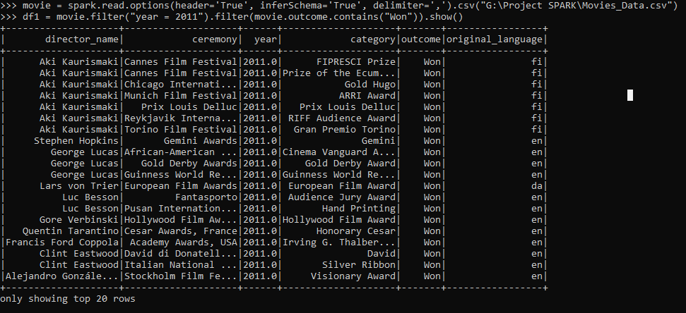
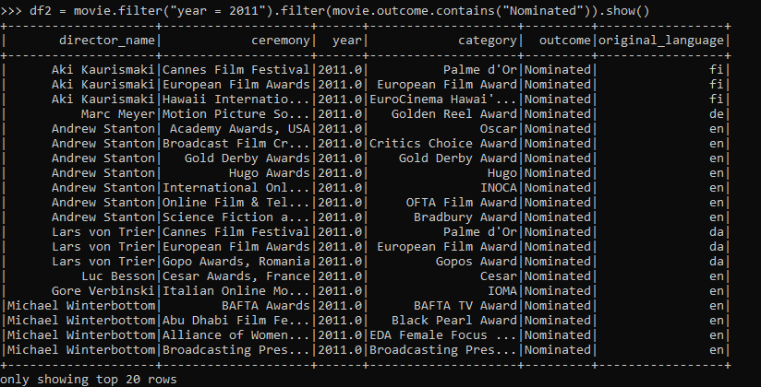
Directors who were nominated and have won awards in the year 2011
df1 = movie.filter("year = 2011").filter(movie.outcome.contains("Won")).show()
df2 = movie.filter("year = 2011").filter(movie.outcome.contains("Nominated")).show()

Slide 14
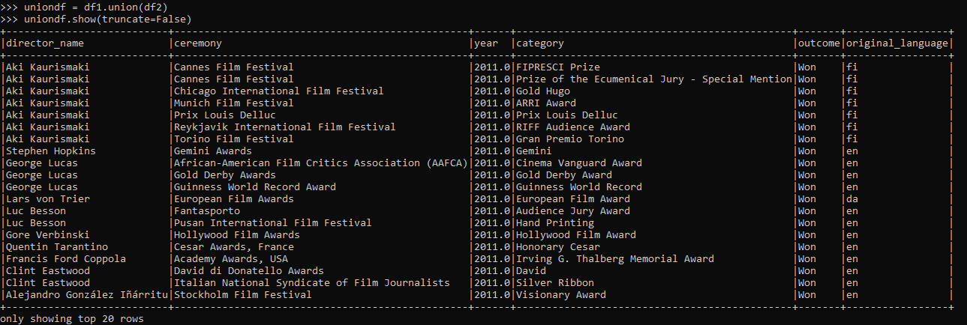
Import pyspark
From pyspark.sql import SparkSession
uniondf = df1.union(df2)
uniondf.show(truncate=False)

Slide 15
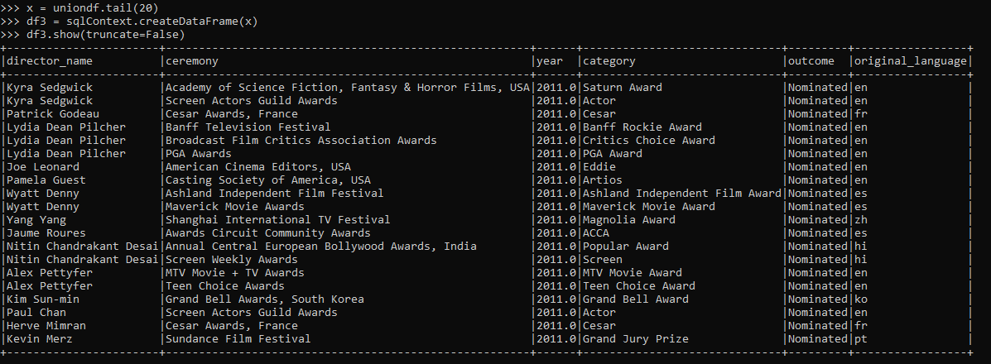
For Nominated and last 20 Records. x = uniondf.tail(20) df3 = sqlContext.createDataFrame(x) df3.show(truncate=False)

Slide 16
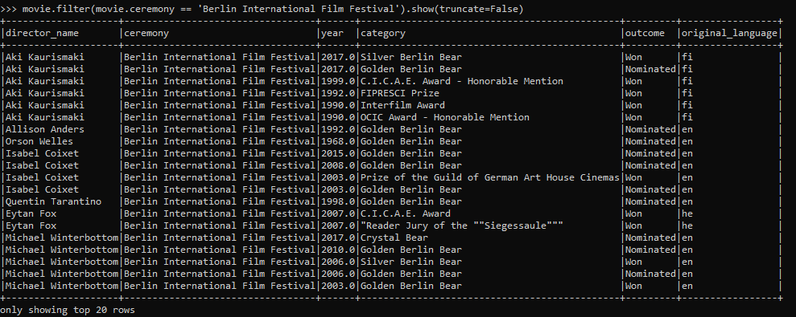
Award categories available in the Berlin International Film Festival
movie.filter(movie.ceremony == 'Berlin International Film Festival').show(truncate=False)

Slide 17
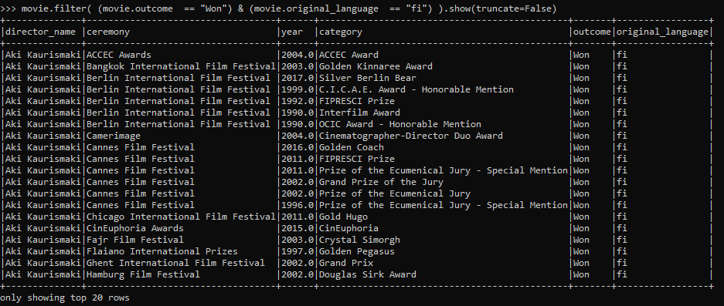
Directors who won awards for making movies in French
movie.filter( (movie.outcome == "Won") & (movie.original_language == "fi") ).show(truncate=False)

Slide 18
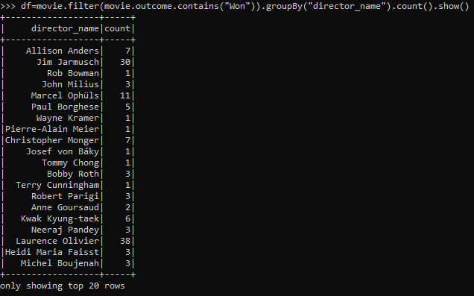
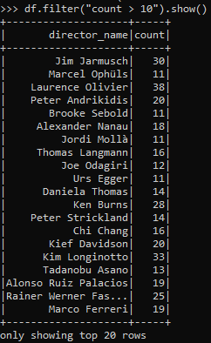
Directors who have won awards more than 10 times
df=movie.filter(movie.outcome.contains("Won")).groupBy("director_name").count().show()
df.filter("count > 10").show()

Slide 19
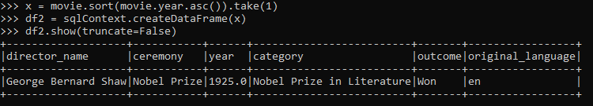
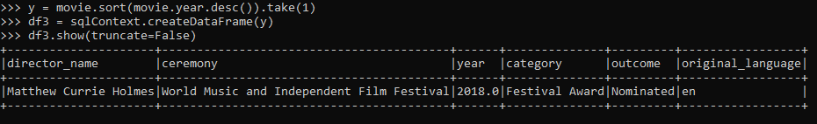
Oldest and Newest movie as per the Records.
x = movie.sort(movie.year.asc()).take(1)
df2 = sqlContext.createDataFrame(x)
df2.show(truncate=False)
y = movie.sort(movie.year.desc()).take(1)
df3 = sqlContext.createDataFrame(y)
df3.show(truncate=False)

Slide 20
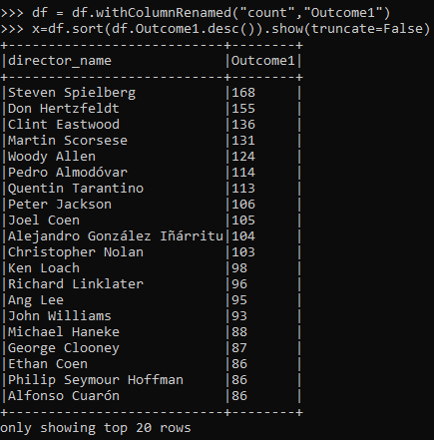
Top 20 Directors awarded as per the records.
df = df.withColumnRenamed("count","Outcome1")
x=df.sort(df.Outcome1.desc()).show(truncate=False)

