Slide 1
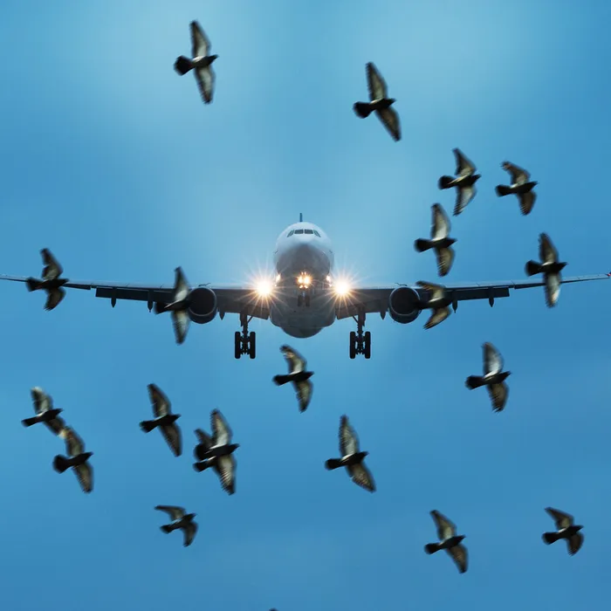
BIRDSTRIKE DATA ANALYSIS
CIS 505: Intro to Enterprise Analytics Team Assignment
TEAM BUSI RAIDERS
Rushabh
Gaurav
Chetas
Namaskrutha
Tian

Slide 2

INTRODUCTION
Background--Data focuses on records of US flights between the years 2019 and 2021 where a bird has been struck by a plane while in flight.
Problem Statement--Focusing on prevention of bird strikes, can not only save people and birds but also reduce the damage to the aircrafts.
Features of Dataset--Consists of various features such as location of the airport, incident occurring during the departure or approach, type of engine, number of engines, incident date, amount of damage, repair costs, part of the aircraft where the bird struck, and the damage caused due to each part along with its expenses etc.

Slide 3
RESEARCH QUESTIONS?
Which phase of flight causes a greater number of accidents?
Which part of the flight is most damaged?
Which part of the flight has the highest number of aggregate cost of damages?
Which region has the greatest number of incidents?
Which season has a greater number of crashes?

Slide 4
DATA ANALYSIS

Slide 5
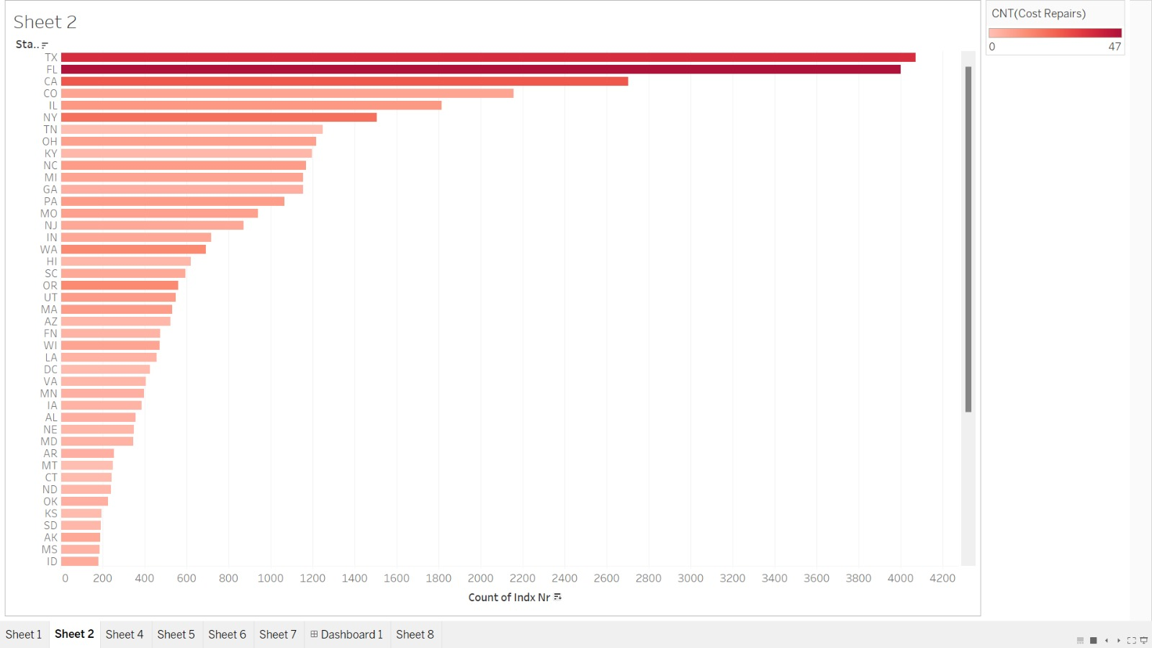
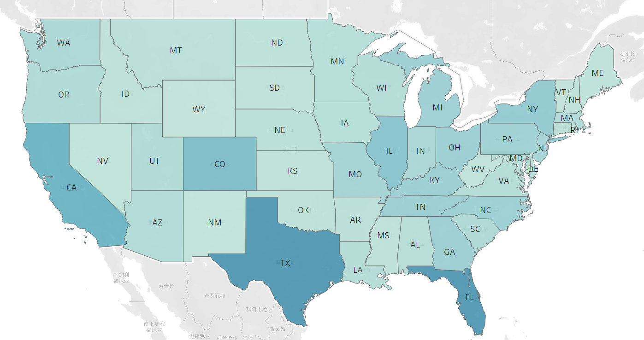
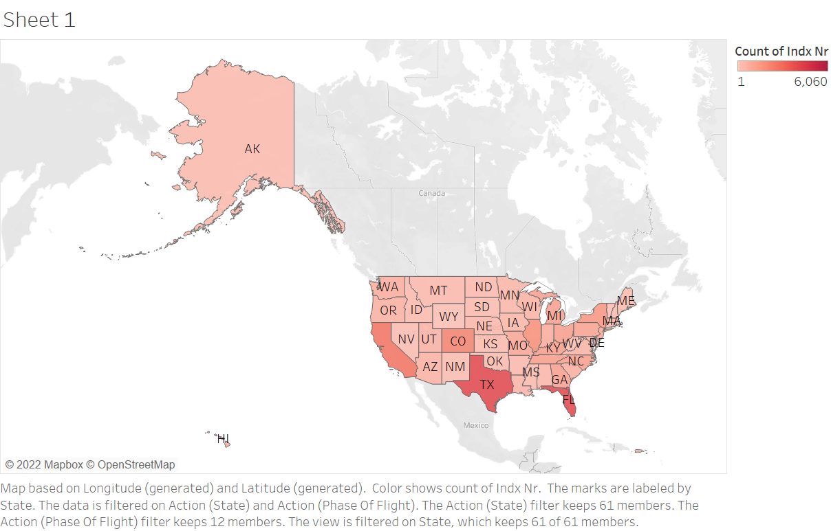
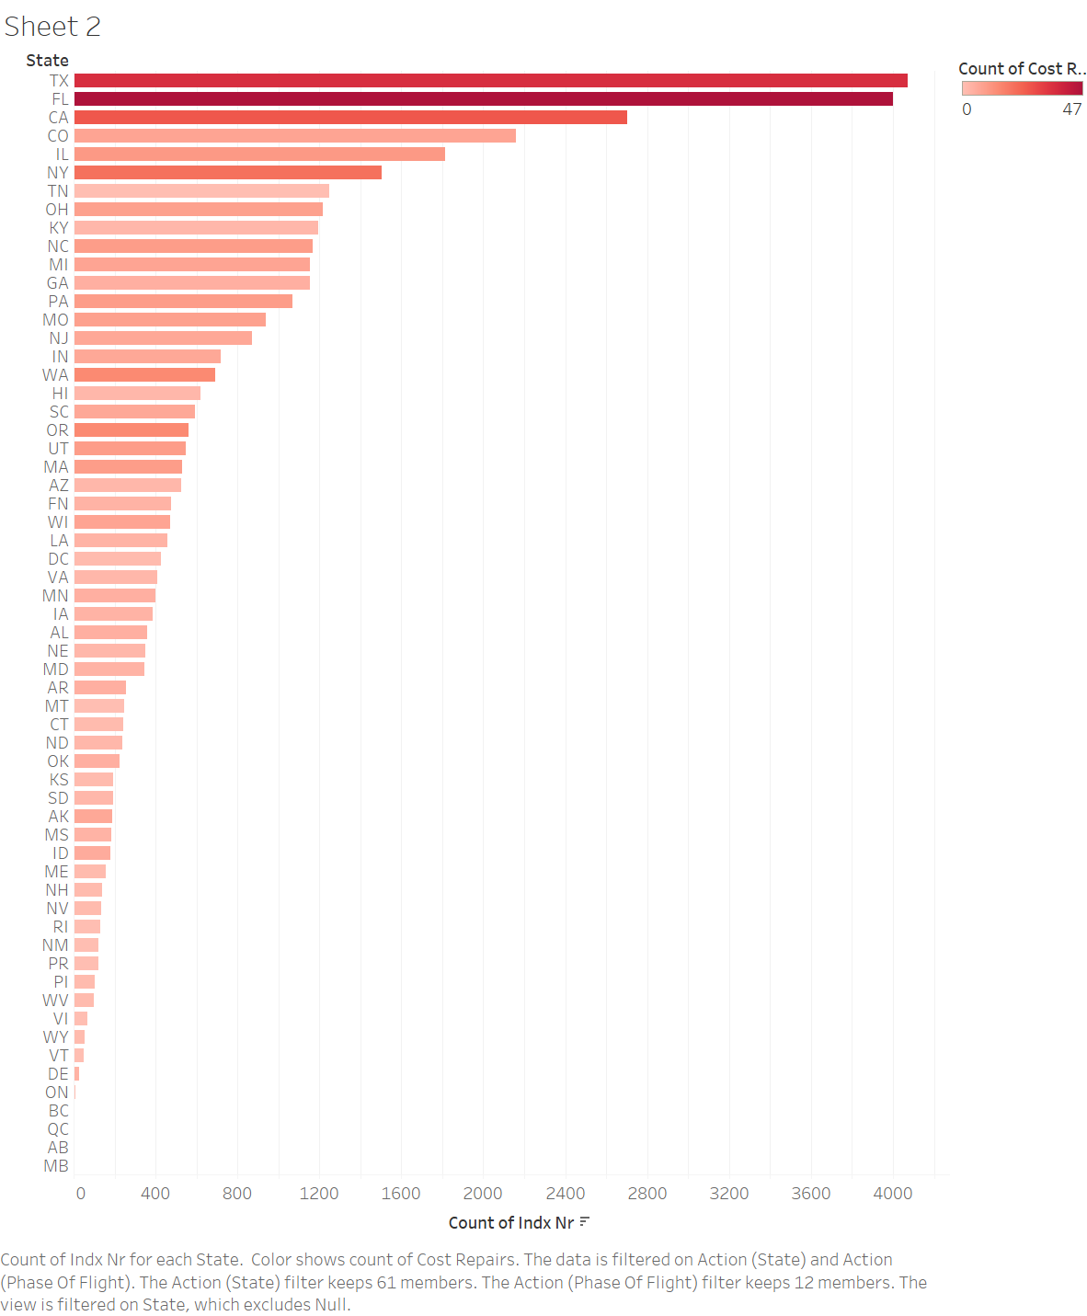
BIRD STRIKES DISTRIBUTED ACROSS US
Texas, Florida and California have the highest incidence of bird strikes. Less than 100 bird strikes are reported in states like Wyoming, Vermont, and New Hampshire
Bird strikes occur mainly in economically developed areas
The cost of repair is directly proportional to the number of incidents
Coastal areas are more vulnerable to bird strikes
Comparing to the west, birds' strikes have mainly affected the eastern land of the US.

Slide 6
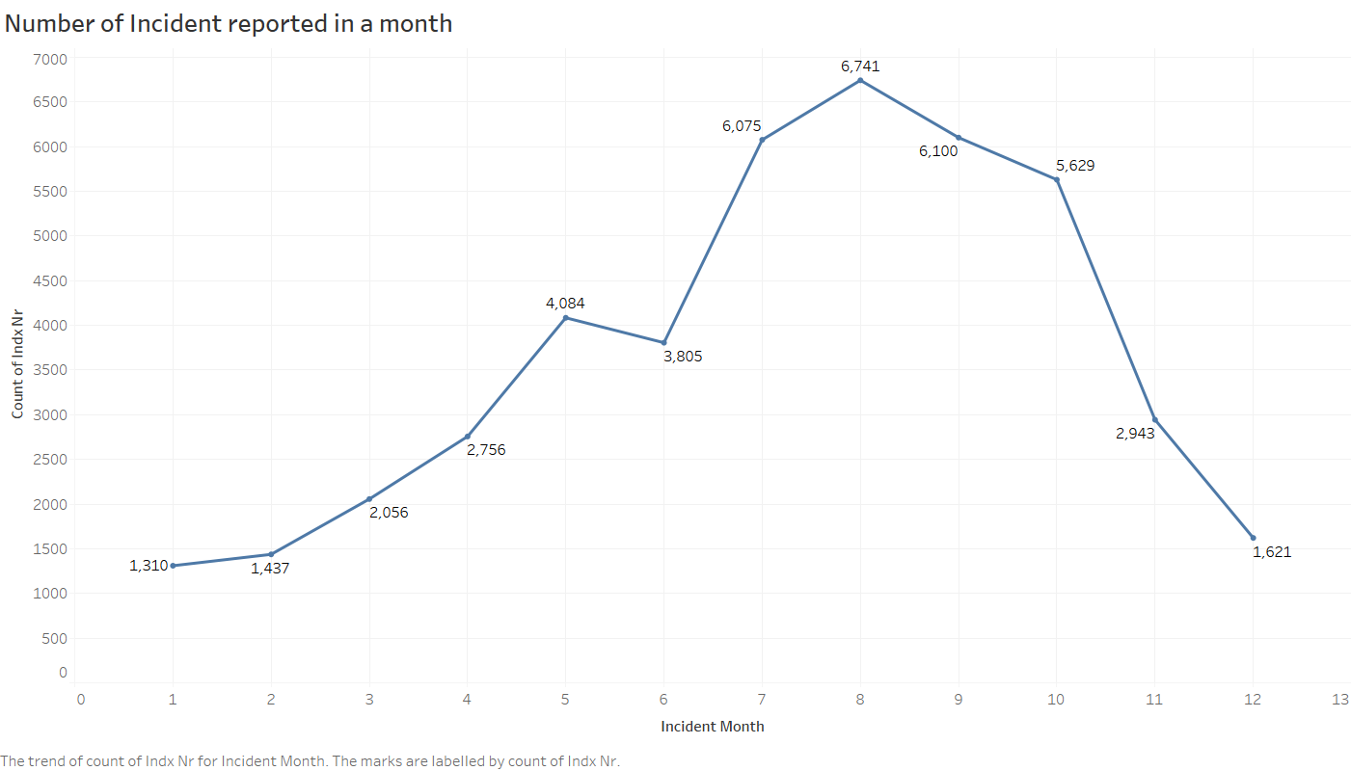
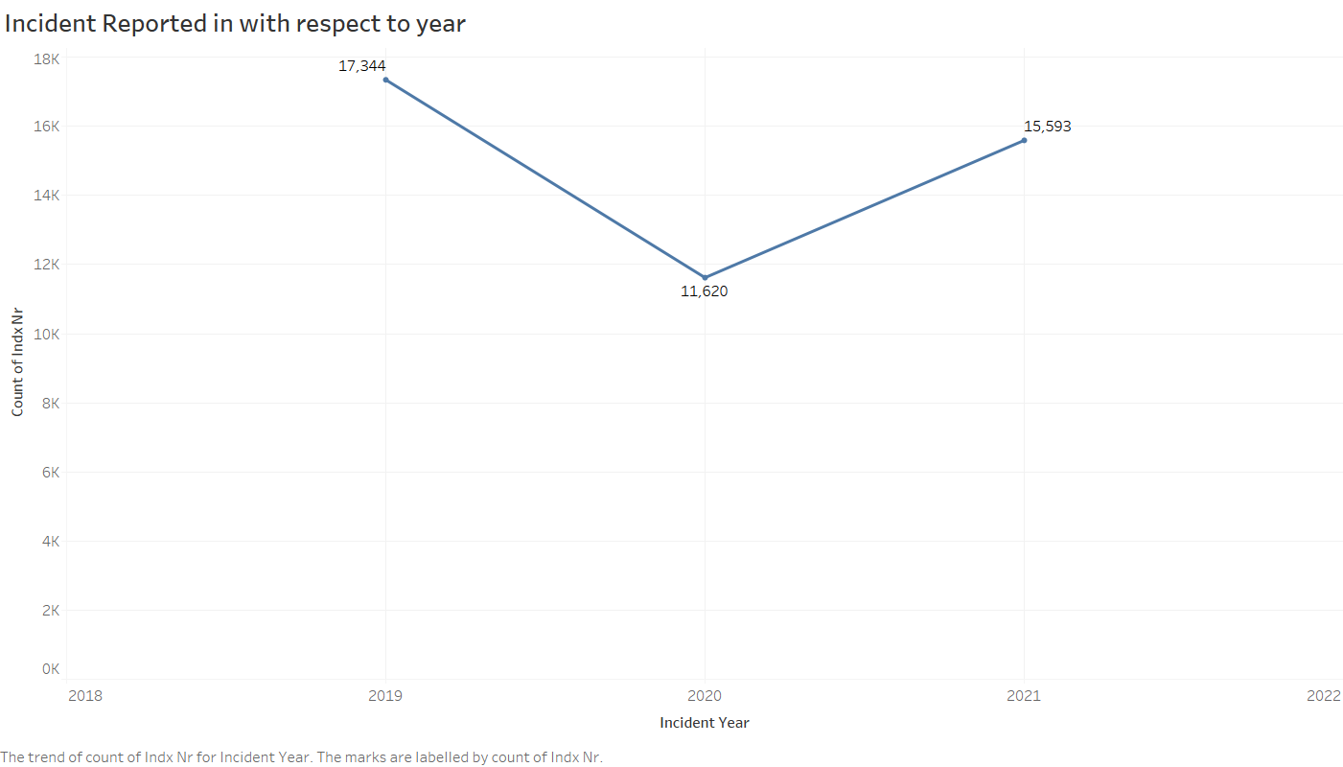
Pattern of incidents
Analysis:
Month 8 ( August ) has the highest reported incident followed by Month 9 ( September )
This data is for all the years ( 2019 – 2021 )
Year 2019 had the highest incident (17,344) followed by Year 2021 ( 15593)

Slide 7
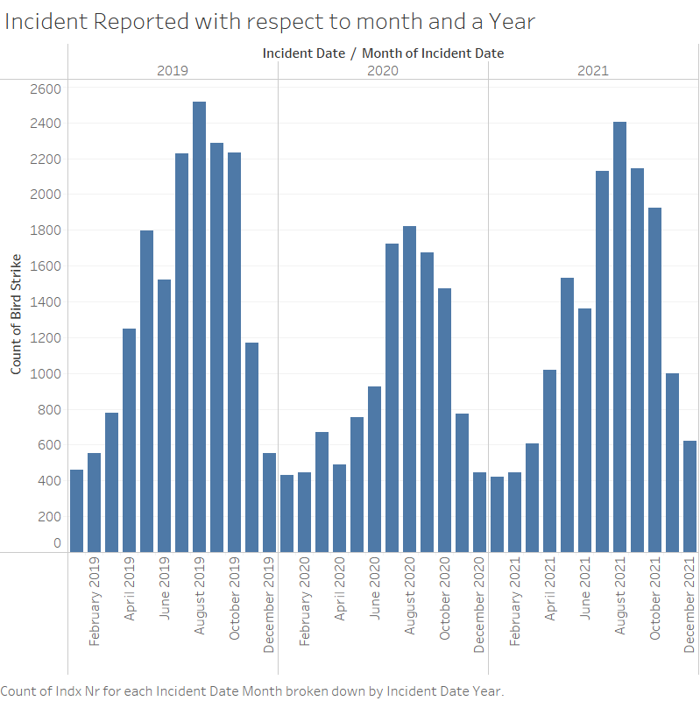
Incidents reported with respect to month and year
Analysis:
For Year 2019, Highest Reported Incidents were in the month of August (2517 )
For Year 2020, Highest Reported Incidents were in the month of August (1822)
For Year 2021, Highest Reported Incidents were in the month of August (2402)

Slide 8
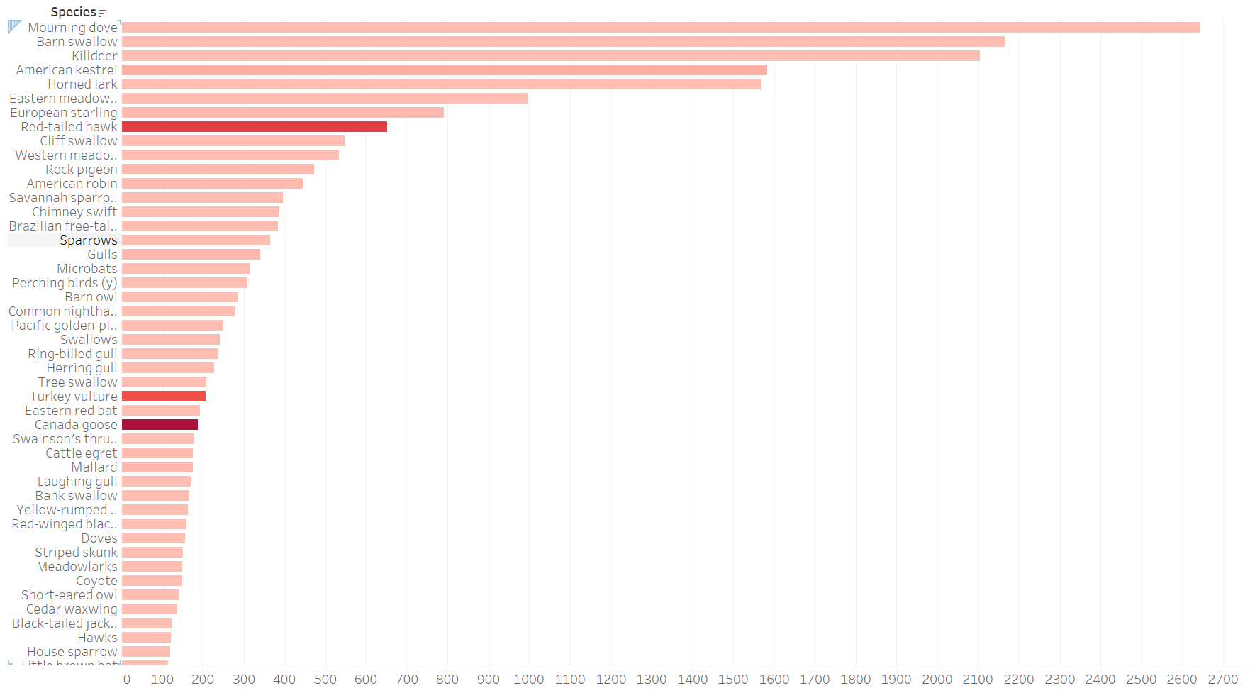
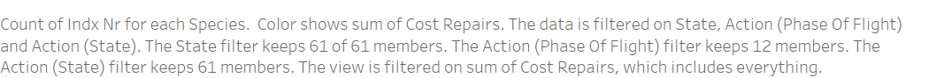
BIRDS CONTRIBUTION OF THE STRIKES
From the graph, we can see that many species of birds cause bird strikes, however it is often a group of smaller migratory birds that cause sustainable damage to the aircrafts.
With the increase in the number, the possibilities of such strikes will increase over time if no precautions are taken.

Slide 9
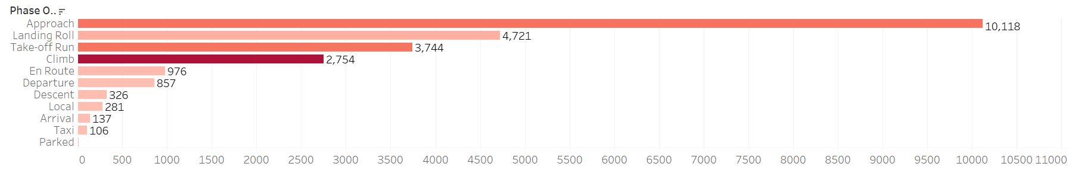
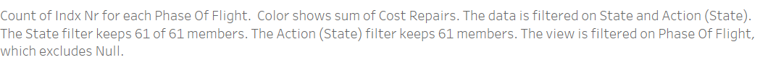
PHASES OF FLGHT
As you can see from the table, most bird strikes occured during the landing, takeoff or approaching stages and the number of bird strikes decreased as aircraft flew higher.
Reason:
Airports are usually located far away from urban centers, with little human construction and activities around them
Most of the buildings in the airport are open and flat, and there are many lawns in the airport, resulting in high biomass in the airport area, which provides a rich food source for birds.

Slide 10
RECOMMENDATION
--The relevant departments of the airport can observe the bird activity on the ground and above the airport at any time. If many birds gather and move, they can close the runway in time, stop the takeoff and landing of the aircraft, or raise the altitude, to reduce the probability of a bird strike. Crew members should also pay attention to birds during takeoff and landing, and control flight speed at low altitudes to reduce the damage of impact.
-- Establishing targeted protected areas in areas away from the airport for the main bird species responsible for airport bird strikes and creating habitats to attract birds near the airport.
--Modern commercial aircrafts are faster and quieter, and hence are harder for birds to spot, leading to bird strikes. The aviation industry could add pulsating lights to aircraft wings to grab the attention of birds.

Slide 11
THANK YOU!

