Slide 1
CIS 508: Assignment 3
Chetas Anand

Slide 2
TO DO:
01. Experiment with SMOTE
02. Perform ensemble predictions
03. Perform hyperparameter tuning on the stacked model
04. Kaggle scores in an Excel table
05. Inferences

Slide 3
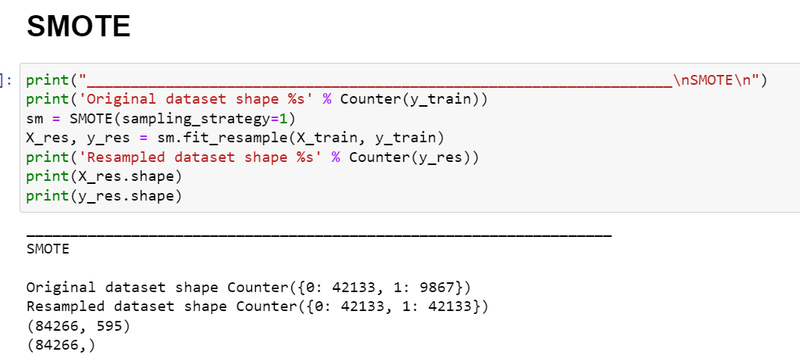
SMOTE

Slide 4
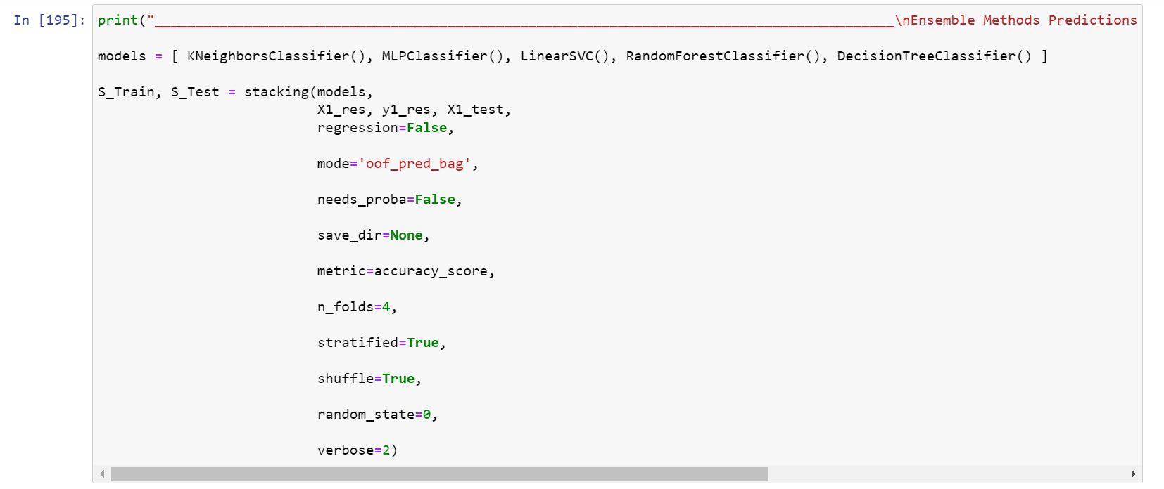
Ensemble models

Slide 5
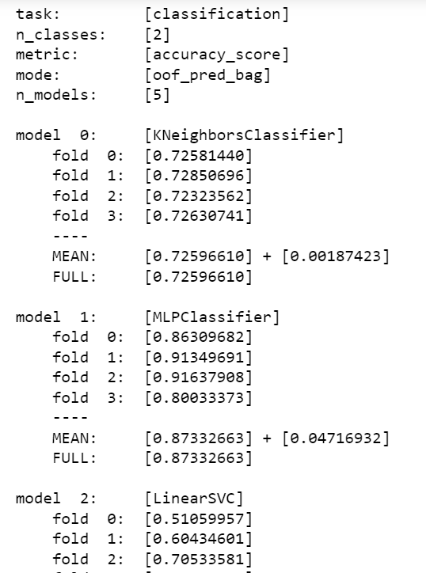
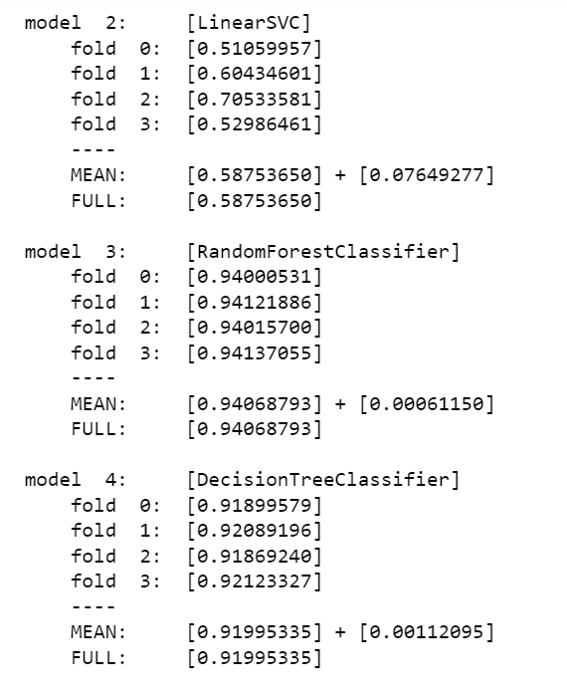

Slide 6
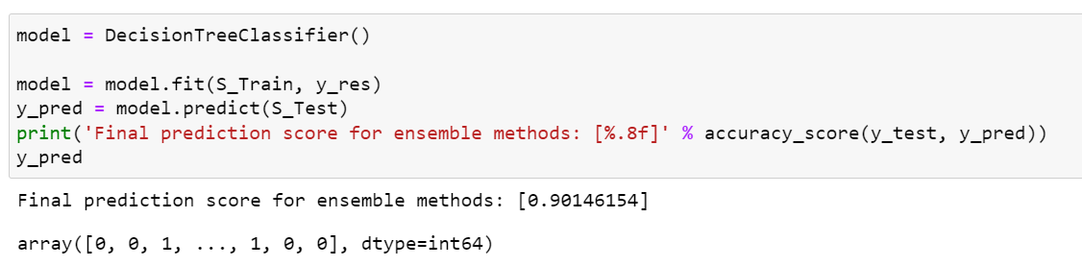
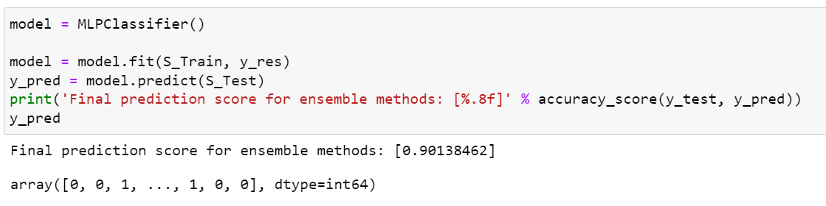

Slide 7
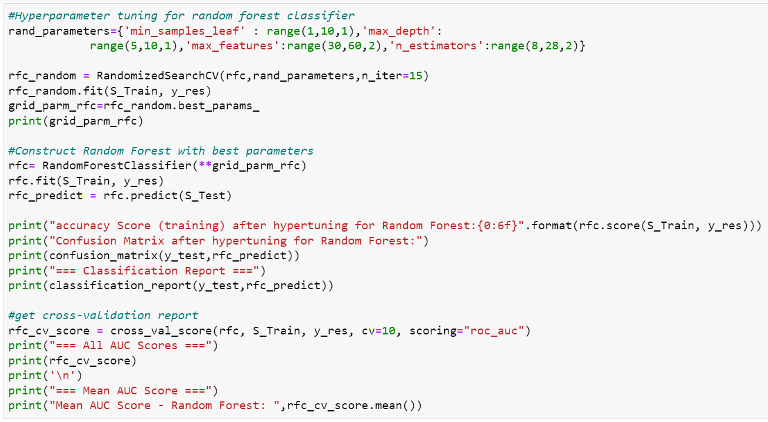
Hyperparameter Tuning on Stacked models

Slide 8
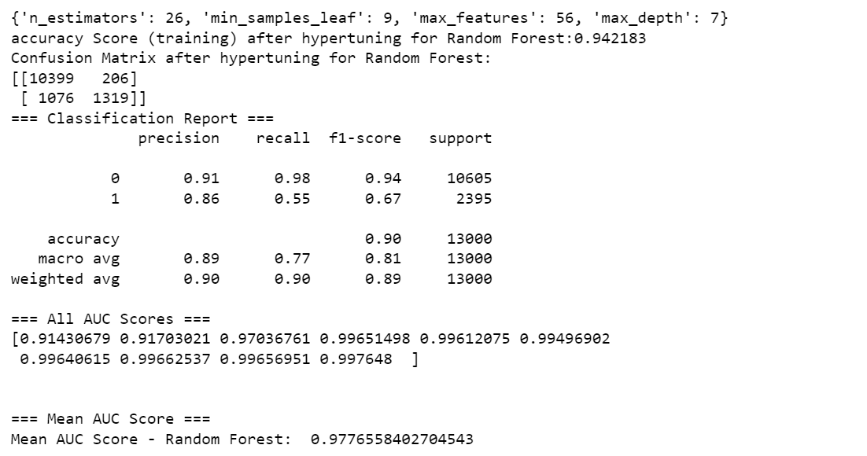
Hyperparameter tuning results

Slide 9
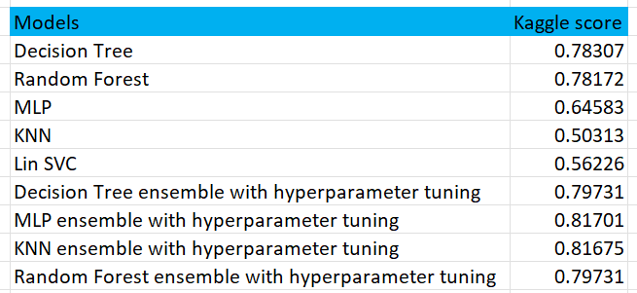
Kaggle Score comparison

Slide 10
Inferences
Ensemble models are better learners, compared to just hyperparameter tuned models in previous assignments
This is because these stacked models combine less efficient learners and as a whole produce better results

Slide 11

Thank you

