Slide 1


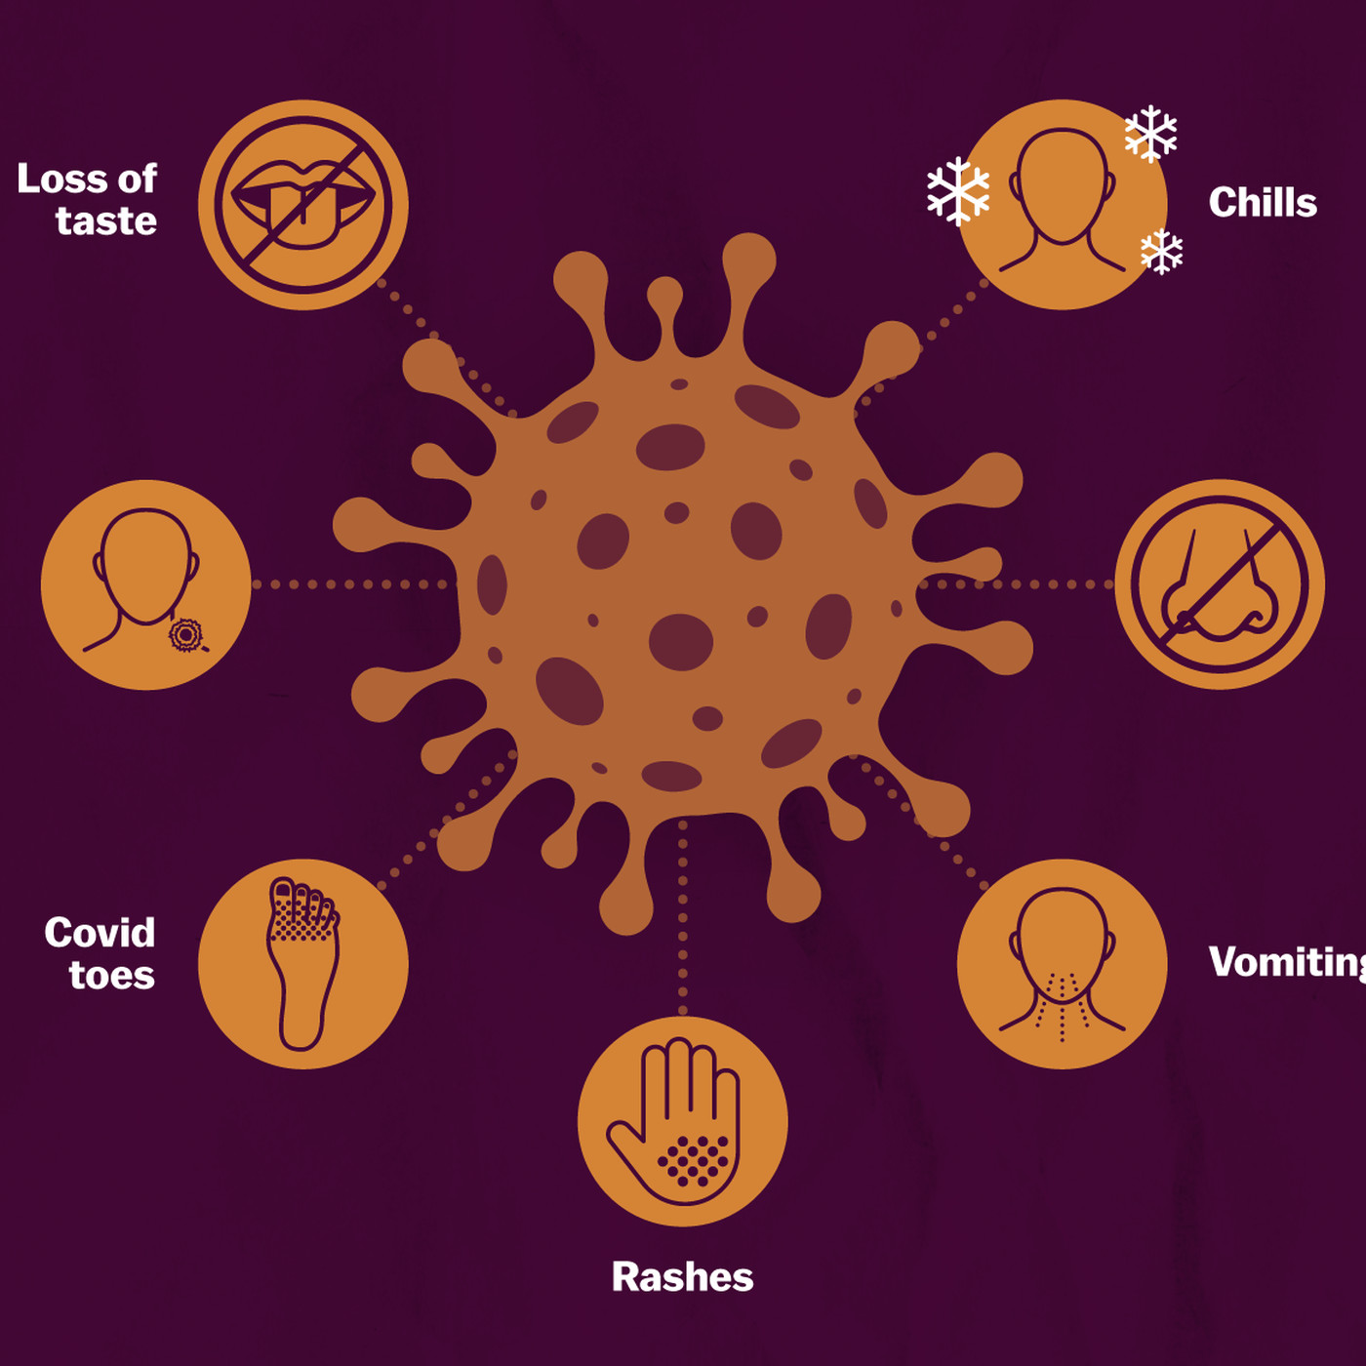
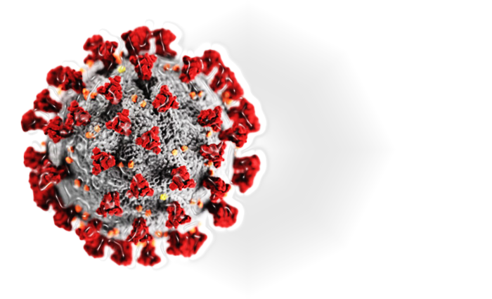
COVID
PREPARE,
DON’T PANIC !
COVID - 19
SYMPTOMS

