Slide 1
Arogya – Smart Healthcare Appointment & Tracking Platform
Project Presentation | Prepared for Faculty Evaluation

Slide 2
Agenda
Problem Statement & Objectives
System Overview & Architecture
Key Features (User, Doctor, Admin)
Algorithms, Flowcharts & Data Model
Tech Stack, Dependencies, Deployment
Results, Limitations, Future Work

Slide 3
Problem Statement
Manual appointment booking leads to delays and poor follow‑ups
No unified place for patients to track visits and care plans
Clinics need admin dashboards for doctors, patients, revenue
Patients need reminders and guided symptom support

Slide 4
Objectives
Build a full‑stack web app for patient‑doctor appointments
Provide role‑based portals: User, Doctor, Admin
Enable payments, reminders, and health tracking
Deploy on cloud for real usage

Slide 5
System Overview
Frontend: Patient web app (React + Vite)
Admin/Doctor portal (React + Vite)
Backend API (Node.js + Express)
Database: MongoDB (Mongoose)
External services: Cloudinary, Razorpay, Twilio

Slide 6
Architecture Diagram
End‑to‑end flow across clients, API, DB, and services
User Web App
(React + Vite)
API Server
(Node.js + Express)
MongoDB
(Mongoose)
Admin/Doctor Portal
(React + Vite)
External Services
Cloudinary, Razorpay, Twilio

Slide 7
User Features
Register/Login and profile management
Doctor discovery by specialization
Book, pay, cancel appointments
Health tracker: visits, records, care plans
AI Assistant for symptom‑based suggestion

Slide 8
Doctor Portal Features
Doctor login and profile update
View appointments and patient details
Complete or cancel appointments
End care plans when treatment is finished

Slide 9
Admin Portal Features
Admin login and dashboard
Add/manage doctors and availability
View all appointments and patients
Operational visibility for clinic management

Slide 10
Key Modules (Backend)
Auth: JWT‑based user/doctor/admin login
Appointments: booking, listing, canceling
Payments: Razorpay integration
Media: profile image upload via Cloudinary
Reminders: scheduled SMS via Twilio + cron

Slide 11
Algorithm: Appointment Booking
Validate user token and doctor availability
Create appointment entry and reserve slot
Initiate payment via Razorpay
On payment verify, confirm appointment
Notify user and update doctor schedule

Slide 12
Flowchart: Appointment Booking
Visual workflow of the booking process
Start
User selects doctor & slot
Server validates availability
Create appointment + initiate payment
Payment verified
Appointment confirmed
End

Slide 13
Algorithm: Reminder Scheduler
Run daily cron at configured hour
Fetch active care plans
Skip if reminder already sent today
Send SMS to patient and doctor
Update lastReminderAt timestamp

Slide 14
Flowchart: Reminder Scheduler
Automated SMS follow‑up workflow
Start (daily cron)
Fetch active care plans
Check lastReminderAt
Send SMS (patient + doctor)
Update lastReminderAt
End

Slide 15
Data Model (MongoDB)
Users: profile, contact, health records
Doctors: profile, speciality, availability
Appointments: user, doctor, time, status
Care Plans: ongoing follow‑up tracking

Slide 16
Database Schema
Entities and relationships
User
Doctor
Appointment
CarePlan

Slide 17
Tech Stack
Core
Frontend: React, Vite, Tailwind
Admin: React, Vite
Backend: Node.js, Express
DB: MongoDB (Mongoose)
Services
Auth: JWT
Payments: Razorpay
Media: Cloudinary
SMS: Twilio
Cron: node-cron

Slide 18
Dependencies (Frontend)
react, react-dom, react-router-dom
axios, react-toastify
tailwindcss, postcss, autoprefixer
vite (build tool)

Slide 19
Dependencies (Admin & Backend)
Admin: react, react-dom, react-router-dom, axios
Backend: express, mongoose, bcrypt, jwt
multer (uploads), cloudinary
razorpay, twilio, node-cron

Slide 20
Deployment & Hosting
Frontend deployed with Vercel (static build)
Backend deployed with Vercel serverless
Environment variables used for secrets
API routes rewired via Vercel rewrites

Slide 21
Security & Validation
JWT auth middleware for protected routes
Password hashing with bcrypt
Input validation and role checks
Secure handling of API keys via env vars

Slide 22
Testing & Demo Plan
Manual functional testing on key flows
Role‑based test cases (User, Doctor, Admin)
Demo: register → book → pay → reminder

Slide 23
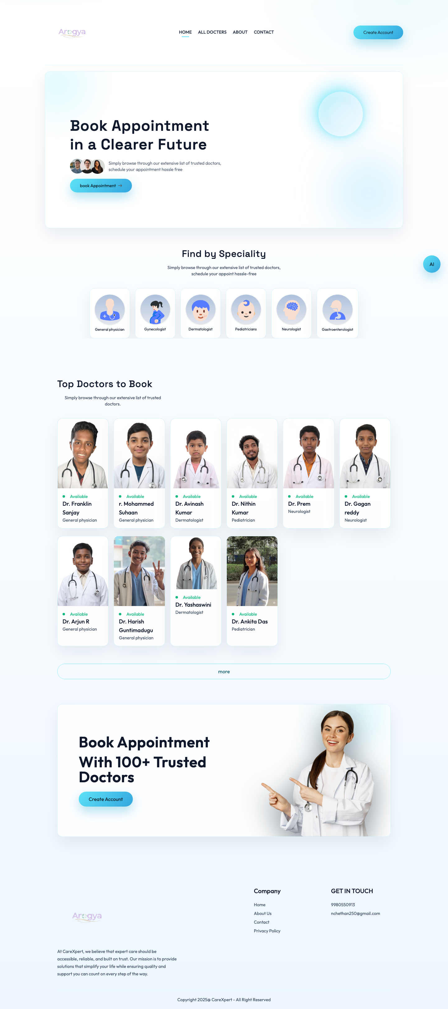

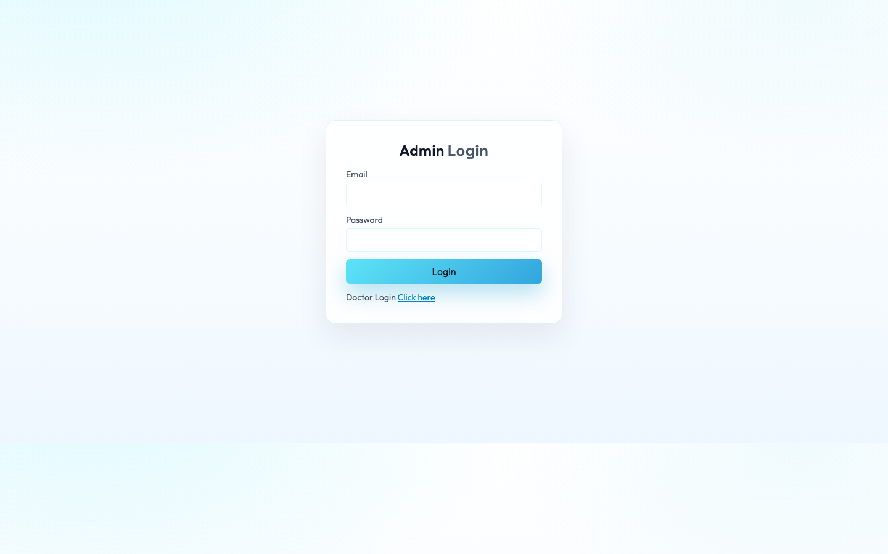
Results & Screenshots
Live UI captures from the application

Slide 24
Limitations
AI assistant is rule‑based (not ML model)
No native mobile app (web only)
Limited analytics in admin dashboard

Slide 25
Future Enhancements
AI‑powered triage and chat
Telemedicine video appointments
Advanced analytics and reports
Mobile app (Android/iOS)

Slide 26
Conclusion
Arogya provides end‑to‑end digital healthcare workflow
Improves scheduling, follow‑up, and patient tracking
Scalable architecture with cloud deployment

Slide 27
Q & A
Thank you

