Slide 1

SREENIVASA INSTITUTE OF TECHNOLOGY AND MANAGEMENT STUDIES
(Autonomous-NBA Accredited)
DEPARTMENT OF COMPUTER SCIENCE AND ENGINEERING
(2023-2024)
A MINI PROJECT REPORT PRESENTATION
ON
COLOR DETECTION USING PYTHON
BY
C CHETHAN | 21751A0541
G VASANTH KUMAR | 21751A0560
A KARTHIK | 21751A0504
E V CHANDRAKANTH GOUD | 21751A0552
Under the Guidance of
Dr.T.KESAVA RAO, M.Tech.,Ph.D
Associate Professor
Department of Computer Science And Engineering,
Sreenivasa Institute of Technology and Management Studies, Chittoor, A.P.

Slide 2
ABSTRACT
This Python application enables real-time color detection in both static images and live video feeds through a user-friendly interface.
Using Tkinter for the graphical user interface (GUI), the application allows users to select an image file or use the web cam The application features a login page to ensure that only authorized users can access the color detection functionality
The interface continuously updates until the user exits by closing the window or pressing a designated key

Slide 3
INTRODUCTION
This presentation introduces about Color Detection application developed using Python.
The application uses the OpenCV for image processing and Tkinter for GUI development.
It serves as a practical tool for identifying colors in images and real-time video feeds.
Through a user-friendly interface, users can interactively explore color information in their media files.

Slide 4
PROBLEM IDENTIFICATION
Color detection in digital images is hard due to lighting, camera variations, and environment changes.
Current methods often fail to adapt, leading to errors in color detecting.
A robust system is needed that can adjust color thresholds dynamically and learn from new scenarios
Standardizing color calibration procedures and fostering collaboration among researchers, engineers, and industry stakeholders are crucial for improving accuracy and reliability in color detection tasks.

Slide 5
OBJECTIVES
Develop an interactive application using Tkinter for detecting colors
Enable users to upload images and access live video from their webcam through a graphical user interface.
Implement accurate color detection algorithms to map RGB values to the closest matching color name and hexadecimal code using a predefined dataset.
By handling mouse events efficiently for dynamic color capture and continuous updates of color information in real-time.

Slide 6
LITERATURE SURVEY
Existing Methods Review:
Summarize current techniques for color picture division, focusing on their reliance on RGB color comparison and the challenges they face.
Innovative Real-time Color Sensing:
Introduce the novel concept of using thermal imagery division results as real-time color , emphasizing adaptability to temperature-induced color variations.

Slide 7
SYSTEM ANALYSIS
Existing System and Limitations
Proposed System and Merits
Feasibility Study

Slide 8
EXISTING SYSTEM AND LIMITATIONS
Existing system:
The existing system is a Python script that performs color detection on static images. It does not utilize a webcam or provide a graphical user interface (GUI). Instead, users select an image file from their system, and the script processes the image to identify the dominant color
Limitations:
The system's accuracy heavily relies on the dataset of colors available for comparison
Since the system operates on static images, it cannot provide real-time feedback or dynamic color tracking

Slide 9
PROPOSED SYSTEM AND MERITS
The color detection system is designed to provide users with two main functionalities:image color detection and real-time color detection through a camera feed. Upon selecting an image file, users can click anywhere on the image to retrieve color information, including the color name, and hexadecimal code And having an login window to acess the color detection application.
Merits:
Both Image and real-time color detection
User-friendly GUI with intuitive buttons and descriptive labels
Used Binary search algorithm for color matching

Slide 10
FEASIBILITY STUDY
Objective Definition: Clearly state the goal of building the color detection application.
Resource Assessment: Evaluate what's needed for development, like programming skills and access to a webcam.
Technical Feasibility: See if the tools we plan to use, like Tkinter, are suitable for the job.
Operational Feasibility: Consider how easy it'll be for users to interact with the app.
Financial Feasibility: Check if we can afford the development, considering time and potential expenses.

Slide 11
SYSTEM DEVELOPMENT MODEL
Iterative and Incremental Model :
Iteration 1: Basic GUI Setup
Iteration 2: Login page setup
Iteration 3: Image File Selection and Display
Iteration 4: Color Detection on Image
Iteration 5: Real-Time Video Feed
Iteration 6: Refinement and Optimization
Iteration 7: Testing and Debugging

Slide 12
SYSTEM DESCRIPTION
Problem definition
Overview of the system
System Block Diagram

Slide 13
Problem definition
The color detection application aims to accurately identify colors in both static images and real-time video feeds.
The project involves various components, such as GUI design for login page and image processing, and real-time video handling .
And adding an alogorithm for color matching.

Slide 14
Overview of the system
System Components
Login page
User Interface
Image File Selection and Display
Color Detection on Static Images
Real-Time Video Feed Integration
Color Database
Key Functionalities

Slide 15
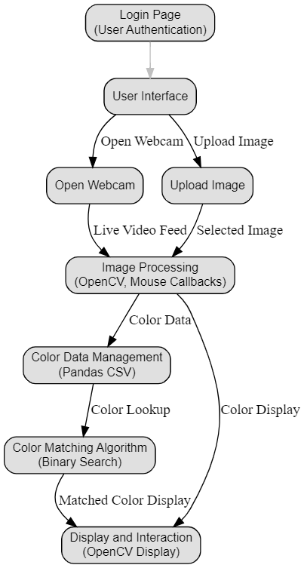
System Block Diagram

Slide 16
SYSTEM DESIGN
Module Description
Algorithm(Explanation)
DFD
Input Design
Output Design

Slide 17
Module Description
Selecting Image:
Users can click a button called UPLOAD IMAGE .This function allowing users to browse and select an image file. Once a file is selected, the image is loaded using OpenCV and its color information is displayed. Users can then click on any point in the image to obtain the RGB values and the corresponding color name.
Starting Video Feed:
Users can click a button called OPEN CAMERA .This function accesses the camera and continuously captures video frames.The video feed is displayed in a window, and users can click on any point in the video feed to obtain the hex code and the corresponding color name.

Slide 18
Algorithm(Explanation)
Binary Search Algorithm:
The binary search algorithm is used to efficiently find the closest color match in a predefined color dataset based on the RGB values of a target color.
The function colorname() takes three parameters representing the Blue (B), Green (G), and Red (R) values of the target color, respectively.
The algorithm returns the name and hexadecimal code of the closest matching color found in the dataset based on the RGB values of the target color.

Slide 19
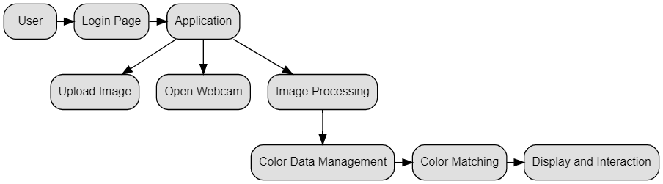
DFD
Data flow diagram:

Slide 20
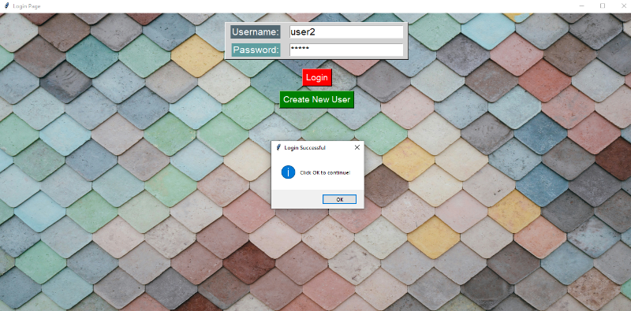
Input Design
Login Page:

Slide 21
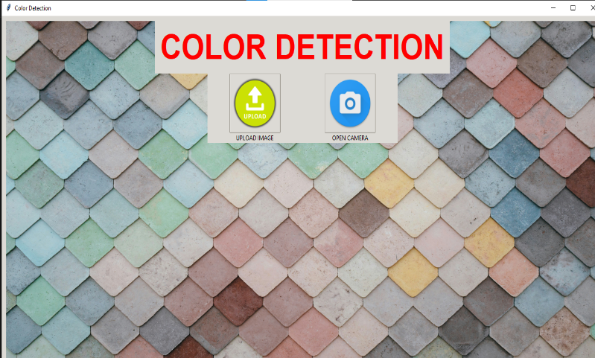
Input Design
User interface:

Slide 22
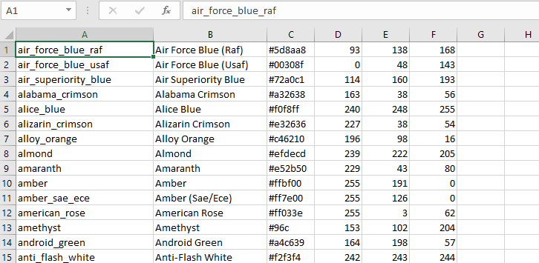
Input Design
Data set:

Slide 23
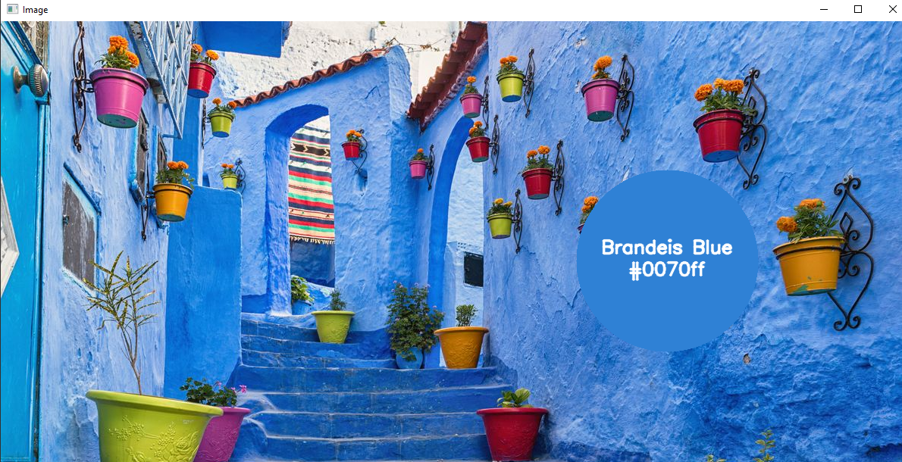
Output Design

Slide 24
SYSTEM SPECIFICATION
System Requirement
Software Requirements
Hardware Requirements

Slide 25
System Requirement
Software Requirements:
Windows 7 or above
Python : version 3.x installed
Python libraries:
NumPy
Pandas
OpenCV
Imutils
Tkinter
Pillow
Hardware Reqirements :
i3 Processor Based Computer or higher
Memory: 4 GB RAM
Hard Drive: 50GB

Slide 26
System Implementation
Setting Up the Environment
Login Page Implementation
User Interface Design
Image Processing Algorithms
Testing and Validation
Performance Considerations

Slide 27
SOFTWARE TESTING
1. Functional Testing:
Verifying that the login functionality works correctly by testing valid and invalid login attempts.
Testing the image processing functionality to ensure that RGB values and color names are accurately displayed when selecting points in the image or video feed.
2.Integration Testing:
Testing the integration between the login page and the main application to ensure that authentication works seamlessly and users are directed to the appropriate interface after login.

Slide 28
SOFTWARE TESTING
SL.NO | TEST CASES | INPUT | EXPECTED OUTPUT | ACTUAL OUTPUT | PASS/FAIL
1 | Read the dataset. | Dataset path. | Dataset need to read successfully. | Dataset fetched successfully. | Pass
2 | Checking login functionality | User name and password | Opens the user interface | User interface opened successfully | Pass
3 | Performing color detecting using image | Selecting image | By clicking on the image it has to display color name | Color name displayed successfully | Pass
4 | Performing color detecting using Web cam | Opening web cam | By clicking on the video it has to display color name | Color name displayed successfully | Pass

Slide 29
Conclusion and Future Enhancement
Conclusion:
The color detection system is a reliable solution for accurately identifying colors from images and video feeds. Through sophisticated image processing algorithms and intuitive GUI design, the system provides users with a seamless color detection experience.
Future Enhancement:
Integration of Deep Learning
Enhanced Color Space Support
Mobile Application Development

Slide 30
References
[1].OpenCV: Open Source Computer Vision Library. Retrieved from https://opencv.org/.
[2].NumPy Documentation. Retrieved from https://numpy.org/doc/.
[3].Pandas Documentation. Retrieved from https://pandas.pydata.org/docs/.
[4].Tkinter Documentation. Retrieved from https://docs.python.org/3/library/tkinter.html.
[5].Pillow Documentation. Retrieved from https://pillow.readthedocs.io/en/stable/.
[6].Smith, S. (2020). Learning OpenCV 4 Computer Vision with Python 3: Get to grips with tools, techniques, and algorithms for computer vision and machine learning. Packt Publishing Ltd.
[7].Rosebrock, A. (2018). Practical Python and OpenCV: Learn Computer Vision in a Single Weekend. PyImageSearch.

Slide 31
THANK YOU

