Slide 1
LOBOSA
DECENTRALISED CAB SERVICE USING BLOCKCHAIN

Slide 2
COMPONENTS
Android App for interface
Firebase cloud for storing details of drivers and customers
Server to act as an interface between the blockchain and the app
Ganache for the blockchain

Slide 3
Purpose
To eliminate middleman in the existing cab service system
A peer 2 peer system for commute
Decentralised application making it transparent and secure

Slide 4
Execution and Screenshots
All the individual components have been developed individually, however and have not been integrated due to time constraints

Slide 5
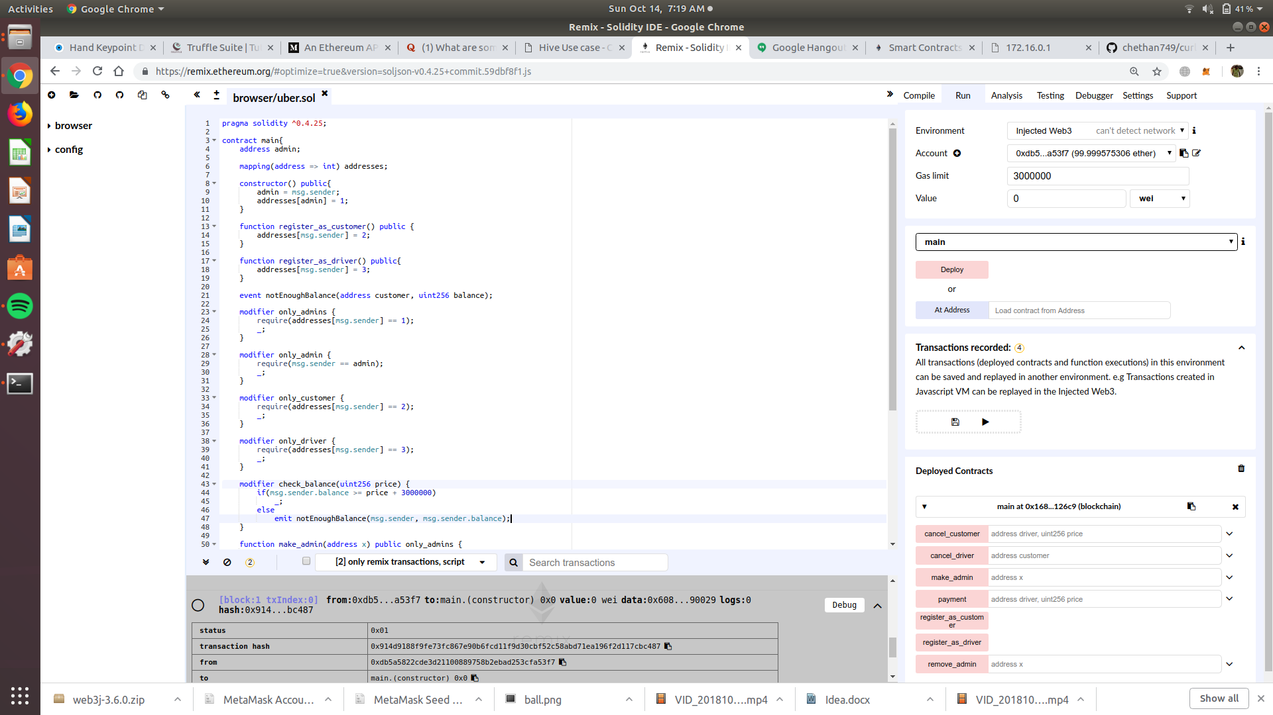

Slide 6
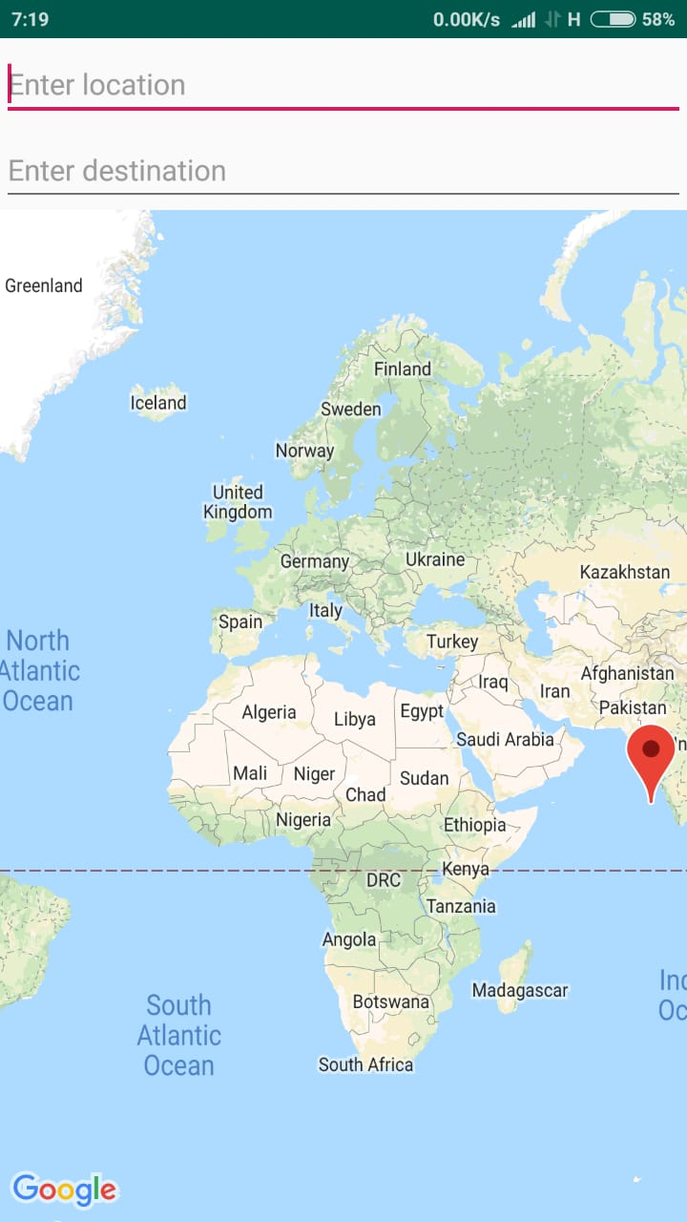
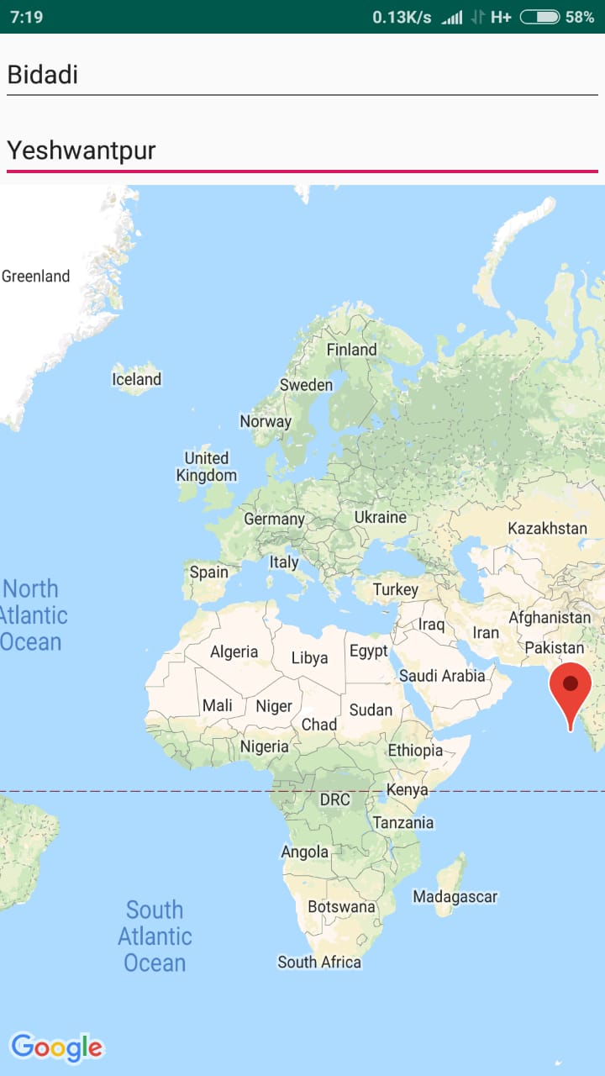

Slide 7
