Slide 1
2020 YEAR PLAN April 2020 – March 2021 (Saswati)

Slide 2
Target for the year 2019-20
Target Given - 35,00,00 profit
Target Achieved – 2,098,027
Percentage Achieved – 60%
Deficit - 1,401,973

Slide 3
Current Cientele
Novo Nordisk
IBM
Intel

Slide 4
Target Clients for 2020-21
Accenture
E&Y
CERA Sanitaryware
More of NBD and new clients research

Slide 5
Accenture
They do lot of team outings and sports activities during weekends.
They also do Award and Recognitions events.
Trying to reach the procurement and fix up meeting

Slide 6
CERA Sanitaryware
Targeting their dealer meets which are huge events for them.
They also do small events every quarter inside and outside India.
Procurement sits in Ahmedabad. Trying to get their contact and fix up meetings.

Slide 7
E&Y
They have several Departments and each department spends over 50,00,000 per year for their events.
Trying to reach out marketing people to get in touch with Procurement.

Slide 8
Strategies & Conclusions
Novo Nordisk
-Need to win majority of the events.
-Better creativity and cost.
IBM
-Build better client relations.
Intel
-Preparing for the upcoming year and getting involved with all the events done by them.

Slide 9
Target for the year 2020-2021
Target Given – 50,00,000 profit

Slide 10
Tentative Sales and Profit
Clients | Sale | Profit
IBM | 90,00,000 | 30,00,00
Novo Nordisk | 50,00,000 | 15,00,000
New Clients | 20,00,000 | 5,00,000

Slide 11
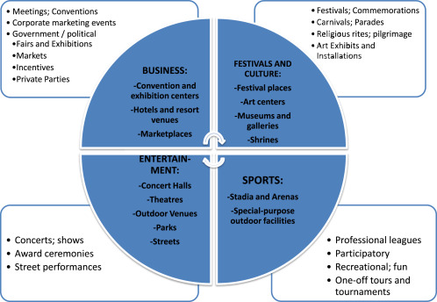
Areas of Improvement
Areas of Research
Research & Power point
NBD
Giving Presentations

Slide 12
THANKS!

