Slide 1

BUSINESS PLAN
‘20 – ‘21

Slide 2



INDEX
EXECUTIVE SUMMARY
OBJECTIVE
EVENTS – ROAD MAP
FUEL TANK
SWOT

Slide 3




OBJECTIVE
Manage
Acquire
Manage existing clients
& projects with finesse
Generate new business
From existing and new
clients
Grow
Achieve
Make a plane to achieve
Goals and targets within
The timeline
Focus on career growth
along with the business

Slide 4
FUEL TANK
40L
40L
7L
88L
7L
88L
0
1CR
0
1CR
Quarter 1
Quarter 2
A slow start to the year due to the unfortunate pandemic outbreak
All carry forward events from last quarter should be executed to achieve the numbers

Slide 5
FUEL TANK
40L
40L
7L
88L
7L
88L
0
1CR
0
1CR
Quarter 3
Quarter 4
This being the peak season, need to push to achieve maximum results
Last 3 months should have a few events lined up to reach our goals

Slide 6

EVENTS – Road Map
QC Newsletter – 2L
QC Newsletter – 2L
Quarter 4
QC Cricket & TT – 3L
Rangotsav – 18L
QC Bi Annual - 7L
Quarter 3
Qutumbotsav – 13L
Others – 15L
Quarter 2
Tally Mahasabha – 6L
QC WFH – 1L
QC Newsletter – 2L
QC Newsletter– 2L
Quarter 1
QC Masterchef –3L
QC NOS – 4L
QC Marathon – 10L
QC Kids Day – 12L

Slide 7
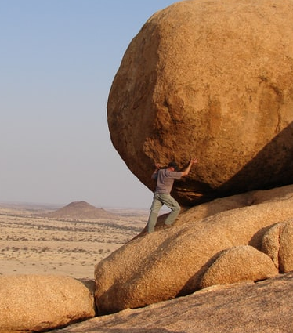


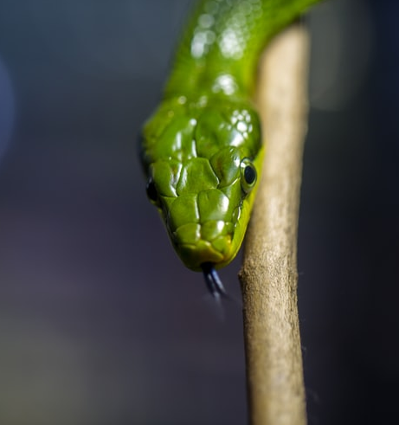
S
W
Existing Clients
Expertise – Ideas & Creative
Competitive Rates
Acquiring new clients
Creative set designs
Timings
O
T
Virtual Events
Postponed Events
Current Situation
Competitors

Slide 8
Thank You

