Slide 1
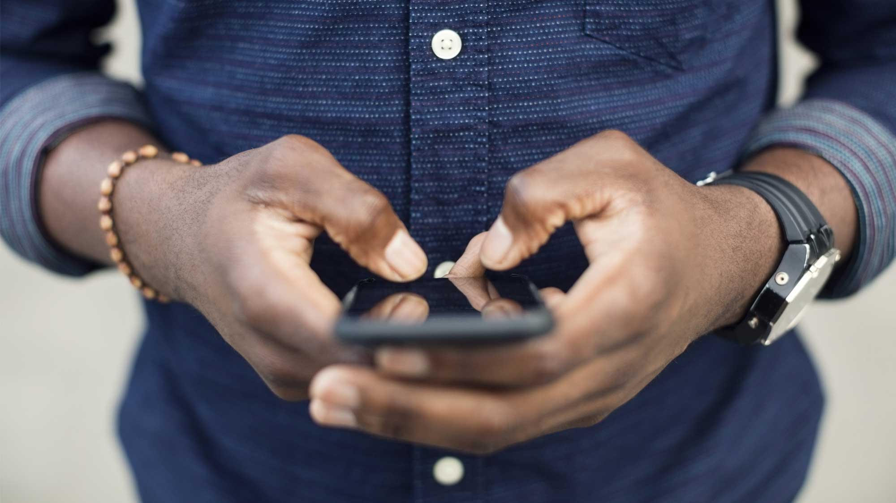

BUSINESS PLAN & PROJECTION
APRIL 2020 – MARCH 2021

Slide 2

CLIENTELE
WIPRO
TOYOTA
NBD

Slide 3
EXPECTED REVENUE
TARGET – 40 lakh
SL.NO. | CLIENT | BILLING AMOUNT | TOH @35%
1 | WIPRO | 5000000 | 1750000
2 | Toyota | 4500000 | 1575000
3 | NBD | 2000000 | 700000
TOTAL |  | 11500000 | 4025000

Slide 4
NBD WISH LIST
Tesco
Virtusa
Xylem
Apple
LRDE
Big Basket
Tiktok

Slide 5
STRATEGY
Do more meetings with existing clients as well as new clients
Will ensure to be more independent and manage events by myself
Have to brainstorm and have regular team meetings to discuss the current events and new ideas
Have to stay updated on new events, themes, technology and creative ideas so that we can sell them
Market and product research and knowledge
Try and bring in new clients by spending dedicated time weekly on NBD

Slide 6

Thank You
Team Anoop Mathew
Richardson & Zoheb - Marketing

