Slide 1
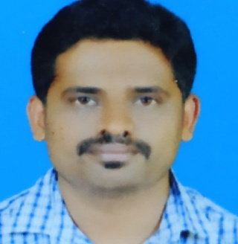
Profile Summary
Relevant Experience
CHETHAN G D
Project Name: Alcyon(oct 2022 to march 2024)
Alcyon is a product, It’s a toll management system where incident data are captured using an camera.
Worked on Containerization Technology. Ex: Docker, Kubernetes
Deploying the application using helm chart
Worked on releasing the microservice version using a helm chart.
Worked on creating an infrastructure using a terraform
Project Name: TeqoOS(April 2021 to Sept 2022)
TeqoOS is a renewable assets computerized maintenance management software.
Automated complete CI process using Jenkins from the scratch.
Installed Jenkins, created jobs for builds, deployment and another task to automate.
Worked on checkmarx for security vulnerabilities.
Installed hashicorp vault CSI driver on Kubernetes.
Project Name: Solar pulse(June 2018 to March 2021)
solarPulse is a cloud-based solar monitoring application specially designed for solar rooftop asset owners, managers & operators to manage plant performance on a real-time basis.
Created AWS EC2 instances and setup to AWS cloud.
Worked on creating S3 bucket attached volume to running instance.
Worked on IAM service and creating VPCs.
Email ID : chethan.G.D@accenture.com
Profile
DevOps with 5+ years of experience as a Kubernetes Engineer.
Worked as a Infrastructure Engineer Using terraform and automated aws services like IAM,S3,EC2,ALB.
Worked on Writing YAML file for creating deployment and services.
Worked on Creating an ingress gateway to route traffic to virtual service which inturn route traffic to internal services of the kubernetes cluster.
Worked on creating a jenkins pipeline to automate the process
Git,Jenkins,Docker,Kubernetes,AWS,Terraform,Shell scripting
Key Expertise
Certification/Trainings

