Slide 1
Sales Forecasting Across Multiple Retail Stores
Presented by: CHETHANA S AMRESH
NextHikes IT Solutions

Slide 2
Business Objective
• Forecast daily sales for Rossmann stores 6 weeks in advance.
• Assist store managers with data-driven decision-making.
• Incorporate factors like promotions, holidays, competition, and seasonality.

Slide 3
Data Overview
• train.csv: Historical sales data per store and date.
• store.csv: Store-specific features (type, competition, promotions).
• test.csv: Data to predict future sales.
• Target Variable: Sales

Slide 4
Key Features
• StoreType, Assortment
• CompetitionDistance, CompetitionOpenSince
• Promo, Promo2, PromoInterval
• StateHoliday, SchoolHoliday
• DayOfWeek, Month, Year, WeekOfYear
• Note: Excluded 'Customers' during modeling to avoid data leakage.

Slide 5
Exploratory Data Analysis
• Sales Distribution: Normalized using log transform.
• Sales by Day of Week: Lower sales on Sundays.
• Sales by StoreType: Type 'a' stores have the highest average sales.

Slide 6
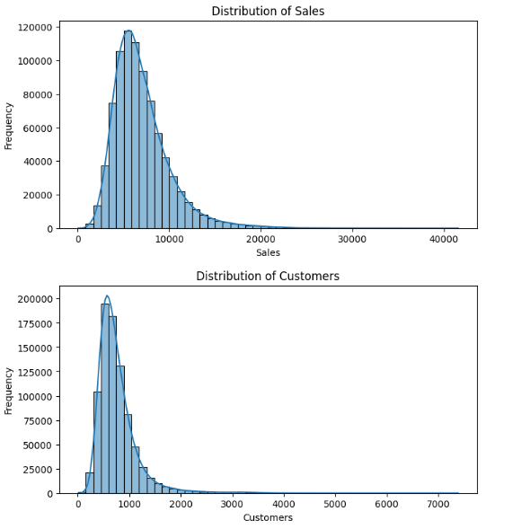
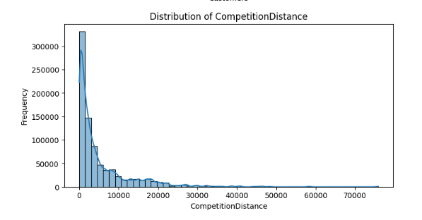
Continued.....

Slide 7
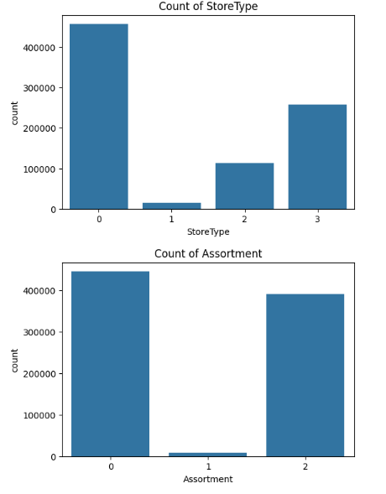
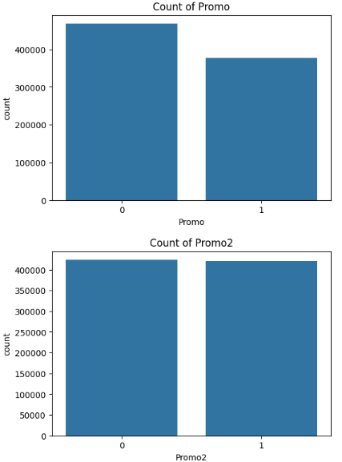
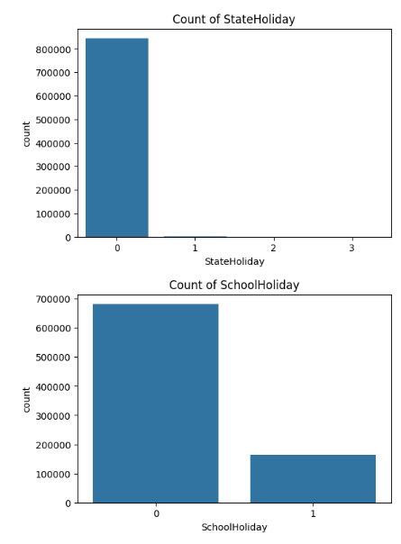
Continued...

Slide 8
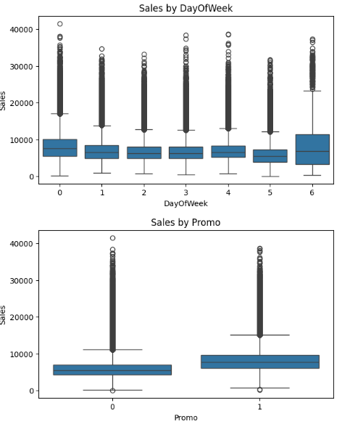
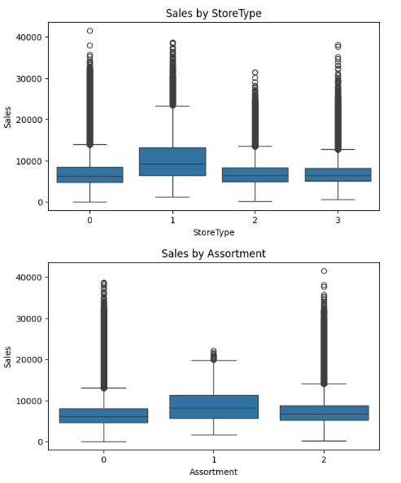
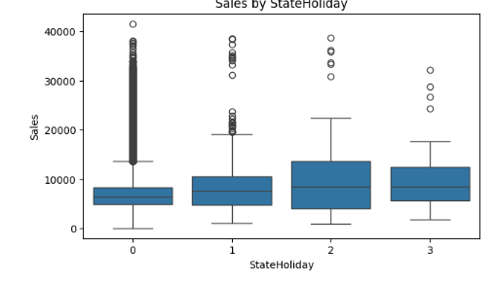
Bivariate Analysis (Two Variables) Categorical vs Sales (Boxplots)

Slide 9
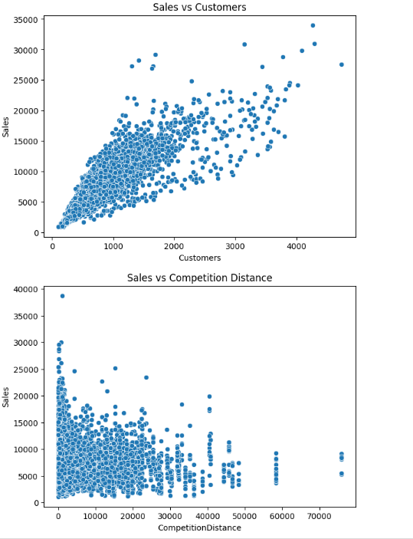
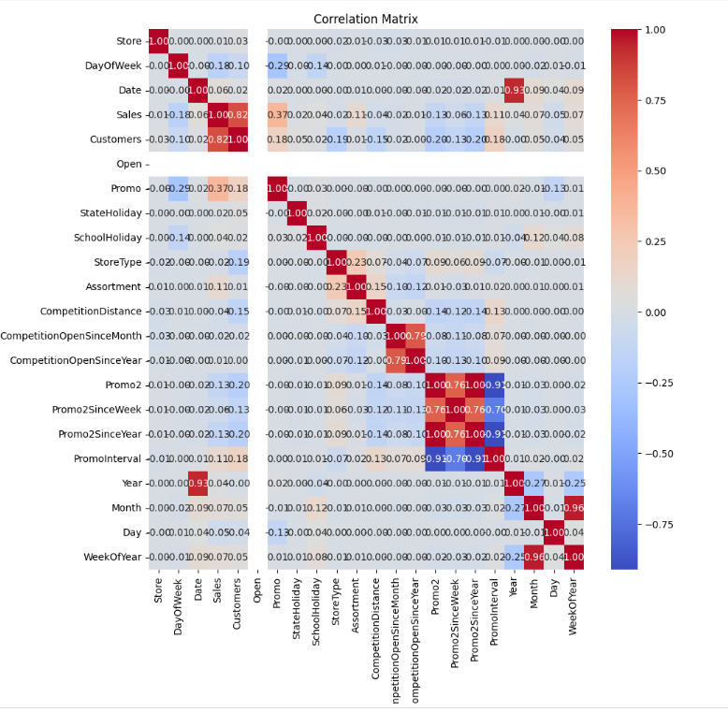
Numerical vs Sales (Scatterplots) & Correlation Heatmap (Only Numeric Features)

Slide 10
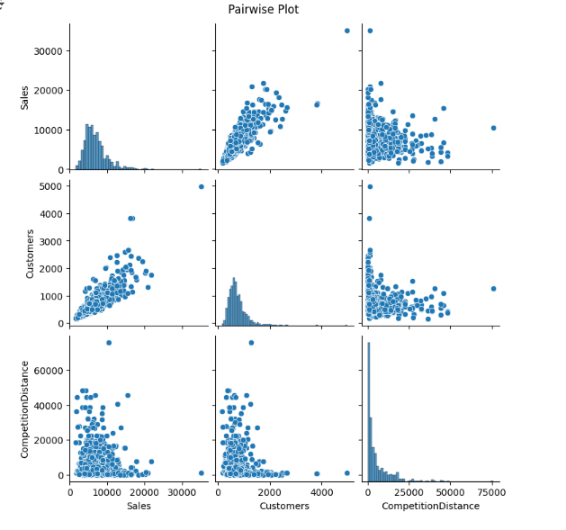
Pairplot (numerical features)

Slide 11
Feature Impact
• Promo – Strongest impact on sales.
• CompetitionDistance – Nearby competitors reduce sales.
• StoreType, Assortment – Influence customer choice.
• DayOfWeek, Month – Reflect seasonality trends.

Slide 12
Model Used
• Model: Gradient Boosting (LightGBM)
• Reason: Fast, accurate, handles missing/categorical data well.
• Steps:
1. Data Preprocessing
2. Feature Engineering
3. Model Training with CV
4. Log-transform on target
5. Inverse transform predictions
• Metric: RMSE (Root Mean Squared Error)

Slide 13
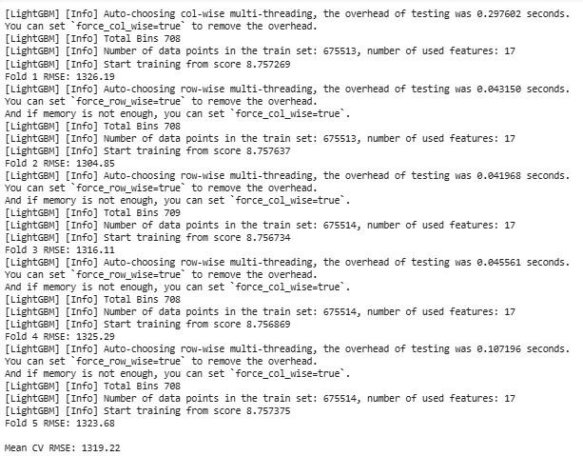
Model Performance
• Validation RMSE (log-transformed): 915.26

Slide 14
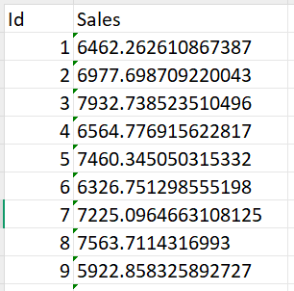
Sample LGBM Results

Slide 15
Key Insights
• Promotions significantly boost sales.
• Competition proximity negatively impacts sales.
• Seasonality (months, holidays) must be accounted for.
• StoreType 'a' stores consistently outperform others.

Slide 16
Recommendations
• Continue aggressive promotions on high-sales days.
• Open new stores away from close competitors.
• Tailor assortment by store type.
• Plan for predictable seasonal drops/increases.

Slide 17
Next Steps
• Deploy model as REST API for real-time predictions.
• Dashboard for finance team with filters (store/date/promo).
• Monitor model accuracy and retrain monthly.

Slide 18
THANK YOU

