Slide 1
IOT IMPLEMENTED SAFETY MODULE
PRESENTED By :
Chethanand V
Dinesh Kumar B
Manoj J V
Guided By :
Dr.K.Lalitha
TEAM NO: 06
22AIC14 & INTERNET OF THINGS AND IT'S APPLICATIONS

Slide 2
Abstract
A wearable safety Module implemented using IOT
Detects sound (scream) and abnormal heart rate.
Sends real-time GPS location to emergency contacts via SMS.
Uses sensors and GSM module to provide quick response in dangerous situation .

Slide 3
Objectives:
Monitor sound and heart rate for distress signals.
Trigger an alarm upon detection of danger.
Send GPS location to predefined contacts through SMS.
Provide immediate response to ensure user safety in emergencies.

Slide 4
Components Required:
1. Arduino Uno– Microcontroller to control sensors and modules.
2. LM393 Sound Sensor– To detect abnormal sound levels (e.g., screams).
3. Heart Rate Sensor(MAX 30102)– To monitor heart rate fluctuations.
4. SIM800L GSM Module– To send SMS alerts with GPS location.
5. Neo-6M GPS Module– To determine the user's current location.
6. Buzzer– To sound an alarm during emergencies.
7. Power Supply– To power all components (e.g., Li-Po battery).
8. Resistors, wires, and connectors– For connections and circuit design.

Slide 5
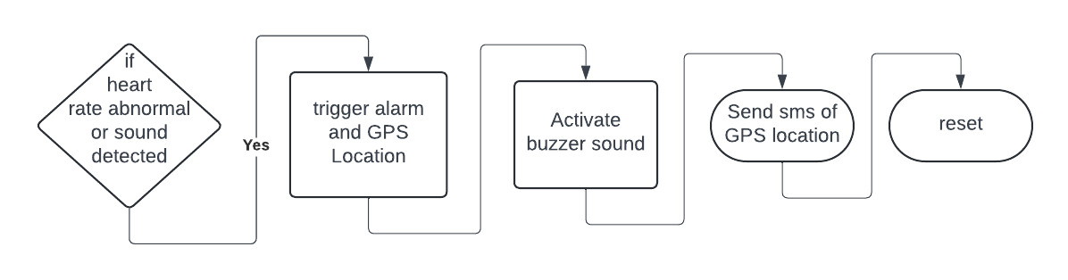
Flow Diagram:

Slide 6
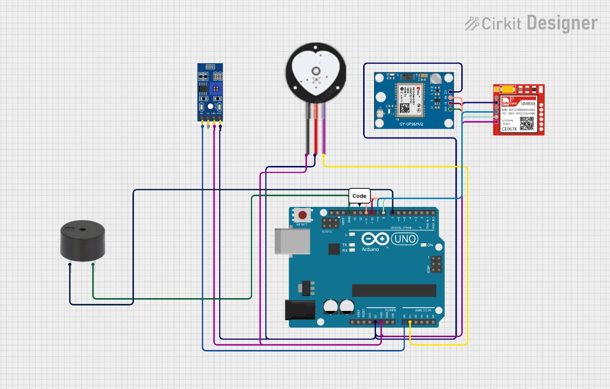
Design:

Slide 7
Implementation:
1. Sensor Integration: - Connect the LM393 sound sensor and the heart rate sensor to the Arduino’s analog pins. 2. GSM and GPS Setup: - Connect the SIM800L GSM module and Neo-6M GPS module to the Arduino. 3. Code Development: - Write the Arduino code to monitor sound and heart rate levels, fetch GPS location, and send SMS via GSM when danger is detected. 4. Alarm Activation: - Program the buzzer to activate when a distress signal (sound or abnormal heart rate) is detected.

Slide 8
Protocol Used
UART: For serial communication between Arduino, SIM800A, and GPS module.
AT Commands: To control the SIM800A for sending SMS or making calls.
NMEA: For transmitting GPS location data as standardized sentences.

Slide 9
Limitations
The system relies on GPS for location and GSM for communication, both of which are affected by poor signal conditions. Additionally, the SIM800A module requires a stable power supply due to its high current draw.
The sound sensor and pulse sensor may produce false positives or negatives due to environmental noise or inaccurate readings, impacting the system's reliability.
The Arduino Uno has limited processing power for handling multiple tasks simultaneously, and the current setup lacks a user-friendly interface for real-time monitoring or remote access.

Slide 10
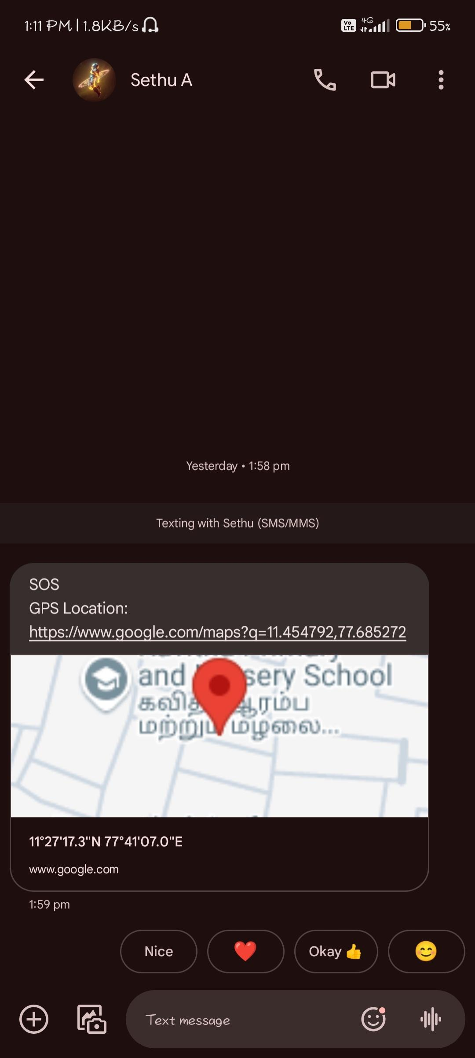
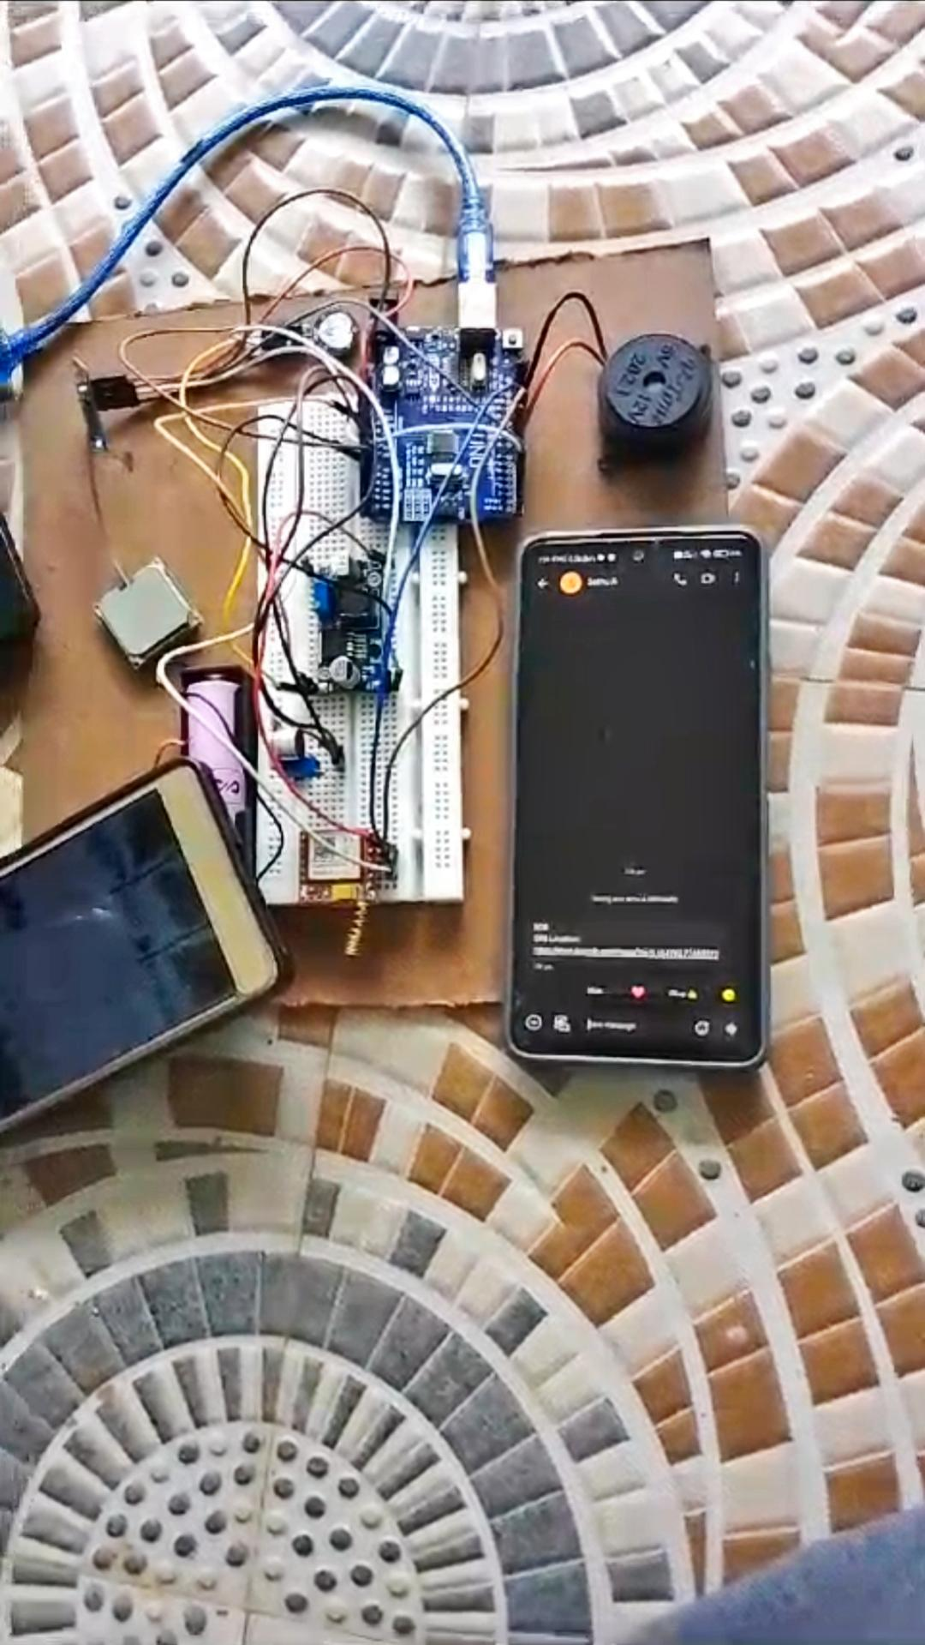
Output

Slide 11
THANK YOU.....!!!

