Slide 1
IOT IMPLEMENTED SAFETY WATCH
PRESENTED By :
Chethanand V
Dinesh Kumar B
Manoj J V
Guided By :
Dr.K.Lalitha
TEAM NO: 06
22AIC14 & INTERNET OF THINGS AND IT'S APPLICATIONS

Slide 2
Abstract
A wearable safety device using IoT.
Detects sound (scream) and abnormal heart rate.
Sends real-time GPS location to emergency contacts via SMS.
Uses sensors and GSM module to provide quick response in dangerous situation .

Slide 3
Objectives:
Monitor sound and heart rate for distress signals.
Trigger an alarm upon detection of danger.
Send GPS location to predefined contacts through SMS.
Provide immediate response to ensure user safety in emergencies.

Slide 4
Components Required:
1. Arduino Uno– Microcontroller to control sensors and modules.
2. LM393 Sound Sensor– To detect abnormal sound levels (e.g., screams).
3. Heart Rate Sensor (PulseSensor)– To monitor heart rate fluctuations.
4. SIM800L GSM Module– To send SMS alerts with GPS location.
5. Neo-6M GPS Module– To determine the user's current location.
6. Buzzer– To sound an alarm during emergencies.
7. Power Supply– To power all components (e.g., Li-Po battery).
8. Resistors, wires, and connectors– For connections and circuit design.

Slide 5
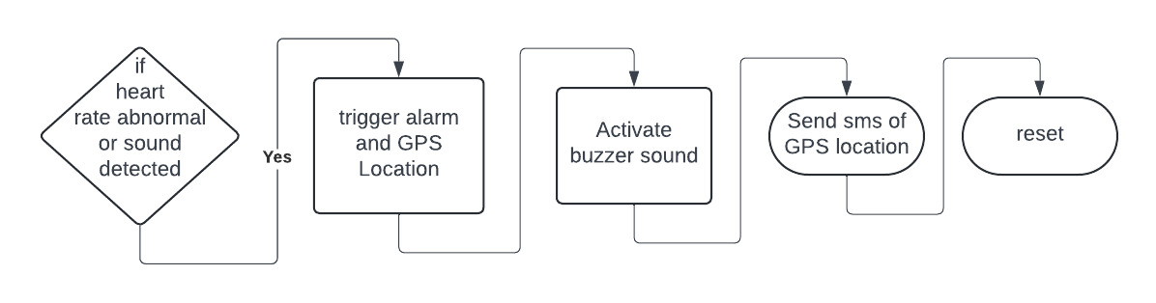
Flow Diagram:

Slide 6
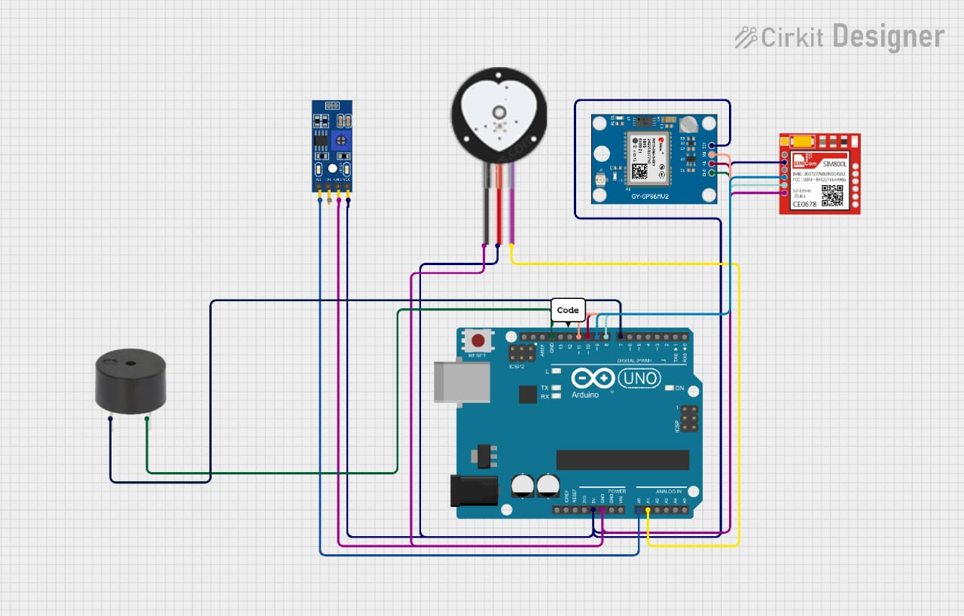
Design:

Slide 7
Implementation:
1. Sensor Integration: - Connect the LM393 sound sensor and the heart rate sensor to the Arduino’s analog pins. 2. GSM and GPS Setup: - Connect the SIM800L GSM module and Neo-6M GPS module to the Arduino. 3. Code Development: - Write the Arduino code to monitor sound and heart rate levels, fetch GPS location, and send SMS via GSM when danger is detected. 4. Alarm Activation: - Program the buzzer to activate when a distress signal (sound or abnormal heart rate) is detected.

Slide 8
THANK YOU.....!!!

