Slide 1
Unit-1
Chapter 1: Model Tuning

Slide 2
Chapter Contents
Data cleaning
Handling text and categorical attributes
Auto encoding
Label encoding
Custom transformers
Feature scaling
Transformation pipelines
Cross validation
Tuning a model using GridSearchcv, RandomizedSearchCV Ensemble methods

Slide 3
Data Cleaning
Data cleaning is an important step in machine learning, where the goal is to improve the quality of data that is being used for training a model. The process of data cleaning involves removing or correcting errors, inconsistencies, and outliers in the data, as well as dealing with missing values.
Handling missing values: One of the most common problems in real-world datasets is missing data. The presence of missing data can affect the accuracy of the model. There are different methods to handle missing values, such as imputation, deletion, or using models that can handle missing data.
Removing duplicates: Duplicate records can create bias and reduce the performance of the model. It is important to identify and remove any duplicate records from the dataset.
Removing outliers: Outliers are data points that lie far away from the majority of the data points. They can negatively impact the performance of the model. It is important to identify and remove outliers or use models that are robust to outliers.
Encoding categorical data: Machine learning models work with numerical data, so categorical data must be encoded before it can be used. One-hot encoding or label encoding are common techniques to encode categorical data.
Handling inconsistencies: Inconsistencies in the data can arise from human error or system errors. It is important to identify and correct any inconsistencies in the data before using it to train the model.

Slide 4
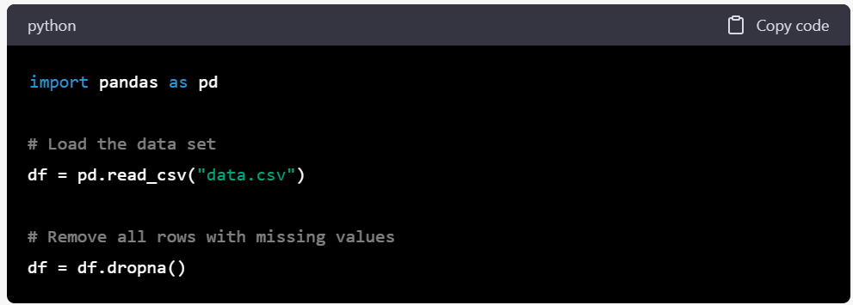
Handling Missing values
Handling missing values in a dataset involves methods for filling in the missing data so that the data can be used for analysis. Some common methods for handling missing values are:
Deletion: This method involves removing all observations with missing values. This method is simple but may lead to a significant loss of data if many observations are missing. For example, if a data set has 1000 observations, but 100 of them have missing values, then deletion would result in only 900 observations being used for analysis.

Slide 5
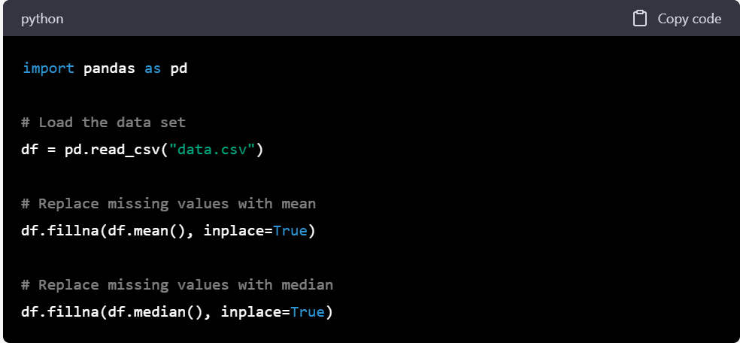
Mean/Median Imputation: This method involves replacing missing values with the mean or median of the variable. For example, if a data set has a column for age, and some observations have missing values, the missing values could be filled in with the mean or median age for the entire data set.

Slide 6
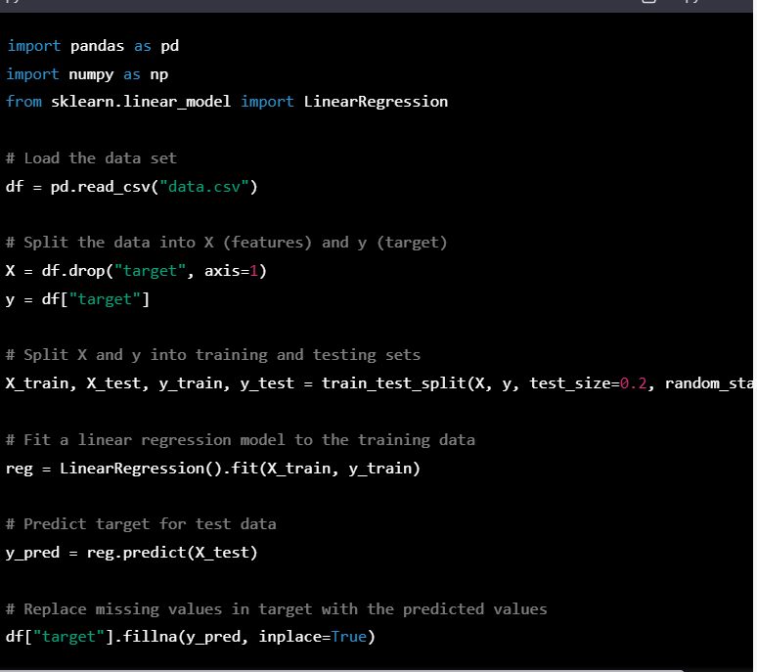
Regression Imputation: This method involves replacing missing values with the predicted values from a regression model. For example, if a data set has variables for height and weight, and some observations have missing values for weight, a linear regression model could be used to predict weight based on height, and the missing values could be filled in with the predicted values.

Slide 7
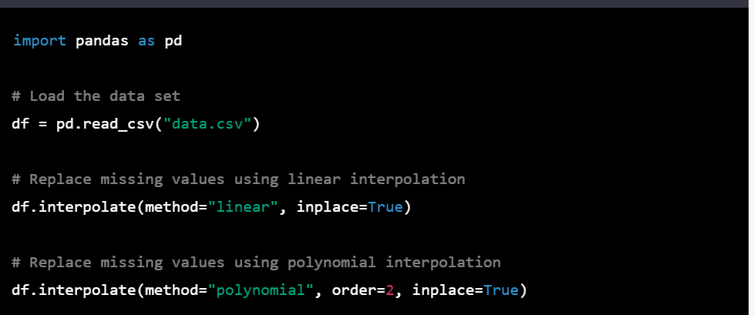
Interpolation: This method involves filling in the missing values using interpolation techniques, such as linear interpolation or polynomial interpolation. For example, if a data set has a column for temperature, and some observations have missing values, the missing values could be filled in by estimating temperature based on the temperatures at surrounding observations.

Slide 8
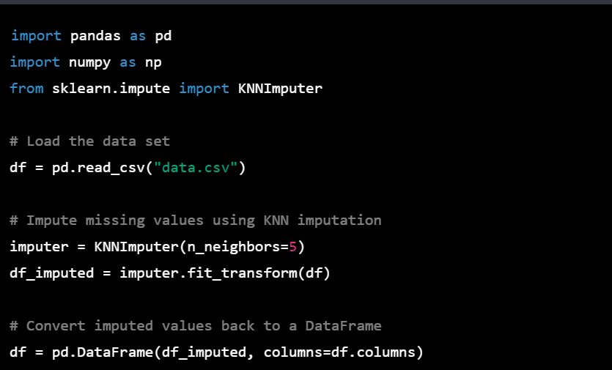
Multiple Imputation: This method involves replacing missing values with multiple estimates, and then combining the results to account for uncertainty. For example, if a data set has a column for income, and some observations have missing values, multiple imputation would involve estimating income based on other variables, generating several different datasets with different estimates for the missing values, and then combining the results to account for the uncertainty in the estimates.

Slide 9
Handling text and categorical attributes
Handling text and categorical attributes is important in many machine learning tasks, as these attributes are often non-numeric and can't be used directly in mathematical models. Here are some common methods for handling text and categorical attributes:
Label Encoding: This method involves converting each unique category into a numeric value. For example, if a data set has a column for "color" with categories "red", "green", and "blue", label encoding would convert these categories into numeric values such as 0, 1, and 2.
One-Hot Encoding: This method involves converting each category into a binary vector, with each element in the vector indicating the presence or absence of a particular category. For example, if a data set has a column for "color" with categories "red", "green", and "blue", one-hot encoding would convert this column into three separate columns, each indicating whether the observation is red, green, or blue.
Word Embeddings: This method involves converting words into dense vectors that capture semantic meaning. Word embeddings can be used to convert text data into numerical data that can be used in machine learning models. For example, if a data set has a column for "reviews" with text data, word embeddings could be used to convert each review into a numerical vector that captures the meaning of the review.

Slide 10
Examples-Label Encoding
from sklearn.preprocessing import LabelEncoder
# create example data
data = ['red', 'green', 'blue', 'green', 'red']
# create label encoder object
le = LabelEncoder()
# fit and transform the data
encoded_data = le.fit_transform(data)
print(encoded_data)
# output: [2 1 0 1 2]

Slide 11
Examples-OneHot Encoding
import pandas as pd
from sklearn.preprocessing import OneHotEncoder
# create example DataFrame
df = pd.DataFrame({'color': ['red', 'green', 'blue', 'green', 'red']})
# create one-hot encoder object
ohe = OneHotEncoder()
# fit and transform the data
encoded_data = ohe.fit_transform(df[['color']])
# create new DataFrame with encoded data
encoded_df = pd.DataFrame(encoded_data.toarray(), columns=ohe.get_feature_names(['color']))
print(encoded_df)
# output: color_blue color_green color_red
# 0.0 0.0 1.0
# 0.0 1.0 0.0
# 1.0 0.0 0.0
# 0.0 1.0 0.0
# 0.0 0.0 1.0

Slide 12
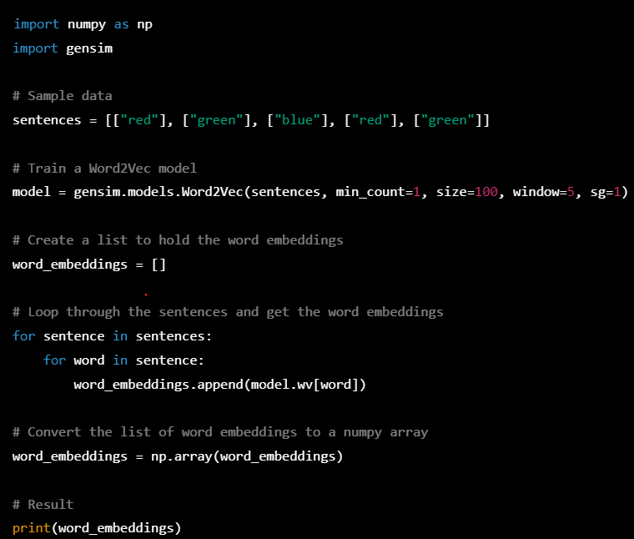
Examples-Word Embedding

Slide 13
Custom transformers
One of the most powerful features of scikit-learn is its ability to create custom transformers that can be seamlessly integrated into a machine learning pipeline.
In scikit-learn, a transformer is an object that transforms data from one representation to another. A transformer typically has a fit method that learns parameters from the training data, and a transform method that applies the learned transformation to new data.
Custom transformers allow you to define your own transformations that are specific to your data and problem domain.

Slide 14
To create a custom transformer in scikit-learn, you need to define a class that implements two methods: fit and transform. The fit method is used to learn any necessary parameters from the training data, while the transform method applies the learned transformation to new data.
If you want your transformer to be able to learn parameters from new data (e.g., in a cross-validation setting), you can also implement a fit_transform method that combines the fit and transform methods.
Here is an example of a custom transformer that scales the features of a dataset using the standardization technique

Slide 15
from sklearn.base import BaseEstimator, TransformerMixin
from sklearn.preprocessing import StandardScaler
class StandardizeTransformer(BaseEstimator, TransformerMixin):
def __init__(self):
self.scaler = StandardScaler()
def fit(self, X, y=None):
self.scaler.fit(X)
return self
def transform(self, X, y=None):
return self.scaler.transform(X)

Slide 16
In this example, the StandardizeTransformer class inherits from two base classes: BaseEstimator and TransformerMixin. The BaseEstimator class provides default implementations for methods such as get_params and set_params, while the TransformerMixin class provides a fit_transform method that combines the fit and transform methods.
The StandardizeTransformer class defines two methods: fit and transform. The fit method fits a StandardScaler object to the training data X, while the transform method applies the learned scaling to new data X.
Once you have defined your custom transformer, you can use it in a scikit-learn pipeline along with other transformers and a machine learning model. For example, you can use the StandardizeTransformer in a pipeline to preprocess the data before training a linear regression model:

Slide 17
from sklearn.pipeline import make_pipeline
from sklearn.linear_model import LinearRegression
pipeline = make_pipeline(StandardizeTransformer(), LinearRegression())
pipeline.fit(X_train, y_train)
In this example, the make_pipeline function creates a pipeline that first applies the StandardizeTransformer to the data, and then trains a LinearRegression model on the transformed data.

Slide 18
Feature Scaling
One of the most important transformations you need to apply to your data is feature scaling.
There are two common ways to get all attributes to have the same scale: min-max scaling and standardization.

Slide 19
Min-max scaling
Min-max scaling, also known as feature scaling or normalization, is a common data preprocessing technique used in machine learning to transform the features of a dataset into a common range. It involves rescaling the data to a fixed range of values, usually between 0 and 1, so that the features have a similar scale and do not affect the learning algorithm in different ways.
The min-max scaling formula for a feature x is as follows:
x_scaled = (x - x_min) / (x_max - x_min)
Where x is the original value
x_min : Minimum value of the feature
x_max: maximum value of the feature
Min-max scaling is particularly useful when the distribution of a feature is skewed or when the range of values is different for different features. It can help to improve the performance of machine learning algorithms, especially those that are sensitive to the scale of the input features, such as k-nearest neighbors and support vector machines.

Slide 20
from sklearn.preprocessing import MinMaxScaler
import numpy as np
# create a sample dataset
X = np.array([[1, 2, 3], [4, 5, 6], [7, 8, 9]])
# create a MinMaxScaler object
scaler = MinMaxScaler()
# fit and transform the data
X_scaled = scaler.fit_transform(X)
print(X_scaled)

Slide 21
Standardization
Standardization scaling, also known as Z-score normalization or standard scaling, is a data preprocessing technique used in machine learning to transform the features of a dataset so that they have zero mean and unit variance.
The standardization formula for a feature x is as follows:
x_scaled = (x - mean) / standard_deviation
Where
x: the original feature value
mean: is the mean of the feature
Standard_deviation: is the standard_deviation of the feature

Slide 22
import pandas as pd
from sklearn.preprocessing import StandardScaler
# load the data into a pandas DataFrame
df = pd.read_csv('your_data_file.csv')
# extract the feature columns you want to scale
feature_cols = ['col1', 'col2', 'col3']
# create a StandardScaler object
scaler = StandardScaler()
# fit and transform the selected features
df[feature_cols] = scaler.fit_transform(df[feature_cols])
# save the scaled DataFrame to a new CSV file
df.to_csv('standardized_data_file.csv', index=False)

Slide 23
Transformation pipelines
Data transformers are a set of techniques used in data preprocessing to transform raw data into a format that is suitable for machine learning algorithms. These techniques can include tasks such as scaling, encoding, feature selection, and feature engineering. Transformer pipelines are a way of combining multiple data transformers into a single pipeline that can be applied to input data.
The process of data transformers typically involves the following steps:
Data cleaning: This step involves removing any missing or erroneous data, such as incomplete or inconsistent records.
Data scaling: This step involves scaling numerical data to a common range, such as between 0 and 1, to avoid numerical instability.
Data encoding: This step involves converting categorical variables into numerical variables, such as using one-hot encoding or label encoding.
Feature selection: This step involves selecting the most relevant features for the task at hand, such as using correlation analysis or principal component analysis.
Feature engineering: This step involves creating new features from the existing data, such as using polynomial features or creating interaction terms.

Slide 24
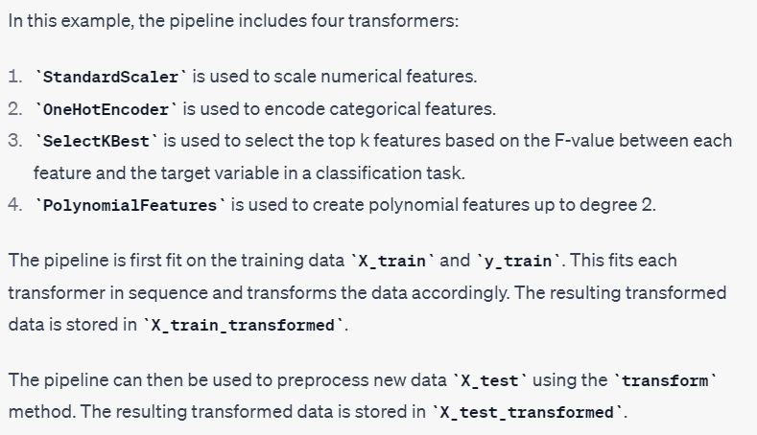
Pipeline –Data transformer
from sklearn.pipeline import Pipeline
from sklearn.preprocessing import StandardScaler, OneHotEncoder, PolynomialFeatures
from sklearn.feature_selection import SelectKBest, f_classif
# Define the pipeline with each transformer in sequence
pipeline = Pipeline([
('scaler', StandardScaler()),
('encoder', OneHotEncoder()),
('selector', SelectKBest(score_func=f_classif, k=10)),
('poly', PolynomialFeatures(degree=2))
])
# Fit the pipeline on training data
X_train_transformed = pipeline.fit_transform(X_train, y_train)
# Use the pipeline to preprocess new data
X_test_transformed = pipeline.transform(X_test)

Slide 25
Cross validation
Cross-validation is a common technique used for evaluating machine learning models. It involves dividing a dataset into multiple subsets, or "folds," and training the model on each fold while using the remaining folds for validation
The process is repeated for each fold, and the results are averaged to produce a final evaluation of the model's performance.
Here are the steps to perform cross-validation for model evaluation:
Split the dataset into k-folds, where k is typically 5 or 10.
For each fold i, train the model on all the other folds except for i.
Evaluate the model on the remaining fold i.
Repeat steps 2-3 for all k folds.
Calculate the average performance across all k evaluations to obtain a final estimate of the model's performance.

Slide 26
from sklearn.model_selection import cross_val_score
from sklearn.tree import DecisionTreeClassifier
from sklearn.datasets import load_iris
# Load iris dataset
iris = load_iris()
X = iris.data
y = iris.target
# Create a decision tree classifier
clf = DecisionTreeClassifier()
# Perform 5-fold cross-validation and compute the mean accuracy
scores = cross_val_score(clf, X, y, cv=5)
mean_accuracy = scores.mean()
print("Mean accuracy:", mean_accuracy)
In this example, we loaded the iris dataset and created a DecisionTreeClassifier model. We then used the cross_val_score function to perform 5-fold cross-validation, passing in the model, the dataset, and the number of folds (cv=5). The function returns an array of scores, one for each fold, which we then averaged to obtain the mean accuracy across all folds.

Slide 27
Tuning a Model
Model tuning is the process of selecting the best hyperparameters for a machine learning model to improve its performance on a given task. Hyperparameters are parameters that are not learned during the training process, but rather are set by the user before training.
Examples of hyperparameters include the learning rate of a neural network, the number of trees in a random forest, or the regularization parameter in a linear regression model.
GridSearchCV is a popular method for hyperparameter tuning that involves systematically searching through a specified grid of hyperparameters and evaluating the model's performance on a validation set for each combination of hyperparameters
The algorithm then selects the hyperparameters that produced the best performance, based on a specified scoring metric.

Slide 28
Gridsearchcv-hyperparameter tuning
from sklearn.model_selection import GridSearchCV
from sklearn.tree import DecisionTreeClassifier
from sklearn.datasets import load_iris
# Load iris dataset
iris = load_iris()
X = iris.data
y = iris.target
# Create a Decision Tree classifier
dtc = DecisionTreeClassifier()
# Define the hyperparameter grid to search over
param_grid = {'criterion': ['gini', 'entropy'],
'max_depth': [3, 4, 5, 6],
'min_samples_split': [2, 3, 4, 5],
'min_samples_leaf': [1, 2, 3, 4]}
# Perform grid search with 5-fold cross-validation and the accuracy score as the scoring metric
grid_search = GridSearchCV(dtc, param_grid, cv=5, scoring='accuracy')
grid_search.fit(X, y)
# Print the best hyperparameters and the corresponding accuracy score
print("Best hyperparameters:", grid_search.best_params_)
print("Best accuracy score:", grid_search.best_score_)

Slide 29
Randomizedsearchcv
The grid search approach is fine when you are exploring relatively few combinations, like in the previous example, but when the hyperparameter search space is large, it is often preferable to use RandomizedSearchCV instead.
This class can be used in much the same way as the GridSearchCV class, but instead of trying out all possible combinations, it evaluates a given number of random combinations by selecting a random value for each hyperparameter at every iteration
This approach has two main benefits:
If you let the randomized search run for, say, 1,000 iterations, this approach will explore 1,000 different values for each hyperparameter (instead of just a few values per hyperparameter with the grid search approach).
You have more control over the computing budget you want to allocate to hyper‐ parameter search, simply by setting the number of iterations

Slide 30
from sklearn.model_selection import RandomizedSearchCV
from sklearn.ensemble import RandomForestClassifier
from sklearn.datasets import load_iris
import numpy as np
# Load iris dataset
iris = load_iris()
X = iris.data
y = iris.target
# Create a Random Forest classifier
rfc = RandomForestClassifier()
# Define the hyperparameter distribution to sample from
param_dist = {'n_estimators': [100, 200, 300, 400, 500],
'max_depth': [3, 5, 7, 9, 11, 13, 15, None],
'min_samples_split': [2, 3, 4, 5, 6, 7, 8, 9, 10],
'min_samples_leaf': [1, 2, 3, 4, 5, 6, 7, 8, 9, 10],
'bootstrap': [True, False],
'criterion': ['gini', 'entropy']}
# Perform randomized search with 5-fold cross-validation and the accuracy score as the scoring metric
random_search = RandomizedSearchCV(rfc, param_distributions=param_dist, n_iter=100, cv=5, scoring='accuracy', random_state=42)
random_search.fit(X, y)
# Print the best hyperparameters and the corresponding accuracy score
print("Best hyperparameters:", random_search.best_params_)
print("Best accuracy score:", random_search.best_score_)

Slide 31
Ensemble methods
One of the advantages of ensemble methods is that they can often produce better results than a single model, especially if the individual models in the ensemble are diverse and complementary to each other.
Steps:
Choose the type of ensemble method that you want to use. Some common types of ensemble methods include:
Bagging: Build multiple models independently on random subsets of the training data and aggregate their predictions.
Boosting: Build models sequentially on the training data, with each subsequent model focusing on the samples that the previous models misclassified.
Stacking: Build multiple models independently on the training data and use their predictions as input to a higher-level model.

Slide 32
Select a base model that you want to use as a building block for the ensemble. For example, you could choose a Decision Tree classifier as your base model.
Define the hyperparameters that you want to tune for the base model. For example, you could tune the max_depth, min_samples_split, and min_samples_leaf hyperparameters.
Use GridSearchCV or RandomizedSearchCV to search over the hyperparameters for the base model, using cross-validation to evaluate the performance of each hyperparameter setting.
Once you have found the best hyperparameters for the base model, use them to train the base model on the full training data.
Use the trained base model to build the ensemble. For example, if you are using bagging, you could train multiple instances of the base model on random subsets of the training data, and then aggregate their predictions by taking the majority vote.
Use GridSearchCV or RandomizedSearchCV to search over the hyperparameters for the ensemble method, using cross-validation to evaluate the performance of each hyperparameter setting.
Once you have found the best hyperparameters for the ensemble method, use them to train the final ensemble on the full training data.
Evaluate the performance of the final ensemble on a holdout dataset to estimate its generalization performance.

Slide 33
from sklearn.ensemble import RandomForestClassifier
from sklearn.model_selection import GridSearchCV, cross_val_score
from sklearn.datasets import make_classification
# Generate a toy dataset
X, y = make_classification(n_samples=1000, n_features=10, n_informative=5, random_state=42)
# Define the hyperparameter grid to search over
param_grid = {
'n_estimators': [100, 200, 300],
'max_depth': [5, 10, None],
'max_features': ['sqrt', 'log2', 0.5],
'min_samples_split': [2, 5, 10],
'min_samples_leaf': [1, 2, 4]
}
# Create a random forest classifier
rf = RandomForestClassifier(random_state=42)
# Perform grid search with 5-fold cross-validation
grid_search = GridSearchCV(estimator=rf, param_grid=param_grid, cv=5, scoring='accuracy')
grid_search.fit(X, y)
# Print the best hyperparameters and corresponding score
print(f"Best hyperparameters: {grid_search.best_params_}")
print(f"Best score: {grid_search.best_score_}")

Slide 34
Chapter 2: Shallow Algorithms

Slide 35
Contents
Logistic regression
Estimating Probabilities
Training and cost function
Decision boundaries
SoftMax regression
Non-linear SVM classification: Polynomial kernel
Adding similarity feature
Gaussian RBF Kernel
SVM Regression

Slide 36

Logistic Regression
Logistic Regression (also called Logit Regression) is commonly used to estimate the probability that an instance belongs to a particular class (e.g., what is the probability that this email is spam?). If the estimated probability is greater than 50%, then the model predicts that the instance belongs to that class (called the positive class, labeled “1”), or else it predicts that it does not (i.e., it belongs to the negative class, labeled “0”). This makes it a binary classifier.
Estimating Probabilities:
A Logistic Regression model computes a weighted sum of the input features (plus a bias term), but instead of outputting the result directly like the Linear Regression model does, it outputs the logistic of this result
→ Equation for Logistic regression

Slide 37
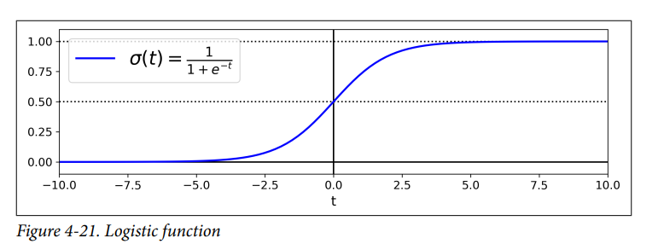
Logistic regression Function

Slide 38
Training and Cost Function
The training process for logistic regression involves finding the values of the model parameters that minimize the cost function. The cost function is a measure of how well the model fits the training data.
The most common cost function for logistic regression is the binary cross-entropy. The binary cross-entropy is a measure of the difference between the predicted probabilities and the actual labels.
The goal of the training process is to find the values of the model parameters that minimize the cost function. This is done using an iterative algorithm, such as gradient descent.
Once the model is trained, it can be used to predict the probability of an event occurring for new data.

Slide 39
The training process in logistic regression involves two main components: the hypothesis function and the cost function.
1. Hypothesis Function: The hypothesis function in logistic regression models the probability of the positive class (e.g., class 1) given the input features. It uses a logistic (or sigmoid) function to squash the output between 0 and 1, representing a probability value. The hypothesis function is defined as:
hθ(x) = 1 / (1 + e^(-θ^T*x))
Here, hθ(x) is the predicted probability of the positive class, θ is a vector of model parameters (also known as weights or coefficients), and x is the vector of input features.
2. Cost Function: The cost function measures the error or discrepancy between the predicted probabilities and the actual binary labels in the training data. In logistic regression, the most commonly used cost function is the logistic loss (or binary cross-entropy) function. The cost function penalizes the model for incorrect predictions and encourages it to adjust the parameters in a way that minimizes the overall loss.
For a single training example (x, y), where y is the binary label, the logistic loss function is defined as:
C(θ) = -y*log(hθ(x)) - (1-y)*log(1-hθ(x))

Slide 40
Decision boundaries in logistic regression
In logistic regression, decision boundaries are the lines or surfaces that separate different classes in the input feature space. The decision boundary represents the point where the logistic regression model classifies an example as belonging to one class or another.
Since logistic regression is a binary classification algorithm, it typically divides the input feature space into two regions corresponding to the two classes. The decision boundary can take different forms depending on the complexity of the data and the model's parameters.
In some cases, it may be impossible to find a single straight line that separates the classes. In such cases, non-linear decision boundaries are used.
The process of determining decision boundaries involves a mathematical technique called optimization, which involves finding the minimum or maximum value of a given function.

Slide 41
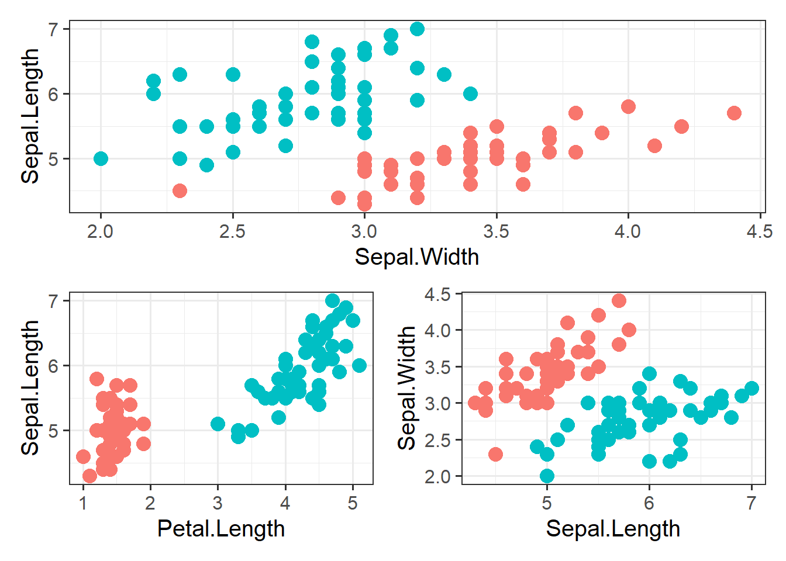

Slide 42

Softmax Regression/Multinominal Logistic Regression
The Logistic Regression model can be generalized to support multiple classes directly, without having to train and combine multiple binary classifiers. This is called Softmax Regression, or Multinomial Logistic Regression
In softmax regression, we aim to assign an input example to one of K possible classes, where K is greater than 2. The output of the softmax regression model is a probability distribution over the K classes, indicating the likelihood of the input example belonging to each class.
The idea is quite simple: when given an instance x, the Softmax Regression model first computes a scores k(x) for each class k, then estimates the probability of each class by applying the somax function (also called the normalized exponential) to the scores

Slide 43
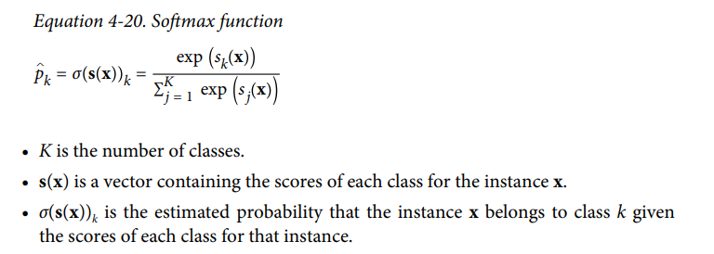
Once you have computed the score of every class for the instance x, you can estimate the probability pk that the instance belongs to class k by running the scores through the softmax function.
It computes the exponential of every score, then normalizes them (dividing by the sum of all the exponentials). The scores are generally called logits or log-odds (although they are actually unnormalized logodds).

Slide 44
Support Vector Machine
A Support Vector Machine (SVM) is a very powerful and versatile Machine Learning model, capable of performing linear or nonlinear classification, regression, and even outlier detection.
SVMs are particularly well suited for classification of complex but small- or medium-sized datasets.
Although linear SVM classifiers are efficient and work surprisingly well in many cases, many datasets are not even close to being linearly separable.
One approach to handling nonlinear datasets is to add more features, such as polynomial features; In some cases this can result in a linearly separable dataset. Consider the left plot in Figure 5-5: it represents a simple dataset with just one feature x1 . This dataset is not linearly separable, as you can see. But if you add a second feature x2 = (x1 ) 2 , the resulting 2D dataset is perfectly linearly separable

Slide 45
Adding polynomial feature
In this approach, we transform the original feature space by creating polynomial combinations of the input features. For example, if we have two input features x and y, we can add polynomial features such as x^2, xy, y^2, etc.
By including these polynomial features, we effectively increase the dimensionality of the data, allowing for a more complex decision boundary.
The SVM model can then be trained on this augmented feature space, where a linear separation may be possible.
The drawback of this approach is that the dimensionality of the feature space can grow rapidly, leading to increased computational requirements and potential overfitting if not properly regularized.

Slide 46
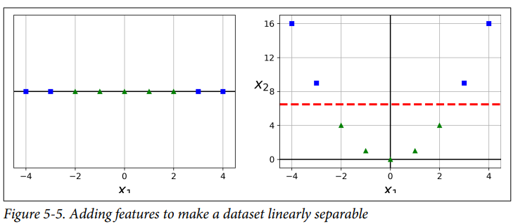
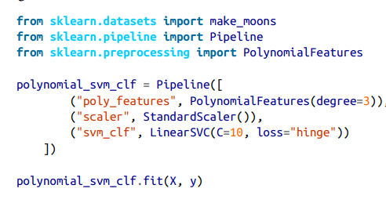
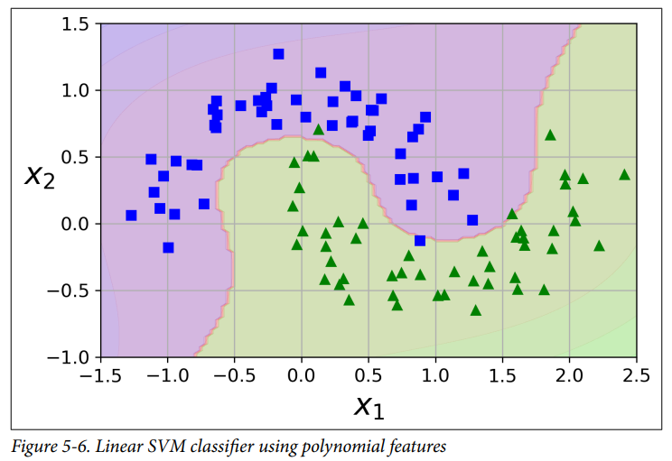
To implement this idea using Scikit-Learn, you can create a Pipeline containing a PolynomialFeatures transformer, followed by a StandardScaler and a LinearSVC.

Slide 47
Handling non-linear data using kernel functions
In SVMs, the goal is to find a hyperplane that separates the data points of different classes with the maximum margin. When the data is not linearly separable in the original feature space, SVMs employ the concept of kernel functions to project the data into a higher-dimensional space where linear separation becomes possible.
The key idea behind kernel functions is that they define a measure of similarity between pairs of data points. The kernel function calculates the inner product (dot product) between the feature vectors of two data points in either the original feature space or a transformed feature space.
Instead of explicitly expanding the feature space by adding polynomial combinations of the input features, kernel functions provide a way to implicitly represent the data in a higher-dimensional space. The transformed feature space is not explicitly computed, saving computational resources.
Common kernel functions like the polynomial kernel, RBF kernel, and sigmoid kernel can capture complex relationships without explicitly adding polynomial features.
Kernels operate directly on the input data, and the transformed feature space is not explicitly computed, which avoids the dimensionality explosion problem.

Slide 48
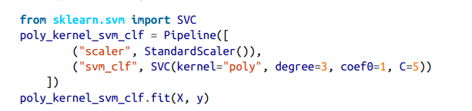
Polynomial Kernel
Fortunately, when using SVMs you can apply an almost miraculous mathematical technique called the kernel trick
It makes it possible to get the same result as if you added many polynomial features, even with very high degree polynomials, without actually having to add them. So there is no combinatorial explosion of the number of features since you don’t actually add any features

Slide 49
Polynomial Kernel and its function
Polynomial Kernel Function:
The polynomial kernel function is defined as K(x, y) = (γ * <x, y> + r)^d, where x and y represent the input feature vectors, <x, y> denotes the dot product between them, and d is the degree of the polynomial.
The dot product <x, y> captures the similarity or inner product between the feature vectors in the original feature space.
By raising the result of the dot product to the power of d and scaling it by the parameter γ, the polynomial kernel computes the similarity between two data points in a higher-dimensional space.

Slide 50
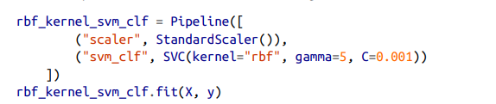
RBF Kernel (Radial Basis Function)/Gaussian RBF Kernel Function
Another technique to tackle nonlinear problems is to add features computed using a similarity function that measures how much each instance resembles a particular landmark.
RBF Kernel Function:
The RBF kernel function is defined as K(x, y) = exp(-γ * ||x - y||^2), where x and y represent the input feature vectors, ||x - y|| denotes the Euclidean distance between them, and γ is a hyperparameter that controls the spread of the kernel.
The RBF kernel computes the similarity between two data points based on the exponential of the negative squared distance between them.

Slide 51
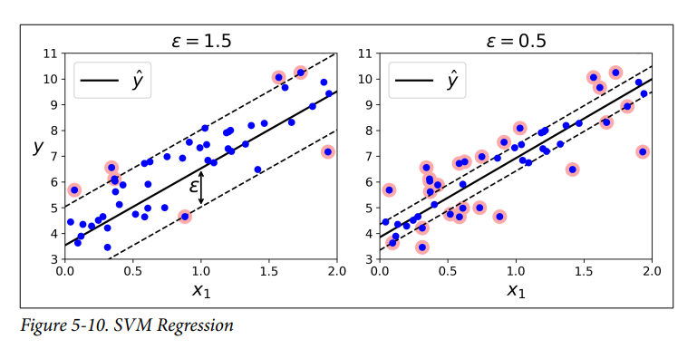
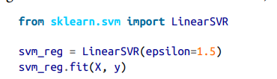
Support Vector machine for Regression
Support Vector Machines (SVMs) can also be used for regression tasks, in addition to classification tasks. Support Vector Machine Regression (SVR) is a supervised learning algorithm that aims to build a regression model by finding an optimal hyperplane that best fits the training data.
The trick is to reverse the objective: instead of trying to fit the largest possible street between two classes while limiting margin violations, SVM Regression tries to fit as many instances as possible on the street while limiting margin violations

Slide 52
Feature Extraction and Feature selection
Chapter 3

Slide 53
Contents
Types of feature selection
Mutual information for feature selection (MI)
Goodman-Kruskal score
Laplacian score
Hybrid genetic algorithm for feature selection
Feature selection based on optimization formulation
Feature ranking using F-Score
Ensemble feature ranking
Feature ranking using linear SVM

Slide 54
Feature Selection and its types
Feature selection is a process in machine learning and data analysis that involves selecting a subset of relevant features or variables from a larger set of available features. The goal of feature selection is to identify the most informative and discriminative features that contribute the most to the predictive power of a model while minimizing redundancy and noise.
Types of Feature Selection
There are three feature selection methods.
Filter methods
Wrapper methods
Embedded methods

Slide 55
Types of feature selection
Filter methods: These methods use statistical measures to rank the features based on their relevance to the target variable, independent of any specific machine learning algorithm. Common techniques include correlation-based feature selection, chi-square test, information gain, and mutual information. Filter methods are computationally efficient but may overlook feature interactions.
Wrapper methods: These methods select features by evaluating the performance of a specific machine learning algorithm using different subsets of features. Wrapper methods involve an iterative process where subsets of features are evaluated, and the selection is based on the performance of the learning algorithm. Examples of wrapper methods include forward selection, backward elimination, and recursive feature elimination. Wrapper methods can be computationally expensive but capture feature interactions.
Embedded methods: These methods perform feature selection as part of the model building process. They incorporate feature selection within the training of the machine learning algorithm itself. Regularization techniques, such as Lasso (L1 regularization) and Ridge (L2 regularization), are examples of embedded methods that penalize or eliminate irrelevant features during the training process. Embedded methods are computationally efficient and provide automatic feature selection.

Slide 56
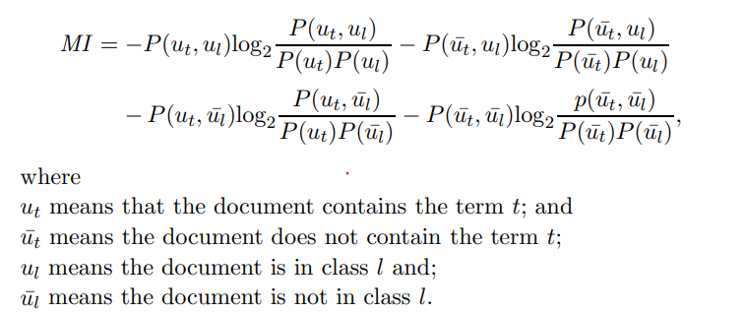
Mutual Information (MI) for feature selection
This function is based on the information gain and takes into account how features work together. MI is used to measure the dependencies between features and classes. MI between term t and class l measures how much information the presence or absence of a term contributes to making the correct classification decision on the class l.
It is computed as below

Slide 57
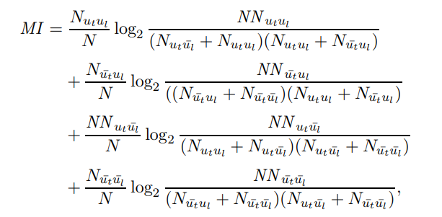
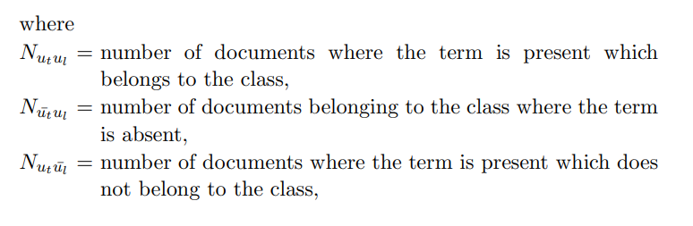
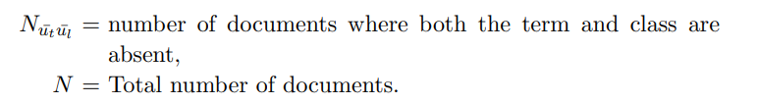
In other words, this can be written as
In the filter approach, a filter is used to discard features having a low value of MI. We can also use the backward filter which discards features if its value of MI with the class is less than some with probability p. The forward filter also can be used which includes a feature if the MI is greater than with a probability p

Slide 58

Goodman-Kruskal measure
The Goodman-Kruskal measure, also known as lambda coefficient, is a statistical measure used to assess the relationship or association between a feature (independent variable) and a class (dependent variable) in categorical data analysis.
It is commonly employed in feature selection tasks to determine the predictive power of individual features for classifying or predicting the outcome.
The Goodman-Kruskal measure λi for a specific feature i is calculated using the following formula:

Slide 59
Where,
ni+: This represents the number of instances or observations where the value of feature i is Vi and the class is '+'. In simpler terms, it's the count of observations that have feature i with value Vi and belong to class '+'.
ni-: This is the number of instances or observations where the value of feature i is Vi and the class is '-'. It represents the count of observations that have feature i with value Vi and belong to class '-'.
max(ni+, ni-): This is the maximum count between ni+ and ni-. It indicates the higher count of observations for feature i at a specific value, representing the most frequent outcome.
n+: This is the total number of instances or observations belonging to class '+'. It represents the count of all observations assigned to class '+'.
n-: This is the total number of instances or observations belonging to class '-'. It represents the count of all observations assigned to class '-'.
n: This is the total number of instances or observations in the dataset, regardless of class or feature values.

Slide 60
In the context of the Goodman-Kruskal measure, Vi represents a specific value taken by the feature i. Each feature can have multiple distinct values or categories, and Vi denotes one of those categories or values for the feature i.
For example, let's say we have a dataset with a feature "color" and two classes "+/-". The feature "color" may have values such as "red," "green," and "blue." In this case, Vi can be any of these specific values, such as Vi = "red," Vi = "green," or Vi = "blue."
When calculating the Goodman-Kruskal measure λi for a feature i, you consider each distinct value of the feature separately. The measure assesses the association between that specific value (Vi) and the class variable.
By evaluating the association of each value Vi with the class, you can determine the overall predictive power of the feature i and identify which specific values contribute the most to the prediction.

Slide 61
Laplacian score
The Laplacian score is a feature selection method that assesses the relevance of features based on the graph Laplacian matrix. It is particularly useful for high-dimensional datasets and has applications in various fields, including computer vision and pattern recognition.
Algorithm : Laplacian Score
Laplacian Matrix: Given a dataset with n samples and m features, we can represent it as an n x m matrix X. The Laplacian matrix, denoted as L, is a square matrix of size n x n. It captures the relationships between the samples in the dataset.
Graph Laplacian: To construct the Laplacian matrix, we can treat the samples as nodes of a graph and define the edges between the nodes based on the similarity or distance between the samples. There are different ways to define the edges, such as k-nearest neighbors or a fully connected graph. The graph Laplacian is a matrix derived from the graph representation and reflects the connectivity and structure of the data.
Laplacian Score Matrix: The Laplacian Score Matrix is derived from the Laplacian matrix. It measures the importance of each feature in the dataset by considering the structure of the data. The Laplacian Score Matrix is calculated as follows:

Slide 62
Laplacian Score = f(T) * L * f
Here, f(T) is the transpose of the feature matrix X, and L is the Laplacian matrix. The matrix multiplication f(T) * L * f represents a projection of the data onto the Laplacian matrix, taking into account the relationships between samples. The resulting Laplacian Score matrix is an m x m matrix, where each element represents the importance of the corresponding feature.
Feature Selection: After obtaining the Laplacian Score matrix, the features can be ranked based on their corresponding scores. Features with higher scores are considered more important, as they capture the underlying structure or patterns in the data.

Slide 63
Hybrid genetic algorithm for feature selection
A Hybrid Genetic Algorithm (GA) for feature selection combines the principles of genetic algorithms with other feature selection techniques to improve the effectiveness and efficiency of the feature selection process. It aims to find an optimal subset of features that maximizes the classification performance while minimizing the computational complexity.
Steps:
Initialization:
Define the population size, which represents a set of candidate feature subsets.
Randomly generate an initial population of feature subsets.
Fitness Evaluation:
Evaluate the fitness of each individual in the population by using an evaluation metric, such as accuracy, error rate, or a specific objective function that reflects the classification performance.
The evaluation metric is typically measured using a machine learning algorithm, such as a classifier, on a training dataset. The classifier is trained and tested using only the selected features.

Slide 64
Genetic Operators: Apply genetic operators, including selection, crossover, and mutation, to evolve the population and generate new feature subsets.
Selection: Select individuals from the current population based on their fitness values. Better-performing individuals have a higher chance of being selected.
Crossover: Perform a crossover operation between selected individuals to produce offspring. This operation exchanges or combines features from the parent individuals to create new feature subsets.
Mutation: Randomly modify certain features within the offspring to introduce diversity and explore new regions of the feature space.
Local Search or Other Feature Selection Techniques: Introduce additional mechanisms or techniques to enhance the search process and improve the quality of feature subsets.
Feature selection methods, such as information gain, correlation analysis, or wrapper methods, can also be used within the genetic algorithm framework to improve the feature selection process.
Termination:
Determine the stopping criteria for the algorithm, such as reaching a maximum number of generations, achieving a desired fitness value, or not observing significant improvements over several iterations.
Once the termination condition is met, select the best individual or feature subset based on the fitness value obtained during the evaluation process.

Slide 65
Feature selection using optimization formulation
Feature selection based on optimization formulation involves formulating the feature selection problem as an optimization problem with a specific objective function and constraints.
The goal is to find an optimal subset of features that maximizes the objective function while satisfying the given constraints.
General framework for feature selection using optimization formulation
Define the Objective Function: The first step is to define an objective function that quantifies the quality or utility of a feature subset. The choice of the objective function depends on the specific problem and the goals of feature selection. It can be formulated to maximize classification accuracy, minimize error rate, maximize information gain, or any other relevant metric.
Set the Constraints: Constraints are used to impose limitations or requirements on the feature subsets. Common constraints include the maximum number of features allowed, the maximum correlation between features, or specific domain knowledge constraints. These constraints help ensure that the selected features meet certain criteria or adhere to specific problem requirements.

Slide 66
Formulate the Optimization Problem: With the objective function and constraints defined, the next step is to formulate the feature selection problem as an optimization problem. This typically involves defining a binary decision variable for each feature, indicating whether it is selected or not.
Select the Optimization Algorithm: Once the problem is formulated, an appropriate optimization algorithm is chosen to solve it. The choice of algorithm depends on the problem's characteristics, such as the problem size, the nature of the objective function and constraints, and computational efficiency requirements. Common optimization algorithms for feature selection include linear programming, quadratic programming, evolutionary algorithms, and gradient-based optimization methods.
Solve the Optimization Problem: The selected optimization algorithm is applied to solve the formulated problem and find the optimal or near-optimal solution. This involves searching the feasible feature subset space and evaluating the objective function while satisfying the constraints. The solution can be obtained by either exact or heuristic optimization techniques, depending on the problem complexity and computational resources.
Evaluate the Selected Features: After obtaining the optimal feature subset, the selected features are used to train a machine learning model or perform any other task of interest. The performance of the model or the effectiveness of the selected features is evaluated using appropriate evaluation metrics, such as accuracy, precision, recall, or any other domain-specific metric.
Refinement and Iteration: Feature selection based on optimization formulation is an iterative process. The initial formulation and solution may not always yield the desired results. Therefore, it is common to refine the formulation, adjust the objective function or constraints, and re-run the optimization process iteratively until a satisfactory solution is obtained.

Slide 67
Feature ranking using F-score
Feature ranking using the F-score is a method to assess the relevance of each feature in a dataset based on their individual contributions to classification or regression tasks. The F-score, also known as the F1-score, is a commonly used metric that combines precision and recall into a single value. It provides a balanced measure of the model's performance, considering both the ability to identify positive instances (recall) and the accuracy of positive predictions (precision).
Compute Individual Feature Scores: Calculate the F-score for each feature independently. To do this, perform the following steps for each feature:
Temporarily remove the feature from the dataset.
Retrain the model using the modified dataset without the feature.
Evaluate the model's performance on the testing data, again computing the relevant evaluation metrics.
Compute the F-score of the feature using precision and recall values derived from the evaluation metrics.
Repeat steps a-d for all features in the dataset.
Rank Features: Rank the features based on their computed F-scores. Features with higher F-scores are considered more relevant or informative for the classification or regression task. You can create a ranked list of features, with the most significant feature at the top and the least significant at the bottom.
F-score = 2 * (precision * recall) / (precision + recall)

Slide 68
Ensemble feature ranking
Ensemble feature ranking is a technique used to rank the importance of features in a dataset by combining the results of multiple machine learning models. It aims to provide a more reliable and robust assessment of feature importance compared to using a single model. Let's say we have a dataset with multiple features (e.g., age, income, education level) and a target variable (e.g., whether a customer will churn or not). We want to determine which features are most important in predicting the target variable.
Ensemble of Models: First, we create an ensemble of machine learning models. Each model is trained on the dataset using a different algorithm or configuration. For example, we can use decision trees, random forests, gradient boosting, or support vector machines as the base models.
Feature Importance Calculation: Once the ensemble models are trained, we can calculate the feature importance for each feature. The importance of a feature is determined by measuring how much the performance of the model deteriorates when that feature is randomly permuted or removed from the dataset.
a. Permutation Importance: One common approach is permutation importance. For each feature, its values are randomly shuffled across the dataset, and the trained model's performance (e.g., accuracy, area under the curve) is evaluated on the permuted dataset. The drop in performance indicates the importance of that feature. This process is repeated for all features in the dataset.
b. Feature Importance from Tree-based Models: In the case of tree-based models such as random forests or gradient boosting, the importance of a feature can be calculated based on how often it is selected for splitting nodes in the ensemble of trees. The more frequently a feature is used for splitting, the higher its importance.

Slide 69
3. Aggregation of Feature Importance: Once the feature importance values are calculated for each model, they can be aggregated to obtain a final ranking. Various aggregation techniques can be used, such as averaging the importance scores across models or taking the maximum importance score for each feature.
The resulting feature ranking provides insight into the relative importance of different features in predicting the target variable. It helps in feature selection, dimensionality reduction, and understanding the underlying patterns in the data.

Slide 70
Feature ranking using Linear SVM
The linear SVM can be used to rank the importance of features based on their coefficients or weights
Steps:
Dataset Preparation: Prepare your dataset by separating the features (X) and the target variable (y) for the SVM algorithm. Ensure that the features are properly scaled or normalized if necessary.
Training the Linear SVM Model: Train a linear SVM model using the scikit-learn library. The linear SVM algorithm aims to find the optimal hyperplane that maximally separates the classes. During training, the model learns the coefficients or weights associated with each feature.
Feature Importance Calculation: Once the SVM model is trained, you can extract the feature importance by examining the coefficients or weights assigned to each feature. The magnitude of the coefficients indicates the importance of the corresponding feature. Positive coefficients indicate that an increase in the feature value positively contributes to the predicted class, while negative coefficients indicate a negative contribution.

Slide 71
4. Ranking Features: Sort the features based on their importance, either by their absolute values or by their positive or negative values. Higher absolute values or larger positive/negative values indicate greater importance.

Slide 72
Thank you

