Slide 1
Unit-2 Web scrapping and its analytics
By,
Disha D N
Assistant Professor II
Department of AIML
NMAMIT

Slide 2
Contents
Introduction to BeautifulSoup()
find() and find_all() methods
Beautifulsoup() objects
Navigating Trees
Regular expression
Writing web crawlers : Single domain
Crawling across the internet
Web crawling models: planning and defining objects
Dealing with different website layouts
Structuring crawlers
Crawling sites through search
Crawling sites through links

Slide 3
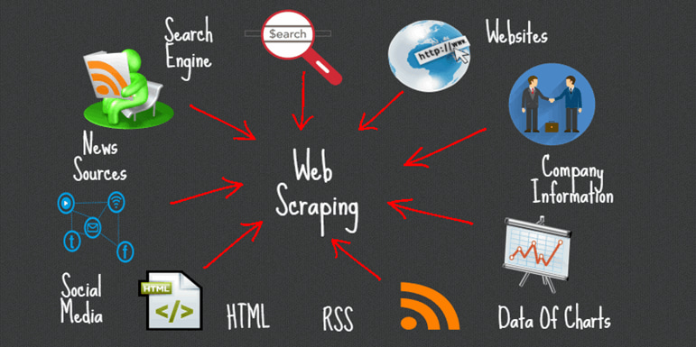
What is web scrapping?
Web scraping is the process of extracting data from websites automatically using a script or program. It involves accessing the HTML code of a webpage, parsing the code to extract the desired information, and then storing or using that information for various purposes.

Slide 4
Different web scrapping techniques
Manual Scraping:
This involves manually inspecting the webpage's HTML code and copying the desired data by hand. It's suitable for simple one-time tasks but can be time-consuming and not practical for large-scale scraping.
Regular Expressions:
Regular expressions (regex) can be used to extract specific patterns from HTML code. It can be effective for simple data extraction tasks but becomes more challenging as the complexity of the HTML structure increases.

Slide 5
BeautifulSoup:
BeautifulSoup is a popular Python library for web scraping. It provides a simple API to navigate and extract data from HTML and XML documents. It handles parsing and traversing the HTML tree structure, making it easier to locate and extract desired elements.
Scrapy:
Scrapy is a powerful Python framework specifically designed for web scraping. It offers more advanced features like asynchronous requests, handling pagination, and handling complex website structures. Scrapy provides a robust framework for building scalable and efficient web scraping applications.
Selenium:
Selenium is a tool commonly used for automating web browsers. It can be useful when dealing with websites that heavily rely on JavaScript or require interactions like clicking buttons or filling out forms. Selenium can programmatically control a browser and extract data from dynamically generated content.
APIs:
Some websites provide APIs (Application Programming Interfaces) that allow developers to access and retrieve data in a structured format. Instead of scraping HTML, you can directly request data from the API endpoint and receive the response in JSON or XML format. APIs provide a more reliable and efficient way to access website data if available.
Headless Browsers:
Headless browsers like Puppeteer or PhantomJS allow you to automate web scraping by running a browser in the background without a graphical user interface. They enable you to interact with web pages, execute JavaScript, and extract data.

Slide 6

Introduction to Beautifulsoup()
BeautifulSoup is a Python library used for web scraping and parsing HTML and XML documents. It provides a convenient way to extract data from web pages by navigating and searching through the HTML structure.
When working with web scraping, the first step is to retrieve the HTML content of a web page. This can be done using various libraries such as requests or urllib. Once we have obtained the HTML content, we can pass it to BeautifulSoup for parsing and data extraction.
To start using BeautifulSoup, first need to import it into Python script:

Slide 7
Next we can create BeautifulSoup object by passing the HTML content and specifying the parser. BeautifulSoup supports different parsers, such as the built-in Python parser or external libraries like lxml or html5lib.
Consider the following example:
html_content = """ <html>
<head>
<title>Example</title>
</head> <body>
<p class="paragraph">This is a paragraph.</p>
<ul> <li>Item 1</li>
<li>Item 2</li> </ul> </body> </html> """
soup = BeautifulSoup(html_content, 'html.parser’)
Once wehave created the BeautifulSoup object, you can start navigating and searching the HTML structure. BeautifulSoup provides various methods and attributes to access different elements and data within the HTML document.

Slide 8
To Access the title of the HTML document, we can use ‘title’ attribute
title = soup.title
print(title.text) # Output: Example
To access the contents of a specific tag, we can use the tag name as an attribute
paragraph = soup.p
print(paragraph.text) # Output: This is a paragraph.

Slide 9
Navigating the Parse TREE
When working with BeautifulSoup, the HTML or XML document is converted into a parse tree, which is a hierarchical representation of the document's structure. This parse tree allows you to navigate and search through the document to access specific elements and data.
Beautiful Soup provides several methods and properties to navigate and search the parse tree. Some commonly used methods include:
1. Tag navigation: We can access elements based on their tag names. For example, to access the first p tag in the document, we can use the find() method:
Example 1: paragraph = soup.find(‘p’)
If we want to find all the ‘p’ tags, we can use the find_all() method
Example 2: paragraphs = soup.find_all('p')

Slide 10
2. Parent and Sibling navigation: BeautifulSoup allows to access the parent, previous sibling, and next sibling of an element. The parent attribute gives the direct parent of an element, previous_sibling gives the element before the current one, and next_sibling gives the element after the current one.
Example 3:
parent_element = element.parent
previous_sibling = element.previous_sibling
next_sibling = element.next_sibling

Slide 11
3. Child navigation: We can access the direct children of an element using the children attribute. This returns an iterable containing all the child elements. Additionally, we can use the descendants attribute to access all the descendants of an element, including nested elements.
Example 4:
for child in element.children:
print(child.text)
4. Searching by CSS class and attributes: BeautifulSoup allows you to search for elements based on their CSS classes or attributes. You can use the class_ parameter to search for elements with a specific CSS class:
Example 5:
elements = soup.find_all('div', class_='my-class')

Slide 12

Find() method
The find() method in BeautifulSoup is used to search for the first occurrence of an element that matches a specific criteria within the parse tree. It allows you to locate elements based on various attributes, tag names, CSS classes, or even custom functions.
Syntax is as follows:
Parameters in detail:
name: This parameter specifies the tag name of the element you are searching for. It can be a string or a list of strings to match multiple tag names. For example, name='div' will search for the first <div> tag.
attrs: This parameter allows you to search for elements based on their attributes. You can pass a dictionary of attribute-value pairs to search for elements with specific attributes. For example, attrs={'class': 'my-class', 'id': 'my-id'} will search for the first element that has the class 'my-class' and the id 'my-id'.

Slide 13
recursive: By default, recursive=True, the find() method searches for elements recursively within the parse tree. This means it searches for elements within the current element and its descendants. Setting recursive=False restricts the search to only the direct children of the current element.
string: This parameter allows you to search for elements that contain a specific string of text. For example, string='example' will search for the first element that contains the text 'example’
**kwargs: Additional keyword arguments can be passed to the find() method to search for elements based on any attribute-value pair. For example, find(data='value') will search for the first element that has a data attribute with the value 'value’.
NOTE: The find() method returns the first matching element that satisfies the specified criteria. If no element is found, it returns None.

Slide 14
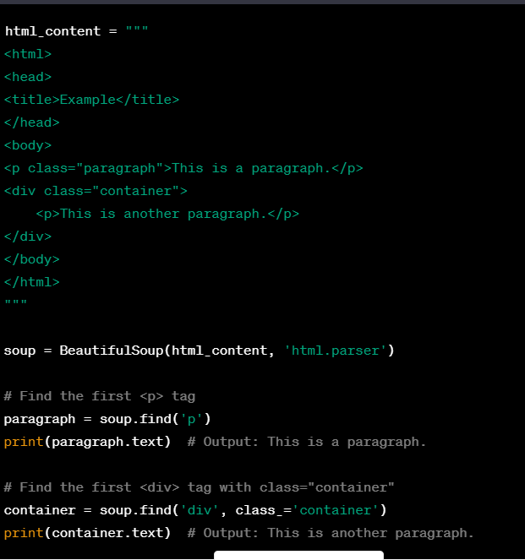
Example: Find() method

Slide 15
Find_all() method
The find_all() method in BeautifulSoup is used to search for all occurrences of elements that match a specific criteria within the parse tree. It allows you to locate elements based on various attributes, tag names, CSS classes, or even custom functions.
Syntax will be as follows:
Parameters are as follows:
name: This parameter specifies the tag name of the elements you are searching for. It can be a string or a list of strings to match multiple tag names. For example, name='div' will search for all <div> tags.

Slide 16
attrs: This parameter allows you to search for elements based on their attributes. You can pass a dictionary of attribute-value pairs to search for elements with specific attributes. For example, attrs={'class': 'my-class', 'id': 'my-id'} will search for elements that have the class 'my-class' and the id 'my-id’.
recursive: By default, recursive=True, the find_all() method searches for elements recursively within the parse tree. This means it searches for elements within the current element and its descendants. Setting recursive=False restricts the search to only the direct children of the current element.
string: This parameter allows you to search for elements that contain a specific string of text. For example, string='example' will search for elements that contain the text 'example’.
limit: This parameter allows you to limit the number of elements returned by the find_all() method. By default, it returns all matching elements. Setting limit=n will return at most n elements.
**kwargs: Additional keyword arguments can be passed to the find_all() method to search for elements based on any attribute-value pair. For example, find_all(data='value') will search for elements that have a data attribute with the value 'value’.

Slide 17
Example find_all()
html_content = """ <html> <head> <title>Example</title> </head> <body> <p class="paragraph">This is a paragraph.</p> <div class="container"> <p>This is another paragraph.</p> </div> </body> </html> """
soup = BeautifulSoup(html_content, 'html.parser’)
# Find all <p> tags paragraphs = soup.find_all('p’)
for paragraph in paragraphs:
print(paragraph.text)
# Find all <div> tags with class="container"
containers = soup.find_all('div', class_='container’)
for container in containers: print(container.text)

Slide 18
Beautifulsoup objects
BeautifulSoup objects are the main interface provided by the BeautifulSoup library. They represent the parsed HTML or XML document and provide a set of methods and attributes to navigate, search, and manipulate the document's structure.
When we create a BeautifulSoup object, we need to pass the HTML or XML content as a string and specify the parser to use. BeautifulSoup supports different parsers, including the built-in Python parser ('html.parser'), the lxml parser ('lxml'), and the html5lib parser ('html5lib'). The parser is responsible for converting the raw document into a parse tree.

Slide 19
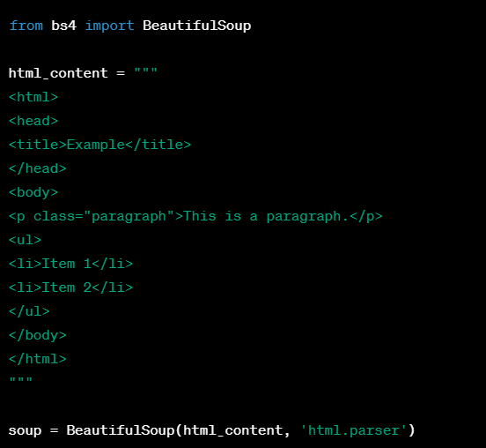
When you parse an HTML or XML document using BeautifulSoup, it creates a BeautifulSoup object that contains the entire document structure. From there, you can navigate the document tree using methods like find(), find_all(), select(), and more, to locate specific tags or elements of interest.
These methods return Tag objects or lists of Tag objects, allowing you to access their attributes, manipulate the data, or extract the text within them. You can also search for tags based on various attributes like class names, IDs, or custom attributes.

Slide 20




Once we have a BeautifulSoup object, various operations on it. Some of them are as follows:
tag: It represents an HTML or XML tag within the document. You can access tags using dot notation or by calling methods like find() or find_all().
text: It represents the text content of an element or a tag. It retrieves the combined text from an element and its descendants.
find(name, attrs, recursive, string, **kwargs): It searches for the first occurrence of an element that matches the specified criteria and returns a Tag object.
find_all(name, attrs, recursive, string, limit, **kwargs): It searches for all occurrences of elements that match the specified criteria and returns a ResultSet object, which is a list-like collection of Tag objects.

Slide 21




parent: It represents the parent element of a tag.
next_sibling and previous_sibling: They represent the next and previous siblings of a tag, respectively.
children: It provides an iterator over the direct children of a tag.
prettify(): It returns a nicely formatted string representation of the document, making it easier to read and debug.

Slide 22
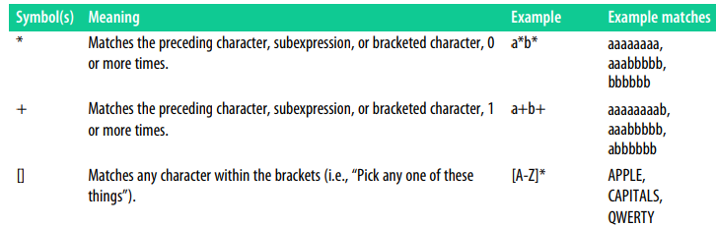
Regular expressions
Regular expressions (often abbreviated as regex or regexp) are powerful tools for pattern matching and manipulating text. A regular expression is a sequence of characters that defines a search pattern. It is commonly used in programming languages and text editors to perform various operations such as searching, matching, replacing, and extracting textual data.
Commonly used regular expressions and Symbols

Slide 23
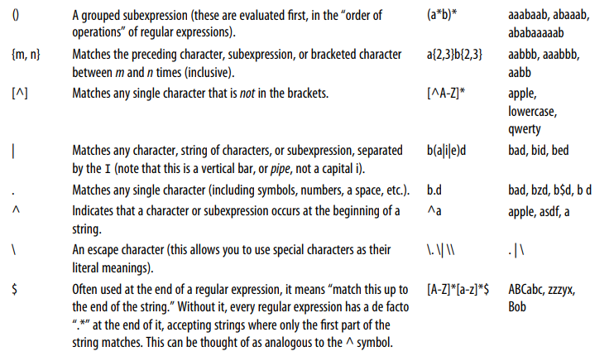

Slide 24
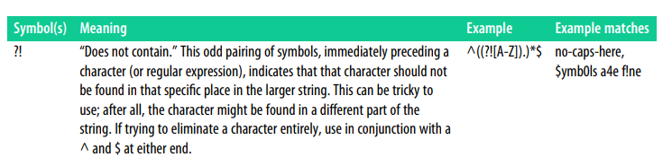

Slide 25
Web crawlers

Slide 26
Introduction to web crawlers
A web crawler, also known as a web spider, is an automated script or program used to systematically browse and index the World Wide Web. It is designed to visit websites, retrieve web pages, and extract information from them for various purposes, such as search engine indexing, data mining, or content scraping.
Purpose of web crawlers
Web crawlers are primarily used for gathering information from the web. Some common use cases include:
Search Engine Indexing: Search engines employ crawlers to discover web pages, analyze their content, and index them for retrieval in search results.
Data Mining and Research: Crawlers can be used to collect specific data from websites, such as product details, news articles, or social media posts, for analysis or research purposes.
Monitoring and Tracking: Crawlers can be used to monitor changes on websites, track prices of products, or gather information for competitive analysis.
Content Aggregation: Crawlers can be used to gather content from multiple websites and aggregate it into a single platform or service.
Link Verification: Crawlers can be used to check the validity and availability of website links.

Slide 27
Web crawling process
Seed URLs: The crawler starts with a set of initial URLs, known as seed URLs, which are typically provided manually or obtained from a predefined list or database.
HTTP Request: The crawler sends an HTTP request to the web server hosting the URL, requesting the corresponding web page.
Web Page Retrieval: The server responds with the HTML content of the web page, which the crawler then retrieves and downloads.
Parsing HTML: The crawler parses the HTML to extract links, content, and other relevant information using techniques like DOM parsing or regular expressions.
URL Frontier: The crawler maintains a queue or list of URLs to visit, known as the URL frontier. It adds newly discovered URLs to this list for subsequent crawling.
Follow Links: The crawler follows the extracted links and repeats the crawling process for each new URL encountered, expanding the scope of the crawl.
Throttling and Politeness: Crawlers often implement politeness rules and rate limits to avoid overloading servers and respect website owner's guidelines.
Data Storage: The extracted data is typically stored in a structured format or database for further analysis or processing.

Slide 28
Crawling policies and challenges
Web crawlers face several challenges and considerations:
Robots.txt: Crawlers respect the "robots.txt" file, a standard mechanism for website owners to control crawler access to their site.
Duplicate Content: Crawlers may encounter duplicate content on different URLs or follow infinite loops of links. Techniques like URL normalization and duplicate content detection are used to address this issue.
Crawl Scope: Crawlers need to define the scope and depth of the crawl, including limitations on domain, subdomains, or specific paths.
Dynamic Content: Crawlers may struggle with dynamic websites that generate content dynamically using JavaScript or require user interactions to access specific pages.
Anti-Crawling Measures: Some websites implement anti-crawling measures like CAPTCHAs, IP blocking, or session tracking to deter or block crawlers.

Slide 29
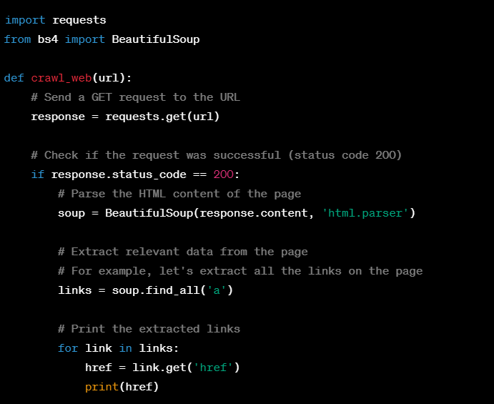
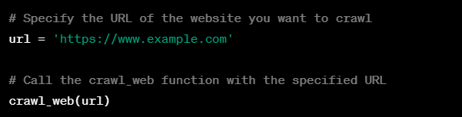
Web crawler example

Slide 30
Web crawler: To search an entire site
Web crawling to search an entire site involves systematically navigating through all the pages of a website to search for specific content or information. The goal is to explore the website in a comprehensive manner, visiting each page and searching for the desired data.
Steps involved are as follows:
Choose a starting point: Select a specific page within the website from which the crawling process will begin. This page could be the homepage or any other relevant entry point.
Send a GET request: Use an HTTP library like requests in Python to send a GET request to the chosen starting page URL. Retrieve the HTML content of the page as a response.
Parse the HTML: Utilize an HTML parser library like BeautifulSoup to parse the HTML content received from the page. This allows you to navigate and search within the HTML structure.
Search for desired content: Define the criteria for the content you want to search for within the pages. This could be specific keywords, phrases, tags, or any other relevant patterns. Use the parsed HTML to search for this content, either by searching for specific tags, examining the text, or applying regular expressions.
Extract relevant information: If the desired content is found, you can extract additional information related to it. This could include extracting metadata, associated links, or any other data that might be useful.
Follow links: Identify all the links on the current page, and add them to a queue or list to visit later. Ensure that these links are complete URLs by resolving any relative URLs with the base URL of the website.

Slide 31
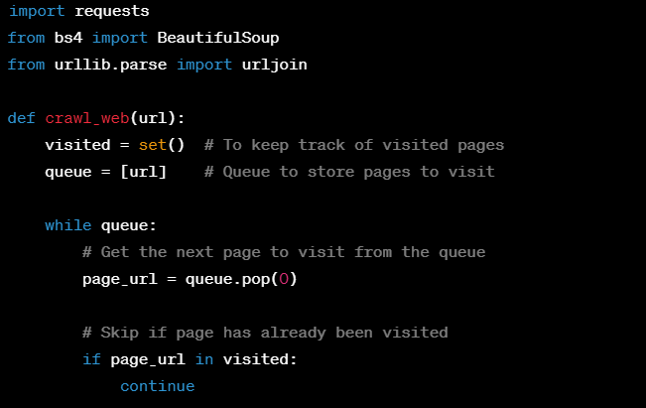
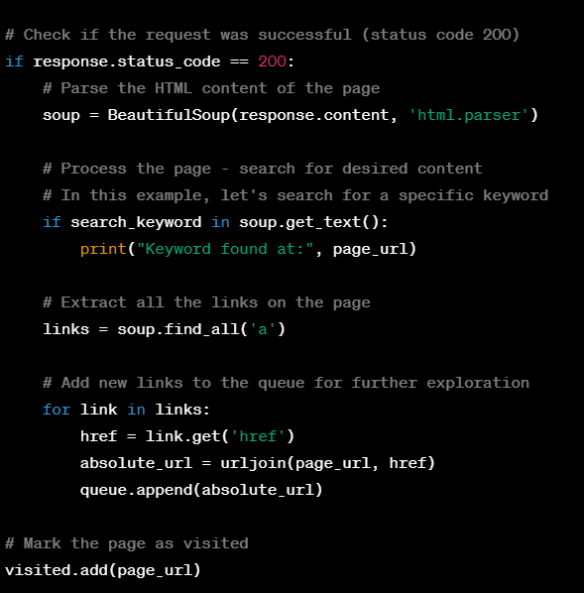
Example code

Slide 32
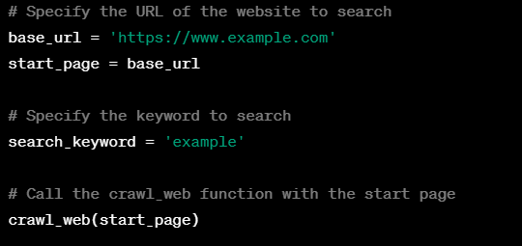

Slide 33
Web crawling for internet
Performing crawling across the entire internet is an enormous task and requires significant resources and infrastructure. Generally, web crawling is focused on specific domains or websites rather than attempting to crawl the entire internet.
It involves the process of getting external links during crawling process
Steps to get external links can be as follows:
Seed URLs: Select initial seed URLs that belong to the domain you want to crawl. These URLs can be the homepage or any other relevant pages within the domain.
Crawling and Parsing: Start crawling the seed URLs by sending HTTP requests and retrieving the corresponding web pages. Parse the HTML content of the web pages using tools like BeautifulSoup to extract relevant information.
Link Extraction: Identify and extract the links from the parsed content. This can be done by searching for anchor tags (<a> tags) in the HTML that contain the href attribute, which indicates the URL of the link.

Slide 34
Filtering Internal and External Links: Differentiate between internal and external links. Internal links refer to URLs within the same domain or website, while external links point to URLs outside of the domain being crawled.
Handling External Links: Once you have identified external links, you can choose how to handle them based on your crawling requirements. Here are a few common options:
Ignore: You may decide to ignore external links and focus solely on crawling and extracting data from the current domain.
Follow: You may choose to follow external links and include them in the crawling process to expand your scope beyond the initial domain.
Record: You may record the external links for analysis or further processing without immediately crawling them.
Recursive Crawling: If you decide to follow external links, you can recursively perform the crawling process on those links as well. This allows you to crawl multiple domains and expand your reach across the internet.

Slide 35
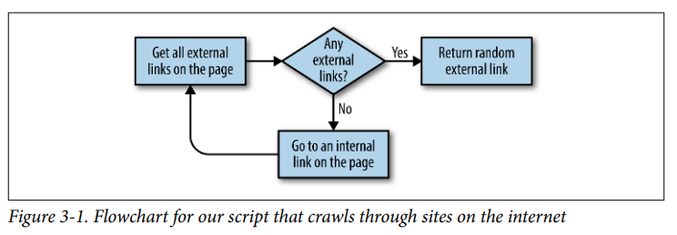
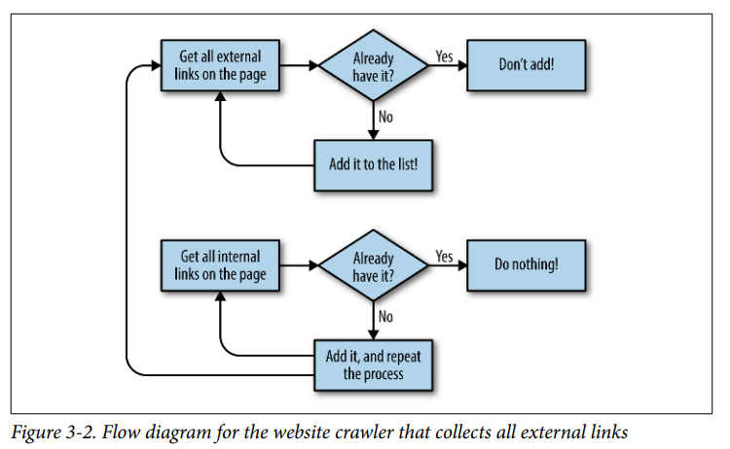

Slide 36
Planning and defining objects
One common trap of web scraping is defining the data that you want to collect based entirely on what’s available in front of your eyes. For instance, if you want to collect product data, you may first look at a clothing store and decide that each product you scrape needs to have the following fields:
• Product name
• Price
• Description
• Sizes
• Colors
• Fabric type
• Customer rating

Slide 37
Looking at another website, you find that it has SKUs (stock keeping units, used to track and order items) listed on the page. You definitely want to collect that data as well, even if it doesn’t appear on the first site! You add this field:
• Item SKU
Although clothing may be a great start, you also want to make sure you can extend this crawler to other types of products. You start perusing product sections of other websites and decide you also need to collect this information:
• Hardcover/Paperback
• Matte/Glossy print
• Number of customer reviews
• Link to manufacturer
Clearly, this is an unsustainable approach. Simply adding attributes to your product type every time you see a new piece of information on a website will lead to far too many fields to keep track of. Not only that, but every time you scrape a new website, you’ll be forced to perform a detailed analysis of the fields the website has and the fields you’ve accumulated so far, and potentially add new fields

Slide 38
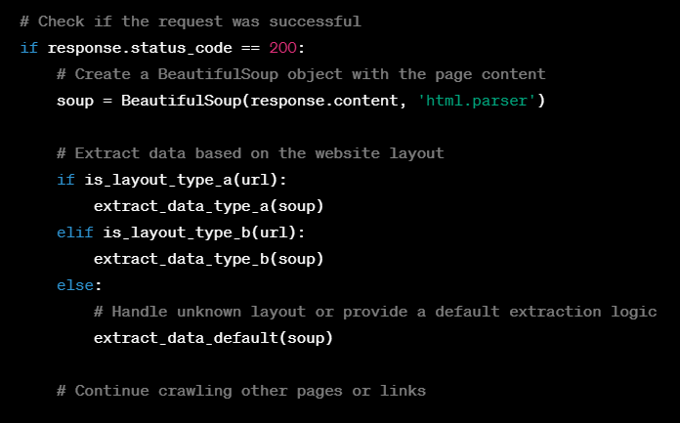
Dealing with different website layouts
When dealing with different website layouts during web crawling, it's important to adapt your crawler to handle the specific structures and elements of each website.
Simple approach would be writing a separate crawlers for different layouts
Example:

Slide 39
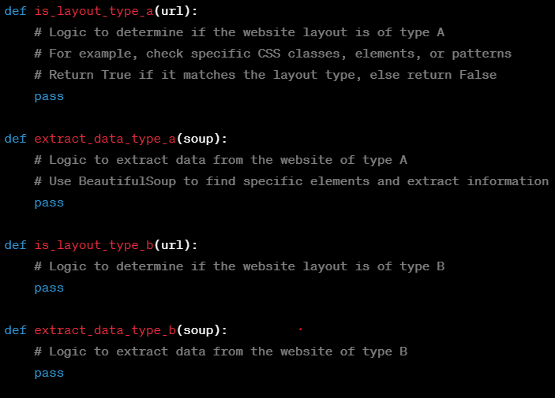
These things can also be modified by search function, search through links function

Slide 40
Advanced Scrapping

Slide 41
Contents
Writing a simple scraper
Spidering with rules
Creating items
Outputting items
Item pipeline
Document encoding, text encoding and global internet
Crawling through APIs: HTTP methods and APIs
Parsing JSON
Overview of libraries: Pillow Processing well formatted text
Adjusting images automatically
Scrapping text from images on websites
Reading captchas and training Tesseract

Slide 42
Introduction to scrappy
Scrapy is an open-source web scraping framework written in Python. It provides a set of tools and libraries that enable developers to extract structured data from websites efficiently.
Key components of Scrappy:
Spider: The Spider is the core component of Scrapy. It is responsible for defining how to navigate websites and extract data. A spider is a Python class that subclasses the scrapy. Spider class defines the rules to follow when crawling a website. It specifies the starting URLs, how to follow links, and how to extract data from the HTML responses.
Selector: Scrapy uses a powerful tool called Selector to extract data from HTML or XML documents. A Selector allows you to specify XPath or CSS expressions to locate elements within the document. It provides methods like xpath() or css() to extract data based on these expressions.

Slide 43
Request and Response: A Request represents an HTTP request made by a spider to a specific URL. It encapsulates information like the URL, headers, and callback function to handle the response. When a spider sends a request, it receives a Response object containing the web page's HTML or XML content, which is then processed to extract the desired data.
Item: An Item is a simple container used to collect the extracted data. It is similar to a dictionary or a data class, where you define the fields to store the data. The extracted data is usually populated into Item objects and later processed or stored.
Pipeline: Pipelines are responsible for processing the extracted data from spiders. They define the operations to perform on the data, such as cleaning, validation, or storing in a database. Scrapy pipelines are implemented as Python classes, and you can enable or disable them in the settings.
Middleware: Middleware components sit between the request/response process and allow you to customize Scrapy's behavior. They can modify requests or responses, handle errors, or perform various preprocessing or postprocessing tasks. Examples of middleware include user-agent rotation, proxy handling, or cookie management.
Settings: Scrapy provides a settings module where you can configure various aspects of your spider and the overall scraping process. Settings include options like allowed domains, maximum crawling depth, concurrent requests, and more. You can override default settings in your spider or provide a separate settings file.
Scrapy Shell: Scrapy Shell is an interactive environment that allows you to experiment and test your scraping code without running a full spider. It provides a convenient way to issue requests, view responses, and test XPath or CSS selectors interactively.

Slide 44
Creating a simple scrapper
Scrapy is an open source tool and it can be easily installed using the command “conda install -c conda-forge scrapy”
Initializing new spider:
Once the installation is completed, a small amount of set up needs to be done for each spider (it is a scrappy project)
To create a new spider in the current directory, run the following command
“ scrapy startproject wikiSpider”
This creates a new subdirectory in the directory the project was created in with the title wikiSpider

Slide 45
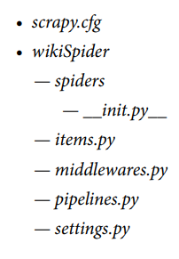

Creating a simple scrapper
To create a crawler, you will add a new file inside the spiders directory at wikiSpider/wikiSpider/spiders/article.py
Then we need to open article.py and can write simple scarpy scripts.

Slide 46
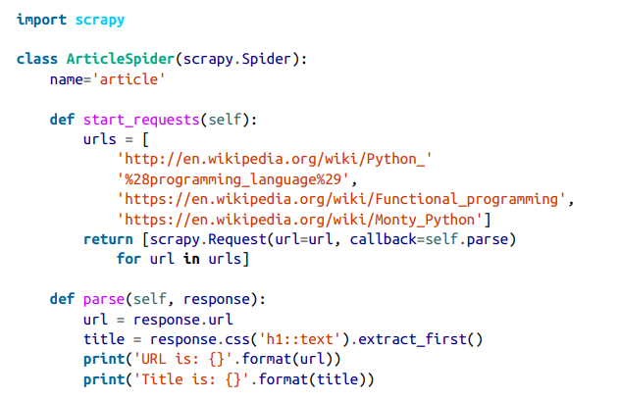
The name of this class (ArticleSpider) is different from the name of the directory (wikiSpider), indicating that this class in particular is responsible for spidering through only article pages, under the broader category of wikiSpider, which you may later want to use to search for other page types.
For large sites with many types of content, you might have separate Scrapy items for each type (blog posts, press releases, articles, etc.), each with different fields, but all running under the same Scrapy project. The name of each spider must be unique within the project.
The other key things to notice about this spider are the two functions start_requests and parse.
start_requests is a Scrapy-defined entry point to the program used to gener‐ ate Request objects that Scrapy uses to crawl the website
parse is a callback function defined by the user, and is passed to the Request object with callback=self.parse.
You can run this article spider by navigating to the wikiSpider/wikiSpider directory and running: $ scrapy runspider article.py

Slide 47
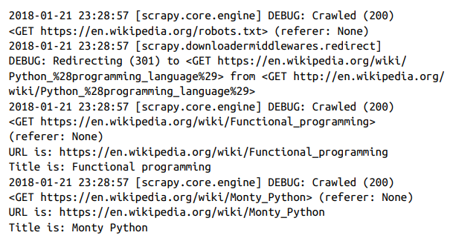
The default Scrapy output is fairly verbose. Along with debugging information, this should print out lines like the following:

Slide 48
Spidering with rules
Spidering with rules, also known as rule-based crawling, is a technique used in web scraping and web crawling to define specific rules or patterns for navigating and extracting data from websites. It involves specifying the structure and behavior of a web crawler by defining rules that determine how the crawler should follow links, identify relevant content, and extract desired data.
import scrapy
from scrapy.linkextractors import LinkExtractor
from scrapy.spiders import CrawlSpider, Rule
class MySpider(CrawlSpider):
name = 'example'
allowed_domains = ['example.com']
start_urls = ['http://www.example.com']
rules = (
Rule(LinkExtractor(allow=r'category\.php'), callback='parse_category', follow=True),
)

Slide 49
def parse_category(self, response):
# Extract relevant data from the category page
# and yield or process the extracted items
# Extract links to individual item pages
item_links = response.css('.item-link::attr(href)').getall()
for item_link in item_links:
yield response.follow(item_link, callback=self.parse_item)
In this example, we have defined a spider called MySpider that extends CrawlSpider from Scrapy. The spider is designed to crawl a website with the domain example.com. We set the starting URL to http://www.example.com.
The rules attribute is a tuple that contains one or more Rule objects. Each Rule defines a pattern for following links and specifies a callback function to handle the response obtained from following those links. In this case, we have a single rule:
def parse_item(self, response):
# Extract data from the individual item page
# and yield or process the extracted item
item = {
'title': response.css('h1::text').get(),
'price': response.css('.price::text').get(),
# ... other item data extraction
}
yield item
Rule(LinkExtractor(allow=r'category\.php'), callback='parse_category', follow=True),
This rule instructs the spider to follow links that match the regular expression pattern category\.php. When a matching link is encountered, the spider will call the parse_category method to handle the response. The follow=True argument indicates that the spider should continue following links on the category page.

Slide 50
The parse_category method is responsible for extracting relevant data from the category page and potentially following links to individual item pages. In this example, we extract the links to item pages using CSS selectors (response.css('.item-link::attr(href)').getall()) and then use response.follow() to navigate to each item page, passing the parse_item method as the callback function.
The parse_item method is called for each item page. Here, we extract the desired data from the page using CSS selectors (response.css('h1::text').get() and response.css('.price::text').get()) and create an item dictionary to yield the extracted data.
By defining rules and callback functions, spidering with rules allows you to navigate a website systematically, following links and extracting data according to your specified patterns.

Slide 51
Creating Items
Creating items in Scrapy refers to the process of defining the structure and data fields for the scraped information. Scrapy is a powerful web scraping framework in Python that allows you to extract data from websites efficiently. The items in Scrapy represent the structured data that you want to extract and store during the scraping process.
Steps are as follows:
Item Definition:
Start by defining an item class in your Scrapy project. This class will represent a single item of data to be scraped.
In Scrapy, items are typically defined as Python classes that inherit from the scrapy.Item class or any of its subclasses.
Each attribute in the item class represents a field of data you want to extract. You can define these attributes as scrapy.Field() or use one of the specific field types provided by Scrapy, such as scrapy.IntField(), scrapy.FloatField(), scrapy.ListField(), etc.

Slide 52
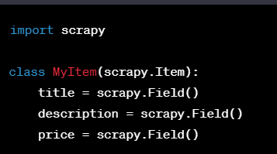
In this example, we define an item class called MyItem with three fields: title, description, and price. Each field is a scrapy.Field().
Yielding Items in Spider:
In your Scrapy spider, which is responsible for crawling and extracting data from websites, you need to instantiate the item class and populate its fields with scraped data.
Inside your spider's parse method or any other callback method, create an instance of the item class and assign values to its fields.
Finally, yield the populated item from the callback method. This tells Scrapy to process and store the scraped item.

Slide 53
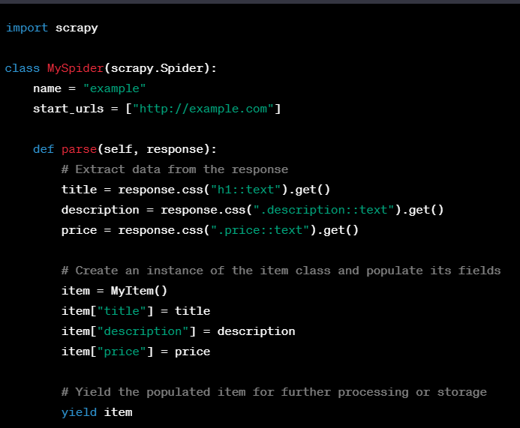
In this example, the spider extracts data from a website's response using CSS selectors. It creates an instance of the MyItem class, assigns values to its fields, and yields the item.
By following this process, you can define the structure of the data you want to scrape using Scrapy items and extract and store the relevant information during the scraping process.

Slide 54
Outputting Item
Scrapy uses the Item objects to determine which pieces of information it should save from the pages it visits. This information can be saved by Scrapy in a variety of ways, such as CSV, JSON, or XML files, using the following commands:
$ scrapy runspider articleItems.py -o articles.csv -t csv
$ scrapy runspider articleItems.py -o articles.json -t json $
$ scrapy runspider articleItems.py -o articles.xml -t xml

Slide 55
The Item Pipeline
The Item Pipeline in Scrapy is a component that allows you to define a series of data processing steps for the scraped items before they are stored or further processed. It provides a convenient way to process, clean, validate, and store the extracted data. The item pipeline is executed sequentially, with each step being applied to each scraped item.
Here's how the Item Pipeline works in Scrapy:
1. Item Pipeline Configuration:
To configure the item pipeline, you need to modify the ITEM_PIPELINES setting in your Scrapy project's settings.py file.
The ITEM_PIPELINES setting is a dictionary where you define the pipelines and their order of execution. Each pipeline is represented by a unique key and assigned a value that represents its priority (a lower value means higher priority).

Slide 56
2. Item Pipeline Components:
The item pipeline is a series of components, also known as "pipeline stages," that process the items. Each component is responsible for performing a specific task on the items.
You can create custom pipeline components by implementing certain methods in Python classes. These methods include process_item, open_spider, close_spider, etc.
3. Process_item Method:
The process_item method is the main method in a pipeline component. It receives each scraped item as input and performs the desired processing or manipulation on it.
In the process_item method, you can modify the item, perform data validation, clean the data, discard irrelevant items, or store the item in a database, file, or other storage.
4. Yielding Items or Dropping Items:
After processing an item in a pipeline component, you have two options: yield the modified item or drop it.
If you yield the item, it will continue to the next pipeline component or, if it's the last component, it will be stored or further processed according to your configuration.
If you choose to drop the item, it will be discarded, and subsequent pipeline components won't process it.

Slide 57
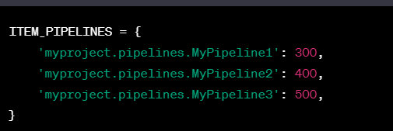
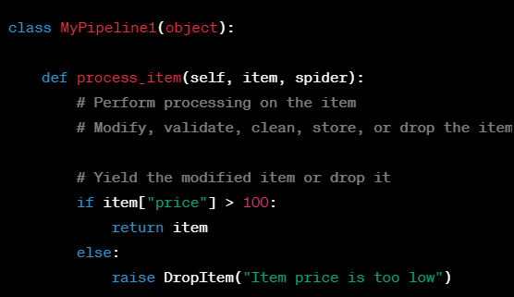
In this example, MyPipeline1 is a custom pipeline component that checks the price field of the item. If the price is greater than 100, it yields the item for further processing or storage. Otherwise, it raises a DropItem exception to discard the item.

Slide 58
Document Encoding, Text encoding and Global internet
Document Encoding: Document encoding refers to the character encoding scheme used to represent and interpret text in a particular document. It defines how characters are encoded and stored as binary data. In the context of web scraping with Scrapy, document encoding is essential because it ensures that the scraped text is correctly interpreted and processed.
When Scrapy fetches a web page, it examines the HTTP headers to determine the document encoding specified by the server. The most common encoding schemes include UTF-8, ISO-8859-1 (also known as Latin-1), and others. Scrapy uses this information to decode the raw HTML response into Unicode text, which can then be processed further.
Text Encoding: Text encoding, also known as character encoding, is the process of converting characters into a specific binary representation. It assigns unique numerical values (code points) to characters, allowing them to be stored and transmitted electronically. Text encoding schemes include ASCII, UTF-8, UTF-16, and many others.
In Scrapy, text encoding is crucial when processing the scraped data. After the raw HTML response is decoded using the document encoding, Scrapy ensures that the extracted text from the web page is correctly encoded into Unicode. This Unicode representation allows Scrapy to handle text in different languages and character sets effectively.

Slide 59
Global Internet in Scrapy: Scrapy operates within the global internet environment, enabling web scraping capabilities across a wide range of websites and online resources. Scrapy leverages the HTTP protocol to send requests and receive responses from web servers. It can navigate websites, follow links, and extract data from HTML, XML, JSON, or any other structured formats.
Scrapy's global internet functionality includes handling cookies, managing user sessions, handling redirects, and respecting robots.txt rules. It also supports various authentication mechanisms, such as handling HTTP basic authentication or form-based logins. This allows Scrapy to crawl and scrape content from different websites efficiently.
Additionally, Scrapy provides powerful tools and features to handle common web scraping challenges, including handling pagination, dealing with AJAX requests, and implementing spider middleware for customization and fine-grained control over the scraping process.

Slide 60
Crawling through APIs: HTTP methods
Crawling through APIs involves using HTTP methods to interact with web APIs and retrieve data programmatically. Web APIs (Application Programming Interfaces) provide a structured way for different software applications to communicate and exchange data. The most common HTTP methods used in API crawling are GET, POST, PUT, and DELETE.
Here's a step-by-step explanation of crawling through APIs using HTTP methods:
Understanding APIs:
APIs define a set of rules and protocols that allow different software applications to interact with each other.
Web APIs, in particular, use HTTP (Hypertext Transfer Protocol) as the communication protocol and provide endpoints or URLs that respond to specific HTTP requests.
Choosing an API:
Determine the API you want to crawl. This could be a public API provided by a third-party service or an API developed by the website you want to retrieve data from.

Slide 61
3. HTTP Methods:
HTTP methods define the actions to be performed on the server's resources. The most commonly used methods in API crawling are:
GET: Used to retrieve data from the server. GET requests are used to read or fetch resources.
POST: Used to submit data to the server. POST requests are often used for creating new resources.
PUT: Used to update data on the server. PUT requests are used for modifying existing resources.
DELETE: Used to delete data from the server. DELETE requests are used to remove resources.
4. Sending API Requests:
Use a programming language or a tool like Scrapy, Python's requests library, or cURL to send HTTP requests to the API endpoints.
Construct the URL for the API endpoint, including any required query parameters or authentication tokens.
Specify the appropriate HTTP method for the desired action (GET, POST, PUT, DELETE).
Send the request to the API endpoint.
5. Handling API Responses:
Receive the API response, which typically includes a status code, headers, and the response body (the data you requested).
Parse and process the response body according to the specific API and your requirements. The response can be in various formats, such as JSON, XML, or plain text.
Extract the relevant data from the response body and store or further process it as needed.

Slide 62

Parsing JSON
When performing web scraping, you may often encounter data in JSON (JavaScript Object Notation) format. JSON is a widely used data interchange format that is easy to read and write for both humans and machines. To parse JSON data during web scraping, you can use the json module in Python.
Here's a step-by-step guide on how to parse JSON data while web scraping:
Obtain JSON data: Retrieve the web page or API response that contains the JSON data you want to scrape. This can be done using libraries like requests in Python.
Import the json module: Start by importing the json module in Python, which provides functions for parsing and working with JSON data.

Slide 63

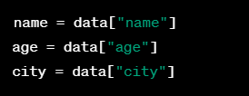
Parse JSON data: Use the json.loads() function to parse the JSON data into a Python object (usually a dictionary or a list).
In this example, the json_data variable contains a JSON string representing an object with attributes like "name," "age," and "city." The json.loads() function parses this JSON data into a Python dictionary stored in the data variable.
Access parsed data: Once the JSON data is parsed, you can access the extracted data using standard Python syntax.

Slide 64
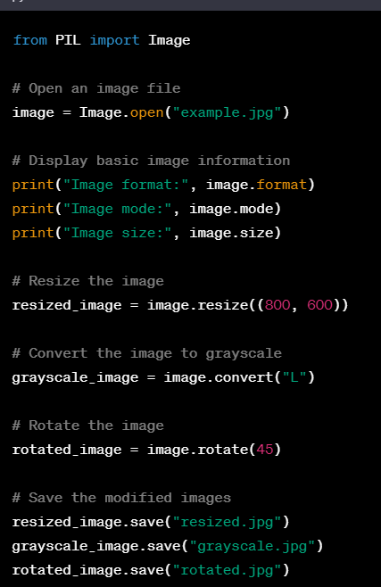
Pillow Library
The Pillow library is a popular Python imaging library that provides a wide range of image processing capabilities. It allows you to open, manipulate, and save different image file formats using a simple and intuitive API. Here's an example that demonstrates the usage of the Pillow library:

Slide 65
In this example, we start by importing the Image module from the Pillow library. We then open an image file called "example.jpg" using the Image.open() function. This creates an Image object representing the image.
We can access various properties of the image object, such as its format, mode, and size, using attributes like format, mode, and size. The image format represents the file format of the image, the image mode indicates the color space and pixel format, and the size represents the dimensions of the image.
Next, we perform some image manipulations. We resize the image using the resize() method, which takes the desired width and height as arguments. We convert the image to grayscale using the convert() method, specifying the mode as "L" (for grayscale). We also rotate the image by 45 degrees using the rotate() method.
Finally, we save the modified images using the save() method, specifying the filename for each saved image.
The Pillow library provides a rich set of methods for image manipulation, including cropping, filtering, blending, and more. It supports a wide range of image file formats, such as JPEG, PNG, GIF, BMP, and TIFF.
By utilizing the capabilities of the Pillow library, you can easily perform image processing tasks, enhance images, and integrate image handling into your Python applications.

Slide 66
Scrapping text from images from the website
Scraping text from images on websites involves extracting textual content embedded within images or screenshots. This task typically requires Optical Character Recognition (OCR) techniques to recognize and convert the text within the image into a machine-readable format.
Install the necessary libraries
Install the pytesseract library: pytesseract is a Python wrapper for Tesseract OCR. You can install it using pip:
pip install pytesseract
Install the PIL or Pillow library: This library is used for image processing and manipulation. Install it using:
pip install Pillow

Slide 67
2. Import the required libraries:
from PIL import Image
import pytesseract
3. Download and preprocess the image
# Download the image
image_url = "https://example.com/image.jpg"
image = Image.open(requests.get(image_url, stream=True).raw)
# Preprocess the image (if required)
# For example, you can apply image enhancement techniques or convert to grayscale.
# image = image.convert("L")
4. Perform OCR on the image:
# Perform OCR using pytesseract
extracted_text = pytesseract.image_to_string(image)_text
In this step, we use the image_to_string() function from pytesseract to extract the text from the image.

Slide 68
Reading captchas and training tesseract
Reading CAPTCHAs in the scraping process: CAPTCHAs are often implemented on websites to prevent automated scraping and ensure that the requests are made by human users. When scraping, encountering CAPTCHAs can pose a challenge as they are specifically designed to be difficult for machines to solve.
It can be handled by one or more following process:
Manual Intervention: In some cases, when a CAPTCHA is encountered, you might prompt a human operator to manually solve it and proceed with the scraping process. This approach involves human intervention and is typically not automated.
CAPTCHA Solving Services: There are third-party services available that specialize in solving CAPTCHAs. These services utilize human workers or advanced algorithms to decipher the CAPTCHA challenges on your behalf. You can integrate with their APIs or use their software development kits (SDKs) to automate the CAPTCHA solving process within your scraping workflow.
CAPTCHA Bypass Techniques: Some CAPTCHAs can be bypassed using automated techniques. These methods involve analyzing the CAPTCHA's structure, image recognition algorithms, or machine learning approaches to recognize and solve the CAPTCHA automatically. However, it's important to note that bypassing CAPTCHAs may violate terms of service or legal agreements with the website owner, and the ethical implications should be considered.

Slide 69
Training Tesseract in the scraping process
Tesseract, being an OCR engine, can be helpful in extracting text from images, including CAPTCHA images. Although Tesseract's pre-trained models may not be effective in reading CAPTCHAs due to their intentional obfuscation, training Tesseract on custom CAPTCHA data can potentially improve its accuracy in recognizing and extracting CAPTCHA text.
Training Tesseract specifically for CAPTCHA recognition involves:
Collecting CAPTCHA Training Data: You need to gather a dataset of CAPTCHA images that represent the variations and challenges you aim to overcome. This dataset should include the corresponding ground truth text for each CAPTCHA image.
Labeling and Preprocessing: Manually transcribe the text in each CAPTCHA image to provide the ground truth. Additionally, you might need to preprocess the CAPTCHA images, removing noise or distortion to improve the training process.
Training Tesseract: Using Tesseract's training tools, you train the OCR model by providing the labeled CAPTCHA images and their ground truth data. Tesseract learns from this data and adjusts its internal models to better recognize and extract text from similar CAPTCHA images.
It's important to note that training Tesseract for CAPTCHA recognition is challenging due to the deliberate obfuscation and variations in CAPTCHA designs. The success of training Tesseract on CAPTCHAs depends on the complexity of the CAPTCHAs and the amount and quality of training data available.

Slide 70
Thank You

