Slide 1
Unit-3 Computer vision basics
By,
Disha D N
Assistant Professor II
Department of AIML
NMAMIT

Slide 2
Contents
Basic image handling and processing:
The python Imaging Library (PIL)
Matplotlib
NumPy-Array image representation
Grey-level transforms
Image resizing
PCA of images
Image De-noising
Haris-corner detector
finding corresponding points between images
SIFT-Scale invariant feature transform
Matching geotagged images

Slide 3
Basic Image handling Processing : (PIL)
Computer vision is the automated extraction of information from images. Information can mean anything from 3D models, camera position, object detection and recognition to grouping and searching image content.
The PIL (The python imaging library) :
The Python Imaging Library (PIL) provides general image handling and lots of useful basic image operations like resizing, cropping, rotating, color conversion and much more
With PIL, you can read images from most formats and write to the most common ones. The most important module is the Image module. To read an image, use
from PIL import Image
pil_im = Image.open('empire.jpg’)
The return value, pil_im, is a PIL image object.
Color conversions are done using the convert() method. To read an image and convert it to grayscale, just add convert('L') like this:
pil_im = Image.open('empire.jpg').convert('L')

Slide 4
Convert images to another format
Using the save() method, PIL can save images in most image file formats. Here’s an example that takes all image files in a list of filenames (filelist) and converts the images to JPEG files:
Example:
from PIL import Image
import os
for infile in filelist:
outfile = os.path.splitext(infile)[0] + ".jpg"
if infile != outfile:
try: Image.open(infile).save(outfile)
except IOError: print "cannot convert", infile

Slide 5
The PIL function open() creates a PIL image object and the save() method saves the image to a file with the given filename.
The new filename will be the same as the original with the file ending “.jpg” instead. PIL is smart enough to determine the image format from the file extension. There is a simple check that the file is not already a JPEG file and a message is printed to the console if the conversion fails.
Using PIL to create thumbnails is very simple. The thumbnail() method takes a tuple specifying the new size and converts the image to a thumbnail image with size that fits within the tuple. To create a thumbnail with longest side 128 pixels, use the method like this: pil_im.thumbnail((128,128))

Slide 6
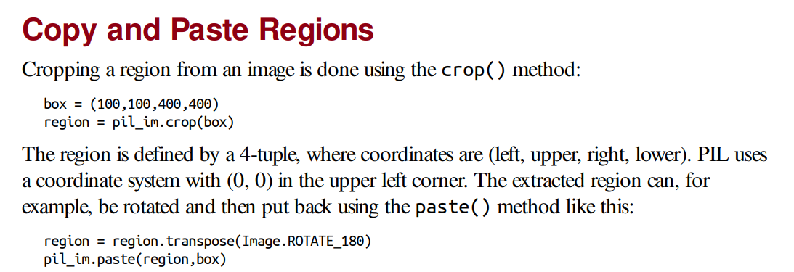
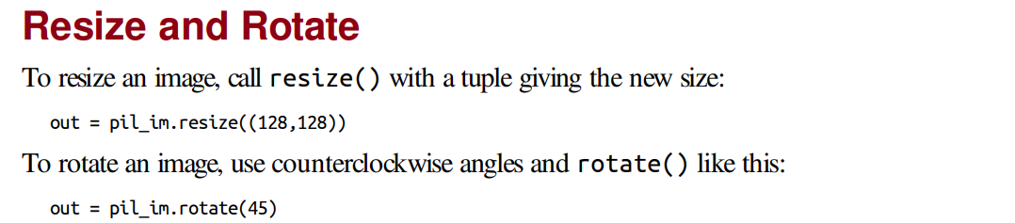

Slide 7
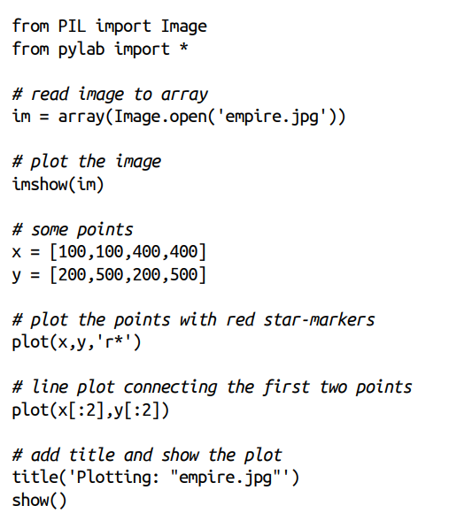
Matplotlib
Plotting images, points, and lines
Although it is possible to create nice bar plots, pie charts, scatter plots, etc., only a few commands are needed for most computer vision purposes.
Most importantly, we want to be able to show things like interest points, correspondences, and detected objects using points and lines. Here is an example of plotting an image with a few points and a line:

Slide 8
This plots the image, then four points with red star markers at the x and y coordinates given by the x and y lists, and finally draws a line (blue by default) between the two first points in these lists
The show() command starts the figure GUI and raises the figure windows. This GUI loop blocks your scripts and they are paused until the last figure window is closed. You should call show() only once per script, usually at the end

Slide 9
Interactive Annotation
Sometimes users need to interact with an application, for example by marking points in an
image, or you need to annotate some training data. PyLab comes with a simple function,
ginput(), that lets you do just that. Here’s a short example:
from PIL import Image
from pylab import *
im = array(Image.open('empire.jpg'))
imshow(im)
print 'Please click 3 points'
x = ginput(3)
print 'you clicked:',x
show()
This plots an image and waits for the user to click three times in the image region of the
figure window. The coordinates [x, y] of the clicks are saved in a list x.

Slide 10
Numpy-Array image representation
In the context of image processing and computer vision, a common way to represent images is by using NumPy arrays. NumPy is a Python library that provides efficient numerical operations and multi-dimensional array manipulation. NumPy arrays are widely used in the field of machine learning and image processing due to their efficiency and compatibility with various mathematical and scientific operations.
Grayscale Images:
Grayscale images have only one color channel, representing the intensity or brightness of each pixel.
In NumPy, grayscale images are typically represented as 2D arrays, where each element represents the pixel intensity.
The shape of the array is (height, width), where height represents the number of rows and width represents the number of columns.

Slide 11
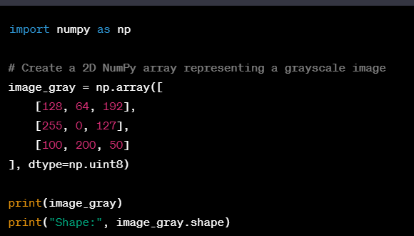

Slide 12
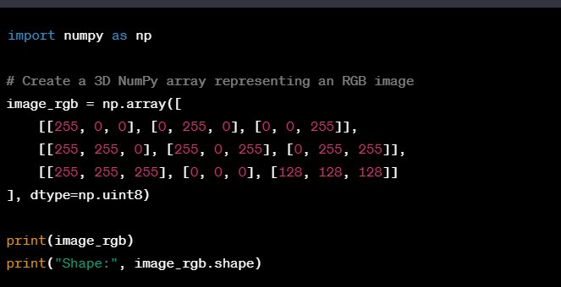
RGB Images:
RGB images consist of three color channels: Red, Green, and Blue.
In NumPy, RGB images are represented as 3D arrays, where each element represents the pixel values for the respective color channels.
The shape of the array is (height, width, channels), where height represents the number of rows, width represents the number of columns, and channels represents the number of color channels (usually 3 for RGB images).

Slide 13
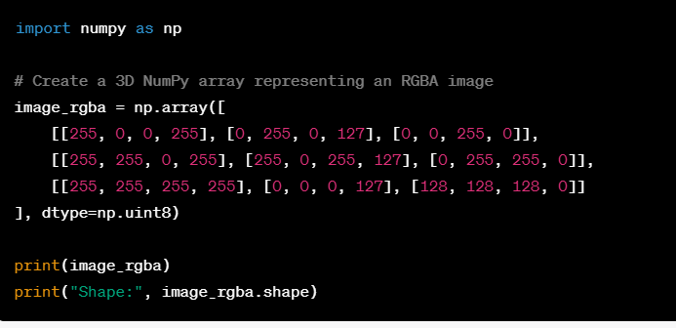
Grayscale Images with Alpha Channel (RGBA):
Some images may have an additional alpha channel, which represents the transparency level of each pixel.
In NumPy, RGBA images are represented as 3D arrays, similar to RGB images, but with an additional channel for transparency.
The shape of the array is (height, width, channels), where channels represents 4 (R, G, B, and Alpha).

Slide 14
PCA of images
PCA (Principal Component Analysis) is a dimensionality reduction technique commonly used in image processing to extract meaningful features from high-dimensional image data. PCA can help reduce the complexity of image data while preserving the most important information.
Steps are as follows:
Image Representation:
Images are typically represented as multi-dimensional arrays, where each element represents the pixel intensity or color value.
For grayscale images, the array can be 2D, while for color images, it can be a 3D array with color channels (e.g., RGB).

Slide 15
Data Preprocessing:
Before applying PCA, it is common to preprocess the image data to ensure it has zero mean and unit variance.
This step helps in normalizing the data and making sure that the image features are comparable.
Flattening the Image:
To apply PCA, the image is often flattened into a 1D vector, irrespective of the number of color channels.
For example, a grayscale image of size 100x100 will be transformed into a vector of length 10,000.
Covariance Matrix Calculation:
The covariance matrix is computed from the flattened image data.
The covariance matrix represents the relationships between pairs of image features.

Slide 16
Eigen decomposition:
The covariance matrix is then decomposed into its eigenvectors and eigenvalues.
The eigenvectors represent the principal components, which capture the directions of maximum variance in the data.
The eigenvalues indicate the amount of variance explained by each eigenvector.
Dimensionality Reduction:
The eigenvectors are ranked based on their corresponding eigenvalues.
The top-k eigenvectors, which explain the most variance, are selected as the principal components.
These principal components form a new basis for representing the image data in a lower-dimensional space.

Slide 17
Image De-noising technique
Image denoising is a technique used to remove or reduce noise from images, which are unwanted variations or distortions that can degrade the quality and clarity of an image. There are several approaches to image denoising, including both traditional methods and deep learning-based techniques. One common traditional approach called "Denoising Filters.“
Denoising Filters: Denoising filters are based on the assumption that noise in an image is typically high-frequency or random variations compared to the underlying signal or structure. These filters aim to preserve the important details while smoothing out the noise. Here are a few commonly used denoising filters:
Gaussian Filter:
The Gaussian filter is a low-pass filter that reduces high-frequency noise while preserving edges and details.
It convolves the image with a Gaussian kernel, which assigns weights based on the Gaussian distribution.
The size of the kernel determines the amount of smoothing applied to the image.
The filter essentially averages the pixel values in the neighborhood, reducing the impact of noise.
Median Filter:
The median filter is a non-linear filter that replaces the pixel value with the median value of its neighboring pixels.
It is effective at removing salt-and-pepper noise, which appears as randomly occurring bright and dark pixels.
The median filter preserves edges and details better than linear filters like the Gaussian filter.

Slide 18
Example for image denoising
import cv2
# Load the noisy image
image = cv2.imread('noisy_image.jpg', cv2.IMREAD_COLOR)
# Apply median filter for denoising
denoised_image = cv2.medianBlur(image, 5)
# Display the original and denoised images
cv2.imshow('Original Image', image)
cv2.imshow('Denoised Image', denoised_image)
cv2.waitKey(0)
cv2.destroyAllWindows()

Slide 19
In this example, make sure to replace 'noisy_image.jpg' with the path to your actual noisy image file. The cv2.imread() function is used to read the image file, and cv2.medianBlur() applies the median filter with a kernel size of 5x5. Adjust the kernel size as per your requirement.
The denoised image is then displayed using cv2.imshow(), and the program waits for a key press before closing the windows with cv2.waitKey(0). Finally, cv2.destroyAllWindows() is used to release the resources and close the windows.

Slide 20
Haris corner detector
Harris corner detection is a popular algorithm used to detect corners or interest points in an image. It operates by calculating the corner response function using the image gradients and then selecting the points with high corner responses as corners
Steps:
Convert the image to grayscale: The algorithm typically operates on grayscale images to simplify the computations. If the input image is in color, it is first converted to grayscale.
Compute image gradients: The algorithm calculates the gradients of the grayscale image in both the horizontal and vertical directions. This is usually done using derivative filters, such as the Sobel operators, to determine how the intensity changes across the image.
Compute the elements of the Harris matrix: The Harris matrix is a matrix that captures the local image structure. It is computed based on the gradients obtained in the previous step. The elements of the Harris matrix are calculated by squaring and multiplying the gradients.
Apply Gaussian smoothing: To reduce noise and improve the detection results, the elements of the Harris matrix are typically smoothed using a Gaussian filter. Smoothing helps in suppressing noise and emphasizing the significant image structures.

Slide 21
5. Compute the corner response function: The corner response function is a measure that determines the likelihood of a pixel being a corner based on the Harris matrix. It is calculated by combining the smoothed elements of the Harris matrix and using an empirical constant called the Harris parameter.
6. Threshold the corner response: A threshold is applied to the corner response function to filter out weak corner candidates. Only pixels with a corner response above a certain threshold are considered as corner candidates.
7. Non-maximum suppression: To avoid multiple detections of corners in close proximity, a non-maximum suppression step is often applied. This step removes redundant corner candidates by considering only the pixels with the maximum corner response in their local neighborhood.
8. Display or utilize the detected corners: The algorithm outputs the coordinates of the detected corners or visually represents them on the image for further analysis or application-specific tasks.

Slide 22
SIFT-Scale invariant feature transform
The Scale-Invariant Feature Transform (SIFT) is a popular computer vision algorithm used for feature detection and matching between images. It was introduced by David Lowe in 1999 and has become widely adopted in various applications, such as image recognition, object tracking, and image stitching.
The SIFT algorithm has several key properties that make it robust to changes in scale, rotation, and affine transformations. Here's an overview of the SIFT algorithm:
Scale-space extrema detection: SIFT operates on multiple scales of an image to detect features that are invariant to scale changes. It starts by constructing a scale-space pyramid by applying Gaussian blurring and downsampling the original image. At each level of the pyramid, the Difference of Gaussians (DoG) is computed by subtracting adjacent blurred images to enhance local extrema. Potential interest points are identified as the local maxima or minima in the DoG scale-space.
Keypoint localization: The detected extrema in the DoG scale-space are refined to locate precise keypoints. This step involves fitting a quadratic function to the nearby points in the scale-space to estimate the location and scale of the keypoints. Keypoints with low contrast or poorly localized are discarded.

Slide 23
3. Orientation assignment: SIFT assigns an orientation to each keypoint to achieve invariance to image rotation. It computes the gradient magnitude and orientation in the neighborhood of the keypoint and constructs a histogram of gradient orientations. The dominant orientation in the histogram is selected as the orientation of the keypoint. The keypoints are then assigned an orientation relative to the dominant orientation.
4. Keypoint descriptor generation: SIFT constructs a descriptor for each keypoint to capture its distinctive characteristics. A local image patch is sampled around the keypoint location, and gradient orientations and magnitudes are computed. The patch is divided into subregions, and histograms of gradient orientations are computed for each subregion. The histograms are concatenated to form the keypoint descriptor, which results in a high-dimensional feature vector.
5. Keypoint matching: SIFT features can be matched across different images by comparing their descriptors. One common method is to use nearest neighbor matching with a distance metric, such as Euclidean distance or cosine similarity. The matches can be further refined using techniques like RANSAC (Random Sample Consensus) to eliminate outliers and estimate geometric transformations between images.

Slide 24
Matching geotagged images
Matching geotagged images in computer vision refers to the process of finding correspondences between images based on their geographic location metadata. Geotagging is the process of associating geographical information, such as latitude and longitude coordinates, with digital images.
Matching geotagged images can be useful in various applications, including image retrieval, panorama stitching, and 3D reconstruction. Here's an overview of the process:
Geotagging images: The first step is to geotag the images by associating each image with its corresponding geographical location. This can be done manually by using GPS devices or automatically by leveraging GPS-enabled cameras or mobile devices that embed location information in the image metadata.

Slide 25
2. Feature extraction: The next step is to extract visual features from the geotagged images. Common feature extraction techniques include Scale-Invariant Feature Transform (SIFT), Speeded-Up Robust Features (SURF), or Oriented FAST and Rotated BRIEF (ORB). These algorithms extract distinctive and invariant features from the images that can be used for matching.
3. Geographic similarity measure: To match geotagged images, a similarity measure is required that takes into account both visual features and geographic information. One approach is to compute the distance between feature descriptors (e.g., Euclidean distance or cosine similarity) and compare the geographical proximity of the images using the associated coordinates.
4. Nearest neighbor matching: The extracted features and similarity measures are then used to perform nearest neighbor matching. For each feature in one image, the most similar feature in another image is identified based on the computed distances or similarity scores. Various matching strategies can be employed, such as brute-force matching or using efficient data structures like kd-trees or vocabulary trees.

Slide 26
5. Geometric verification: Once the initial matches are obtained, geometric verification techniques can be applied to further refine the matches and eliminate outliers. Common methods include RANSAC (Random Sample Consensus) or geometric constraints based on the camera pose or scene geometry.
6. Post-processing and filtering: Finally, post-processing steps can be applied to filter and refine the matched image pairs. This may involve applying geometric consistency checks, considering temporal information (if available), or employing more sophisticated algorithms such as graph-based matching.

Slide 27
Thank You

