Slide 1
Databases and Database Users

Slide 2
Basic Definitions
Database:
A collection of related data.
Data:
Known facts that can be recorded and have an implicit meaning.
Mini-world or Universe of discourse:
Some part of the real world about which data is stored in a database. For example, student grades and transcripts at a university.
Database Management System (DBMS):
A collection of programs that enables users to create and maintain database. DBMS is a general purpose software system that facilitates the processes of defining, constructing, manipulating and sharing databases among various users and applications.
Database System:
The DBMS software together with the database. Sometimes, the applications are also included.

Slide 3
Typical DBMS Functionality
Define a database
In terms of data types, structures and constraints.
Construct or Load the Database on a secondary storage medium.
Manipulating the database
Querying, generating reports, insertions, deletions and modifications to its content.
Concurrent Processing and Sharing by a set of users and programs – yet, keeping all data valid and consistent.
Metadata : The database definition or descriptive information present in the database in the form of data catalog or data dictionary.
Protection or Security measures to prevent unauthorized access

Slide 4
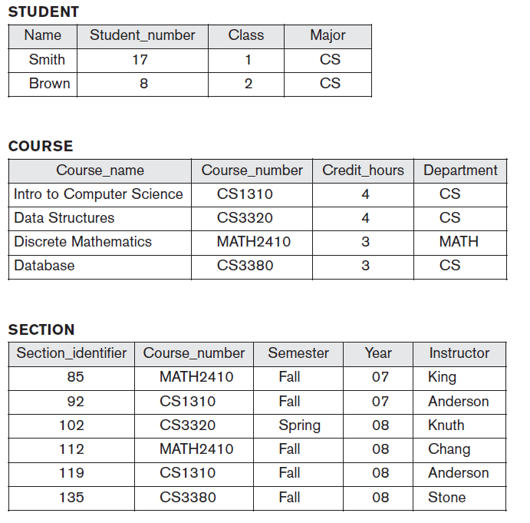
Example of a Database System

Slide 5
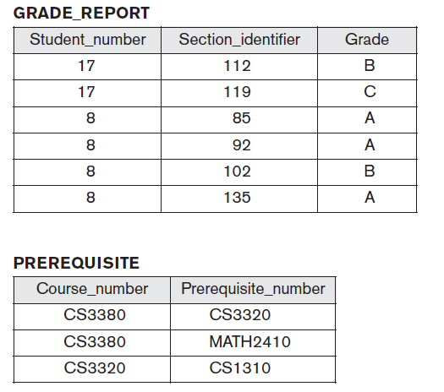

Slide 6
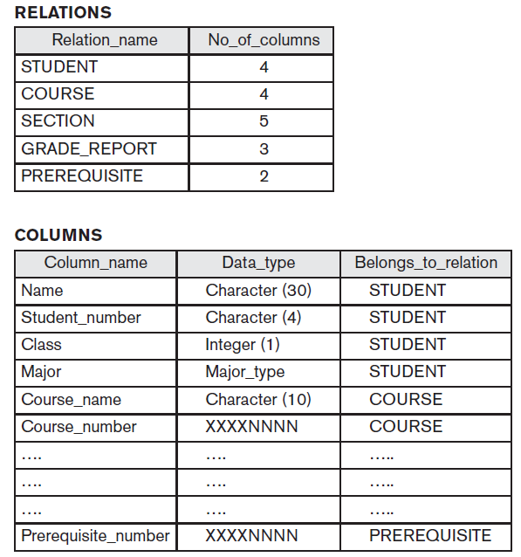
Main Characteristics of the Database Approach
Self-describing nature of a database system:
A DBMS catalog stores the description of the database. The description is called meta-data. This allows the DBMS software to work with different databases.

Slide 7
Insulation between programs and data:
Program – data independence
Allows changing data storage structures and operations without having to change the DBMS access programs.
Program – operation independence
User application programs can operate on the data by invoking operations through their names and parameters regardless how operations are implemented.
Data Abstraction:
The characteristic that allows program – data independence and program – operation independence is called data abstraction.
A data model is used to hide storage details and present the users with a conceptual view of the database.

Slide 8
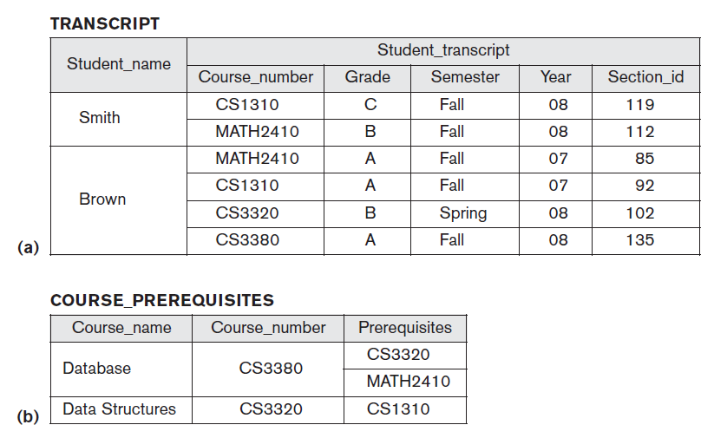
Support of multiple views of the data:
Each user may see a different view of the database, which describes only the data of interest to that user.

Slide 9
Sharing of data and multiuser transaction processing :
Allowing a set of concurrent users to retrieve and to update the database. Concurrency control within the DBMS guarantees that each transaction is correctly executed or completely aborted.
OLTP (Online Transaction Processing) is a major part of database applications.

Slide 10
Database Users
Actors on the scene
Database administrators
responsible for authorizing access to the database, for coordinating and monitoring its use, acquiring software, and hardware resources, controlling its use and monitoring efficiency of operations.
Database Designers
responsible to define the content, the structure, the constraints, and functions or transactions against the database. They must communicate with the end-users and understand their needs.
End-users
they use the data for queries, reports and some of them actually update the database content.
System Analysts and Application Programmers(Software Engineers)
System Analyst determine the requirements of end users, especially Naïve and parametric end users and develop specifications for canned transactions that meet these requirements.
Application Programmers implement these specifications as programs, then they test, debug, document and maintain these canned transactions.

Slide 11
Categories of End-users
Casual
access database occasionally when needed
Naive or Parametric
they make up a large section of the end-user population. They use previously well-defined functions in the form of “canned transactions” against the database. Examples are bank-tellers or reservation clerks who do this activity for an entire shift of operations.
Sophisticated
include engineers, scientists, business analysts, and others who thoroughly familiarize themselves with the facilities of the DBMS in order to implement their own applications
Stand-alone
mostly maintain personal databases using ready-to-use packaged applications. An example is a tax program user that creates his or her own internal database.

Slide 12
Database Users
Workers behind the scene
DBMS System Designers and Implementers design and implement the DBMS modules and interfaces as a software package.
Tool Developers design and implement tools—the software packages that facilitate database modeling and design, database system design, and improved performance.
Operators and Maintenance Personnel are responsible for the actual running and maintenance of the hardware and software environment for the database system.

Slide 13
Advantages of Using the Database Approach
Controlling redundancy in data storage and in development and maintenance efforts.
Restricting unauthorized access to data.
Providing persistent storage for program Objects
Providing Storage Structures for efficient Query Processing

Slide 14
Advantages of Using the Database Approach
Providing backup and recovery services.
Providing multiple interfaces to different classes of users.
Representing complex relationships among data.
Enforcing integrity constraints on the database.

Slide 15
Additional Implications of Using the Database Approach
Potential for enforcing standards:
This is very crucial for the success of database applications in large organizations Standards refer to data item names, display formats, screens, report structures, meta-data (description of data) etc.
Reduced application development time:
Incremental time to add each new application is reduced.
Flexibility to change data structures:
Database structure may evolve as new requirements are defined.
Availability of up-to-date information:
Very important for on-line transaction systems such as airline, hotel, car reservations.

