Slide 1
Data Models
Data Model: A set of concepts to describe the structure of a database, and By structure of a database we mean the data types, relationships, and constraints that apply to the data.

Slide 2
Categories of data models
Conceptual (high-level, semantic) data models
Provide concepts that are close to the way many users perceive data. (Also called entity-based or object-based data models.)
Physical (low-level, internal) data models
Provide concepts that describe details of how data is stored in the computer.
Implementation (representational) data models
Provide concepts that fall between the above two, balancing user views with some computer storage details.

Slide 3
Schemas, Instances and Database State
Database Schema
The description of a database. Includes descriptions of the database structure and the constraints that should hold on the database.
Schema Diagram
A diagrammatic display of (some aspects of) a database schema. shows a schema diagram for the database shown in Figure 1; the diagram displays the structure of each record type but not the actual instances of records.
Schema Construct
A component of the schema or an object within the schema, e.g., STUDENT, COURSE.
Database State
The actual data stored in a database at a particular moment in time. Also called snapshot or instance or occurrence.

Slide 4
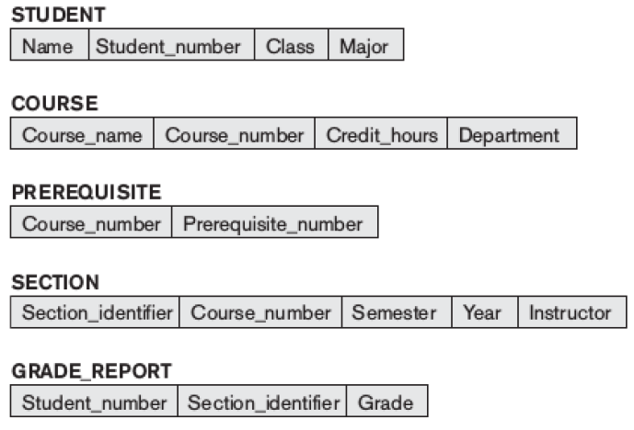

Slide 5
Database Schema Vs. Database State
Initial Database State
Refers to the database when the database is first populated or loaded with the initial data.
Valid State
A state that satisfies the structure and constraints of the database.
Distinction
The database schema changes very infrequently. The database state changes every time the database is updated.
Schema is also called intension, whereas state is called extension.

Slide 6
Three-Schema Architecture
Three of the four important characteristics of the database approach
use of a catalog to store the database description (schema) so as to make it self describing,
insulation of programs and data (program-data and program-operation independence)
support of multiple user views.
The three-schema architecture, was proposed to help achieve and visualize these characteristics.

Slide 7
Three-Schema Architecture
Defines DBMS schemas at three levels:
Internal schema at the internal level to describe physical storage structures and access paths. Typically uses a physical data model.
Conceptual schema at the conceptual level to describe the structure and constraints for the whole database for a community of users. Uses a conceptual or an implementation data model.
External schemas at the external level to describe the various user views. Usually uses the same data model as the conceptual level.

Slide 8
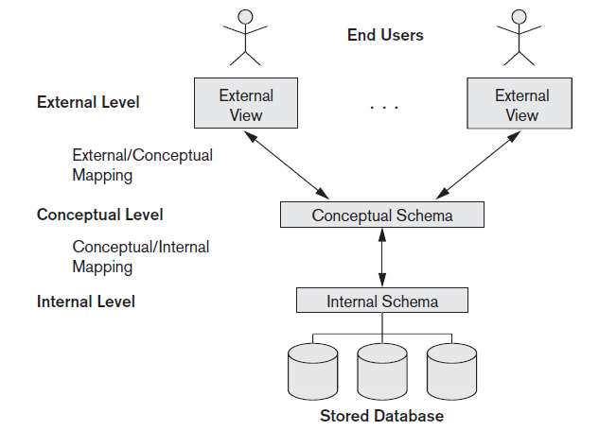
Three-Schema Architecture
Mappings among schema levels are needed to transform requests and data. Programs refer to an external schema, and are mapped by the DBMS to the internal schema for execution.

Slide 9
Data Independence
The capacity to change the schema at one level of a database system without having to change the system at the next higher level.
Two types of data independences:
Logical Data Independence: The capacity to change the conceptual schema without having to change the external schemas and their application programs.
Physical Data Independence: The capacity to change the internal schema without having to change the conceptual schema.
Data independence occurs because when the schema is changed at some level, the schema at the next higher level remains unchanged; only the mapping between the two levels is changed. Hence, application programs referring to the higher-level schema need not be changed. Three schema architecture can make it easier to achieve true data independence, both physical and logical.

Slide 10
DBMS Languages
Data Definition Language (DDL)
Used by the DBA and database designers to specify the conceptual schema of a database.
In many DBMSs, the DDL is also used to define internal and external schemas (views).
Storage Definition Language (SDL)
Used to specify internal schema
View Definition Language (VDL)
Used to specify user views and their mappings to the conceptual schema.

Slide 11
DBMS Languages
Data Manipulation Language (DML): Used to specify database retrievals and updates.
DML commands (data sublanguage) can be embedded in a general-purpose programming language (host language), such as COBOL, C or an Assembly Language.
Alternatively, stand-alone DML commands can be applied directly (query language).

Slide 12
DML Types
High Level or Non-procedural DML: can be used on its own to specify complex database operations concisely. Many DBMSs allow high level DML statements either to be entered interactively from a display monitor or terminal or to be embedded in a general-purpose programming language.
Low Level or Procedural DML: must be embedded in a general-purpose programming language. This type of DML typically retrieves individual records or objects from the database and processes each seperately.

Slide 13
DBMS Interfaces
User-friendly interfaces:
Menu-based interfaces for Web Clients or Browsing
Forms-based, designed for naive users
Graphics-based (Point and Click, Drag and Drop etc.)
Natural language: requests in written English
Speech as Input and Output
Parametric interfaces (e.g., bank tellers) using function keys.
Interfaces for the DBA:
Creating accounts, granting authorizations
Setting system parameters
Changing schemas or access path

Slide 14
A Sample Database Application
COMPANY database
The COMPANY database keeps track of a company’s employees, departments, and projects.
The company is organized into departments. Each department has a unique name, a unique number, and a particular employee who manages the department.
We keep track of the start date when that employee began managing the department.
A department may have several locations.
A department controls a number of projects, each of which has a unique name, a unique number, and a single location.
We store each employee’s name, Social Security number, address, salary, gender, and birth date.

Slide 15
An employee is assigned to one department, but may work on several projects, which are not necessarily controlled by the same department.
We keep track of the current number of hours per week that an employee works on each project.
We also keep track of the direct supervisor of each employee (who is another employee).
We want to keep track of the dependents of each employee for insurance purposes.
We keep each dependent’s first name, sex, birth date, and relationship to the employee.

Slide 16
Entity Types, Entity Sets, Attributes and Keys
Entity
A thing in the real world with an independent existence.
Eg: A particular person, Car, House or an Employee
Attribute
The particular property that describes the entity.
Eg: An Employee’s name, age, address, salary and job

Slide 17
Types of Attributes
Composite versus simple(Atomic) Attributes
Single Valued versus Multivalued Attributes
Stored versus Derived Attributes
Null Values

Slide 18
Entity Types
A collection of entities that have the same attributes.
Each entity type in the database is described by its name and attributes.
An entity type describes the schema or intension for a set of entities that share the same structure.
Eg: EMPLOYEE and COMPANY and a list of attributes for each.
An entity type is represented in ER diagrams as a rectangular box enclosing the entity type name.
The collection of entities of a particular entity type is grouped into an entity set.
This is also called as Extension of the entity type.

Slide 19
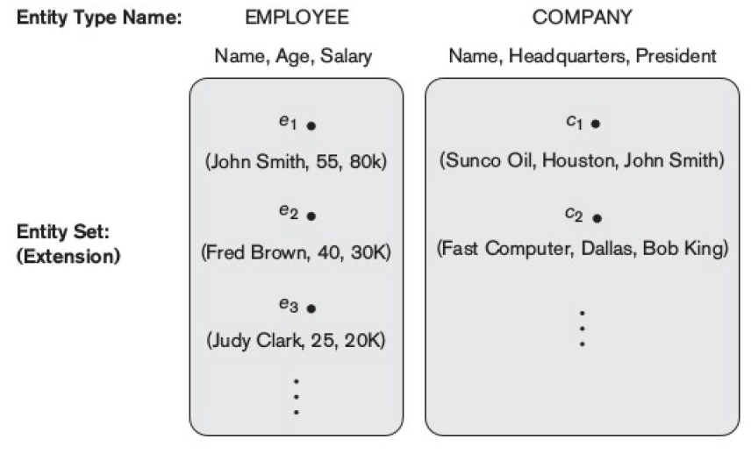
Two entity types EMPLOYEE and COMPANY and some member entities of each.

Slide 20
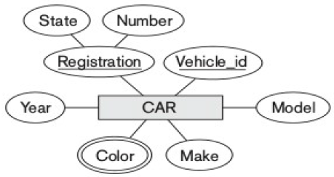
Key Attribute of an Entity Type
An entity type usually has an attribute whose values are distinct for each individual entity in the entity set.
Such an attribute is called as key attribute and its value can be used to identify each entity uniquely.
Eg: No two companies will have the same name, so name attribute is the key attribute in COMPANY.
In ER diagrammatic notation, each key attribute has its name underlined inside the oval.

Slide 21
Value Sets (Domains) of Attributes
Each simple attribute of an entity type is associated with a value set (or domain of values), which specifies the set of values that may be assigned to that attribute for each individual entity.
Value sets are typically specified using the basic data types.

Slide 22
Relationship Types, Relationship Sets, and Instances
A relationship type R among n entity types E₁, E₂, … E_{n} defines a set of associations – or a relationship set – among entities from these entity types.
Mathematically, the relationship set R is a set of relationship instances r_{i}, where each r_{i} associates n individual entities.

Slide 23
Example 1…
EMPLOYEE
WORKS_FOR
DEPARTMENT
e_{1 }
e_{2 }
e_{3 }
e_{4 }
e_{5 }
e_{6 }
e_{7 }
r₁
r₂
r₃
r₄
r₅
r₆
r₇
● d₁
● d₂
● d₃

Slide 24
Relationship Degree
The degree of a relationship type is the number of participating entity types.
A relationship type of degree two is called binary, and one of degree three is called ternary.

Slide 25
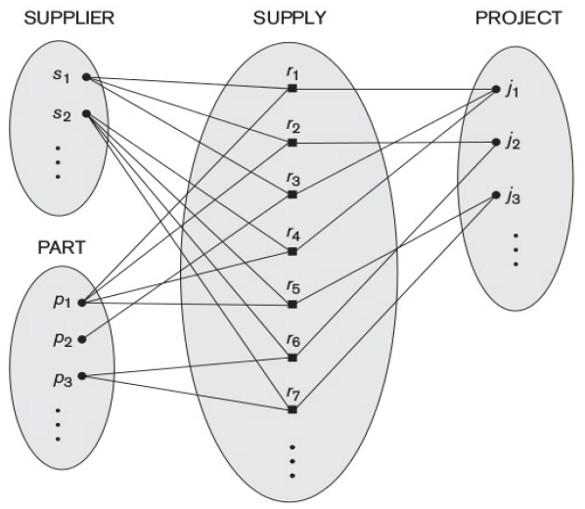
An example of a ternary relationship is SUPPLY, shown in Figure, where each relationship instance r_{i} associates three entities—a supplier s, a part p, and a project j— whenever s supplies part p to project j.

Slide 26
Role Names and Recursive Relationships
Each entity type that participates in a relationship type plays a particular role in the relationship.
The role name signifies the role that a participating entity from the entity type plays in each relationship instance, and helps to explain what the relationship means.
Some entity types participates more than once in a relationship type in different roles. Such relationship types are called recursive relationships.

Slide 27
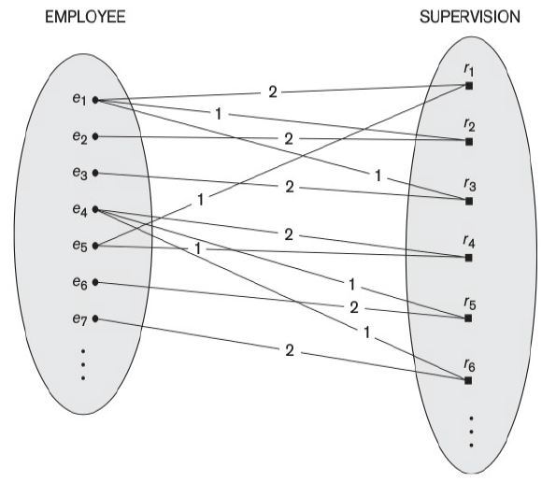
The SUPERVISION relationship type relates an employee to a supervisor, where both employee and supervisor entities are members of the same EMPLOYEE entity set.
Hence, the EMPLOYEE entity type participates twice in SUPERVISION: once in the role of supervisor (or boss), and once in the role of supervisee (or subordinate).
In Figure, the lines marked ‘1’ represent the supervisor role, and those marked ‘2’ represent the supervisee role.

Slide 28
Constraints on Relationship Types
There are two types of relationship constraints:
Cardinality ratio
The cardinality ratio for binary relationship specifies the maximum number of relationship instances that an entity can participate in.
The possible cardinality ratio for binary relationship types are 1:1, 1:N, N:1 and M:N
Participation
The participation constraint specifies whether the existence of an entity depends on its being related to another entity via the relationship type.
This constraint specifies the minimum number of relationship instances that each entity can participate in.
The cardinality ratio and participation constraint together called as structural constraint.

Slide 29
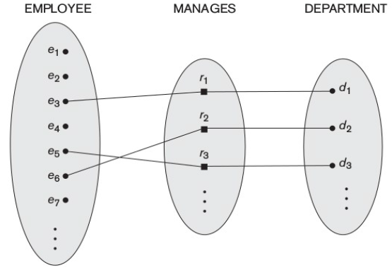
1:1 Relationship

Slide 30
1:N Relationship
EMPLOYEE
WORKS_FOR
DEPARTMENT
e_{1 }
e_{2 }
e_{3 }
e_{4 }
e_{5 }
e_{6 }
e_{7 }
r₁
r₂
r₃
r₄
r₅
r₆
r₇
● d₁
● d₂
● d₃

Slide 31
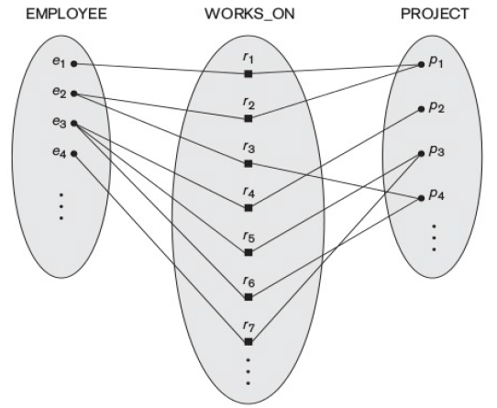
M:N Relationship

Slide 32
Participation Constraint and Existence Dependence
The participation constraint specifies whether the existence of an entity depends on it being related to another entity via the relationship type.
This is also called as minimum cardinality constraint.
Two types of participation constraint:
Total Participation, also called as Existence Dependency
Partial Participation

Slide 33
Attributes as Relationship Types
A relationship type can have attributes; for example, HoursPerWeek of WORKS_ON; its value for each relationship instance describes the number of hours per week that an EMPLOYEE works on a PROJECT.

Slide 34
Weak Entity Types
Entity types that do not have key attributes of their own are called weak entity types.
The entity types which contain key attributes of their own are called regular entity types or strong entity types.
Entities belonging to weak entity type are identified by being related to specific entities from another entity type in combination with one of their attribute values. This other entity type is called as identifying entity type or owner entity type.
The relationship type that relates a weak entity type to its owner is called as identifying relationship of the weak entity type.
The weak entity type normally has a partial key, which is the set of attributes that can uniquely identify weak entities that are related to the same owner entity.

Slide 35
Example…
Example:
Suppose that a DEPENDENT entity is identified by the dependent’s first name and birth date, and the specific EMPLOYEE that the dependent is related to.
DEPENDENT is a weak entity type with EMPLOYEE as its identifying entity type via the identifying relationship type DEPENDENT_OF.

Slide 36
Notations Used in ER Diagrams
Symbol
Meaning
ENTITY TYPE
WEAK ENTITY TYPE
RELATIONSHIP TYPE
IDENTIFYING RELATIONSHIP TYPE
ATTRIBUTE
KEY ATTRIBUTE
MULTIVALUED ATTRIBUTE
COMPOSITE ATTRIBUTE
DERIVED ATTRIBUTE
TOTAL PARTICIPATION OF E₂ IN R
CARDINALITY RATIO 1:N FOR E₁:E₂ IN R
STRUCTURAL CONSTRAINT (min, max) ON PARTICIPATION OF E IN R
E₁
R
E₂
E₁
1
R
N
E₂
R
(min,max)
E

Slide 37
Proper Naming of Schema Constructs
Use singular names for entity types, rather than plural one.
Verbs tend to indicate the relationship types.
Another naming consideration involves choosing the binary relationship names to make the ER diagram of the schema readable from left to right and top to bottom.

Slide 38
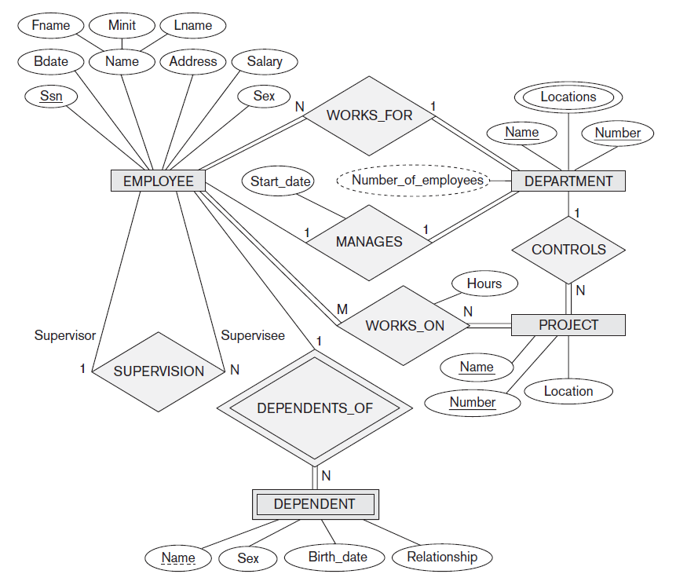
E – R Diagram for COMPANY Database

Slide 39
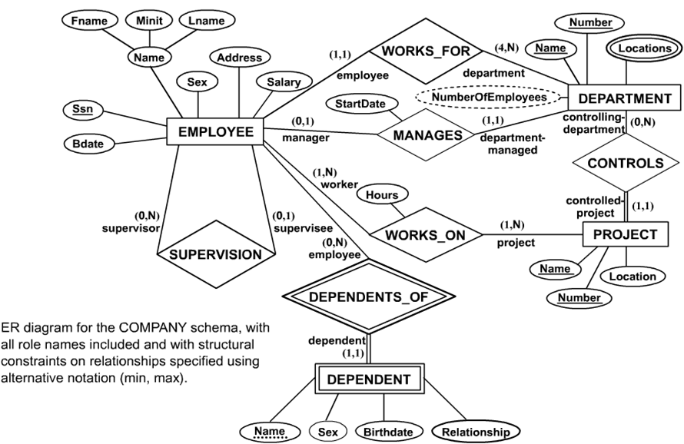
Alternative ER Notations

