Slide 1
Relational Model Concepts
The relational model represents the database as a collection of relations.
Informally, each relation resembles a table of values or, to some extent, a flat file of records.
It is called a flat file because each record has a simple linear or flat structure.
When a relation is thought of as a table of values, each row in the table represents a collection of related data values.
The table name and column names are used to help to interpret the meaning of the values in each row.
In the formal relational model terminology, a row is called a tuple, a column header is called an attribute, and the table is called a relation.

Slide 2
Domains, Attributes, Tuples and Relations
Domain
A domain D is a set of atomic values.
Atomic means that each value in the domain is indivisible as far as the relational model is concerned.
Relation Schema
Relation schema R, denoted by R (A₁, A₂, .....A_{n}) is made up of a relation name R and a list of attributes A₁, A₂, …, A_{n}
Each attribute A_{i} is a name of a role played by some domain D in the relation schema R.
D is called the domain of A_{i} and is denoted by dom(A_{i}).
Degree of the relation
The degree of a relation is the number of attributes n of its relation schema.

Slide 3
Contd…
Relation
A relation or relation state r of the relation schema R (A₁, A₂, .....A_{n}), also denoted by r(R), is a set of n – tuples r = {t₁, t₂, …, t_{m}}.
Each n – tuple t is an ordered list of n values t = <v₁, v₂, …,v_{n}> , where each v_{i}, 1≤ i ≤ n, is an element of dom(A_{i}) or is a special NULL value.
The terms relation intension for the relation schema R and relation extension for a relation state r(R) are commonly used.

Slide 4
Mathematical Definition
A relation state r(R) is a mathematical relation of degree n on the domains dom(A₁), dom(A₂),…, dom(A_{n}) which is a subset of the Cartesian product of the domains that defines R:
r(R) ⊆ (dom(A₁) X dom(A₂) X … X dom(A_{n}))
The Cartesian product specifies all possible combinations of values from the underlying domains.
The total number of values, or cardinality in a domain D by |D|, the total number of tuples in the Cartesian product is
|dom(A₁)| X |dom(A₂)| X … X |dom(A_{n})|
Current relation state
A relation state at a given time is called the current relation state.

Slide 5
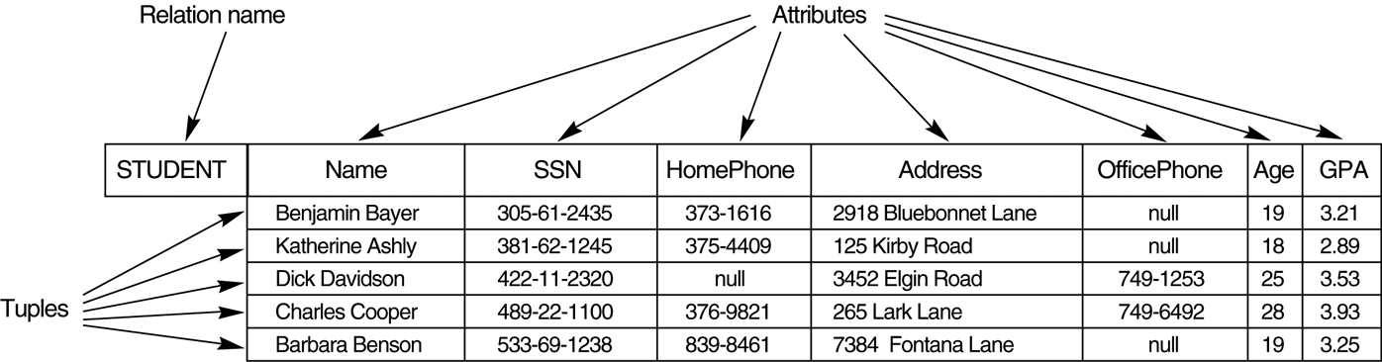
Example…

Slide 6
Characteristics of Relations
Ordering of tuples in a relation
Ordering of values within a tuple and an Alternative definition of a relation
Values and NULLs in tuples
Interpretation (Meaning) of a relation

Slide 7
Ordering of Tuples in a Relation
A relation is defined as a set of tuples.
Mathematically, elements of a set have no order among them; hence, tuples in a relation do not have any particular order.
Many tuple orders can be specified on the same relation.
When a relation is implemented as a file or displayed as a table, a particular ordering may be specified on the records of the file or the rows of the table.

Slide 8
Ordering of values within a tuple and an Alternative definition of a relation
According to the preceding definition of a relation, an n-tuple is an ordered list of n values, so the ordering of values in a tuple—and hence of attributes in a relation schema—is important.
However, at a more abstract level, the order of attributes and their values is not that important as long as the correspondence between attributes and values is maintained.

Slide 9
Values and NULLs in the Tuples
All values are considered atomic (indivisible).
A special NULL value is used to represent values that are unknown or inapplicable to certain tuples.

Slide 10
Interpretation (Meaning) of a Relation
The relation schema can be interpreted as a declaration or a type of assertion.
For example, the schema of the student entity has a Name, SSN, HomePhone, Address, Officephone, Age and GPA. Each tuple in the relation can then be interpreted as a fact or a particular instance of the relation.

Slide 11
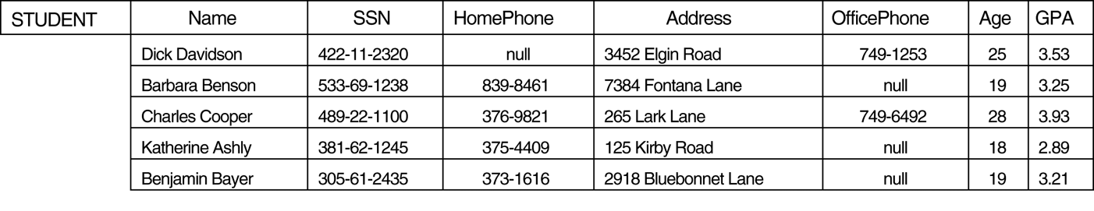
Example…

Slide 12
Relational Model Notations
Following notations are used in the Relational Model:
A relation schema R of degree n is denoted by R(A1, A2, …, An).
The letters Q, R, S denote relation names.
The letters q, r, s denote relation states.
The letters t, u, v denote tuples.

Slide 13
Relational Model Constraints and Relational Database Schemas
Constraints on databases can generally be divided into three main categories:
Inherent model based or Implicit constraint
Constraints that are inherent to the data model
Schema based or Explicit constraint
Constraints that are directly expressed in schemas of the data model
Application based or Semantic constraint or Business rules
Constraints that can not be directly expressed in schemas of the data model and hence must be expressed and enforced by the application programs

Slide 14
Constraints in the Relational Model
Domain Constraints
Key Constraints and Constraint on NULL values
Entity integrity constraints
Referential integrity constraints

Slide 15
Domain Constraints
These constraints specify that within each tuple, the value of each attribute A must be an atomic value from the domain dom(A).
The data types associated with domains typically include standard numeric data types for integers and real numbers.

Slide 16
Key Constraints and Constraints on NULL values
Super Key
It is a subset of attributes SK where any two distinct tuples t1 and t2 in a relation state r of R, we have the constraint that t1[SK] ≠ t2[SK]
Key
A key K of a relation schema R is a super key of R with the additional property that removing any attribute A from K leaves set of attributes K’ that is not a super key of R any more.
Candidate Key
A relation schema may have more than one key. In this case, each of the keys is called a candidate key.
Primary Key
This is the candidate key whose values are used to identify tuples in the relation. The primary key of the relation schema are underlined.

Slide 17
Relational Databases and Relational Database Schemas
Relational Database Schema
A relational database schema S is a set of relation schemas S = {R₁, R₂, …, R_{m}} and a set of integrity constraints IC.
Relational Database State
A relational database state DB of S is a set of relation states DB = {r₁, r₂, …, r_{m}} such that each r_{i} is a state of R_{i} and such that the r_{i} relation states satisfy the integrity constraints specified in IC.
A database state that does not obey all the integrity constraints is called an invalid state, and a state that satisfies all the constraints in IC is called a valid state.

Slide 18
Entity Integrity Constraints
The entity integrity constraint states that no primary key can be NULL.
This is because the primary key value is used to identify individual tuples in a relation.
Having NULL values for the primary key implies that we can not identify some tuples.
For example, if two or more tuples had NULL for their primary keys, we might not be able to distinguish them if we tried to reference them from other relations.

Slide 19
Referential Integrity Constraints
The referential integrity constraint is specified between two relations and is used to maintain the consistency among tuples in the two relations.
Informally, the referential integrity constraint states that a tuple in one relation that refers to another relation must refer to an existing tuple in that relation.
For example, the DNO of EMPLOYEE gives the department number for which each employee works; hence, its value in every EMPLOYEE tuple must match the DNUMBER value of some tuple in the DEPARTMENT relation.

Slide 20
Foreign Key
The condition for a foreign key specify a referential integrity constraint between the two relation schemas R₁ and R₂.
A set of attributes FK in the relation schema R₁ is a foreign key of R₁ that references relation R₂ if it satisfies the following rules:
The attributes in FK have the same domain(s) as the primary key attributes PK of R₂; the attributes FK are said to reference or refer to the relation R₂.
The value of FK in a tuple t₁ of the current state r₁(R₁) either occurs as a value of PK for some tuple t₂ in the current state r₂(R₂) or is NULL. In the former case, we have t₁[FK] = t₂[PK], and we say that the tuple t₁ references or refers to the tuple t₂.
In this definition, R₁ is called the referencing relation and R₂ is the referenced relation.

Slide 21
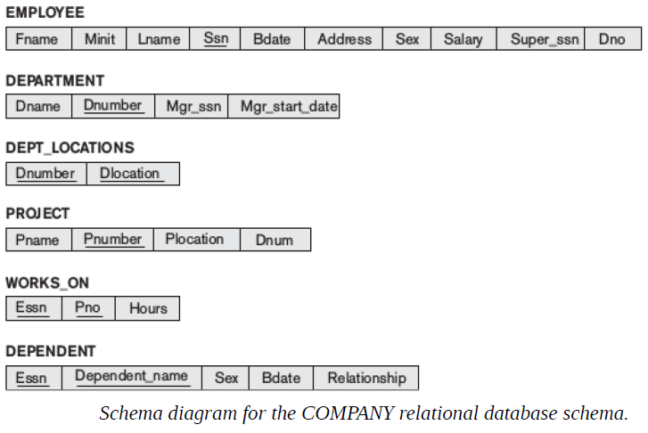

Slide 22
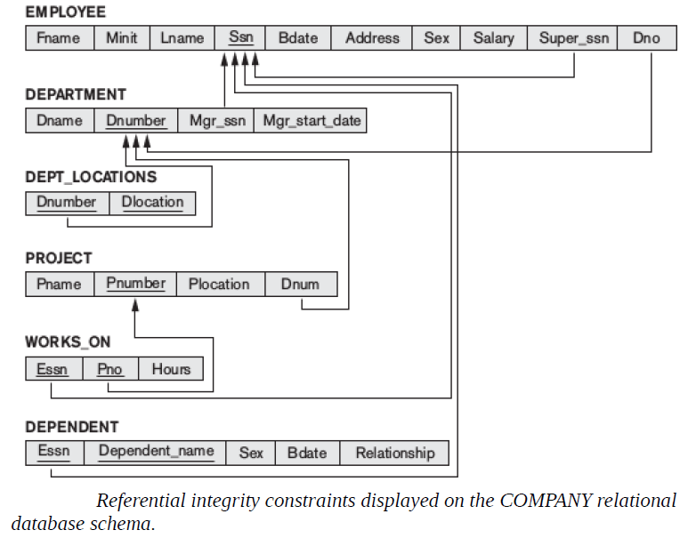

Slide 23
Update Operations and Dealing with Constraint Violations
The operations of the relational model can be categorized into retrievals and update.
There are three basic update operations:
Insert
Delete
Modify

Slide 24
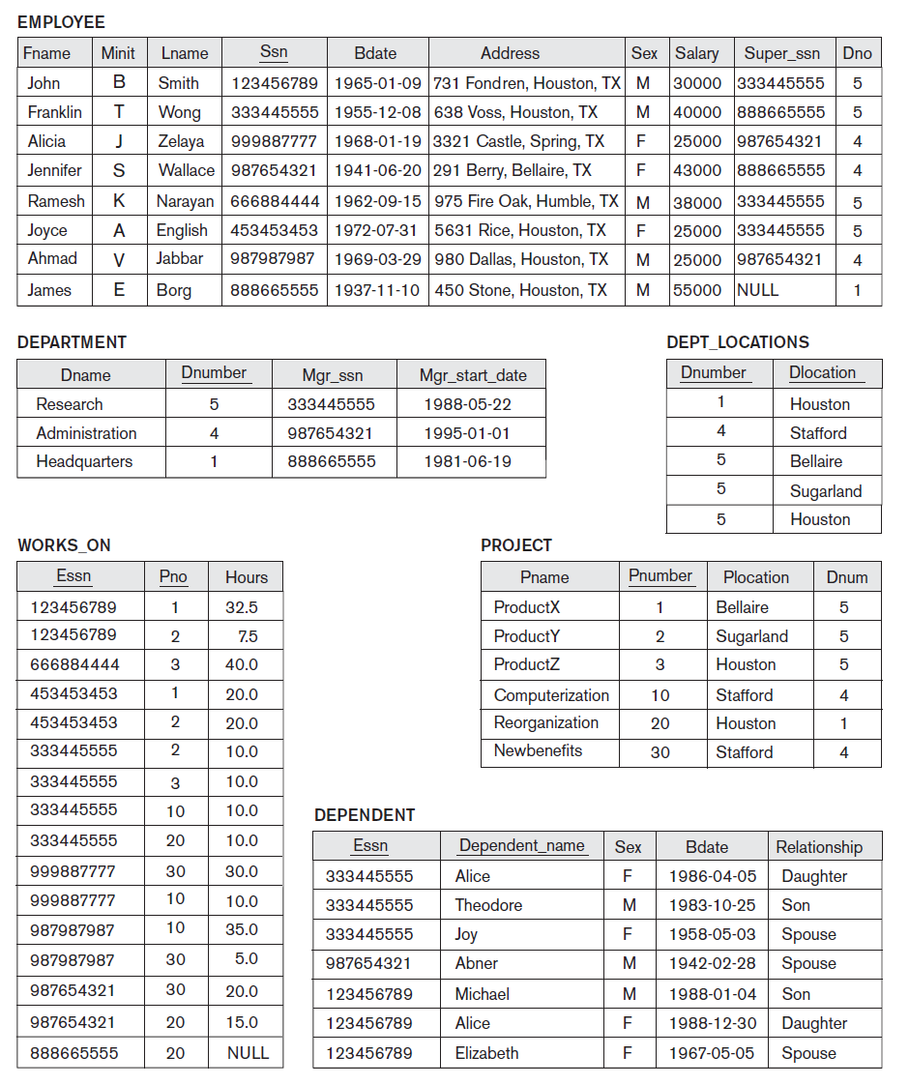

Slide 25
The Insert Operation
The insert operation provides a list of attribute values for a new tuple t that is to be inserted into a relation R.
Insert can violate any of the four types of constraints.

Slide 26
Example…
Insert <‘Cecilia’, ‘F’, ‘Kolonsky’, null, ‘1960-04-05’, ‘6357 Windy Lane, Katy, TX’, F, 28000, null, 4> into EMPLOYEE.
Insert <‘Alicia’, ‘J’, ‘Zelaya’, ‘999887777’, ‘1960-04-05’, ‘6357 Windy Lane, Katy, TX’, F, 28000, ‘987654321’, 4> into EMPLOYEE.
Insert <‘Cecilia’, ‘F’, ‘Kolonsky’, ‘677678989’, ‘1960-04-05’, ‘6357 Windswept, Katy, TX’, F, 28000, ‘987654321’, 7> into EMPLOYEE.
Insert <‘Cecilia’, ‘F’, ‘Kolonsky’, ‘677678989’, ‘1960-04-05’, ‘6357 Windy Lane, Katy, TX’, F, 28000, null, 4> into EMPLOYEE.

Slide 27
The Delete Operation
The delete operation is used to delete the tuples from the relation.
Eg:
Delete the WORKS_ON tuple with ESSN = ‘999887777’ and PNO = 10.
Delete the EMPLOYEE tuple with SSN = ‘999887777’.
Delete the EMPLOYEE tuple with SSN = ‘333445555’.

Slide 28
The Update Operation
The update(or Modify) operation is used to change the values of one or more attributes in a tuple(or tuples) of some relation R.
Eg:
Update the SALARY of the EMPLOYEE tuple with SSN = ‘999887777’ to 28000.
Update the DNO of the EMPLOYEE tuple with SSN = ‘999887777’ to 1.
Update the DNO of the EMPLOYEE tuple with SSN = ‘999887777’ to 7.
Update the SSN of the EMPLOYEE tuple with SSN = ‘999887777’ to ‘987654321’.

