Slide 1
Relational Database Design Using ER – to – Relational Mapping
Mapping of Regular Entity Types
Mapping of Weak Entity Types
Mapping of Binary 1:1 Relationship Types
Mapping of Binary 1:N Relationship Types
Mapping of Binary M:N Relationship Types
Mapping of Multivalued Attributes
Mapping of N – ary Relationship Types

Slide 2
Mapping of Regular Entity Types
For each regular(strong) entity type E in the ER schema, create a relation R that includes all simple attributes of E.
Include only the simple component attributes of a composite attribute.
Choose one of the key attributes of E as the primary key of R.
If the chosen key of E is a composite, then the set of simple attributes that form it will together form the primary key of R.
If multiple keys were identified for E during the conceptual design, the information describing the attributes that form each additional key is kept in order to specify secondary keys of relation R.

Slide 3
Mapping of Weak Entity Types
For each weak entity type W in the ER schema with owner entity type E, create a relation R and include all simple attributes of W as attributes of R.
In addition, include as foreign key attributes of R, the primary key attribute(s) of the relation(s) that correspond to the owner entity type(s).
The primary key of R is the combination of the primary key(s) of the owner(s) and the partial key of the weak entity type W, if any.
If there is a weak entity type E₂ whose owner is also a weak entity type E₁, then E₁ should be mapped before E₂ to determine its primary key first.

Slide 4
Mapping of Binary 1:1 Relationship Types
For each binary 1:1 relationship type R in ER schema, identify the relations S and T that correspond to the entity types participating in R.
There are three possible approaches:
The foreign key approach
The merged relationship approach
The cross reference or relationship relation approach

Slide 5
Mapping of Binary 1:N Relationship Types
For each regular binary 1:N relationship type R, identify the relation S that represents the participating entity type at the N – side of the relationship type.
Include as foreign key in S the primary key of relation T that represents the other entity type participating in R.
Include any simple attributes of the 1:N relationship type as attributes of S.

Slide 6
Mapping of Binary M:N Relationship Types
For each binary M:N relationship type R, create a new relation S to represent R.
Include as foreign key attributes in S the primary keys of the relations that represent the participating entity types.
Their combination will form the primary key of S.
Also include any simple attributes of the M:N relationship type as attributes of S.

Slide 7
Mapping of Multivalued Attributes
For each Multivalued attribute A, create a new relation R.
This relation R will include an attribute corresponding to A, plus the primary key attribute K – as foreign key in R – of the relation that represents the entity type or the relationship type that has A as an attribute.
The primary key of R is the combination of A and K.

Slide 8
Mapping of N – ary Relationship Types
For each N – ary relationship type R, where n>2, create a new relation S to represent R.
Include as foreign key attributes in S the primary keys of the relations that represent the participating entity types.
Also include any simple attributes of the n – ary relationship type as attributes of S.
The primary key of S is usually a combination of all the foreign keys that reference the relations representing the participating entity types.

Slide 9
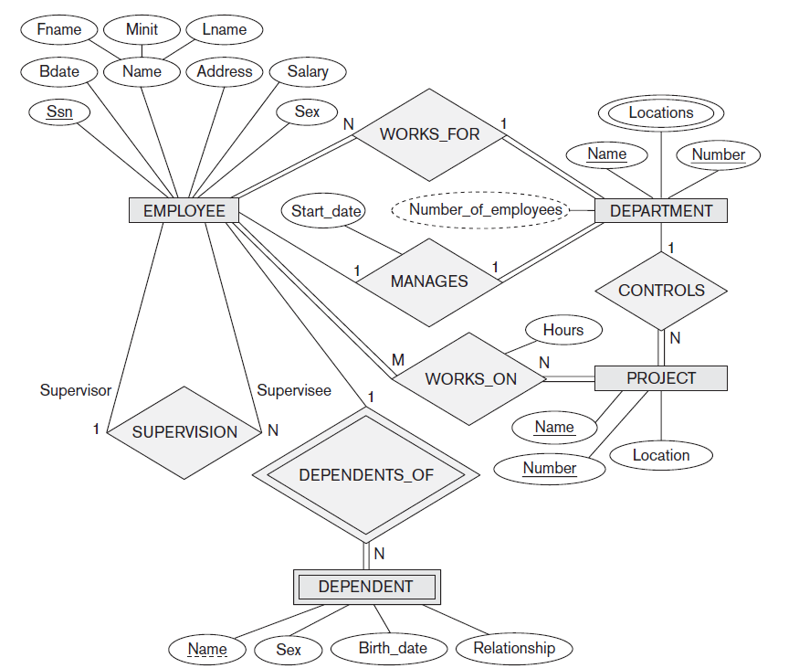

Slide 10
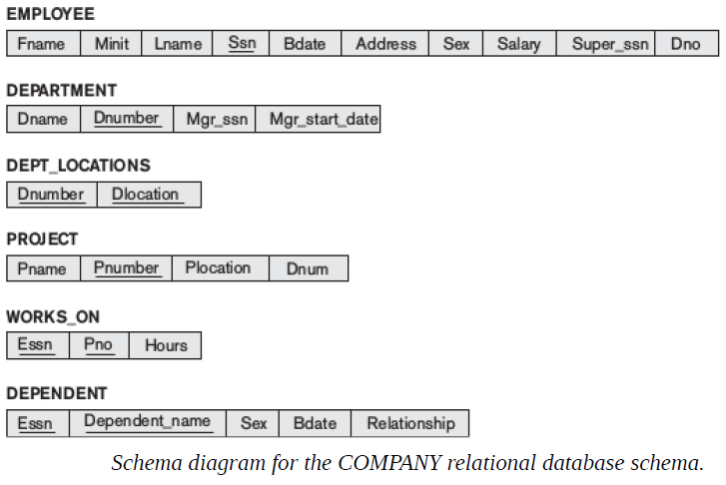

Slide 11
Certainly! Here are some notes on the mapping of different entity types, relationship types, and attributes in the context of database design:
1. Mapping of Regular Entity Types:
- Regular entity types are entities that have their own unique identifier (primary key).
- Each regular entity type maps to a separate table in the relational schema.
- The attributes of the entity type are mapped to columns in the table, with the primary key as one of the columns.
2. Mapping of Weak Entity Types:
- Weak entity types are entities that depend on another entity (owner entity) for their existence. They don't have a unique identifier on their own.
- A weak entity type is mapped to a separate table in the relational schema, with a foreign key column that references the primary key of the owner entity.
- The combination of the owner entity's primary key and the weak entity's partial key forms the primary key of the weak entity's table.
3. Mapping of Binary 1:1 Relationship Types:
- In a binary 1:1 relationship, each entity instance in one entity type is associated with at most one entity instance in the other entity type.
- The relationship is typically represented by placing the primary key of one entity as a foreign key in the other entity.
- The primary key of either entity type can be chosen to be the primary key of the resulting table, and the foreign key column is added for the other entity.

Slide 12
4. Mapping of Binary 1:N Relationship Types:
- In a binary 1:N relationship, each entity instance in one entity type is associated with zero or more entity instances in the other entity type, but each entity instance in the other entity type is associated with at most one entity instance in the first entity type.
- The relationship is represented by adding a foreign key column in the "N" side entity table that references the primary key of the "1" side entity table.
5. Mapping of Binary M:N Relationship Types:
- In a binary M:N relationship, each entity instance in one entity type can be associated with zero or more entity instances in the other entity type, and vice versa.
- The M:N relationship is resolved by creating a new table, known as a junction table or associative table.
- The junction table contains foreign key columns that reference the primary keys of both entity types involved in the relationship.
6. Mapping of Multivalued Attributes:
- A multivalued attribute is an attribute that can have multiple values for a single entity instance.
- Multivalued attributes are mapped by creating a separate table for the attribute, with a foreign key referencing the primary key of the entity to which the attribute belongs.
- The separate table allows storing multiple values for the attribute, with each value represented as a separate row.
7. Mapping of N-ary Relationship Types:
- N-ary relationship types involve more than two entity types.
- The N-ary relationship is typically resolved by creating a separate table that represents the relationship.
- The table contains foreign key columns that reference the primary keys of the participating entity types.

