Slide 1
Boyce-Codd Normal Form
We can see the need for a stronger normal form than 3NF by going back to the LOTS relation schema.
Suppose that we have thousands of lots in the relation but the lots are from only two counties: DeKalb and Fulton.
Suppose also that lot sizes in DeKalb County are only 0.5, 0.6, 0.7, 0.8, 0.9, and 1.0 acres, whereas lot sizes in Fulton County are restricted to 1.1, 1.2, ..., 1.9, and 2.0 acres.
In such a situation we would have the additional functional dependency FD5: Area→County_name.
If we add this to the other dependencies, the relation schema LOTS1A still is in 3NF because County_name is a prime attribute.

Slide 2
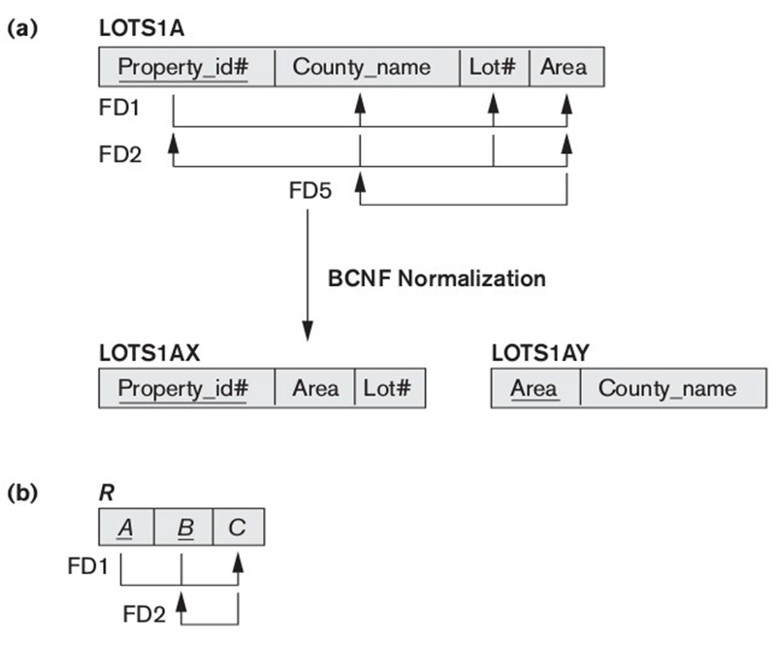

Slide 3
Definition. A relation schema R is in BCNF if whenever a nontrivial functional dependency X → A holds in R, then X is a superkey of R.
As another example, consider Figure below, which shows a relation TEACH with the following dependencies:
FD1: { Student, Course } → Instructor
FD2: Instructor → Course
Note that {Student, Course} is a candidate key for this relation and that the dependencies shown follow the pattern in Figure (b) above, with Student as A, Course as B, and Instructor as C. Hence this relation is in 3NF but not BCNF.
Decomposition of this relation schema into two schemas is
{ Instructor , Course } and { Course , Student }.
We lose the functional dependency FD1.

Slide 4
Multivalued Dependency and Fourth Normal Form
Multivalued dependencies are a consequence of first normal form (1NF), which disallows an attribute in a tuple to have a set of values, and the accompanying process of converting an unnormalized relation into 1NF.
If we have two or more multivalued independent attributes in the same relation schema, we get into a problem of having to repeat every value of one of the attributes with every value of the other attribute to keep the relation state consistent and to maintain the independence among the attributes involved.
This constraint is specified by a multivalued dependency.

Slide 5
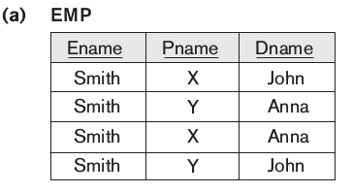
For example, consider the relation EMP shown in Figure below. An employee may work on several projects and may have several dependents, and the employee’s projects and dependents are independent of one another. To keep the relation state consistent, and to avoid any spurious relationship between the two independent attributes, we must have a separate tuple to represent every combination of an employee’s dependent and an employee’s project. This constraint is specified as a multivalued dependency on the EMP relation.

Slide 6
Formal Definition of Multivalued Dependency
Definition. A multivalued dependency X →→ Y specified on relation schema R, where X and Y are both subsets of R, specifies the following constraint on any relation state r of R:
If two tuples t1 and t2 exist in r such that t1[X] = t2[X], then two tuples t3 and t4 should also exist in r with the following properties, where we use Z to denote (R – (X ∪ Y)):
t3[X] = t4[X] = t1 [X] = t2[X].
t3[Y] = t1[Y] and t4[Y] = t2[Y].
t3[Z] = t2[Z] and t4[Z] = t1[Z].
Whenever X →→ Y holds, we say that X multidetermines Y.
Because of the symmetry in the definition, whenever X →→ Y holds in R, so does X →→ Z. Hence, X →→ Y implies X →→ Z, and therefore it is sometimes written as X →→ Y|Z.
An MVD X →→ Y in R is called a trivial MVD if (a) Y is a subset of X, or (b) X ∪ Y = R.
An MVD that satisfies neither (a) nor (b) is called a nontrivial MVD.

Slide 7
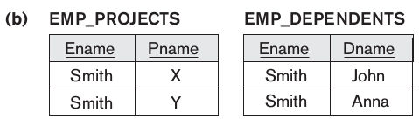
Definition. A relation schema R is in 4NF with respect to a set of dependencies if, for every nontrivial multivalued dependency X →→ Y, X is a superkey for R.
A relation that is not in 4NF due to a nontrivial MVD must be decomposed to convert it into a set of relations in 4NF.
The process of normalizing a relation involving the nontrivial MVDs that is not in 4NF consists of decomposing it so that each MVD is represented by a separate relation where it becomes a trivial MVD.
Consider the EMP relation in Figure (a). EMP is not in 4NF because in the nontrivial MVDs Ename→→Pname and Ename→→Dname, and Ename is not a superkey of EMP. We decompose EMP into EMP_PROJECTS and EMP_DEPENDENTS, shown in Figure (b). Both EMP_PROJECTS and EMP_DEPENDENTS are in 4NF, because the MVDs Ename→→Pname in EMP_PROJECTS and Ename→→Dname in EMP_DEPENDENTS are trivial MVDs.

Slide 8
Join Dependencies and Fifth Normal Form
Definition. A join dependency (JD), denoted by JD(R1, R2, ...,Rn), specified on relation schema R, specifies a constraint on the states r of R. The constraint states that every legal state r of R should have a nonadditive join decomposition into R1, R2, ...,Rn.
Hence, for every such r we have • (πR1(r), πR2(r), ...,πRn(r)) = r A join dependency JD(R1, R2, ...,Rn), specified on relation schema R, is a trivial JD if one of the relation schemas Ri in JD(R1, R2, ...,Rn) is equal to R.
We can now define fifth normal form, which is also called project-join normal form.
Definition. A relation schema R is in fifth normal form (5NF) (or project-join normal form (PJNF)) with respect to a set F of functional, multivalued, and join dependencies if, for every nontrivial join dependency JD(R1, R2, ...,Rn) in F⁺ (that is, implied by F), every Ri is a superkey of R.

Slide 9
For an example of a JD, consider the SUPPLY all-key relation in Figure below. Suppose that the following additional constraint always holds: Whenever a supplier s supplies part p, and a project j uses part p, and the supplier s supplies at least one part to project j, then supplier s will also be supplying part p to project j.
This constraint can be restated in other ways and specifies a join dependency JD(R1, R2, R3) among the three projections R1(Sname, Part_name), R2(Sname, Proj_name), and R3(Part_name, Proj_name) of SUPPLY.

Slide 10
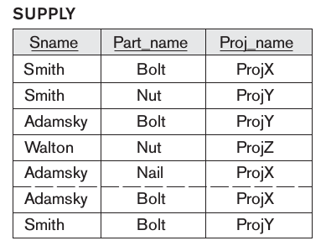
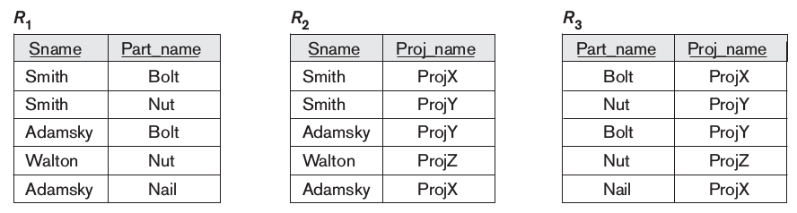

Slide 11
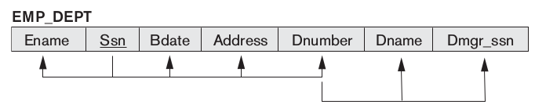
Inference Rules for Functional Dependencies
Definition. Formally, the set of all dependencies that include F(given set of functional dependencies) as well as all dependencies that can be inferred from F is called the closure of F; it is denoted by F⁺.
F = {Ssn → {Ename, Bdate, Address, Dnumber}, Dnumber → {Dname, Dmgr_ssn}}
Some of the additional functional dependencies that we can infer from F are the following:
Ssn → {Dname, Dmgr_ssn}
Ssn → Ssn
Dnumber → Dname

Slide 12
We use the notation F| = X → Y to denote that the functional dependency X → Y is inferred from the set of functional dependencies F.
The FD {X, Y} → Z is abbreviated to XY → Z, and the FD {X, Y, Z} → {U, V} is abbreviated to XYZ → UV.
The following six rules IR1 through IR6 are well-known inference rules for functional dependencies:
IR1 (reflexive rule) 1 : If X ⊇ Y, then X →Y.
IR2 (augmentation rule) 2 : {X → Y} |= XZ → YZ.
IR3 (transitive rule): {X → Y, Y → Z} |= X → Z.
IR4 (decomposition or projective rule): {X → YZ} |=X → Y.
IR5 (union or additive rule): {X → Y, X → Z} |= X → YZ.
IR6 (pseudotransitive rule): {X → Y, WY → Z} |=WX → Z.

Slide 13
Proof of IR1. Suppose that X ⊇ Y and that two tuples t1 and t2 exist in some relation instance r of R such that t1[X] = t2[X]. Then t1[Y] = t2[Y] because X ⊇ Y; hence, X → Y must hold in r.
Proof of IR2 (by contradiction). Assume that X → Y holds in a relation instance r of R but that XZ → YZ does not hold.
Then there must exist two tuples t1 and t2 in r such that
t1[X] = t2[X]
t1[Y] = t2[Y]
t1[XZ] = t2[XZ], and
t1[YZ] ≠ t2[YZ]. This is not possible because from (1) and (3) we deduce
t1[Z] = t2[Z], and from (2) and (5) we deduce
t1[YZ] = t2[YZ], contradicting (4).

Slide 14
Definition. For each such set of attributes X, we determine the set X⁺ of attributes that are functionally determined by X based on F; X⁺ is called the closure of X under F.
Algorithm 1. Determining X⁺, the Closure of X under F
Input: A set F of FDs on a relation schema R, and a set of attributes X, which is a subset of R.
X⁺ := X;
repeat
oldX⁺ := X⁺ ;
for each functional dependency Y → Z in F do
if X⁺ ⊇ Y then X⁺ := X⁺ ∪ Z;
until (X⁺ = oldX⁺);

Slide 15
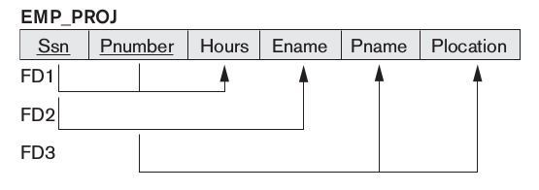
F = { Ssn → Ename, Pnumber →{ Pname, Plocation }, {Ssn, Pnumber } → Hours }
Using Algorithm, we calculate the following closure sets with respect to F:
{Ssn}⁺ = { Ssn, Ename }
{Pnumber}⁺ = { Pnumber, Pname, Plocation }
{Ssn, Pnumber}⁺ = { Ssn, Pnumber, Ename, Pname, Plocation, Hours}

Slide 16
Equivalence of Sets of Functional Dependencies
Definition. A set of functional dependencies F is said to cover another set of functional dependencies E if every FD in E is also in F⁺;
Definition. Two sets of functional dependencies E and F are equivalent if E⁺= F⁺. Therefore, equivalence means that every FD in E can be inferred from F, and every FD in F can be inferred from E; that is, E is equivalent to F if both the conditions—E covers F and F covers E—hold.
show that the following two sets of FDs are equivalent:
F = {A → C, AC → D, E → AD, E → H}
and G = {A → CD, E → AH}.

Slide 17
Minimal Sets of Functional Dependencies
Informally, a minimal cover of a set of functional dependencies E is a set of functional dependencies F that satisfies the property that every dependency in E is in the closure F⁺ of F.

Slide 18
Algorithm: Finding a Minimal Cover F for a Set of Functional Dependencies E
Input: A set of functional dependencies E.
Set F := E.
Replace each functional dependency X → {A₁, A₂, ..., A_{n}} in F by the functional dependencies X →A₁, X →A₂, ..., X → A_{n}.
For each functional dependency X → A in F for each attribute B that is an element of X if { {F – {X → A} } ∪ { (X – {B} ) → A} } is equivalent to F then replace X → A with (X – {B} ) → A in F.
For each remaining functional dependency X → A in F if {F – {X → A} } is equivalent to F, then remove X → A from F.

Slide 19
We illustrate the above algorithm with the following:
Let the given set of FDs be E: {B → A, D → A, AB → D}. We have to find the minimal cover of E.
All above dependencies are in canonical form (that is, they have only one attribute on the right-hand side), so we have completed step 1.
In step 2 we need to determine if AB → D can be replaced by B → D or A → D?
AB → D may be replaced by B → D. We now have a set equivalent to original E, say E': {B → A, D → A, B → D}.
In step 3 we look for a redundant FD in E'. By using the transitive rule on B → D and D → A, we derive B → A. Hence B → A is redundant in E' and can be eliminated.
Therefore, the minimal cover of E is {B → D, D → A}.

Slide 20
Algorithm: Finding a Key K for R Given a set F of Functional Dependencies
Input: A relation R and a set of functional dependencies F on the attributes of R.
Set K := R.
For each attribute A in K
{compute (K – A)⁺ with respect to F;
if (K – A)⁺ contains all the attributes in R, then set K := K – {A} };

