Slide 1
Transactions
The basic database access operations that a transaction can include are as follows:
read_item(X). Reads a database item named X into a program variable.
write_item(X). Writes the value of program variable X into the database item named X.

Slide 2
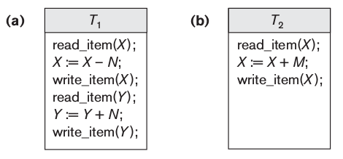
Why Concurrency Control Is Needed
We illustrate some of these problems by referring to a much simplified airline reservations database in which a record is stored for each airline flight.
Each record includes the number of reserved seats on that flight as a named data item, among other information.
Figure (a) below shows a transaction T1 that transfers N reservations from one flight whose number of reserved seats is stored in the database item named X to another flight whose number of reserved seats is stored in the database item named Y.
Figure (b) below shows a simpler transaction T2 that just reserves M seats on the first flight (X) referenced in transaction T1.

Slide 3
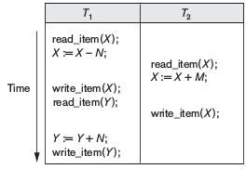
The Lost Update Problem.
Suppose that transactions T1 and T2 are submitted at approximately the same time, and suppose that their operations are interleaved as shown in Figure below;
Then the final value of item X is incorrect because T2 reads the value of X before T1 changes it in the database, and hence the updated value resulting from T1 is lost.

Slide 4
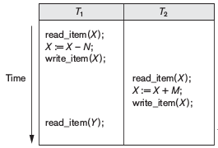
The Temporary Update (or Dirty Read) Problem
This problem occurs when one transaction updates a database item and then the transaction fails for some reason.
Meanwhile, the updated item is accessed (read) by another transaction before it is changed back to its original value.

Slide 5
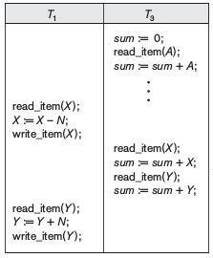
The Incorrect Summary Problem.
If one transaction is calculating an aggregate summary function on a number of database items while other transactions are updating some of these items, the aggregate function may calculate some values before they are updated and others after they are updated.

Slide 6
The Unrepeatable Read Problem.
Another problem that may occur is called unrepeatable read, where a transaction T reads the same item twice and the item is changed by another transaction T_{Ј} between the two reads.
This may occur, for example, if during an airline reservation transaction, a customer inquires about seat availability on several flights.
When the customer decides on a particular flight, the transaction then reads the number of seats on that flight a second time before completing the reservation, and it may end up reading a different value for the item.

Slide 7
Desirable Properties of Transactions
Transactions should possess several properties, often called the ACID properties; The following are the ACID properties:
The atomicity property requires that we execute a transaction to completion. A database program should be written in a way that guarantees that, if the database is in a consistent state before executing the transaction, it will be in a consistent state after the complete execution of the transaction.
The isolation property is enforced by the concurrency control subsystem of the DBMS. If every transaction does not make its updates (write operations) visible to other transactions until it is committed.
And last, the durability property is the responsibility of the recovery subsystem of the DBMS.

Slide 8
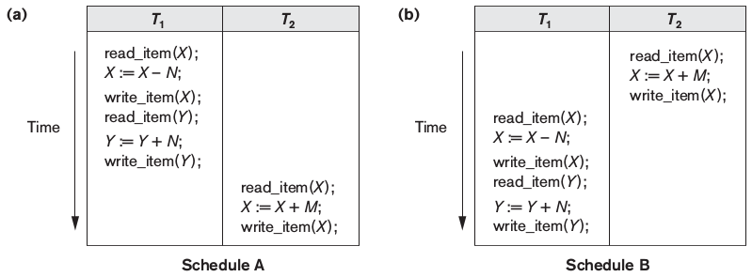
Characterizing Schedules Based on Serializability
Suppose that two users—for example, two airline reservations agents—submit to the DBMS transactions T1 and T2 at approximately the same time. If no interleaving of operations is permitted, there are only two possible outcomes:
Execute all the operations of transaction T1(in sequence) followed by all the operations of transaction T2 (in sequence).
Execute all the operations of transaction T2(in sequence) followed by all the operations of transaction T1(in sequence).
These two schedules—called serial schedules—are shown in Figure (a) and (b) below, respectively.

Slide 9
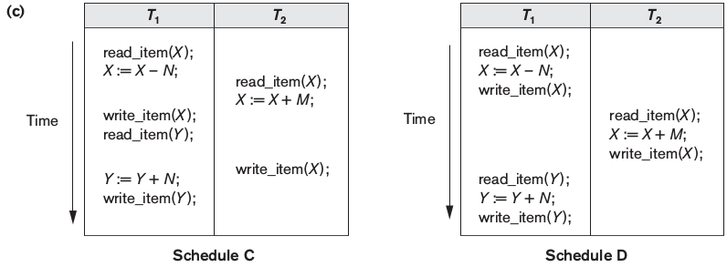
Serial, Nonserial, and Conflict-Serializable Schedules
Schedules C and D in Figure (c) are called nonserial because each sequence interleaves operations from the two transactions.
The problem with serial schedules is that they limit concurrency by prohibiting interleaving of operations. In a serial schedule, if a transaction waits for an I/O operation to complete, we cannot switch the CPU to another transaction, thus wasting valuable CPU processing time. Hence, serial schedules are considered unacceptable in practice.

Slide 10
Schedule C gives an erroneous result because of the lost update problem;
However, some non-serial schedules give the correct expected result, such as schedule D.
We would like to determine which of the non-serial schedules always give a correct result and which may give erroneous results.
The concept used to characterize schedules in this manner is that of serializability of a schedule.
The definition of serializable schedule is as follows: A schedule S of n transactions is serializable if it is equivalent to some serial schedule of the same n transactions.

Slide 11
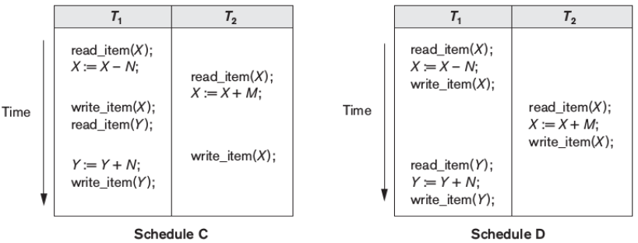
consider the schedules in Figure above, and assume that the initial values of database items are X = 90 and Y = 90 and that N = 3 and M = 2.
After executing transactions T1 and T2, we would expect the database values to be X = 89 and Y = 93, according to the meaning of the transactions.
Executing either of the serial schedules A or B gives the correct results.
Now consider the non-serial schedules C and D. Schedule C gives the results X = 92 and Y = 93, in which the X value is erroneous, whereas schedule D gives the correct results.

Slide 12
Two definitions of equivalence of schedules are generally used: conflict equivalence and view equivalence.
The definition of conflict equivalence of schedules is as follows: Two schedules are said to be conflict equivalent if the order of any two conflicting operations is the same in both schedules.
Using the notion of conflict equivalence, we define a schedule S to be conflict serializable if it is (conflict) equivalent to some serial schedule SJ.
In such a case, we can reorder the non-conflicting operations in S until we form the equivalent serial schedule S_{J}.

Slide 13
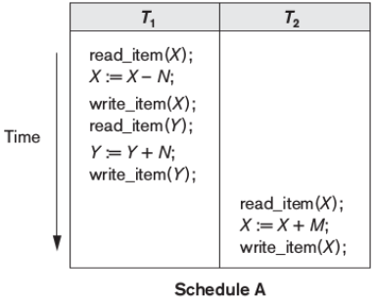
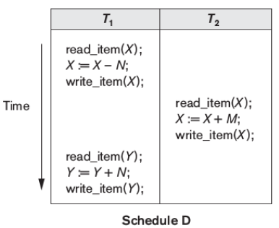
According to this definition, schedule D above is equivalent to the serial schedule A in Figure.
In both schedules, the read_item(X) of T2 reads the value of X written by T1, while the other read_item operations read the database values from the initial database state.
Additionally, T1 is the last transaction to write Y, and T2 is the last transaction to write X in both schedules. Because A is a serial schedule and schedule D is equivalent to A, D is a serializable schedule.
Notice that the operations r1(Y) and w1(Y) of schedule D do not conflict with the operations r2(X) and w2(X), since they access different data items.
Therefore, we can move r1(Y), w1(Y) before r2(X), w2(X), leading to the equivalent serial schedule T1, T2.

Slide 14
Testing for Conflict Serializability of a Schedule
Algorithm can be used to test a schedule for conflict serializability. The algorithm looks at only the read_item and write_item operations in a schedule to construct a precedence graph (or serialization graph), which is a directed graph G = (N, E)
Algorithm Testing Conflict Serializability of a Schedule S
For each transaction T_{i} participating in schedule S, create a node labeled T_{i} in the precedence graph.
For each case in S where T_{j} executes a read_item(X) after T_{i} executes a write_item(X), create an edge (Ti → Tj ) in the precedence graph.
For each case in S where Tj executes a write_item(X) after Ti executes a read_item(X), create an edge (Ti → Tj) in the precedence graph.
For each case in S where Tj executes a write_item (X) after Ti executes a write_item(X), create an edge (Ti → Tj) in the precedence graph.
The schedule S is serializable if and only if the precedence graph has no cycles.

Slide 15
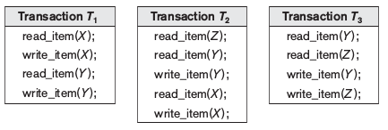
Another example, in which three transactions participate, is shown in Figure above. Figure shows the read_item and write_item operations in each transaction.

Slide 16
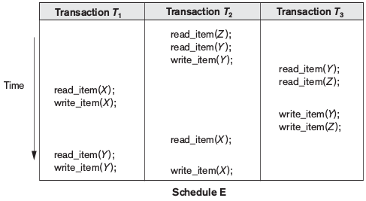
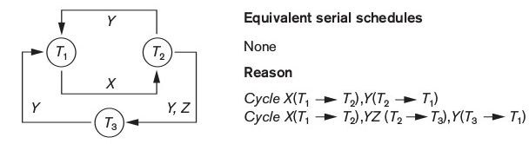

Slide 17
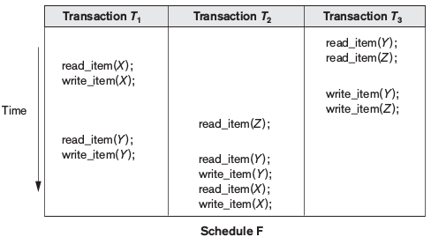
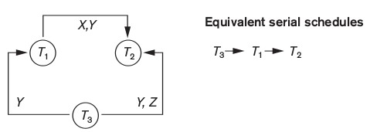

Slide 18
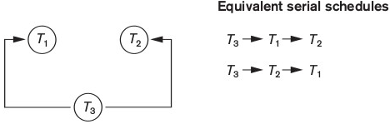
Figure below shows a precedence graph representing a schedule that has two equivalent serial schedules.
To find an equivalent serial schedule, start with a node that does not have any incoming edges, and then make sure that the node order for every edge is not violated.

Slide 19
Two-Phase Locking Techniques for Concurrency Control
Binary Locks
A binary lock can have two states or values: locked and unlocked (or 1 and 0)
A distinct lock is associated with each database item X. If the value of the lock on X is 1, item X cannot be accessed by a database operation that requests the item.
If the value of the lock on X is 0, the item can be accessed when requested, and the lock value is changed to 1.
We refer to the current value (or state) of the lock associated with item X as lock(X). Two operations, lock_item and unlock_item, are used with binary locking.

Slide 20
lock_item(X):
B:if LOCK(X) = 0 (* item is unlocked *)
then LOCK(X) ← 1 (* lock the item *)
else
begin
wait (until LOCK(X) = 0
and the lock manager wakes up thetransaction);
go to B
end;
unlock_item(X):
LOCK(X) ← 0; (* unlock the item *)
if any transactions are waiting
then wakeup one of the waiting transactions;

Slide 21
Shared/Exclusive (or Read/Write) Locks
We should allow several transactions to access the same item X if they all access X for reading purposes only.
However, if a transaction is to write an item X, it must have exclusive access to X.
In this scheme—called shared/exclusive or read/write locks—there are three locking operations: read_lock(X), write_lock(X), and unlock(X).
A lock associated with an item X, LOCK(X), now has three possible states: read-locked, write-locked, or unlocked.

Slide 22
read_lock(X):
B: if LOCK(X) = “unlocked”
then begin
LOCK(X) ← “read-locked”;
no_of_reads(X) ← 1
end
else if LOCK(X) = “read-locked”
then no_of_reads(X) ← no_of_reads(X) + 1
else begin
wait (until LOCK(X) = “unlocked”
and the lock manager wakes up the transaction);
go to B
end;

Slide 23
write_lock(X):
B: if LOCK(X) = “unlocked”
then LOCK(X) ← “write-locked”
else begin
wait (until LOCK(X) = “unlocked” and the lock manager wakes up the transaction);
go to B
end;
unlock (X):
if LOCK(X) = “write-locked”
then begin LOCK(X) ← “unlocked”;
wakeup one of the waiting transactions, if any
end
else if LOCK(X) = “read-locked”
then begin
no_of_reads(X) ← no_of_reads(X) −1;
if no_of_reads(X) = 0
then begin LOCK(X) = “unlocked”;
wakeup one of the waiting transactions, if any
end
end;

Slide 24
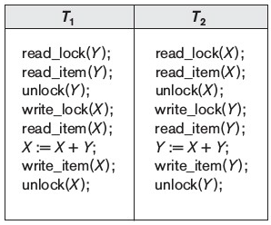
Guaranteeing Serializability by Two-Phase Locking
A transaction is said to follow the two-phase locking protocol if all locking operations (read_lock, write_lock) precede the first unlock operation in the transaction.
Such a transaction can be divided into two phases: an expanding or growing (first) phase, during which new locks on items can be acquired but none can be released; and a shrinking (second) phase, during which existing locks can be released but no new locks can be acquired.
Transactions T1 and T2 in Figure below do not follow the two-phase locking protocol because the write_lock(X) operation follows the unlock(Y) operation in T1, and similarly the write_lock(Y) operation follows the unlock(X) operation in T2.

Slide 25
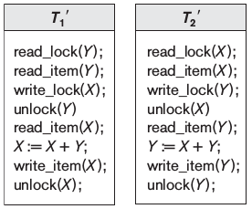
Transactions T1' and T2‘ are same as T1 and T2, but follow two-phase locking protocol.
It can be proved that, if every transaction in a schedule follows the two-phase locking protocol, the schedule is guaranteed to be serializable.
The locking protocol, by enforcing two phase locking rules, also enforces serializability.

Slide 26
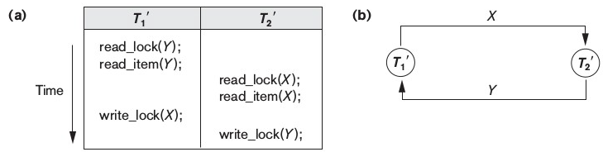
Dealing with Deadlock and Starvation
Deadlock occurs when each transaction T in a set of two or more transactions is waiting for some item that is locked by some other transaction T_{Ј} in the set.
A simple example is shown in Figure (a), where the two transactions T1'and T2' are deadlocked; T1' is in the waiting queue for X, which is locked by T2', while T2' is in the waiting queue for Y, which is locked by T1'.
Meanwhile, neither T1' nor T2' nor any other transaction can access items X and Y.

Slide 27
Deadlock Prevention Protocols
One deadlock prevention protocol, which is used in conservative two phase locking, requires that every transaction lock all the items it needs in advance—if any of the items cannot be obtained, none of the items are locked.
Some of these techniques use the concept of transaction timestamp TS(T), if transaction T1 starts before transaction T2, then TS(T1) < TS(T2).
Notice that the older transaction (which starts first) has the smaller timestamp value. Two schemes that prevent deadlock are called wait-die and wound- wait.
Wait-die. If TS(Ti) < TS(Tj), then Ti is allowed to wait; otherwise abort Ti (Ti dies) and restart it later with the same timestamp.
Wound-wait. If TS(Ti) < TS(Tj), then abort Tj and restart it later with the same timestamp; otherwise (Ti younger than Tj) Ti is allowed to wait.

Slide 28
Another group of protocols that prevent deadlock do not require timestamps. These include the no waiting (NW) and cautious waiting (CW) algorithms.
In the no waiting algorithm, if a transaction is unable to obtain a lock, it is immediately aborted and then restarted after a certain time delay without checking whether a deadlock will actually occur or not.
The cautious waiting algorithm was proposed to try to reduce the number of needless aborts/restarts.
Suppose that transaction Ti tries to lock an item X but is not able to do so because X is locked by some other transaction Tj with a conflicting lock. The cautious waiting rules are as follows:
If Tj is not blocked (not waiting for some other locked item), then Ti is blocked and allowed to wait; otherwise abort Ti.

Slide 29
Deadlock Detection
A simple way to detect a state of deadlock is for the system to construct and maintain a wait-for graph.
One node is created in the wait-for graph for each transaction that is currently executing.
Whenever a transaction Ti is waiting to lock an item X that is currently locked by a transaction Tj, a directed edge (Ti → Tj) is created in the wait-for graph.
We have a state of deadlock if and only if the wait-for graph has a cycle.
One problem with this approach is the matter of determining when the system should check for a deadlock.

Slide 30
Timeouts
Another simple scheme to deal with deadlock is the use of timeouts. In this method, if a transaction waits for a period longer than a system-defined timeout period, the system assumes that the transaction may be deadlocked and aborts it—regardless of whether a deadlock actually exists or not.
Starvation
Another problem that may occur when we use locking is starvation, which occurs when a transaction cannot proceed for an indefinite period of time
while other transactions in the system continue normally. This may occur if the waiting scheme for locked items is unfair, giving priority to some transactions over others.

