Slide 1


Connecting Smart Objects
Module 2

Slide 2
Connecting Smart Objects
IoT devices and sensors must be connected to the network
for their data to be utilized.
In addition to the wide range of sensors, actuators, and smart objects that make up IoT, there are also a number of different protocols used to connect them

Slide 3
COMMUNICATIONS CRITERIA
The characteristics and attributes you should consider when selecting and dealing with connecting smart objects
Range
Frequency Bands:
Power Consumption:
Topology
Constrained Devices:
Constrained-Node Networks:

Slide 4
Range
How far does the signal need to be propagated?
That is, what will be the area of coverage for a selected wireless technology?
Should indoor versus outdoor deployments be differentiated?

Slide 5
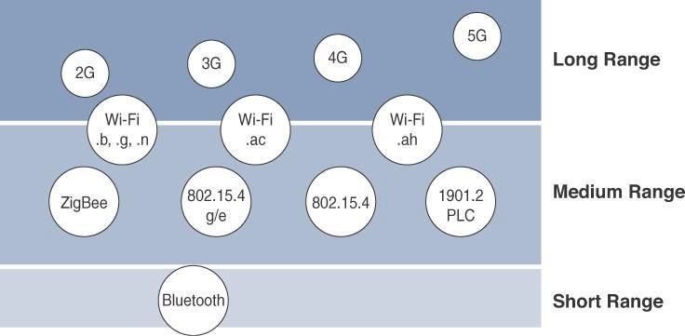

Slide 6
Short range:
The classical wired example is a serial cable.
Wireless short-range technologies are often considered as an alternative to a serial cable, supporting tens of meters of maximum distance between two devices.
Examples of short-range wireless technologies are IEEE
802.15.1 Bluetooth and IEEE 802.15.7 Visible Light
Communications (VLC)

Slide 7
Medium range:
This range is the main category of IoT access technologies.
In the range of tens to hundreds of meters, many specifications and implementations are available.
The maximum distance is generally less than 1 mile
between two devices
Examples of medium-range wireless technologies include IEEE 802.11 Wi-Fi, IEEE 802.15.4, and 802.15.4g WPAN.
Wired technologies such as IEEE 802.3 Ethernet and IEEE
1901.2 Narrowband Power Line Communications (PLC)

Slide 8
Long range:
Distances greater than 1 mile between two devices require
long-range technologies.
Wireless examples are cellular (2G, 3G, 4G) and some applications of outdoor IEEE 802.11 Wi-Fi and Low-Power Wide-Area (LPWA) technologies.
LPWA communications have the ability to communicate over a large area without consuming much power. These technologies are therefore ideal for battery-powered IoT sensors

Slide 9
Frequency Bands
Radio spectrum is regulated by countries and/or organizations, such as the International Telecommunication Union (ITU) and the Federal Communications Commission (FCC).
These groups define the regulations and transmission requirements for various frequency bands
For example, portions of the spectrum are allocated to types of telecommunications such as radio, television, military, and so on.

Slide 10
Focusing on IoT access technologies, the frequency bands leveraged by wireless communications are split between licensed and unlicensed bands.
Licensed spectrum is generally applicable to IoT long- range access technologies
In order to utilize licensed spectrum, users must subscribe
to services when connecting their IoT devices
In exchange for the subscription fee, the network operator can guarantee the exclusivity of the frequency usage over the target area and can therefore sell a better guarantee of service.

Slide 11
The ITU has also defined unlicensed spectrum for the industrial,
scientific, and medical (ISM) portions of the radio bands.
These frequencies are used in many communications
technologies for short-range devices (SRDs).
Unlicensed means that no guarantees or protections are
offered in the ISM bands for device communications
ISM bands for IoT access
2.4 GHz band as used by IEEE 802.11b/g/n Wi-Fi
IEEE 802.15.1 Bluetooth
IEEE 802.15.4 WPAN

Slide 12
Unlicensed spectrum is usually simpler to deploy than
licensed because it does not require a service provider.
However, it can suffer from more interference because other devices may be competing for the same frequency in a specific area
The frequency of transmission directly impacts how a signal propagates and its practical maximum range.

Slide 13
Power Consumption
Powered nodes and battery-powered nodes
A powered node has a direct connection to a power source, and communications are usually not limited by power consumption criteria.
However, ease of deployment of powered nodes is limited by the availability of a power source, which makes mobility more complex
Battery-powered nodes bring much more flexibility to IoT devices.
These nodes are often classified by the required lifetimes
of their batteries.

Slide 14
For
battery-powered
nodes,
IoT wireless
access
power
technologies must address the needs of low
consumption and connectivity
A new wireless environment known as Low-Power Wide- Area (LPWA)
Battery-powered nodes are often placed in a “sleep mode”
to preserve battery life when not transmitting
Wired IoT access technologies consisting of powered nodes
are not exempt from power optimization

Slide 15
Topology
Among the access technologies available for connecting IoT devices, three main topology schemes are dominant: star, mesh, and peer-to-peer
For long-range and short-range technologies, a star topology is prevalent
Star topologies utilize a single central base station or controller to
allow communications with endpoints
For medium-range technologies, a star, peer-to-peer, or mesh topology is common
Peer-to-peer topologies allow any device to communicate with any other device as long as they are in range of each other

Slide 16
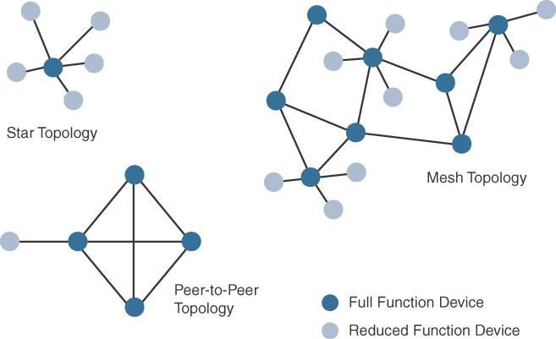
Ex: Indoor Wi-Fi deployments and Outdoor Wi-Fi deployments

Slide 17
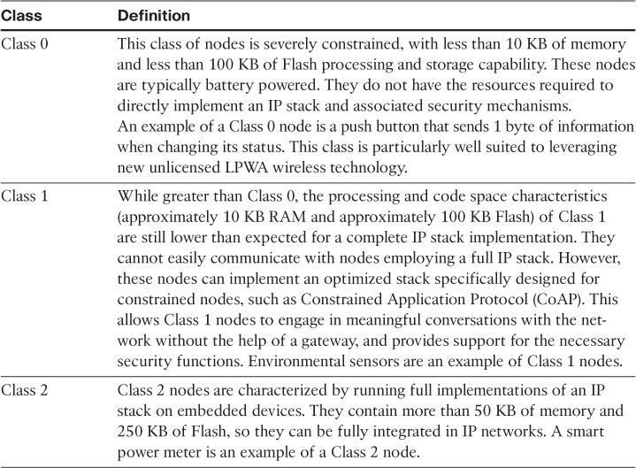
Constrained Devices

Slide 18
Constrained-Node Networks
 IEEE 802.15.4 and 802.15.4g RF, IEEE 1901.2a PLC,
LPWA, and IEEE 802.11ah access technologies
Constrained-node networks are often referred to as
low-power and lossy networks (LLNs).
Low power – battery powered constraints
Lossy network -- network performance may suffer from interference and variability due to harsh radio environments
Protocols that can be used for constrained-node networks must be evaluated in the context of the following characteristics: data rate and throughput, latency and determinism, and overhead and payload.

Slide 19
Data Rate and Throughput
The data rates available from IoT access technologies range from 100 bps with protocols such as Sigfox to tens of megabits per second with technologies such as LTE and IEEE 802.11ac
However, the actual throughput is less
Therefore, understanding the bandwidth requirements of a particular technology, its applicability to given use cases, the capacity planning rules, and the expected real throughput are important for proper network design and successful production deployment

Slide 20
Technologies not particularly designed for IoT, such as cellular and Wi-Fi, match up well to IoT applications with high bandwidth requirements
For example, nodes involved with video analytics have a need for high data rates, IoT endpoints are not constrained in terms of computing or network bandwidth, the design guidelines tend to focus on application requirements, such as latency and determinism

Slide 21
Short-range technologies can also provide medium to high data rates that have enough throughput to connect a few endpoints.
For example, Bluetooth sensors that are now appearing on connected wearables fall into this category.
In this case, the solutions focus more on footprint and battery lifetime than on data rate.
The IoT access technologies developed for constrained nodes are optimized for low power consumption, but they are also limited in terms of data rate

Slide 22
Another characteristic of IoT devices is that a majority of
them initiate the communication.
Upstream traffic toward an application server is usually more common than downstream traffic from the application server.
Understanding this behavior also helps when deploying an IoT access technology, such as cellular, that is asymmetrical because the upstream bandwidth must be considered a key parameter for profiling the network capacity

Slide 23
Latency and Determinism
Latency expectations of IoT applications should be known
when selecting an access technology
This is particularly true for wireless networks, where packet loss and retransmissions due to interference, collisions, and noise are normal behaviors
On constrained networks, latency may range from a few milliseconds to seconds, and applications and protocol stacks must cope with these wide-ranging values

Slide 24
Overhead and Payload
When considering constrained access network technologies, it is important to review the MAC payload size characteristics required by applications
You should be aware of any requirements for IP.
The minimum IPv6 MTU size is expected to be 1280 bytes.
Therefore, the fragmentation of the IPv6 payload has to be taken into account by link layer access protocols with smaller MTUs

Slide 25
IoT Access Technologies
The following topics are addressed for each
IoT access technology:
Standardization and alliances:
The standards bodies that maintain the protocols for a technology
Physical layer:
The wired or wireless methods and relevant frequencies
MAC layer:
Considerations at the Media Access Control (MAC) layer, which bridges the physical layer with data link control
Topology:
The topologies supported by the technology
Security:
Security aspects of the technology
Competitive technologies:
Other technologies that are similar and may be suitable alternatives to the given technology

Slide 26
IoT Access Technologies
 IEEE 802.15.4
 IEEE 802.15.4g and 802.15.4e
 IEEE 1901.2a
IEEE 802.11ah
LoRaWAN
NB-IoT and other LTE Variations

Slide 27
IEEE 802.15.4
Wireless access technology for low-cost and low-data-rate devices that are powered or run on batteries
This access technology enables easy installation while
remaining both simple and flexible
IEEE 802.15.4 is commonly found in the following types
of deployments:
Home and building automation
Automotive networks
Industrial wireless sensor networks
Interactive toys and remote controls

Slide 28
Drawbacks of this includes MAC reliability, unbounded latency,
and susceptibility to interference and multipath fading
The negatives around reliability and latency often have to do with the Collision Sense Multiple Access/Collision Avoidance (CSMA/CA) algorithm.
CSMA/CA is an access method in which a device “listens” to make sure no other devices are transmitting before starting its own transmission.
If another device is transmitting, a wait time (which is usually
random) occurs before “listening” occurs again

Slide 29
Standardization and Alliances
IEEE 802.15.4 or IEEE 802.15 Task Group 4 defines low- data-rate PHY and MAC layer specifications for wireless personal area networks (WPAN).
This is a well-known solution for low complexity wireless devices with low data rates that need many months or even years of battery life.
 IEEE 802.15.4-2003 , 802.15.4-2006 , 802.15.4-2011 and
802.15.4-2015

Slide 30
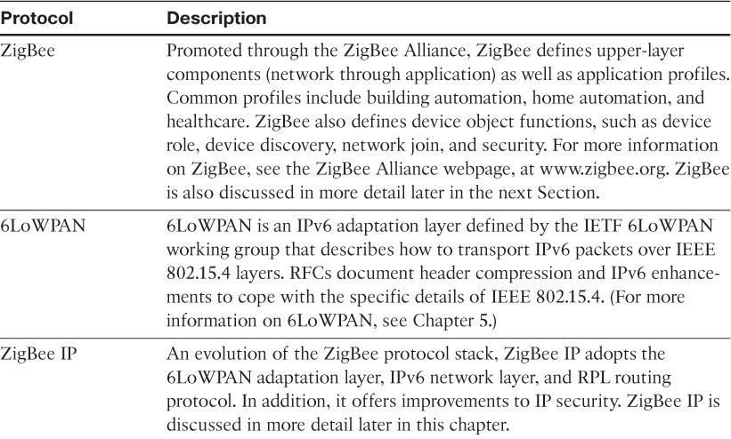
Protocol Stacks Utilizing IEEE 802.15.4

Slide 31
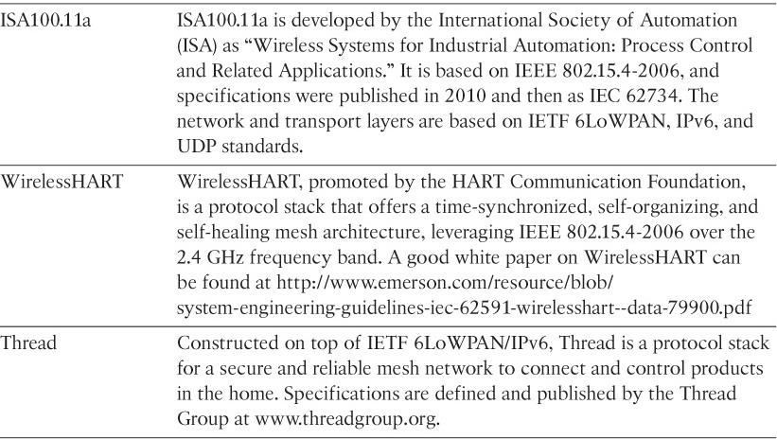

Slide 32
ZigBee
ZigBee solutions are aimed at smart objects and sensors that have low bandwidth and low power needs.
Furthermore, products that are ZigBee compliant and certified by the ZigBee Alliance should interoperate even though different vendors may manufacture them
The Zigbee specification has undergone several revisions.
In the 2006 revision, sets of commands and message types were introduced, and increased in number in the 2007 (called Zigbee pro) iteration, to achieve different functions for a device, such as metering, temperature, or lighting control

Slide 33
The main areas where ZigBee is the most well-known include automation for commercial, retail, and home applications and smart energy
In the industrial and commercial automation space, ZigBee- based devices can handle various functions, from measuring temperature and humidity to tracking assets.
For home automation, ZigBee can control lighting, ZigBee Smart Energy brings together a variety of interoperable products, such as smart meters, that can monitor and control the use and delivery of utilities, such as electricity and water

Slide 34
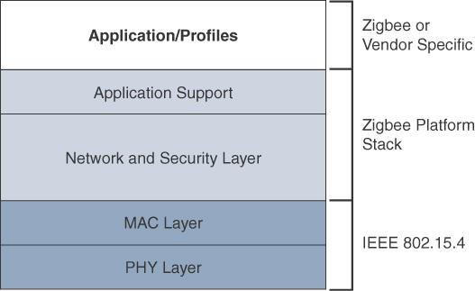
The traditional ZigBee stack

Slide 35
The ZigBee network and security layer provides
mechanisms for network startup, configuration, routing, and securing communications.
This includes calculating routing paths in what is often a changing topology, discovering neighbors, and managing the routing tables as devices join for the first time.
The network layer is also responsible for forming the appropriate topology, which is often a mesh but could be a star or tree as well.
From a security perspective, ZigBee utilizes 802.15.4 for security at the MAC layer, using the Advanced Encryption Standard (AES) with a 128-bit key and also provides security at the network and application layers.

Slide 36
ZigBee uses Ad hoc On-Demand Distance Vector
(AODV) routing across a mesh network.
Interestingly, this routing algorithm does not send a message until a route is needed.
Assuming that the next hop for a route is not in its routing table, a network node broadcasts a request for a routing connection.
This causes a burst of routing related traffic, but after a comparison of various responses, the path with the lowest number of hops is determined for the connection.

Slide 37
The application support layer interfaces the lower
portion of the stack dealing with the networking of ZigBee devices
with the higher-layer applications.
ZigBee predefines many application profiles for certain industries, and vendors can optionally create their own custom ones at this layer.
As mentioned previously, Home Automation and Smart
Energy are two examples of popular application profiles.

Slide 38
ZigBee IP
With the introduction of ZigBee IP, the support of IEEE
802.15.4 continues, but the IP and TCP/UDP protocols and various other open standards are now supported at the network and transport layers.
The ZigBee-specific layers are now found only at the top of
the protocol stack for the applications

Slide 39
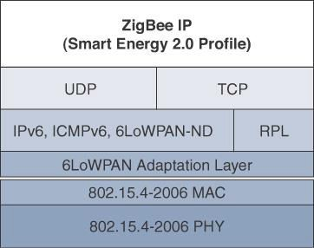
The ZigBee IP stack

Slide 40
ZigBee IP supports 6LoWPAN as an adaptation layer.
The 6LoWPAN mesh addressing header is not required as ZigBee IP utilizes the mesh-over or route-over method for forwarding packets.
ZigBee IP requires the support of 6LoWPAN’s fragmentation and
header compression schemes.
At the network layer, all ZigBee IP nodes support IPv6, ICMPv6, and 6LoWPAN Neighbor Discovery (ND), and utilize RPL for the routing of packets across the mesh network.
Both TCP and UDP are also supported, to provide both
connection-oriented and connectionless service.

Slide 41
Physical Layer
The 802.15.4 standard supports an extensive number of PHY options that range from 2.4 GHz to sub-GHz frequencies in ISM bands
The original IEEE 802.15.4-2003 standard specified only three PHY options based on direct sequence spread spectrum (DSSS) modulation.
DSSS is a modulation technique in which a signal is intentionally spread in the frequency domain, resulting in greater bandwidth.

Slide 42
Modulation
In the modulation process, some parameter of the carrier wave (such as amplitude, frequency or phase ) is varied in accordance with the modulating signal .This modulated signal is then transmitted by the transmitter
In the modulation process, two signals are used namely the
modulating signal and the carrier
The modulating signal is nothing but the baseband signal or information signal while the carrier is a high frequency sinusoidal signal

Slide 43
Advantages of Modulation
Reduction in the height of antenna
Avoids mixing of signals
Increases the range of communication
Multiplexing is possible
Improves quality of reception

Slide 44

For the transmission of radio signals, the antenna height must
be multiple of λ/4 ,where λ is the wavelength .
λ = c /f
where c : is the velocity of light

f: is the frequency of the signal to be transmitted
The minimum antenna height required to transmit a baseband signal of f = 10 kHz is calculated as follows :

Slide 45
The original physical layer transmission options were as
follows:
2.4 GHz, 16 channels, with a data rate of 250 kbps
915 MHz, 10 channels, with a data rate of 40 kbps
868 MHz, 1 channel, with a data rate of 20 kbps
 IEEE 802.15.4-2006, 802.15.4- 2011, and IEEE 802.15.4-
2015 introduced additional PHY communication options, including the following:

Slide 46
OQPSK PHY:
This is DSSS PHY, employing offset quadrature phase shift keying (OQPSK) modulation. OQPSK is a modulation technique that uses four unique bit values that are signalled by phase changes.
An offset function that is present during phase shifts allows data to be transmitted more reliably.

Slide 47
BPSK PHY:
This is DSSS PHY, employing binary phase-shift keying (BPSK) modulation.
BPSK specifies two unique phase shifts as its data encoding
scheme.
ASK PHY:
This is parallel sequence spread spectrum (PSSS) PHY, employing amplitude shift keying (ASK) and BPSK modulation.
PSSS is an advanced encoding scheme that offers increased range,
throughput, data rates, and signal integrity compared to DSSS.
ASK uses amplitude shifts instead of phase shifts to signal different bit values

Slide 48
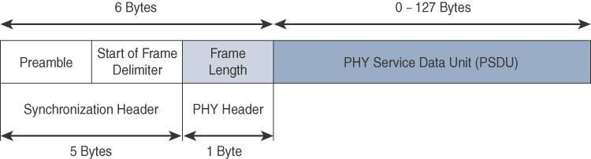
The frame for the 802.15.4 physical layer
The synchronization header for this frame is composed of the
Preamble and the Start of Frame Delimiter fields
The Preamble field is a 32-bit 4-byte pattern that identifies the start of the frame and is used to synchronize the data transmission
The Start of Frame Delimiter field informs the receiver that frame
contents start immediately after this byte

Slide 49
The PHY Header portion of the PHY frame is frame length
value. It lets the receiver know how much total data to
expect in the PHY service data unit (PSDU) portion of the
802.4.15 PHY.
The PSDU is the data field or payload

Slide 50
MAC Layer
At this layer, the scheduling and routing of data frames are
coordinated
The 802.15.4 MAC layer performs the following tasks:
Device security
Reliable link communications between two peer MAC
entities

Slide 51
The MAC layer achieves these tasks by using various predefined
frame types
Four types of MAC frames are specified in 802.15.4:
Data frame:
Handles all transfers of data
Beacon frame:
Used in the transmission of beacons from a PAN coordinator
Acknowledgement frame:
Confirms the successful reception of a frame
MAC command frame:
Responsible for control communication between devices

Slide 52
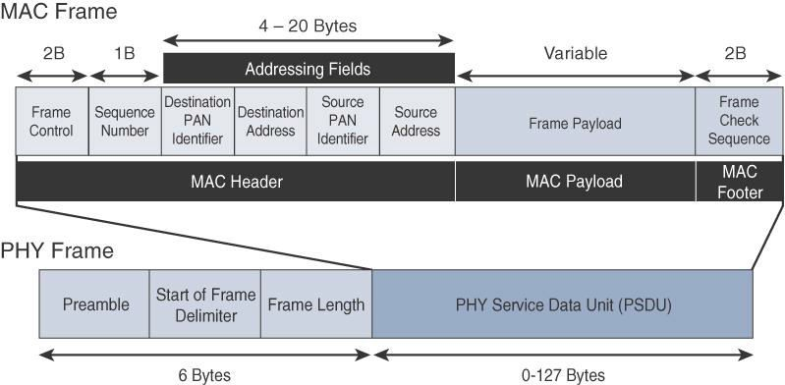
IEEE 802.15.4 MAC Format

Slide 53
The MAC Header field is composed of the Frame Control,
Sequence Number and the Addressing fields.
The Frame Control field defines attributes such as frame type, addressing modes, and other control flags.
The Sequence Number field indicates the sequence identifier for the frame.
The Addressing field specifies the Source and Destination PAN Identifier fields as well as the Source and Destination Address fields
Notes:
Frame type: management ,control,Data Extension Frames.

Slide 54
The MAC Payload field varies by individual frame type.
For example, beacon frames have specific fields and payloads related to beacons.
The MAC Footer field is nothing more than a frame check sequence (FCS).
An FCS is a calculation based on the data in the frame that is used by the receiving side to confirm the integrity of the data in the frame.
Notes:
PAN:personel ar

Slide 55
IEEE 802.15.4 requires all devices to support a unique 64-bit
extended MAC address, based on EUI-64.
However, because the maximum payload is 127 bytes,
802.15.4 also defines how a 16-bit “short address” is assigned
to devices.
This short address is local to the PAN and substantially reduces the frame overhead compared to a 64-bit extended MAC address

Slide 56
Topology
IEEE 802.15.4–based networks can be built as star, peer-to-
peer, or mesh topologies.
Mesh networks tie together many nodes.
This allows nodes that would be out of range if trying to communicate directly to leverage intermediary nodes to transfer communications.
Every 802.15.4 PAN should be set up with a unique ID.
All the nodes in the same 802.15.4 network should use the
same PAN ID
Notes:
Lr-wpan:- low range personel area network .

Slide 57
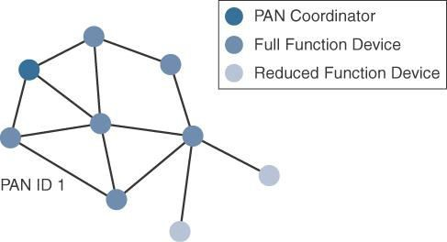

Slide 58
A minimum of one FFD acting as a PAN coordinator is required to deliver services that allow other devices to associate and form a cell or PAN.
A single PAN coordinator is identified for PAN ID 1.
FFD devices can communicate with any other devices, whereas RFD devices can communicate only with FFD devices.

Slide 59
The IEEE 802.15.4 specification does not define a path
selection within the MAC layer for a mesh topology.
This function can be done at Layer 2 and is known as mesh- under.
The routing function can occur at Layer 3, using a routing protocol, such as the IPv6 Routing Protocol for Low Power and Lossy Networks (RPL).
This is referred to as mesh-over

Slide 60
Security
The IEEE 802.15.4 specification uses Advanced Encryption Standard (AES) with a 128-bit key length as the base encryption algorithm for securing its data
symmetric key - means that the same key is used for both the encryption and decryption of the data
In addition to encrypting the data, AES in 802.15.4 also validates the data that is sent.
This is accomplished by a message integrity code (MIC), which is calculated for the entire frame using the same AES key that is used for encryption

Slide 61
Using the Security Enabled field in the Frame Control portion of the 802.15.4 header is the first step to enabling AES encryption.
This field is a single bit that is set to 1 for security.
Once this bit is set, a field called the Auxiliary Security Header is created after the Source Address field, by stealing some bytes from the Payload field.

Slide 62
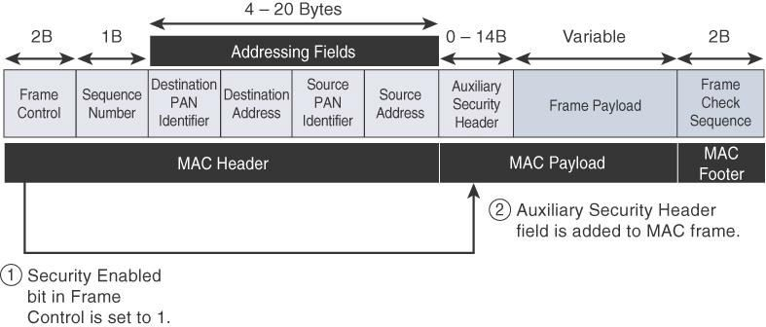
Frame Format with the Auxiliary Security Header Field for 802.15.4- 2006 and Later Versions

Slide 64
LoRaWAN
Low-Power Wide-Area (LPWA) adapted for long-range and
battery powered endpoints
LoRaWAN is unlicensed-band LPWA technology
LoRa was a physical layer, or Layer 1, modulation that was developed by a French company named Cycleo
Later, Cycleo was acquired by Semtech
Optimized for long-range, two-way communications and low power consumption

Slide 65
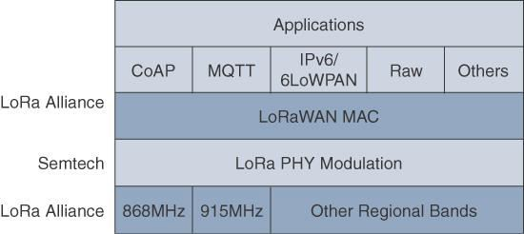
LoRaWAN Layers
Notes:
Constrained application protocol ,MQTT captures wireless sensor traffic

Slide 66
Physical Layer
Semtech LoRa modulation is based on chirp spread spectrum
modulation
Chirp - Compressed High Intensity Radar Pulse
Lower data rate and increase the communication distance

Slide 67
Understanding LoRa gateways is critical to understanding a
LoRaWAN system.
A LoRa gateway is deployed as the center hub of a star network architecture.
It uses multiple transceivers and channels and can demodulate multiple channels at once or even demodulate multiple signals on the same channel simultaneously.
LoRa gateways serve as a transparent bridge relaying data between endpoints, and the endpoints use a single-hop wireless connection to communicate with one or many gateways.

Slide 68
The data rate in LoRaWAN varies depending on the frequency
bands and adaptive data rate (ADR).
ADR is an algorithm that manages the data rate and radio signal for each endpoint.
The ADR algorithm ensures that packets are delivered at the best data rate possible and that network performance is both optimal and scalable.
Endpoints close to the gateways with good signal values transmit with the highest data rate, which enables a shorter transmission time over the wireless network, and the lowest transmit power.
Meanwhile, endpoints at the edge of the link budget communicate
at the lowest data rate and highest transmit power.

Slide 69
An important feature of LoRa is its ability to handle various
data rates via the spreading factor.
Devices with a low spreading factor (SF) achieve less distance in their communications but transmit at faster speeds, resulting in less airtime.
A higher SF provides slower transmission rates but achieves a higher reliability at longer distances.

Slide 70
MAC Layer
The MAC layer is defined in the LoRaWAN specification.
This layer takes advantage of the LoRa physical layer and classifies LoRaWAN endpoints to optimize their battery life and ensure downstream communications to the LoRaWAN endpoints.
The LoRaWAN specification documents three classes of
LoRaWAN devices:
Class A:
This class is the default implementation. Optimized for battery powered nodes, it allows bidirectional communications, where a given node is able to receive downstream traffic after transmitting.
Two receive windows are available after each transmission

Slide 71
Class B:
A Class B node or endpoint should get additional receive windows compared to Class A, but gateways must be synchronized through a beaconing process.
Class C:
This class is particularly adapted for powered nodes.
This classification enables a node to be continuously listening
by keeping its receive window open when not transmitting.
Notes:
Gateway is a device that connects different networks by translating different protocols and data formats.

Slide 72

LoRaWAN messages, either uplink or downlink, have a PHY payload composed of a 1-byte MAC header, a variable-byte MAC payload, and a MIC that is 4 bytes in length.
The MAC payload size depends on the frequency band and the data rate, ranging from 59 to 230 bytes for the 863–870 MHz band and 19 to 250 bytes for the 902–928 MHz band
Notes:
Uplink ground to upeer layer and vice versa.
MAC header will consist of source and destination address.
Payload : packet or data sent by communicating end point

Slide 73
In version 1.0.x, LoRaWAN utilizes six MAC message types.
LoRaWAN devices use join request and join accept messages for activation and joining the network.
The other message types are unconfirmed data up/down and
confirmed data up/down.
A “confirmed” message is one that must be acknowledged, and “unconfirmed” signifies that the end device does not need to acknowledge.
“up/down” is simply a directional notation identifying whether the
message flows in the uplink or downlink path.
Uplink messages are sent from endpoints to the network server and are relayed by one or more LoRaWAN gateways.
Downlink messages flow from the network server to a single endpoint and are relayed by only a single gateway

Slide 74
LoRaWAN endpoints are uniquely addressable through a
variety of methods, including the following:
An endpoint can have a global end device ID or DevEUI represented as an IEEE EUI-64 address.
An endpoint can have a global application ID or AppEUI represented as an IEEE EUI-64 address that uniquely identifies the application provider, such as the owner, of the end device

Slide 75
In a LoRaWAN network, endpoints are also known by their
end device address, known as a DevAddr, a 32-bit address.
The 7 most significant bits are the network identifier (NwkID), which identifies the LoRaWAN network.
The 25 least significant bits are used as the network address (NwkAddr) to identify the endpoint in the network.

Slide 76
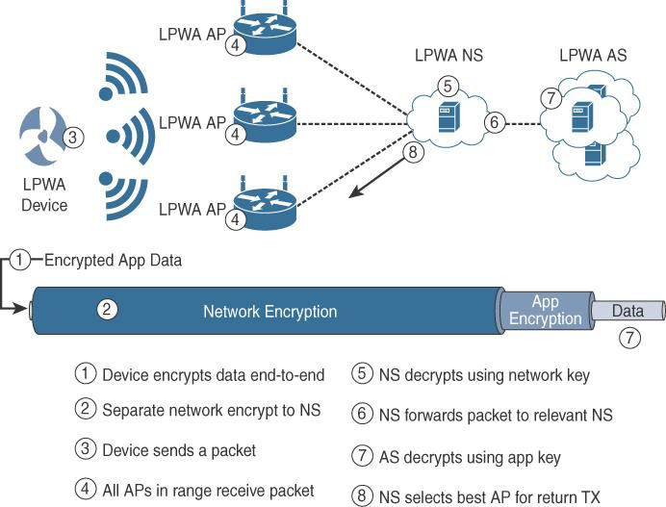
Security
Notes:
Network servers, application servers.

Slide 77
LoRaWAN endpoints must implement two layers of security, protecting communications and data privacy across the network.
The first layer, called “network security” but applied at the MAC layer, guarantees the authentication of the endpoints by the LoRaWAN network server.
Also, it protects LoRaWAN packets by performing encryption based on AES(advanced encryption standards)

Slide 78
Each endpoint implements a network session key (NwkSKey), used by both itself and the LoRaWAN network server.
The NwkSKey ensures data integrity through computing and checking the MIC of every data message as well as encrypting and decrypting MAC-only data message payloads
The second layer is an application session key (AppSKey), which performs encryption and decryption functions between the endpoint and its application server.
Notes:
Messege integrity check-checks for unauthorized changes to the content of the message also prevents attacks.

Slide 79
LoRaWAN endpoints attached to a LoRaWAN network must
get registered and authenticated.
This can be achieved through one of the two join mechanisms:
Activation by personalization (ABP):
Endpoints don’t need to run a join procedure as their individual details, including DevAddr and the NwkSKey and AppSKey session keys, are preconfigured and stored in the end device.
This same information is registered in the LoRaWAN
network server

Slide 80
Over-the-air activation (OTAA):
Endpoints are allowed to dynamically join a particular LoRaWAN
network after successfully going through a join procedure.
The join procedure must be done every time a session context is renewed.
During the join process, which involves the sending and receiving of MAC layer join request and join accept messages, the node establishes its credentials with a LoRaWAN network server, exchanging its globally unique DevEUI, AppEUI, and AppKey.
The AppKey is then used to derive the session NwkSKey and
AppSKey keys

Slide 81
NB-IoT and Other LTE Variations
Existing cellular technologies, such as GPRS, Edge, 3G, and 4G/LTE, are not particularly well adapted to battery- powered devices and small objects specifically developed for the Internet of Things
LTE -M
The new LTE-M device category was not sufficiently close to LPWA (low power wide area)capabilities
A new narrowband radio access technology called
Narrowband IoT (NB-IoT) It addresses the requirements of a massive number of low- throughput devices, low device power consumption, improved indoor coverage, and optimized network architecture
Notes:
Narrow band iot ,LTE long term evolution.LTE M long term evolution Machine type.

Slide 82
LTE Cat 0
The first enhancements to better support IoT devices in
3GPP(3rd generation partnership project) occurred in LTE Release 12.
A new user equipment (UE) category, Category 0, was added, with devices running at a maximum data rate of 1 Mbps
Category 0 includes important characteristics to be supported by both the network and end devices
Notes:
3GPP-3rd generation partnership project.

Slide 83
Cat 0 characteristics include the following .
Power saving mode (PSM)
This new device status minimizes energy consumption.
PSM is defined as being similar to “powered off ” mode, but the
device stays registered with the network.
By staying registered, the device avoids having to reattach or re- establish its network connection
When it wakes up, it initiates a tracking area update (TAU), after which it stays available for a configured time and then switches back to sleep mode or PSM.
A TAU is a procedure that an LTE device uses to let the network know its current tracking area, or the group of towers in the network from which it can be reached

Slide 84
Half-duplex mode
This mode reduces the cost and complexity of a device’s
implementation because a duplex filter is not needed.
Most IoT endpoints are sensors that send low amounts of data that do not have a full duplex communication requirement.

Slide 85
LTE-M
LTE Release 13
Lower receiver bandwidth
Bandwidth has been lowered to 1.4 MHz versus the usual 20
MHz.This further simplifies the LTE endpoint
Lower data rate
Data is around 200 kbps for LTE-M, compared to 1 Mbps for Cat 0.

Slide 86
Half-duplex mode
Just as with Cat 0, LTE-M offers a half-duplex mode that
decreases node complexity and cost
Enhanced discontinuous reception (eDRX)
This capability increases from seconds to minutes the amount
of time an endpoint can “sleep” between paging cycles

