Slide 1
Management
Chapter 1

Slide 2
Importance of Management
Formerly, the word “management” was used mostly in relation to circuses and restaurants.
By bringing together the four factors of production(viz., men, money, material and machines), management enables a country to experience a substantial level of economic development.
Peter Drucker rightly observes that without management, a country’s resources of production remain resources and never become production.
Principles of management are now universally used not just for managing business organizations; they are also applied to various other types of organizations, such as educational, social, military and government. Management is thus the same process in all forms of organization, although it may vary widely in its complexity with the size of the organization.
Management is the dynamic, life-giving element in every organization. It is this element that coordinates current organizational activities and plans future ones. It arbitrates disputes and provides leadership.

Slide 3
Definition of Management
It is difficult to define management. In fact, no definition of management has been universally accepted. One popular definition is by Mary Parker Follet. Management, she says, is the “art of getting things done through people.”
A manager is one who contributes to the organization’s goals indirectly by directing the efforts of others-not by performing the task himself.
Sometimes, however, a person in an organization may play both these rules
simultaneously. For e.g., a sales manager is performing a managerial role when he is directing his sales force to meet the organization’s goals, but when he himself is contacting a large customer and negotiating deal, he is performing a non- managerial role.
Two weaknesses of Mary Parker Follett’s definition are:
It uses the word “art” in defining management. To say that management is merely an art is to state a half-truth. Art deals with the application of knowledge.
Management is not merely application of knowledge. It also involves acquisition of knowledge i.e., science. Management based on rules of thumb or intuition is not correct management.
This definition does not throw light on the various functions of a manager.

Slide 4
A somewhat more elaborate definition of management is given by George R. He defines management as a process “consisting of planning, organizing, actuating and controlling, performed to determine and accomplish the objectives by the use of people and resources”.
The four management activities included in this process are: planning, organizing, actuating and controlling. Planning means that managers think of their actions in advance. Their actions are usually based on some method, plan, or logic, rather than on a hunch. Organizing means that managers coordinate the human and material resources of the organization. Actuating means that managers motivate and direct subordinates. Controlling means that managers attempt to ensure that there is no deviation from the norm or plan. This definition also indicates that managers use people and other resources, such as, finance, equipment, etc. in attaining their goals. For e.g., a manager who wishes to increase sales might try not only to motivate the sales force but also to increase the advertising budget.
Finally, this definition states that management involves the act of achieving the organization’s objectives. These objectives will, of course, vary with each organization. The objective of a hospital might be to provide comprehensive medical care to a community. The objective of a university might be to give students a well-founded education in a congenial environment. Whatever the objectives of a particular organization, management is the process by which the objectives are achieved.

Slide 5
MEANING
‘the art of getting things done through people’
From the view point of economics, sociology, psychology, statistics and anthropology management has different meanings. There are four views of management:
(1) Management is a process.
(2) Management is a discipline.
(3) Management is a human activity.
(4) Management is a career.

Slide 6
CHARACTERISTICS OF MANAGEMENT
Management is a continuous process
Management is an art as well as science
Management aims at achieving predetermined objectives
Management is a factor of production
Management is decision-making
Universal application
Management is needed at all levels
Management aims at maximum profit
Dynamic
Management as a career
Management is a profession
Management is a discipline

Slide 7
NATURE OF MANAGEMENT
Multidisciplinary
Dynamic nature of principles
Relative not absolute principles
Management – science or art
Universality of management

Slide 8
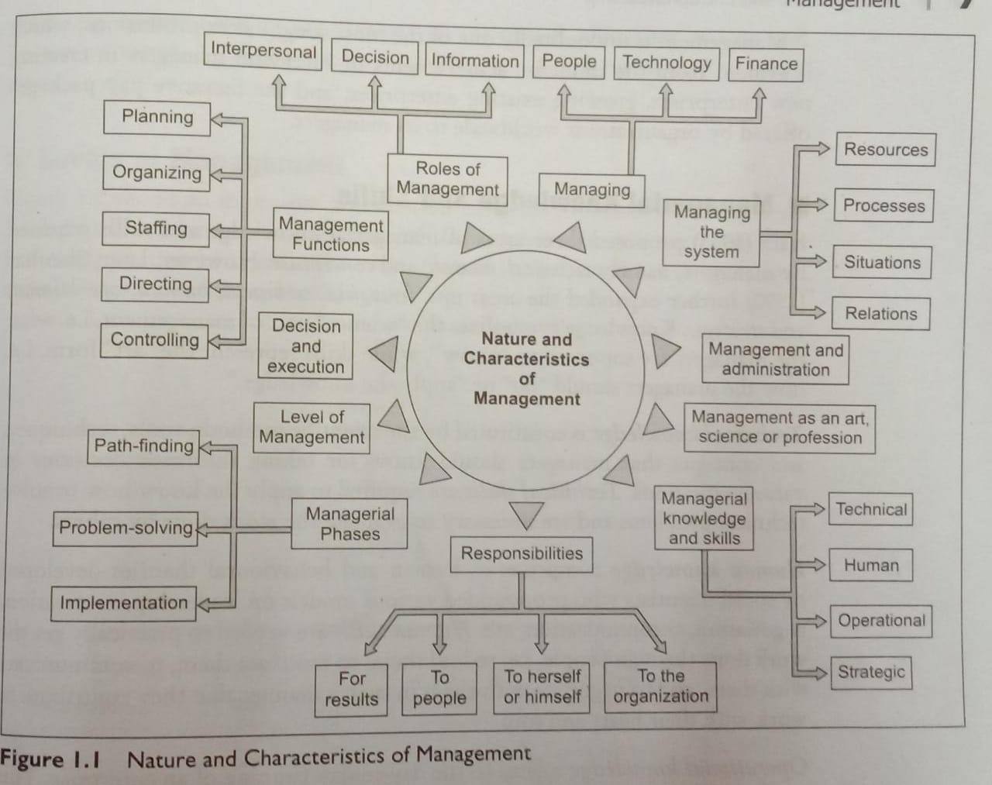

Slide 9
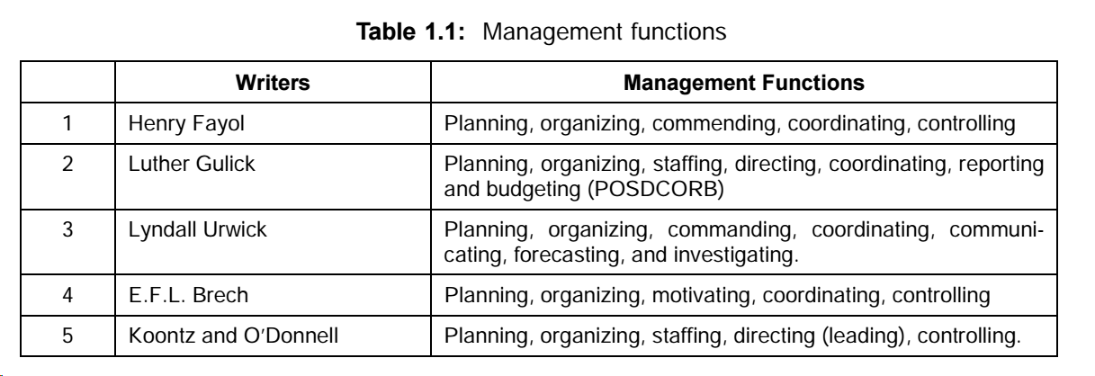
MANAGEMENT FUNCTIONS OR THE PROCESS OF MANAGEMENT
“What functions are undertaken by managers in organizations?”

Slide 10
Functions of management
Planning
Planning is the process of setting goals, and charting the best way of action for achieving the goals.
1
Organizing
Organizing is the process of allocating and arranging work, authority and resources, to the members of the organization so that they can successfully execute the plans.
2
Staffing
Staffing is the process of recruiting /selecting the right person for the right job at the right time in the right place.
3
Leading/
Directing
Leading involves directing, influencing and motivating employees to perform essential tasks.
4
Controlling
Controlling is the process of devising various checks to ensure that planned performance is actually achieved. It involves ensuring that actual activities conform to the planned activities.
5

Slide 11
FUNCTIONS OF MANAGEMENT
Control involves three elements:
(a) Establishing standards of performance.
(b) Measuring current performance and comparing it against the established standard.
(c) Taking action to correct any performance that does not meet those standards.

Slide 12
(6) Innovation: Innovation means creating new ideas which may be either results in the development of new products or finding new uses for the old ones.
(7) Representation: A manager has to spend a part of his time in representing his organization before various groups which have some stake in the organization.

Slide 13
FUNCTIONAL AREAS OF MANAGEMENT
A distinction should be maintained between management functions (planning, organizing, staffing, directing and controlling) and the organizational functions (productions, finance etc.)
Organizational functions differ from organization to organization depending upon their nature while management functions are common to all.

Slide 14
There are four functional areas of management namely :
Production: This is generally put under production manager and he is responsible for all production related activities.
This area has a number of activities, few of them are given below:
Purchasing: Which is related with the purchase of various materials required by the organization. Purchasing involves procuring right quantity of materials at the right quality, at the right time and at the right price from the right supplier.
(2) Materials management: This involves storing of materials, issue of materials to various departments.
(3) Research and Development: It deals with improving the existing products and process and developing new products and process

Slide 15
Marketing: This area involves the distribution of organizations’ products to the buyers. The sub-activities are:
(1) Advertising: Involves giving information about products to buyers.
(2) Marketing research: It is related with the systematic collection, analysis of data relating to the marketing of goods and services.
(3) Sales management: It involves management efforts directed towards movement of products and services from producers to consumers.

Slide 16
Finance and accounting: It deals with intelligent investment of financial resources and record-keeping of various transactions. The various sub-functions are
(1) Financial Accounting: Deals with record keeping of various transactions.
(2) Management Accounting: Deals with analysis and interpretation of financial records so that management can take certain decision.
(3) Costing: It deals with recording of costs, their classification and analysis for cost control.
(4) Investment Management: Takes care of how financial resources can be invested in various alternatives to maximize returns.
(5) Taxation: Deals with various direct and indirect taxes to be paid by the organization.

Slide 17
Personnel: It deals with the management of human resources with the following sub-activities:
(1) Recruitment and Selection: It deals with recruitment and selection of employees.
(2) Training and Development: It deals with training of employees and making them more efficient.
(3) Wage and Salary Administration: Deals with fixing of salaries, job evaluation, promotion, incentives etc.
(4) Industrial Relations: Deals with maintenance of good employee relations.

Slide 18
MANAGEMENT: A SCIENCE OR ART?
Management as science:
(1) Methods of inquiry are systematic and empirical.
(2) Information can be ordered and analyzed; and
(3) Results are cumulative and communicable
Science denotes two types of systematic knowledge:
Natural or exact
Behavioral or inexact.

Slide 19
Management is an art:
Management is the art of getting things done through others in dynamic situations.
A manager has to coordinate various resources against several constraints to achieve predetermined objectives in the most efficient manner.

Slide 20
MANAGEMENT: A PROFESSION
“Profession” possesses the following characteristics:
(1) Existence of an organized knowledge.
(2) Formalized method of acquiring training and expertise.
(3) Existence of professional association.
(4) Existence of an ethical code to regulate the behaviour.
(5) Charging of fees based on service with due regard to social interest.

Slide 21

MANAGEMENT AND ADMINISTRATION

Slide 22
MANAGEMENT AND ADMINISTRATION
Various views expressed by thinkers of management led to the emergence of there approaches:
(1) Administration is above management.
(2) Administration is a part of management.
(3) Management and administration are same.

Slide 23
“Administration is that phase of business enterprise that concerns itself with the overall determination of institutional objectives and the policies necessary to be followed in achieving those objectives.
Management on the other hand is an executive function which is primarily concerned with carrying of broad policies laid down by the administration”.

Slide 24
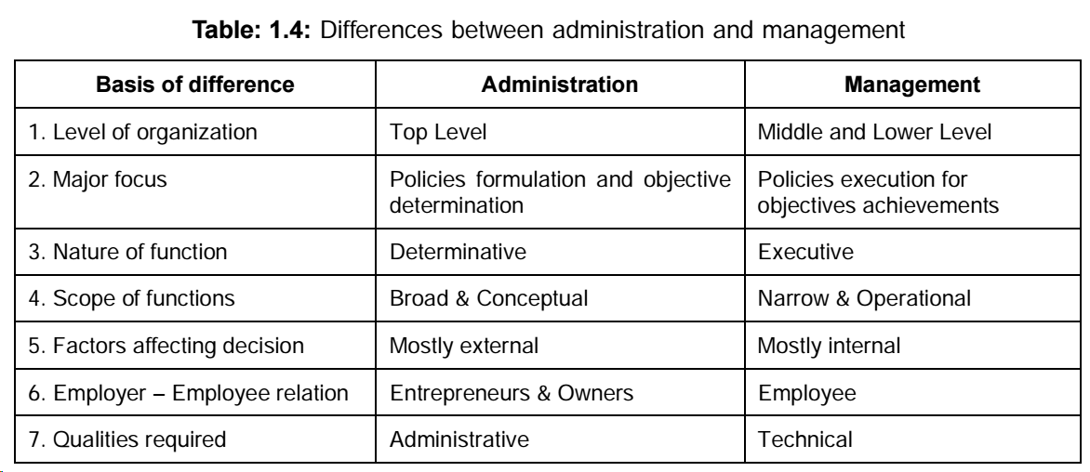

Slide 25
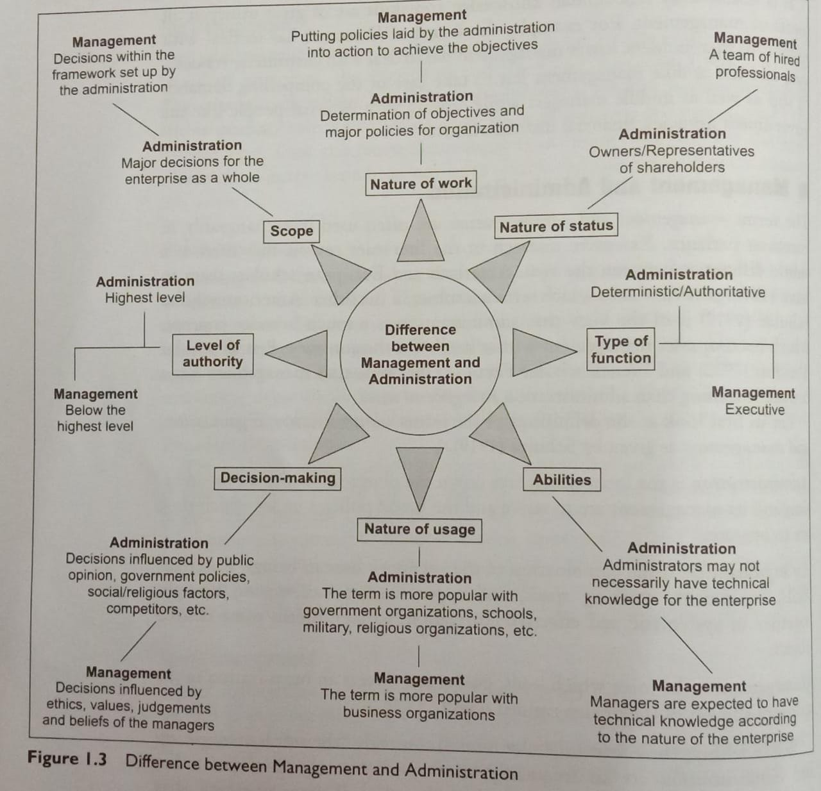

Slide 26
According to Brech, “Management is a generic name for the total process of executive control in industry or commerce. It is a social process entailing responsibility for the effective and economical planning and regulation of the operation of an enterprise in the fulfilment of a given purpose or risk.
Administration is that part of management which is concerned with the installation and carrying out of procedures by which it is laid down and communicated, and the process of activities regulated and checked against plans.

Slide 27
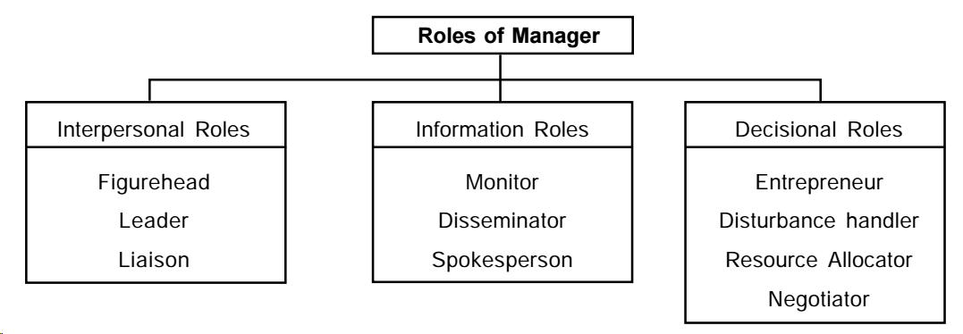
ROLE OF MANAGEMENT
Mintzberg has identified ten roles of manager which are classified into three broad categories

Slide 28
Interpersonal role: This role is concerned with his interacting with people both organizational members and outsiders. There are three types of interpersonal roles:
Figure head role: In this role manager has to perform duties of ceremonial nature such as attending social functions of employees, taking an important customer to lunch and so on.
(2) Leader role: Manager’s leader role involves leading the subordinates motivating and encouraging them.
(3) Liaison: In liaison role manager serves as a connecting link between his organization and outsiders. Managers must cultivate contacts outside his vertical chain to collect information useful for his organization.

Slide 29
Information roles: It involves communication. There are three types of informational roles:
(1) Monitor: In his monitoring role, manager continuously collects information about all the factors which affects his activities. Such factors may be within or outside organization.
(2) Disseminator: In the disseminator role, manager possesses some of his privileged information to his subordinates who otherwise not be in a position to collect it.
(3) Spokesperson: As a spokesperson manager represents his organization while interacting with outsiders like customers, suppliers, financers, government and other agencies of the society

Slide 30
Decisional roles: Decisional role involves choosing most appropriate alternative among all so that organizational objectives are achieved in an efficient manner. In his decisional role manager perform four roles:
Entrepreneur: As an entrepreneur, a manager assumes certain risks in terms of outcome of an action. A manager constantly looks out for new ideas and seeks to improve his unit by adopting it to dynamic environment.
Disturbance handler: In this role manager works like a fire-fighter manager contains forces and events which disturb normal functioning of his organization. The forces and events may be employee complaints and grievances, strikes, shortage of raw materials etc.
Negotiator: In his role of negotiator, manager negotiates with various groups in the organization. Such groups are employees, shareholders and other outside agencies.

Slide 31
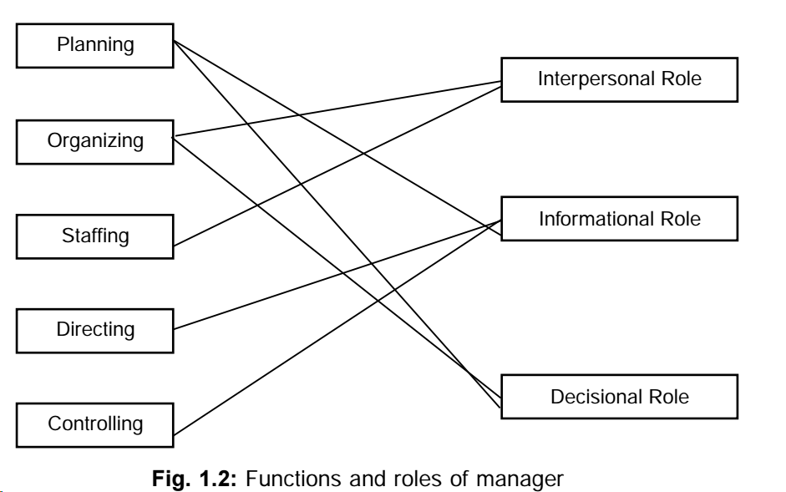

Slide 32
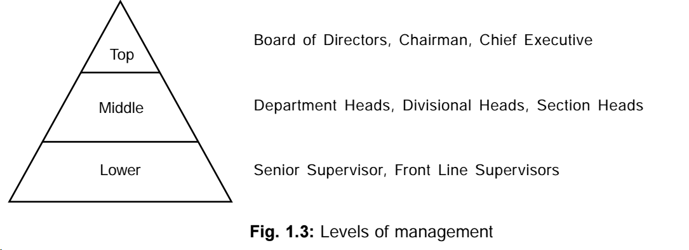
LEVELS OF MANAGEMENT
E.F.L. Brech has classified management levels into three categories – Top Management, Middle Management and Supervisory/Lower Level

Slide 33
EVOLUTION OF MANAGEMENT
Several economists explained the concept of management.
Adam Smith explained the concept of division of labour,
Jacques Turgot explained the importance of direction and control, and
Baptiste explained the importance of planning.
But management is emerged as a separate discipline in the second half of 19th century with the introduction of Joint Stock Company.
This form of enterprises separated management of business from their ownership and gave rise to labour inefficiency and inadequate systems of wage payments.

Slide 34
The evaluation of management thought during this period can be classified into two parts namely
(1) Early management approaches represented by Taylor’s scientific management, Foyal’s administrative management and human relations movement.
(2) Modern management approaches, represented by behavioural approach, quantitative/management science approach, systems approach and contingency approach.

Slide 35
Early Management Approaches
Taylor’s Scientific Management
He launched a new movement in 1910 which is known as scientific management. Taylor is known as father of scientific management and has laid down the following principles of scientific management.
Separation of planning and doing
Functional foremanship:Under eight-boss-scheme of functional foremanship, four persons: (i) route clerk, (ii) instruction card clerk, (iii) time and cost clerk and (iv) disciplinarian are related with planning function, and the remaining four: (vi) speed boss, (vii) inspector, (viii) maintenance foreman, and (ix) gang boss are concerned with operating function.

Slide 36
Elements of scientific management:
Work study involving work important and work measurement using method and time study.
(b) Standardization of tools and equipment for workmen and improving working conditions.
(c) Scientific Selection, placement and training of workers by a centralized personal department.
Bilateral mental revolution
Financial incentives
Economy

Slide 37
Taylor summed up his approach in these words:
Science, not rule of thumb
Harmony, not discord
Cooperation and not individualism
Maximum output, in place of restricted output
The development of each man to his greatest efficiency and prosperity

Slide 38
Henry Fayol’s Administrative Management (1841–1925)
Foyal divided activities of business enterprise into six groups:
Technical, Financial, Accounting, Security, and Administrative or Managerial.
He focused on this last managerial activity and defined management in terms of five functions: Planning, Organizing, Commanding, Coordinating and Controlling.
He emphasized repeatedly that these managerial functions are the same at every level of an organization and is common to all types of organizations

Slide 39
Fayol’s Fourteen Principles of Management
Division of work-Specialization increases output by making employees more efficient.
Authority-Managers must be able to give orders, and authority gives them this right.
Discipline-Employees must obey and respect the rules that govern the organization.
Unity of command-Every employee should receive orders from only one superior.
Unity of direction-The organization should have a single plan of action to guide managers and workers.
Subordination of individual interests to the general interest-The interests of any one employee or group of employees should not take precedence over the interests of the organization as a whole.
Remuneration-Workers must be paid a fair wage for their services.
Centralization-This term refers to the degree to which subordinates are involved in decision making.
Scalar chain-The line of authority from top management to the lowest ranks is the scalar chain.
Order- People and materials should be in the right place at the right time.
Equity-Managers should be kind and fair to their subordinates.
Stability of tenure of personnel-Management should provide orderly personnel planning and ensure that replacements are available to fill vacancies.
Initiative-Employees allowed to originate and carry out plans will exert high levels of effort.
Esprit de corps-Promoting team spirit will build harmony and unity within the organization.

Slide 40
Human Relations Approach
The human relationists, proposed the following points as a result of Hawthorne experiments.
(1) Social system: The organization in general is a social system composed of numerous interacting parts. The social system defines individual roles and establishes norms that may differ from those of formal organization.
(2) Social environment: The social environment of the job affects the workers and is also affected.
(3) Informal organization: The informal organization does also exist within the frame work of formal organization and it affects and is affected by the formal organization.

Slide 41
(4) Group dynamics: At the workplace, the workers often do not act or react as individuals but as members of group. The group plays an important role in determining the attitudes and performance of individual workers.
(5) Informal leader: There is an emergence of informal leadership as against formal leadership and the informal leader sets and enforces group norms.
(6) Non-economic reward: Money is only one of the motivators, but not the sole motivator of human behaviour. Man is diversely motivated and sociopsychological factors act as important motivators.

Slide 42
Modern Management Approaches
Behavioural Approach
Decision-making is done in a sub-optimal manner, because of practical and situational constraints on human rationality of decision-making. The behaviorists attach great weight age on participative and group decision-making.
Behavioral Scientists encourage self direction and control instead of imposed control.
Behavioral Scientists consider the organization as a group of individuals with certain goals

Slide 43
In view of behavioural scientists the democratic-participative styles of leadership are desirable, the autocratic, task oriented styles may also be appropriate in certain situation.
They suggest that different people react differently to the same situation. No two people are exactly alike and manager should tailor his attempts to influence his people according to their needs.
They recognize that organizational conflict and change are inevitable

Slide 44
What is Quality Management?
Intense focus on the customer: The customer includes outsiders who buy the organization’s products or services and internal customers who interact with and serve others in the organization.
Concern for continual improvement: QM is a commitment to never being satisfied. Quality can always be improved.
Process focused: QM focuses on work processes as the quality of goods and services is continually improved.
Improvement in the quality of everything the organization does: This relates to the final product, how the organization handles deliveries, how rapidly it responds to complaints, how politely the phones are answered, and the like.
Accurate measurement-QM uses statistical techniques to measure every standards to identify problems, trace them to their roots, and eliminate their causes.
6. Empowerment of employees: QM involves the people on the line in the improvement process. Teams are widely used in QM programs as empowerment vehicles for finding and solving problems.

Slide 45
Systems Approach
A system is a set of interdependent parts which form a unit as a whole that performs some function.
An organization is also a system composed of four independent parts namely, task, structure, people and technology.
The central to the system approach is ‘holism’ which means that each part of the system bears relation of interdependence with other parts and hence no part of the system can be accurately analyzed and understood apart from the whole system.
A system can be open or closed system. In open system, a system interacts with surrounding. An organization is open system because it interacts with it.

Slide 46
Contingency Approach
Management principles and concepts have no general and universal application under all conditions.
Methods and techniques which are highly effective in one situation may not give the same results in another situation. This approach suggests that the task of managers is to identify which technique in a situation best contribute to the attainment of goals.
Managers therefore have to develop a sort of situational sensitivity and practical selectivity.
Contingency views are applicable in designing organizational structure, in deciding degree of decentralization, in motivation and leadership approach, in establishing communication and control systems, in managing conflicts and in employee development and training.

Slide 47
Review Questions
Define management. List its functions. What is meant by the “management process”?
Distinguish between management and administration. How far is this distinction justified in your opinion?
Comment on the true nature of management. Is it a science or an art?
Explain the principal functions of management. Would you attach different levels of importance to these functions at various levels of management? Are there any differences in planning, organising, leading, controlling, and coordinating between a restaurant and a food processing firm? Between a general hospital and a steel plant? And between a college and a recreation club?
“Management is getting things done through others.” Elaborate.
Discuss the importance of management in the present-day world.
What are the attributes of a profession? Is management a profession? Is it necessary for every business to have a professional management?
“Managers at all levels require some competence in each of the technical, human and conceptual skills, albeit with difference in emphasis.” Analyse this statement with suitable examples from your work experience.

