Slide 1
Planning
Chapter 2

Slide 2
Planning
Planning is the beginning of the process of management. A manager must plan before he can possibly organize, staff, direct or control.
Planning is an intellectual process which requires a manager to think before acting. It is by planning that managers of organizations decide what is to be done, when it is to be done, how it is to be done, and who is to do it. Decision-making is thus an integral part of planning.
Decision making will occur at many points in the planning process. For e.g., in planning for their organization, managers must first decide which goal to pursue: “Shall we manufacture all parts internally or buy some from outside?” In fact, deciding which goal to pursue is probably the most important part of the planning process.
Managers must also decide which assumptions about the future and about the environment they will use in making their plans: ”Will taxes on our earnings increase, and thus strain our company’s cash flow, or can we expect taxes to remain at the present level?” In addition, managers must decide how they will allocate their resources to attain their goals: “Should we fill up a senior position by promoting an existing employee or should we hire someone from outside the organization?”

Slide 3
Strategic planning in the Indian Industry
Nowadays, corporate planning is receiving great importance by Indian companies. Many large companies have established separate corporate planning divisions and have formalized the planning process.
Many companies have now come to realise on the basis of their SWOT(Strengths and Weaknesses, Opportunities and Threats) analysis that they should concentrate on their core competence and should not spread themselves too thin by getting into more businesses than they can handle. Notable among these organisations are the Videocon Group, the Thapars, Whirlpool India Ltd., Mafatlals, Hindustan Lever and Larsen and Toubro.
Several banks in India from across regions(north-south, east-west) are wanting to merge in a bid to create a larger market for themselves.
Joint ventures are also becoming the order of the day. Some notable joint ventures of recent years are Shriram-Honda, Ford-Mahindra, Telco-Benz, Pal-Peugot, Hindustan Motors-Mitsubishi and Govt. of India-Suzuki.

Slide 4
On the other hand, there are also cases of diversification and demergers. Examples of diversified firms in India include Reliance Industries(Petrochemicals, Textiles, Power Telecommunications), Nagarjun Group(Power, Fertilizers, Finance), Tata(Paper, Tea, Automobiles, Steel, Telecommunications, Software, Consultancy) and Aditya Birla Group(Cement, Textiles, Rayon, Palm Oil).
Examples of demergers include demerger of Ciba specialities from Hindustan Ciba-Geigy Ltd., demerger of Sandoz India Ltd., from the old Sandoz and demerger of Aptech from Apple Industries Ltd.

Slide 5
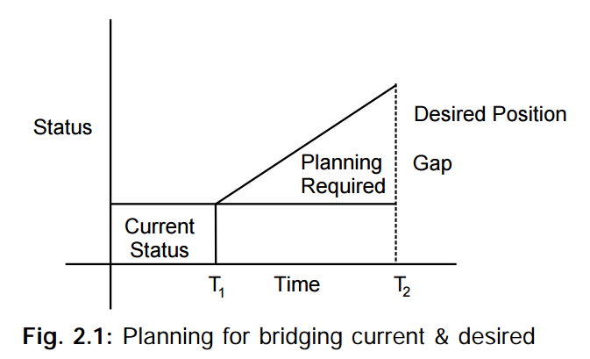
NATURE OF PLANNING
Planning: A Rational Approach

Slide 6
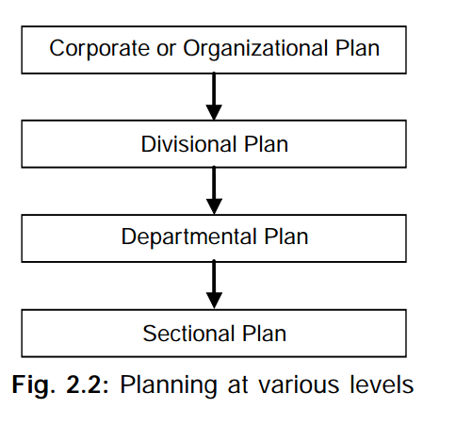
Planning: An Open System Approach
Flexibility of Planning
Pervasiveness of Planning

Slide 7
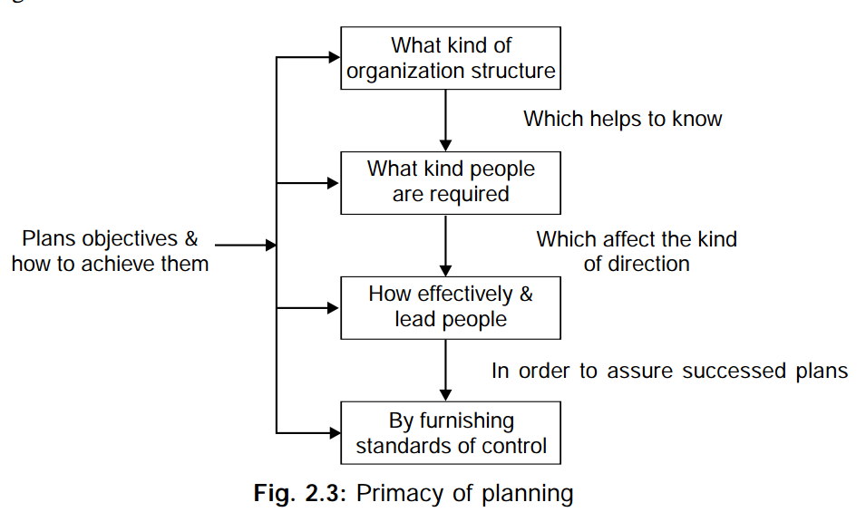
Importance of Planning
Without planning, business decisions would become random, ad hoc choices. Four concrete reasons for the paramount importance of the planning function are as follows:
Primacy of planning:

Slide 8
Minimises Risk and Uncertainty
In today’s increasingly complex organizations, intuition alone can no longer be relied upon as a means for making decisions. By providing a more rational, fact-based procedure for making decisions, planning allows managers and organizations to minimise risk and uncertainty.
Planning does not deal with future decisions, but with the futurity of present decisions. For instance, if a manager does not make any provision for the replacement of plant and machinery, the problems he will have to face after ten years can well be imagined. It is through planning that the manager relates the uncertainties and possibilities of tomorrow to the facts of today and yesterday.

Slide 9
Leads to success
Planning does not guarantee success, but studies have shown that, often things being equal, companies which plan not only outperform the nonplanners but also outperform their own past results. Planning leads to success by doing beyond mere adaptation to market fluctuations. With the help of a sound plan, management can act proactively, and not simply react. It involves an attempt to shape the environment on the belief that business is not just the creation of environment but its creator as well.
Focuses attention on the organization’s Goals
Planning helps the manager to focus attention on the organization’s goals and activities. This makes it easier to apply and coordinate the resources of the organization more economically. The whole organization is forced to embrace identical goals and collaborate in achieving them. It also enables the manager to chalk-out in advance an orderly sequence of steps for the realisation of an organization’s goals and to avoid a needless overlapping of activities.

Slide 10
Facilitates control
In planning, the manager sets goals and develops plans to accomplish these goals. These goals and plans then become standards or benchmarks against which performance can be measured. The function of control is to ensure that the activities conform to the plans. Thus, controls can be exercised only if there are plans.
Trains executives
Planning is also an excellent means for training executives. They become involved in the activities of the organization, and the plans arouse their interest in the multifarious aspects of planning.

Slide 11
Types of Planning
Planning may be comprehensive or limited in scope. There are organisations that plan to the last detail; others rest content, simply with setting broad targets for the next financial period. Planning may be done by an army of experts using sophisticated forecasting techniques; or it may be done in a seat-of-the-pants manner, by a number of executives sharing their judgements over a cup of coffee.
Planning may begin at the top with the top executives deciding on targets and passing them down for implementation; or it may begin at the bottom with the lowest sections formulating their targets and sending them up for evaluation and coordination.
Planning may be done participatively, with many members of the organization chipping in with their ideas and judgements or it may be done in elitist manner by a few executives or technocrats.

Slide 12
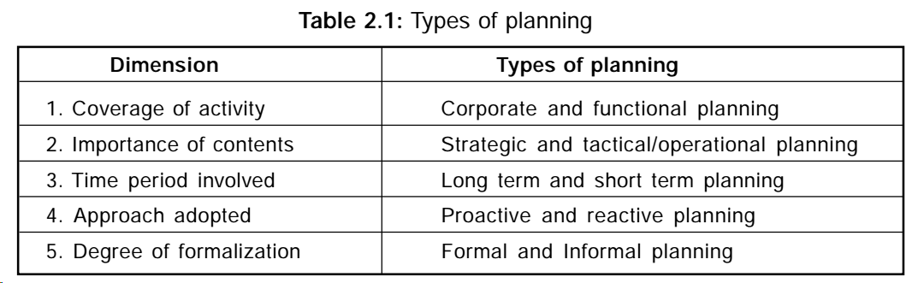

Slide 13
Corporate and functional planning:
The planning activities at the corporate level which cover the entire organizational activities are known as corporate planning. The focus in corporate planning is to determine long term objectives as a whole and to generate plans to achieve these objectives bearing in mind the probable changes in dynamic environment. This corporate planning is the basis for functional planning.
Functional planning which is derived from corporate planning is undertaken for each major function of the organization like production, marketing, finance etc., Since functional planning is derived out of corporate planning and therefore it should contribute to the corporate planning.

Slide 14
Strategic planning involves deciding what the major goals of the entire organisation will be and what policies will guide the organisation in its pursuit of these goals. It deals with questions such as: What business should the organisation be in a decade from now? What should the organisation look like in five years? In answering such questions the organisation relies heavily on external information, i.e., on data collected from outside the organisation, such as, market analyses, estimates of costs, technological developments and so on. These data being mostly imprecise make strategic planning less certain.
Tactical planning involves deciding specifically how the resources of the organisation will be used to help the organisation achieve its strategic goals. If the organisation has prepared a ten-year strategic plan which envisages a profit rate of 25% on capital employed in the tenth year, it is also necessary to prepare a more detailed tactical plan for the next year, with a specific target of say, 10% profit on the capital employed.

Slide 15
Operational planning
Also called functional plans are very specific, focused and short-term plans in line with the tactical(say annual) plans. These plans pertain to the various functional departments of an organization like finance, operations, marketing, HR, and IT. The time duration covered by these plans can be monthly, weekly, or even daily. If the tactical goal is, say, to increase the revenue by 20% this year and the corresponding tactical plan is to gain 10% new business(from new clients) while increasing 10% business from existing clients, the operational plan of the marketing department may be to create a new advertisement for electronic media to attract new clients while arousing the interest(and business volumes) from existing clients.

Slide 16
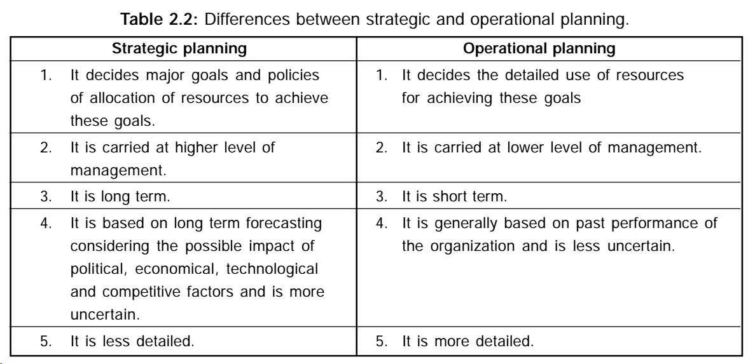

Slide 17
Long and short term planning: The long term planning is strategic in nature and involves more than one year period and can extend to 15 to 20 years or so.
Short term planning usually covers one year. Short term plans are made with reference to long term plans because short term plans contribute to long term plans.

Slide 18
Proactive and reactive plans:
Planning is an open system approach and hence it is affected by environmental factors which keep on changing continuously.
The organization’s response to these changes differs. Based on these responses planning may be proactive and reactive.
Proactive planning involves designing suitable courses of action in anticipation of likely changes of environment.
Managers adopting proactive changes do not wait for environment to change, but take action in advance of environmental changes. For this, continuous scanning of environment is necessary.
In reactive planning response comes after environmental changes take place. By the time organization responds to change in environment there may be further change in environment. Hence this type of planning is suitable in the environment which is fairly stable over a long period of time.

Slide 19
Formal and informal planning:
Large organizations undertake planning in a formal way. Generally a separate corporate planning cell is formed at higher level. The cell is staffed by people of different backgrounds like engineers, economists, statisticians etc., depending upon the nature. The cell continuously monitors the environment.
When environment shows some change the cell analysis the environment and suggest suitable measures to take the advantage of the changing environment. This type of planning is rational, systematic, regular and well documented.
On the other hand informal planning is undertaken generally by small organizations. This planning process is based on manager’s experience, intuitions rather than based on systematic evaluation of environmental changes. This planning process is part of manager’s regular activity and is suitable for small organizations.

Slide 20
Types of Plans
Plans are arranged in a hierarchy within the organisation. At the top of this hierarchy stand objectives. Objectives are the broad ends of the organisation which are achieved by means of strategies.
Strategies in their turn are carried out by means of the two other major groups of plans-single-use plans and standing plans. Single-use plans, as their name suggests, are developed to achieve a specific end; when that end is reached, the plan is dissolved. The major types of single-use plans are programmes and budgets.
Standing plans, on the other hand, are designed for situations that recur often enough to justify a standardised approach. For e.g., it would be inefficient for a bank to develop a single-use plan for processing a loan application of each new client. Instead, it uses one standing plan that anticipates in advance whether to approve or turn down any request based on the information furnished, credit rating, and the like. The major types of standing plans are policies, procedures, methods, and rules.

Slide 21
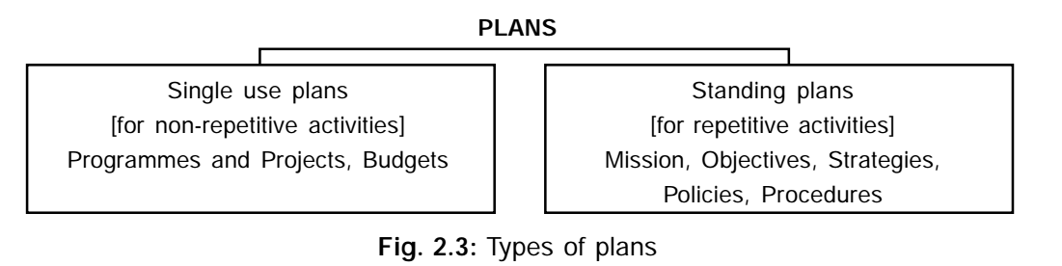

Slide 22
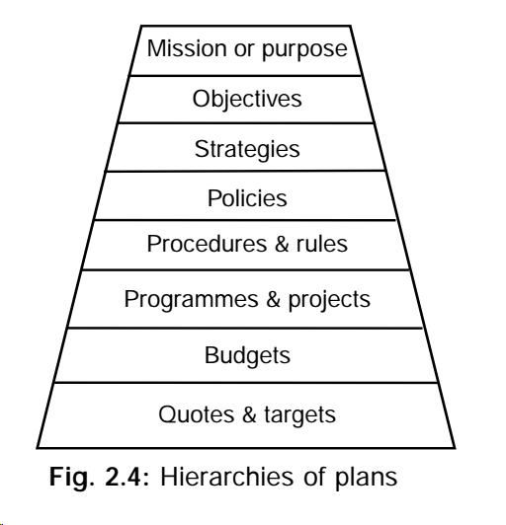

Slide 23
Mission and Purpose
Mission and purpose are often used interchangeably though there is difference between the two at least at theoretical level. Mission has external orientation and relates the organization to the society in which it operates. A mission statement links the organization activities to the needs of the society and legitimates its existence.
Purpose is also externally focused but is relates the organization to that segment of the society to which it serves; it defines the business which the company will undertake.

Slide 24
The mission statement of HLL is:
“Hindustan Lever’s commitment to national priorities has ensured that the company is a part of people lives at the grass root level, making a difference to India and to Indians- in depth, width and size. Hindustan has always identified itself with the nations priorities; employment generation, development of backward area, agricultural linkages, exports etc.”
The purpose of the company is:
Our purpose in Hindustan lever is to meet the every day needs of the people every where – to anticipate the aspirations of consumers and customers and to respond creatively and competitively with branded products and services which raise the quality of life.

Slide 25
Objectives
Are goals or aims which the management wishes the organization to achieve. These are the end points or pole-star towards which all business activities like organizing, staffing, directing and controlling are directed. Only after having defined these end points can the manager determine the kind of organization, the kind of personnel and their qualifications, the kind of motivation, supervision and direction and the kind of control techniques which he must employ to reach these points.
Objectives should be distinguished from three other words “vision”, “purpose”, and “mission. The vision is the dream that an entrepreneur creates in his waking hours of his preferred future. In fact it is the root of all objectives. The purpose of an organization is its primary role defined by the society in which it operates. Purpose is a broad aim that applies not only to a given organization but to all organisations of its type in that society. The mission of an organization is the unique aim that sets the organization apart from others of its type. Indeed, this may lead to turning away business-ruling out a customer segment that would simply be unprofitable or too hard to serve, given the organization’s capabilities.

Slide 26
Characteristics of Objectives
Objectives are the specific targets to be reached by an organization. They are the translation of an organisation’s mission into concrete terms against which results can be measured. For e.g., a university may decide to admit a certain number of students or a hospital may decide to admit a certain number of indoor patients.
An organization’s objectives take into account all stakes and specify a common viewpoint acceptable to all the stakeholders.
Objectives are multiple in number: This implies that every business enterprise has a package of objectives set out in various key areas. As point out by Peter Drucker, there are eight key areas in which objectives of performance and results have to be set. These are: market standing, innovation, productivity, physical and financial resources, profitability, manager performance and development, worker performance and attitude and public responsibility.

Slide 27
For e.g., a fertilizer manufacturing and marketing company may have the following objectives:
A specified capacity utilization
Specified costs and return on capital
Specified quality of the product
Specified marketing services
Extension and market development
Serving remote areas
Maintaining the desired network of retail outlets
Extension of warehouse facilities and ex-warehouse sales to small retailers and farmers close to consumption points.
Objectives are either tangible or intangible- For some of the objectives(such as in the areas of market standing, productivity, and physical and financial resources) there are quantifiable values available. Other areas of objectives are not readily quantifiable and are intangible, such as manager’s performance, workers’ morale, public responsibility, etc.

Slide 28
Objectives have a priority- This implies that at a given point in time, the accomplishment of one objective is relatively more important than of others. For e.g., the goal of maintaining a minimum cash balance may be critically important to a firm having difficulty in meeting pay rolls and due dates on accounts. At all points in time, managers are confronted with alternate goals which must be evaluated and ranked. Managers of non-business organisations are particularly concerned with the ranking of seemingly independent goals. For e.g., a university vice-chancellor must determine, implicitly, or explicitly, the relative importance of teaching, research and service goals. Of course, the determination of goals and priorities is often a judgemental decision and, therefore, is difficult.
Objectives are generally arranged in a hierarchy- This means that we have corporate objectives of the total enterprise at the top, followed by divisional or departmental objectives. Next come objectives of each section and finally individual objectives. Objectives at all levels(except at the top) serve both as an end and as a means.

Slide 29
Objectives sometimes clash with each other- The process of breaking down the enterprise into units, for e.g., production, sales and finance, requires that objectives be assigned to each unit. Each unit is given the responsibility for attaining an assigned objective. The process of allocating objectives among various units creates the problem of potential goal conflict and suboptimization, wherein achieving the goals of one unit may jeopardize achieving the goals of another. For e.g., the production goal of low unit cost achieved through mass production of low-quality products may conflict with the sales goal of selling high quality products.

Slide 30
Requirement of Sound Objectives
While laying down objectives there are certain requirements that the manager should always keep in mind.
Objectives must be both clear and acceptable: As Barnard pointed out, each participant in an organization determines for himself the range of acceptable behavior, and if the activities required of him are outside this range, he will not pursue the objective. A production line foreman can find all kinds of legitimate means to foil a production schedule if the meeting of that schedule requires behavior which he considers unacceptable.

Slide 31
Objectives must support one another- Objectives could interlock or interfere with one another. For e.g., the goals of the production department in a company may be operating at cross purposes with those of the marketing department. In view of this, there is need for coordination and balancing the activities of the entire organization, otherwise its members may pursue different paths making it difficult for the manager to achieve the company’s overall objectives.
Objectives must be precise and measurable- An objective must always be spelled out in precise, measurable terms. There are several reasons for this:
The more precise and measurable the goal, the easier it is to decide how to achieve it. For e.g., the goal of “becoming more active in the community” leaves managers in doubt as to how to proceed. If instead, managers select as their goal “increasing profits by 10 percent”, they have described their goals in much more meaningful terms.
Precise and measurable goals are better motivators of people than general goals.
Precise and measurable goals make it easier for lower level managers to develop their own plans for achieving those goals. For e.g., if a general manager is aiming for a 15 percent growth rate over the next four years, the sales manager can determine how sales must increase in order to meet this goal.
It is easier for managers to ascertain whether they are succeeding or failing if their goals are precise and measurable. For e.g., if they are aiming for a profit of Rs.15lakh over the next two years, they can check progress as profit and loss figures come in.

Slide 32
Objectives should always remain valid- This means that the manager should constantly review, reassess and adjust them according to changed conditions. With the passage of time stakeholders’ preferences change and it becomes necessary for the manager to work out a new common minimum programme.
Advantages of objectives
(1) Unified planning: Various plans are prepared at various level in the organization. These plans are consistent with the objectives and hence objectives encourage unified planning.
(2) Individual motivation: Objectives act as motivators for individual and departments imbuing their activity with a sense of purpose.
(3) Coordination: Objectives facilitate coordinated behavior of various groups which otherwise may pull in different directions.
(4) Control: Objectives provide yardstick for performance. The actual performance is compared with standard performance and hence objectives facilitate control.
(5) Basis for decentralization: Department-wise or section wise objectives are set in order to achieve common objectives of the organization. These objectives provide basis for decentralization.

Slide 33
Strategies
In a competitive situation, it is not enough to build plans logically from goals unless the plans take into account the environmental opportunities and threats and the organizational strengths and weaknesses. Two important activities involved in strategy formulation are environmental appraisal and corporate appraisal.
Environmental appraisal- An analysis of the relevant environment results in the identification of threats and opportunities. Andrews defines the environment of a company as the pattern of all external influences that affect its life and development. While every company must define its own relevant environment, some key environment factors which need to be studied are given below:
Political and legal factors:
Stability of the government and its political philosophy
Taxation and industrial licensing laws
Monetary and fiscal policies
Restrictions on capital movement, repatriation of capital, state trading, etc.
2. Economic factors:
Level of economic development and distribution of personal income
Trend in prices, exchange rates, balance of payments, etc.
Supply of labour, raw material, capital, etc.

Slide 34
3. Competitive factors:
Identification of principal competitors
Analysis of their performance and programmes in major areas, such as market penetration, product life-cycle, product mix, distribution channels and sales organization, servicing, credit and delivery, advertising and promotion, pricing and branding, labour unions, training of personnel, technological development, productivity and efficiency in manufacturing, financial strength, profitability and rate of return on sales and investment.
Anti-monopoly laws and rules of competition
Protection of patents, trademarks, brand names and other industrial property rights.
4. Social and cultural factors:
Literacy levels of population
Religious and social characteristics
Extent and rate of urbanization
Rate of social change

Slide 35
Corporate analysis involves identifying and analyzing company’s strength and weakness. For example a companies strength may be low cost manufacturing skill, excellent product design, efficient distribution etc.,. Its weakness may be lack of physical and financial resources. A company must plan to exploit these strengths to maximum and circumvent it’s weakness.
The formulation of strategy is like preparing for beauty contest in which a lady tries to highlight her strong points and hide her weak points. The process of matching company’s strength and weakness with environmental opportunities and threats is known as SWOT analysis.

Slide 36
Standing Plans
Policies- A policy is general guideline for decision-making. It sets up boundaries around decisions, including those that can be made and shutting out those that cannot. In so doing, it channelizes the thinking of the organization members so that it is consistent with the organizational objectives. In the words of George R Terry, “policy is a verbal, written or implied overall guide, setting up boundaries that supply the general limits and direction in which managerial action will take place.
Although, policies deal with “how to do” the work, they do not dictate terms to subordinates. They only provide a framework within which decisions must be made by the management in different spheres. Thus we may hear that the recruitment policy of a company is to recruit meritorious people through the employment exchange; or the advertisement policy of a company is to avoid cut-throat competition with its rivals in the field; or the distribution policy of a fertilizer company is farmer-oriented. In all these examples, respective policies leave it to the discretion of the subordinates, the decisions regarding which candidates are meritorious, what is cut-throat competition and what is to be farmer-oriented.

Slide 37
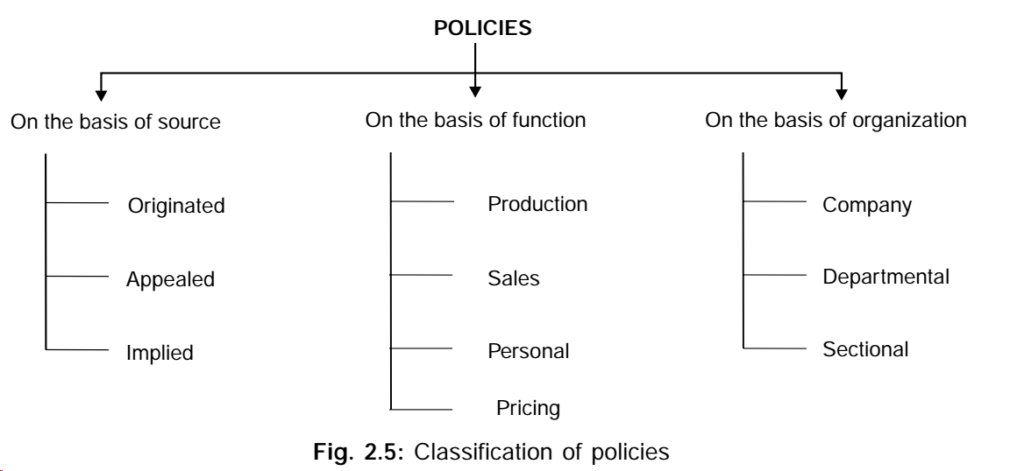

Slide 38
It should be noted that both policies and objectives guide thinking and action, but with difference. Objectives are end points of planning while policies channelize decisions to these ends; or, to put it another way, policies lead to objectives in the way a series of alternate highway routes lead to a city.
Advantage of policies
Policies ensure uniformity of action in respect of various matters at various organizational points.
Policies speed up decisions at lower levels because subordinates need not consult their superiors frequently.
Policies make it easier for the superior to delegate more and more authority to his subordinates without being unduly concerned because he knows that whatever decision the subordinates make will be within the boundaries of the policies.
Policies give a practical shape to the objectives by elaborating and directing the way in which the predetermined objectives are to be attained.

Slide 39
Types of Policies
Policies may be variously classified on the basis of sources, functions or organisational level.
Classification on the basis of sources: On this basis, policies may be divided into originated, appealed, implied and externally imposed policies.
Originated policies: These are policies which are usually established formally and deliberately by top managers for the purpose of guiding the actions of their subordinates and also their own. These policies are generally set down in print and embodied in a manual.
Appealed policies: are those which arise from the appeal made by a subordinate to his superior regarding the manner of handling a given situation.
Implied policies: There are also policies which are stated neither in writing nor verbally. Such policies are called implied policies. For e.g., if office space is repeatedly assigned to individuals on the basis of seniority, this may become an implied policy of the organisation.

Slide 40
2. Classification on the basis of functions: Policies may be classified into production, sales, finance, personal policies, etc. Every one of these functions will have a number of policies. For e.g., the sales functions may have policies relating to market, price, packaging, distribution channel, commission to middlemen, etc.; the production function may have policies relating to the method of production, output, inventory, research, etc.; the financial function may have policies relating to capital structure, working capital, internal financing, dividend payment, etc., the personnel function may have policies relating to recruitment, training, working conditions, welfare activities, etc.
3. Classification on the basis of organisational level: On the basis, policies range from major company policies through major departmental policies to minor or derivative policies applicable to the smallest segment of the organisation.

Slide 41
Procedures
Policies are carried out by means of more detailed guidelines called “procedures”. A procedure provides a detailed set of instructions for performing a sequence of actions involved in doing a certain piece of work. The same steps are followed each time that activity is performed.
For e.g., the procedure for purchasing raw material may be:
(i) requisition from the storekeeper to the purchasing department;
(ii) Calling tenders for purchase of materials;
(iii) Placing orders with the suppliers who are selected;
(iv) Inspecting the materials purchased by the inspecting department;
(v) Making payment to the supplier of materials by the accounts department.

Slide 42
Similarly, the procedure for recruitment of personnel may be:
Inviting applications through advertisement;
Screening the applications;
Conducting written test;
Conducting interview for those who have passed the written test;
Medical examination of those who are selected for the posts.
Procedures may also exist for conducting the meetings of directors and shareholders, granting loans to employees, issuing raw materials from the stores department, granting sick leave to the employees, passing bills by the accounts department, and so on.
Difference between policy and procedure
Policies are general guides to both thinking and action of people at higher levels. Procedures are general guides to action only usually for people at lower levels.
Policies help in fulfilling the objectives of the enterprise. Procedures show us the way to implement policies.
Policies are generally broad and allow some latitude in decision making. Procedures are specific and do not allow latitude.
Policies are often established without any study or analysis. Procedures are always established after thorough study and analysis of work.

Slide 43
Advantages of Procedures
First, they indicate a standard way of performing a task. This ensures a high level of uniformity of performance in the enterprise.
Second, they result in work simplification and elimination of unnecessary steps and overlapping.
Third, they facilitate executive control over performance. By laying down the sequence and timing of each task, executive’s dependence on the personal attributes of his subordinates is reduced, supervision becomes more routine and discipline is externalised.
Finally, they enable employees to improve their efficiency by providing them with knowledge about the entire range of work.

Slide 44
Methods
A method is a prescribed way in which one step of a procedure is to be performed. The specified technique to be used in screening the applications or conducting a written test is a method, whereas the sequence of steps involved in the recruitment of personnel constitutes a procedure.
The method that is selected for discharging a particular step under the existing conditions may become outdated in due course of time because of the discovery of better and more economical methods.
Methods help in increasing the effectiveness and usefulness of the procedure. By improving the methods, reduced fatigue, better productivity and lower costs can be achieved. Methods can be improved in a number of ways. Manual methods of performing a task can be replaced by mechanical means, or the existing mechanised process may be improved, or work simplified and unproductive efforts removed by conducting “motion study”.

Slide 45
Rules
Are detailed and recorded instructions that a specific action must or must not be performed in a given situation. In sanctioning overtime to workmen, in regulating travelling allowances, in sanctioning entertainment bills and in other similar matters, a uniform way of handling them or dealing with the case has to be followed. These are all covered by the rules of the enterprise, the objective of which is to avoid repeated reference to higher levels for authorisation of routine matters which occur frequently.
Like procedures, rules also bring in predictability. They make sure that a job is done in the same manner every time, bringing uniformity in efforts and results.
A rule is different from a policy, procedure or method. It is not a policy because it does not give a guide to thinking and does not leave any discretion to the party involved. It is not a procedure because there is no time sequence to a particular action. It is not a method because it is not concerned with any one particular step of a procedure.

Slide 46
Single-use Plans
Programmes- are precise plans or definite steps in proper sequence which need to be taken to discharge a given task. In other words, programmes are drawn in conformity with the objectives and are made up of policies, procedures, budgets, etc. Thus, an enterprise may have a programme or opening five branches in different parts of the country or of deputing its employees for training or of acquiring a new line of business or installing new machines in the factory or of introducing a new product in the market. The essential ingredients of every programme are time phasing and budgeting. In the absence of these ingredients it may be a prospect or a hope but it is not a programme.
Thus, a programme for the opening of five branches must earmark money and specific time periods for:
Securing the necessary accommodation.
Recruiting personnel to manage the branches.
Arranging the supply of goods which are to be sold through the branches.

Slide 47
Budgets
According to the Institute of Costs and Works Accountants, London, a budget is “a financial and/or quantitative statement prepared prior to a definite period of time, of the policy to be pursued during that period, for the purpose of obtaining a given objective.” The important budgets are sales budget, production budget, cash budget, and revenue and expense budget. The sales budget shows the expected sales of finished goods for a period, the production budget reflects the anticipated production over a period, a cash budget projects the expected flow of cash for a period in advance, and the revenue and expense budget shows the anticipated revenue and expenses for a period.
In zero-based budget the sums appropriated to various heads of expenditure in previous years are set to zero and the manager is required to justify each expenditure afresh from scratch.

Slide 48
Steps in Planning
1. Establishing Verifiable Goals or Set of Goals to be achieved: The first step is to determine the enterprise objectives. These are most often set by upper level or top managers, usually after a number of possible objectives have been carefully considered. There are many types of objectives managers may select: a desired sales volume or growth rate, the development of a new product or service, or even a more abstract goal such as becoming more active in the community. The type of goal selected will depend on a number of factors: the basic mission of the organisation, the value its managers hold, and the actual and potential abilities of the organisation.
The values and beliefs held by top men are very important in the selection of goals. Walchand Hirachand’s belief, for e.g., that a cheap and efficient transport system was necessary for rapid industrialization resulted in the establishment of the Scindia Shipping Company, Premier Automobiles and the Hindustan Aircraft Company.

Slide 49
2. Establishing Planning Premises- Certain assumptions about the future on the basis of which the plan will be ultimately formulated. Planning premises are vital to the success of planning as they supply pertinent facts and information relating to the future such as population trends, the general economic conditions, production costs and prices, probable competitive behavior, capital and material availability, governmental control and so on.
Planning premises can be variously classified as under:
Internal and external premises:Premises may exist within or outside the
enterprise. Internal premises include sales forecasts, ability of the organization
in the form of machines, methods of design, behavior of the owners and
employees etc., The external premises exists outside the enterprise and include
general business and economic environment, technological changes, government policies and regulations, population growth etc.,

Slide 50
Tangible and intangible premises: Tangible premises are those which can be quantitatively measured while intangible premises are those which being qualitative in character cannot be so measured. Population growth, industry demand, capital and resources invested in the organisation are all tangible premises whose quantitative measurement is possible. On the other hand, political stability, sociological factors, business and economic environment, attitudes, philosophies and behavior of the owners of the organisation are all intangible premises whose quantitative measurement is possible.
Controllable and non-controllable premises: Because of the presence of uncontrollable factors, there is need for the organisation to revise the plans periodically in accordance with current developments. Some of the examples of uncontrollable factors are strikes, wars, natural calamities, emergency, legislation, calculations of the organisation regarding the plan. Some of the examples of controllable factors are: the company’s advertising policy, competence of management members, skill of the labour force, availability of resources in terms of capital and labour, attitude and behaviour of the owners of the organisation, etc.

Slide 51
3. Deciding the Planning Period: Once upper-level managers have selected the basic long-term goals and the planning premises, the next task is to decide the period of the plan. In some instances plans are made for a year only while in others they span decades. Companies generally base their period on a future that can reasonably be anticipated. Other factors which influence the choice of a period are as follows: (a) lead time in development and commercialization of a new product; (b) time required to recover capital investments or the pay-back period; and (c) length of commitments already made.
Lead time in development and commercialisation of a new product: For e.g., a heavy engineering company planning to start a new project should have a planning period of, say, five years with one or two years for conception, engineering and development and as many more years for production and sales. On the contrary, a small manufacturer of spare parts who can commercialise his idea in a year or so need make annual plans only.
Time required to recover capital investments or the pay-back period: These are the number of years over which the investment outlay will be recovered or paid back from the cash inflow if the estimates turn out to be correct. If a machine costs Rs.10 lakh and generates cash inflow of Rs.2 lakh a year, it has a pay-back period of five years. Therefore, the plan should also be for at least five years.

Slide 52
(c) Length of commitments already made: The plan period should, as far as possible, be long enough to enable the fulfilment of commitments already made. For e.g., if a company has agreed to supply goods to the buyers for five years or has agreed to work out mines for ten years it need also plan for the same period to fulfil its commitments. However, if the length of commitment can somehow be reduced, the plan period can also be reduced.
Finding alternative courses of action: The fourth step in planning is to search for and examine alternative courses of action. For instance, technical know-how may be secured by engaging a foreign technician or by training staff abroad. Similarly, products may be sold directly to the consumer by the company’s salesman or through exclusive agencies.
Evaluating and selecting a course of action: Having sought alternative courses, the fifth step is to evaluate them in the light of the premises and goals and to select the best course or courses of action. This is done with the help of quantitative techniques and operations research.

Slide 53
Developing Derivative Plans: Once the plan has been formulated, its broad goals must be translated into day-to-day operations of the organisation. Middle and lower-level managers must draw up the appropriate plans, programmes and budgets for their sub-units. These are called derivative plans. In developing these derivative plans, lower-level managers take steps similar to those taken by upper level managers-selecting realistic goals, assessing their sub-units’ particular strengths and weaknesses and analysing those parts of the environment that can affect them.
Measuring and controlling the Progress: Obviously, it is foolish to let a plan run its course without monitoring its progress. Hence, the process of controlling is a critical part of any plan. Managers need to check the progress of their plans so that they can (a) take whatever remedial action is necessary to make the plan work, or (b) change the original plan if it is unrealistic.

Slide 54
DECISION-MAKING
The decision-making has the following factors.
(1) Decision-making implies that there are various alternatives and the most desirable alternative is chosen to solve the problem.
(2) Existence of alternatives suggests that the decision-maker has freedom to choose an alternative of his liking.
(3) Decision-making like any other managerial process is goal oriented. It implies that the decision maker attempts to achieve some results through decision making.

Slide 55
Types of Decisions
Programmed and non-programmed decisions
Major and minor decisions
Simple and complex decisions
Strategic and tactical or operational decisions
Individual and group decisions

Slide 56
Decision Making Process: Steps in Rational Decision Making
A decision is rational if appropriate means are chosen to reach the desired end. The following steps are involved in the process decision making.
(1) Recognizing the problem.
(2) Deciding priorities among the problems.
(3) Diagnosing the problem.
(4) Developing alternative solutions or courses of activities.
(5) Evaluating alternatives.
(6) Converting the decision into effective action and follow up of action.

Slide 57
CASE
Godha Engineering Works specialises in the installation of heating and air conditioning equipment in a metropolitan area of about one million people.
Although the company usually installs nationally known equipment, it engages in limited manufacturing of certain components needed for commercial installations, since it was established some forty years ago, the company has earned a reputation for quality work.
Prabhu Lal has been with the company as sales representative for two years. During this period he believes that the company has missed a number of opportunities to obtain lucrative contracts because of the conditions under which he is forced to operate. Particularly in the case of commercial installations, he does not have the authority to make any decision or commitments during preliminary contract negotiations. He has to postpone discussion of price, completion time, and credit terms until after each of the technical experts in these areas has studied the job and made formal commitments. By this time, some competing firm already completes negotiations and gets the contract. Prabhu Lal considers this a continuing problem, and feels hampered.
In what respects do you think Prabhu Lal is justified or not justified in his complaint?
What can be done on a company-wide basis to improve the situation?

Slide 58
Review Questions
What is Planning? What are the steps involved in it?
Define Plan and Planning.
What is the nature and purpose of Planning? Briefly explain the components of planning.
“Planning is the essence of management, it is a management function”. Elucidate.
What is planning? Explain its characteristics.
Explain the advantages and limitations of planning. What should be done to overcome the limitations?
Define objectives. Discuss the characteristics of business objectives. Why should objectives be verifiable? Enumerate the various types of objectives.
What do you understand by the term “policy”. List some of the issues on which a policy is to be laid down in the area of finance. How can policies be made effective?
What is the difference between a policy and a procedure? Should a policy be permanent or subject to changes?
“Planning is essentially forward looking”. Explain.
Why are strategies important? Can an organisation be successful without effective strategies? How do policies differ from strategies?

Slide 59
Explain the key points of the MBO theory.
What is a balanced scorecard? How is it similar/different from the MBO?
Explain the various types of plans and the interconnections between them.
What is the hierarchy of plans? Are some plans more important than others?
Justify with suitable reasoning the importance of planning.
What are planning premises? Give some examples.
Explain the various steps in the planning process with suitable illustrations.
What is decision-making? Explain the various steps in decision-making.
What is sequential decision-making? How is the roll-back technique useful in sequential decision-making using the decision tree diagram? Explain with a suitable illustration.

