Slide 1
Organizing and Staffing
Chapter 3

Slide 2
Organizing is the function of management which involves arranging human and other resources for the achievement of goals. After a manager has planned to perform certain task, s/he needs to deploy various types of resources to ensure that the end objectives are met.
Organization is a group of individuals with a common goal, bound together by a set of authority-responsibility relationships(Megginson, Mosley & Pietri, 1986).

Slide 3
Formal Organization | Informal Organization
Mandatory participation | Social group voluntary membership
Driven by authority | Driven by personal influence and group cohesion
Represented by formal hierarchical structure with superior-subordinate relationships | Represented by a small group of friends or associates(known as “clique”)
Job description for each member | No specific job profile for a member
Performance appraisal at regular intervals | Co-member subjective evaluation
Chain of command | Social interaction and teamwork
Formal communication | Grapevine
Policies | Group culture and traditions
Control exercised through supervision | Control happens through peer-pressure
Organizational objectives are at the core | Group objectives are at the core

Slide 4
NATURE OF ORGANIZATION
Organization is always related to certain objectives
An organization connotes a group of people
Communication is the nervous system of organization
Organizing is a basic function of management
Organization is a continuous process
Organization connotes a structure of relationship
Organization involves a network of authority and responsibility relationship

Slide 5
PURPOSE OF ORGANISATION
To facilitate pattern of communication
To allocate authority and responsibility
To locate decision centres
To create proper balance
To stimulate creativity
To encourage growth
To make use of technological improvements

Slide 6
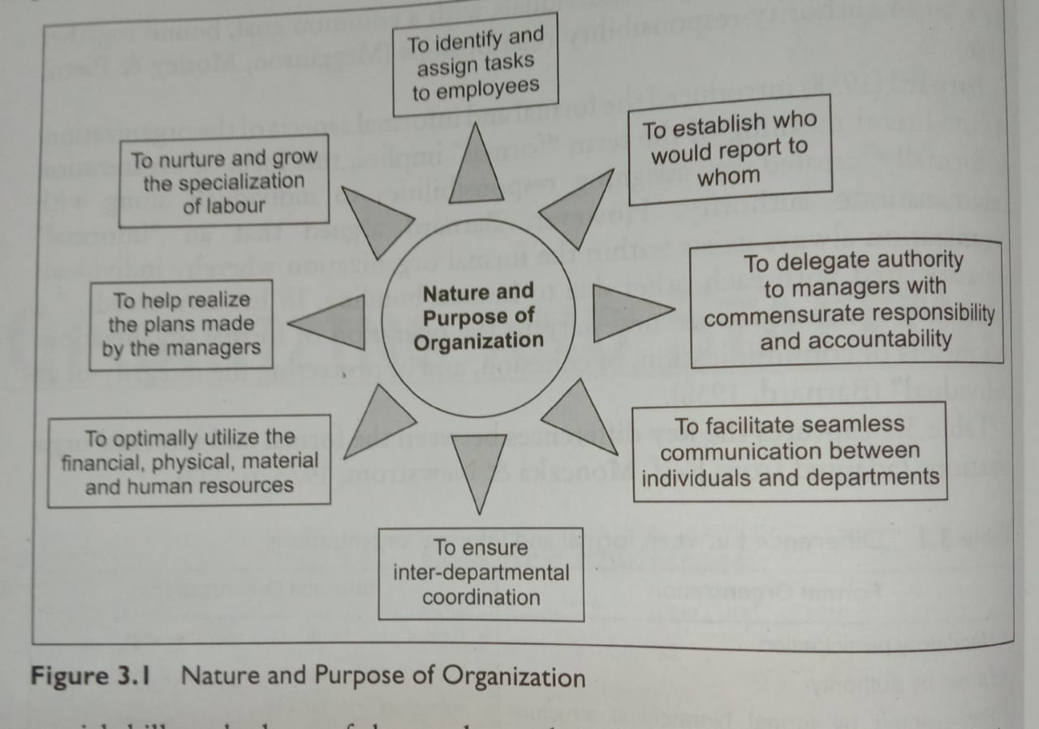

Slide 7
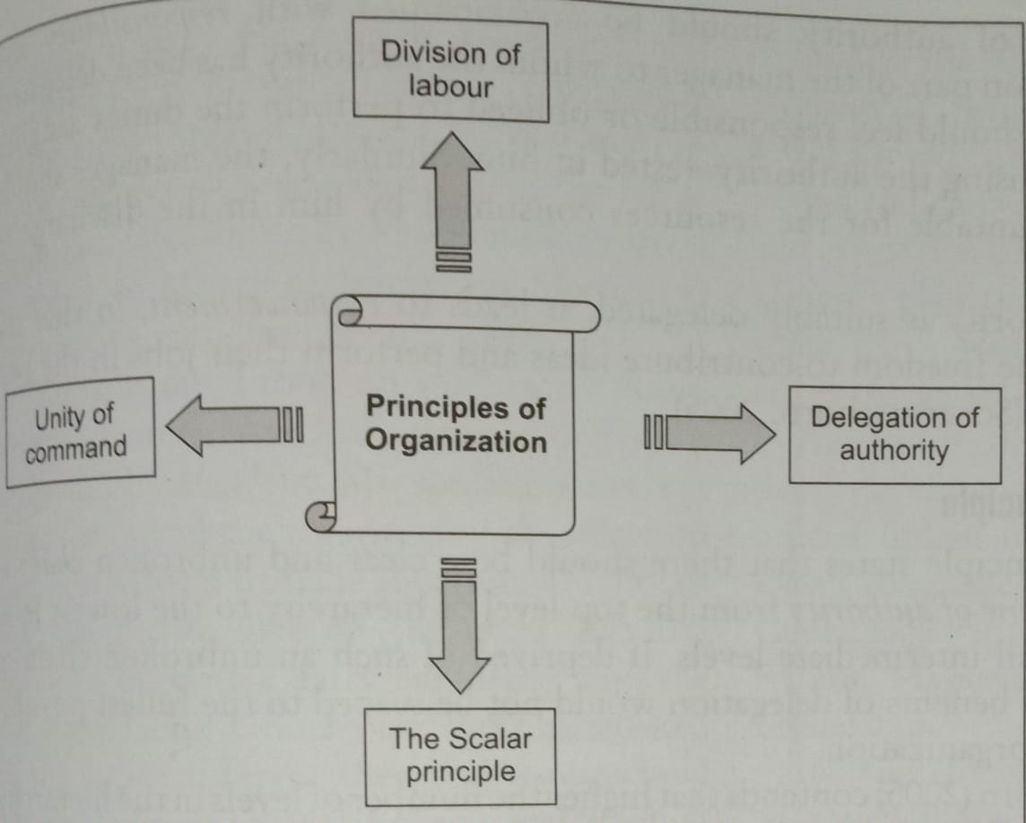

Slide 8
Principles of Organization
Division of labour: Also called the principle of specialization) was first highlighted by Plato in 350BC when he compared the workmanship of people in small cities with their counterparts in big cities. The assembly lines in automotive manufacturing have work stations in a sequence and on each work station, a worker performs a highly specialized task. For e.g., on one workstation, a worker fits the head lights to the chassis of the car which comes before his work station on a moving conveyor. On the next work station, another worker has the sole task of attaching the steering assembly to the car chassis. Yet another worker on the subsequent work station attaches the windshield to the chassis.
Delegation of authority: is the process by which managers allocate authority downward to the people who report to them. Delegation of authority should be accompanied with responsibility and accountability on part of the manager to whom the authority has been delegated. The manager should feel responsible or obliged to perform the duties assigned to him while using the authority vested in him. Similarly, the manager should be made accountable for the resources consumed by him in the discharge of duties.

Slide 9
The scalar principle: states that there should be a clear and unbroke chain of command or line of authority from the top level of hierarchy to the lowest level by including all intermediate levels. Schermerhorn(2005) contends that higher the number of levels in the hierarchy of the organization, the overhead costs increase, the communication flow slows down, decision-making becomes tardy and worst of all, the organization may lose contact with the customer.
Unity of command: recommends that every individual in the organization should report to a single boss. The situation may get even more complicated if the individual receives(at times conflicting) instructions from his/her boss and also from the boss’s boss.

Slide 10
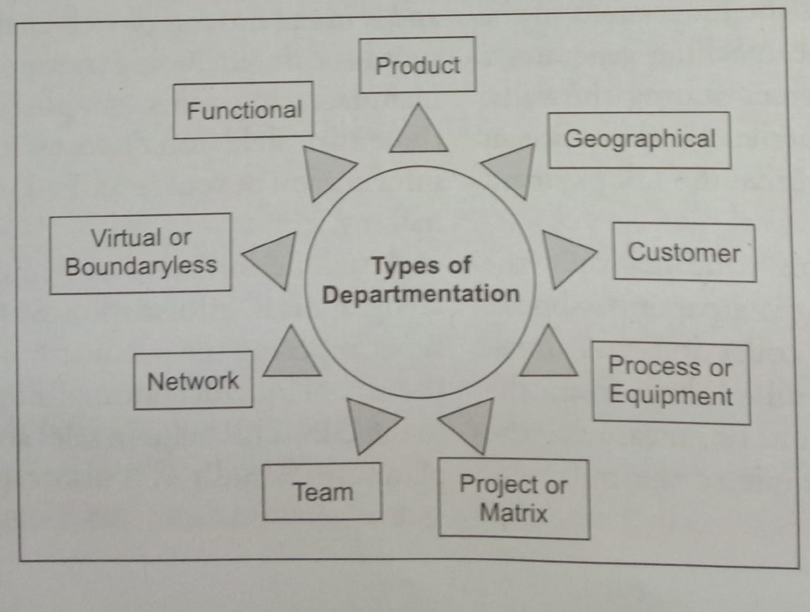

Slide 11
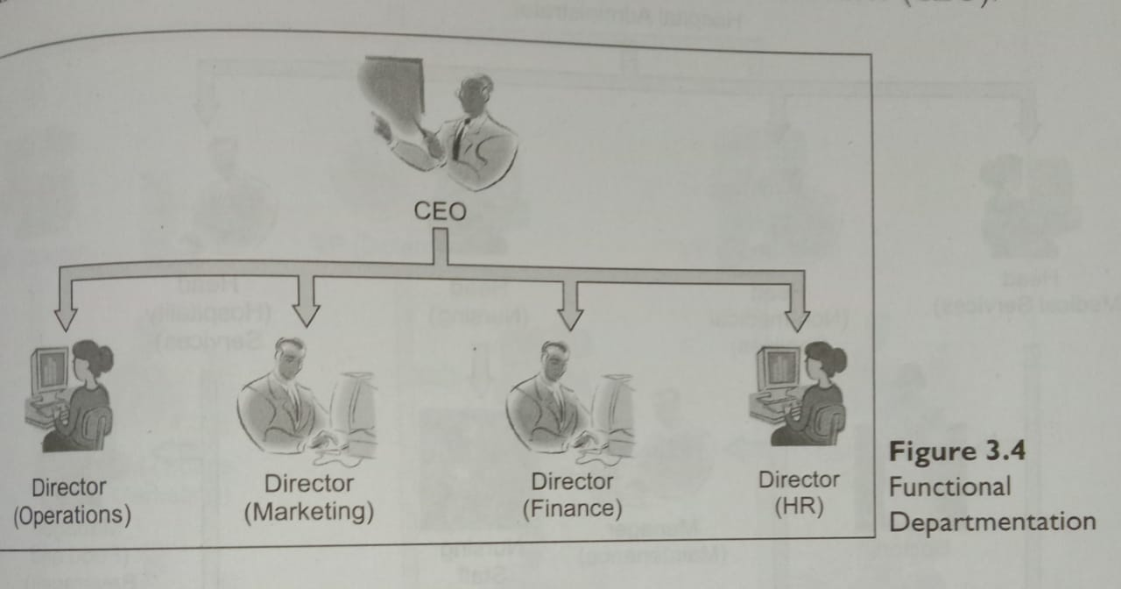
Types of organization Departmentation
Departmentation is the way in which an organization groups its various activities.
Functional departmentation: Similar activities or functional areas are grouped together. The directors of operations, marketing, finance, and human resources report to the Chief Executive Officer. A functional form of departmentation in a hospital, whereby the functional areas are medical services, non-medical services, nursing, and hospitality services.

Slide 12
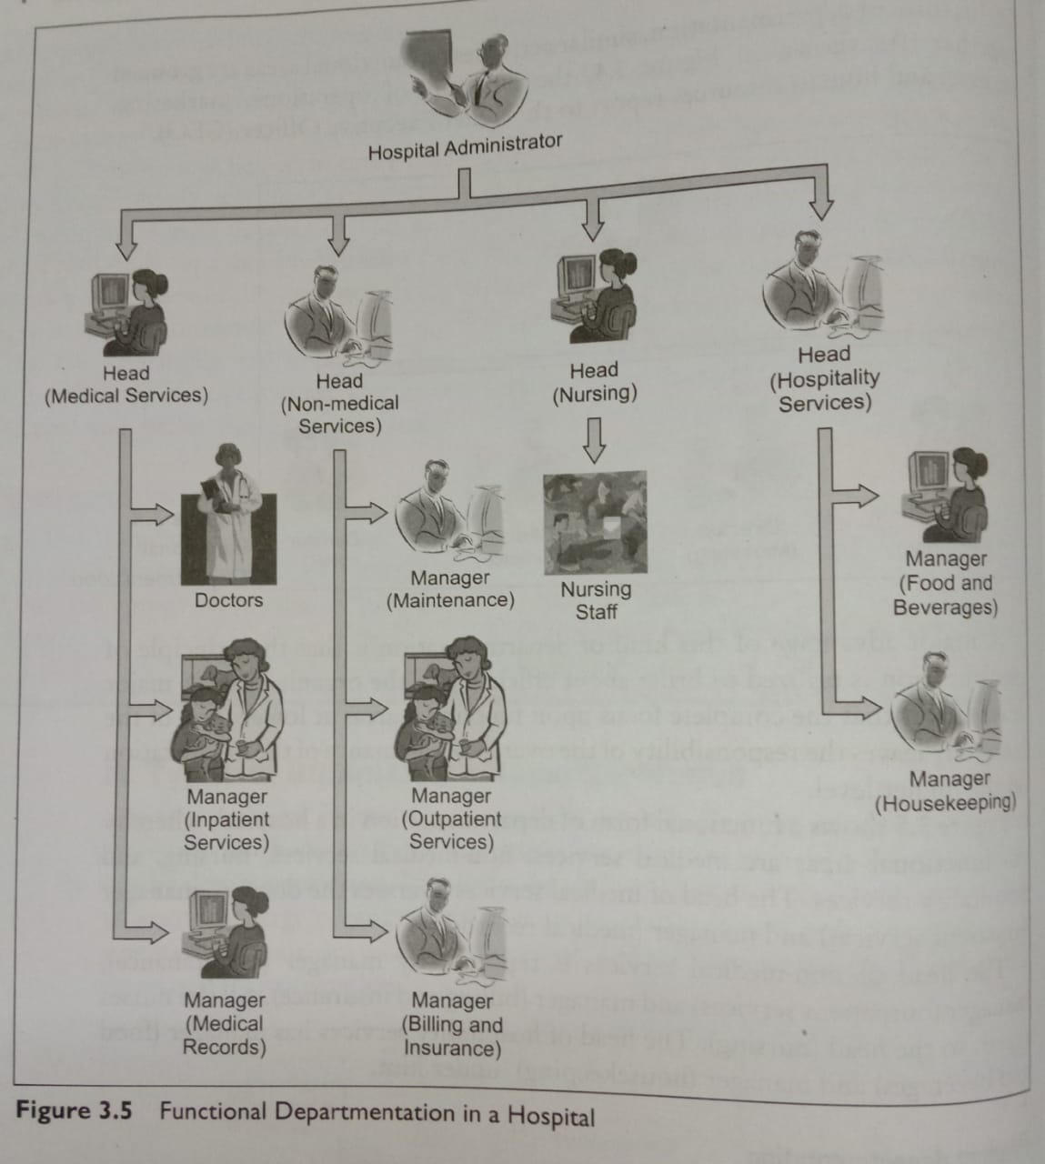

Slide 13
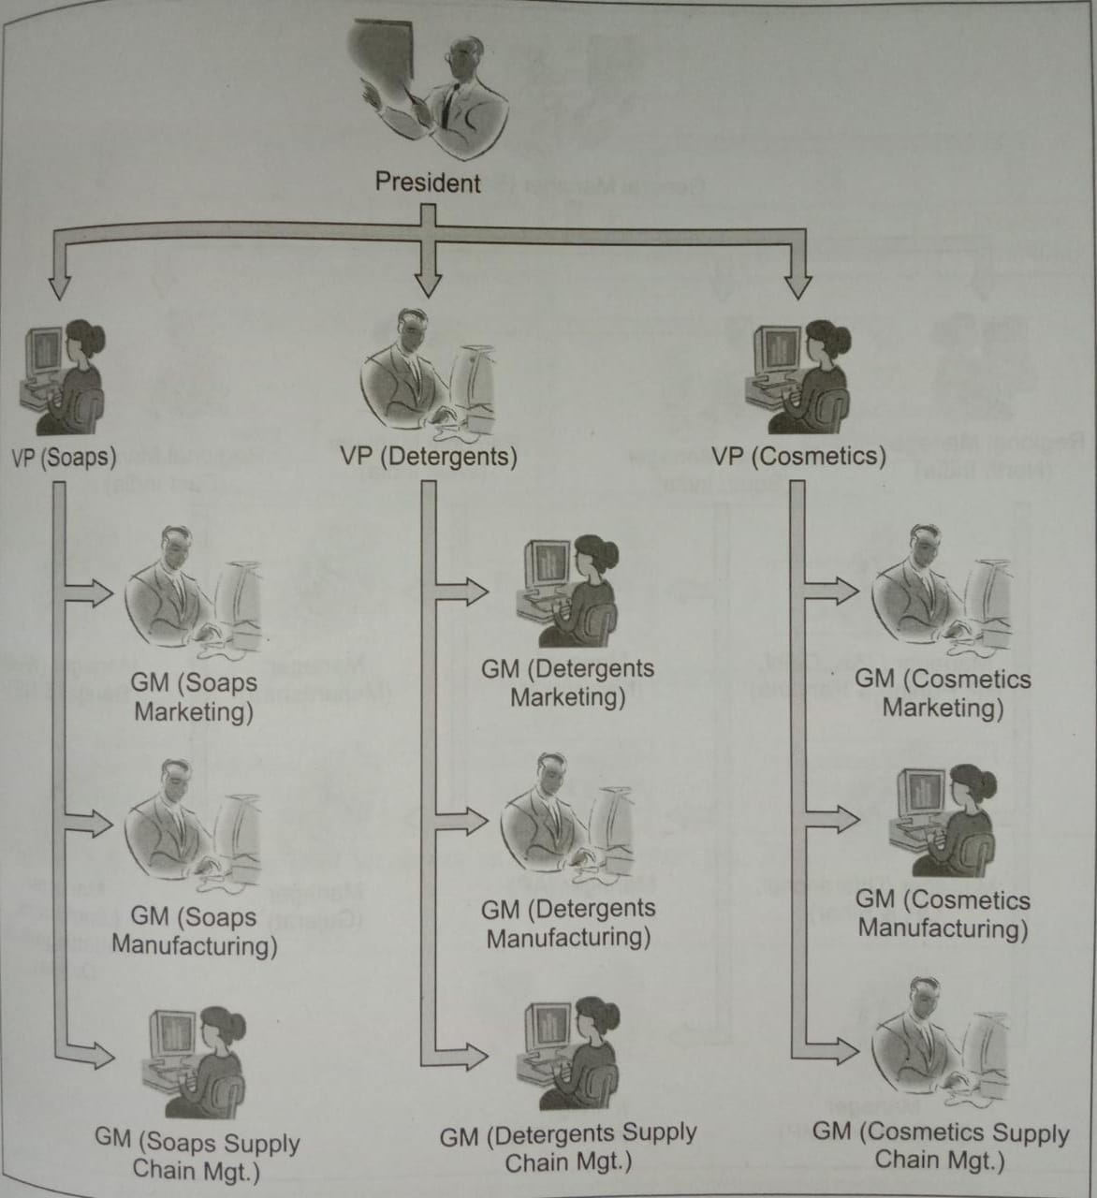
Product departmentation: For e.g., Vice-President(soaps), vice president(detergents) and vice president(cosmetics) all report to the president of an organization. Each with functional responsibilities of, say, marketing, manufacturing, and supply chain management of their respective products.

Slide 14
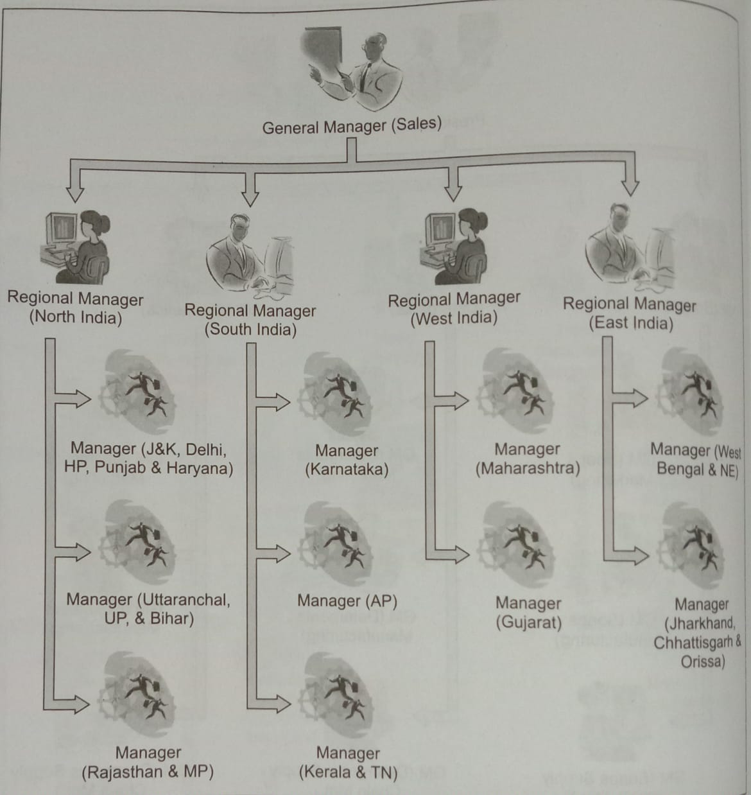
Geographical departmentation: is the grouping of the organization according to the territorial areas, nationally or internationally.

Slide 15
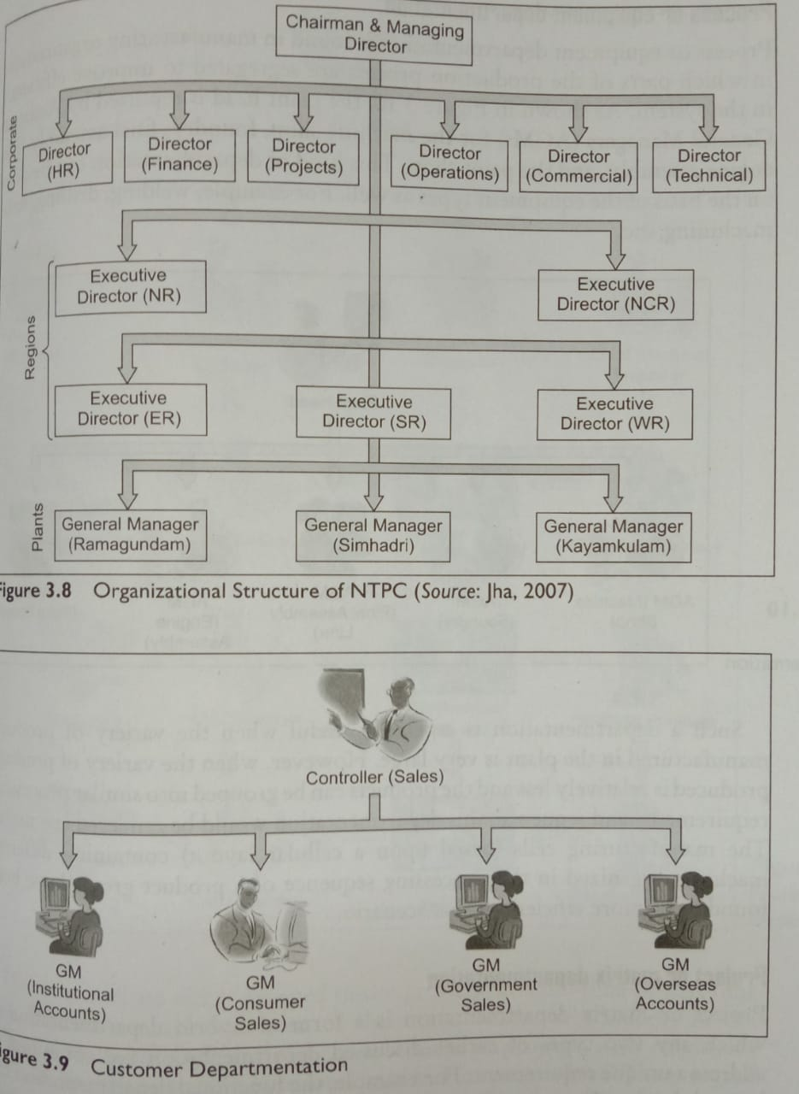
Customer departmentation: Here, managers are assigned different types of customers to service. A GM takes care of institutional customer accounts, another GM is in charge of consumer sales, the third GM is into Government sales, and the fourth GM services overseas customer accounts.

Slide 16
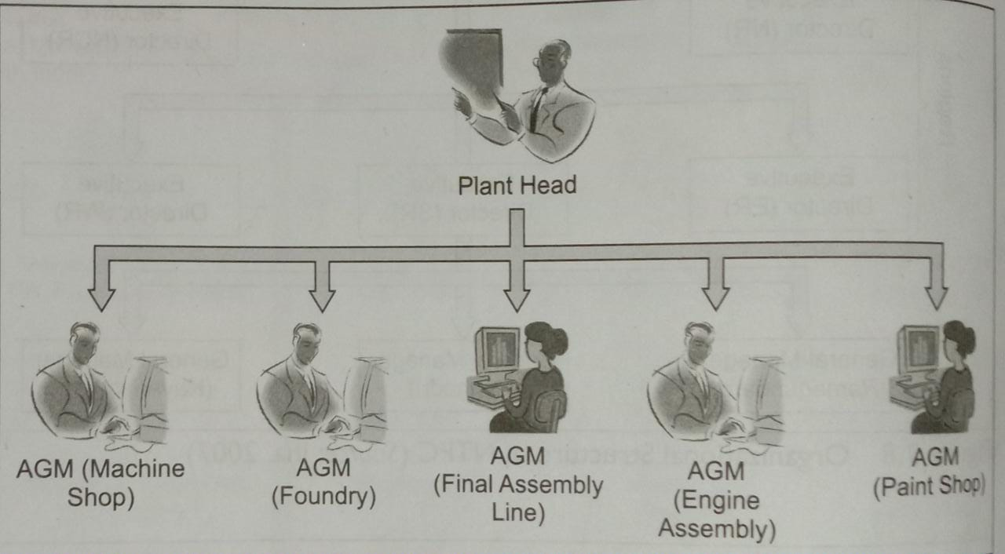
Process or equipment departmentation: is found in manufacturing organizations in which parts of the production process are segregated to improve efficiency in the system.

Slide 17
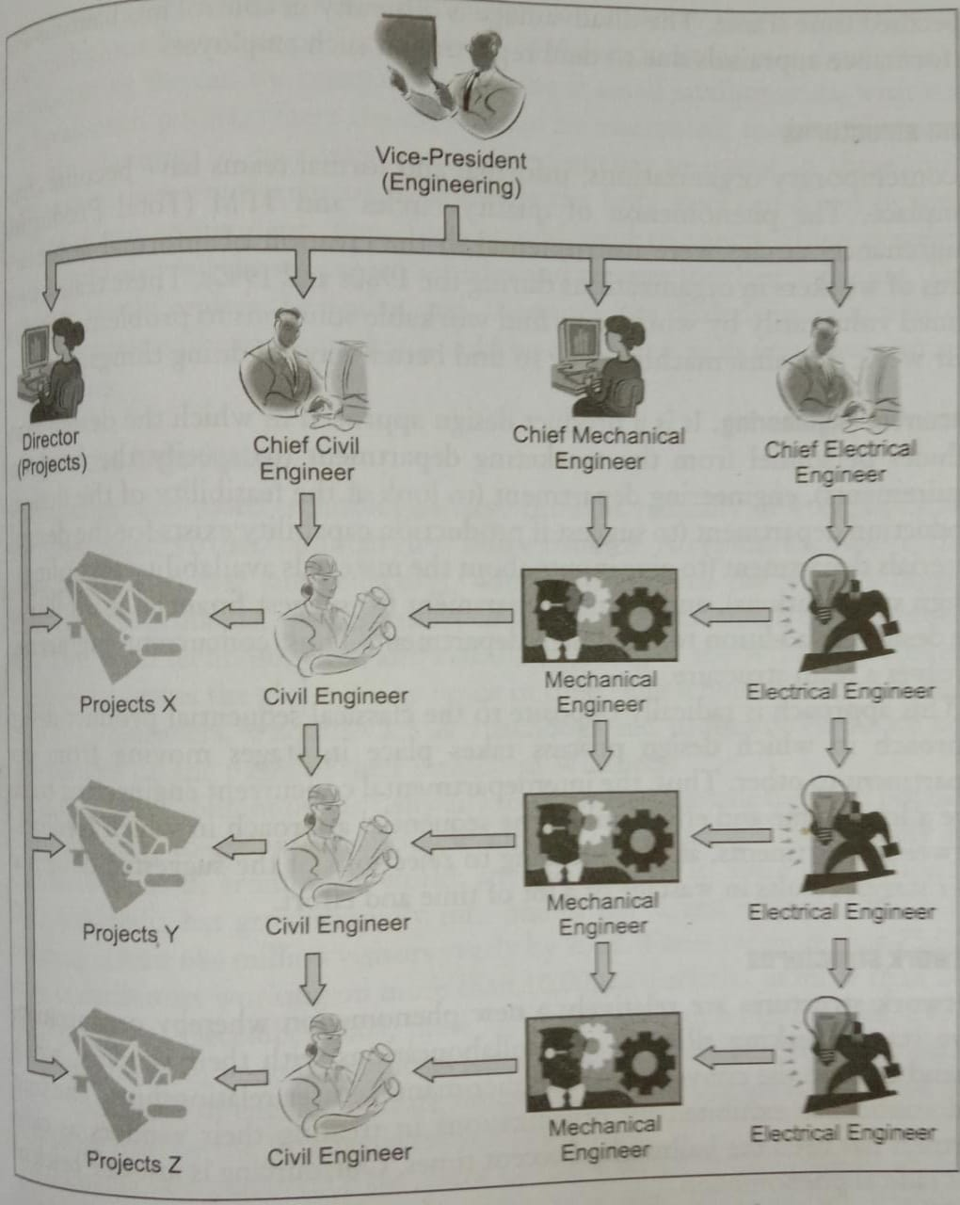
Project or matrix departmentation: is a form of hybrid departmentation in which any two types of earlier discussed departmentation are conjoined to address a unique requirement.

Slide 18
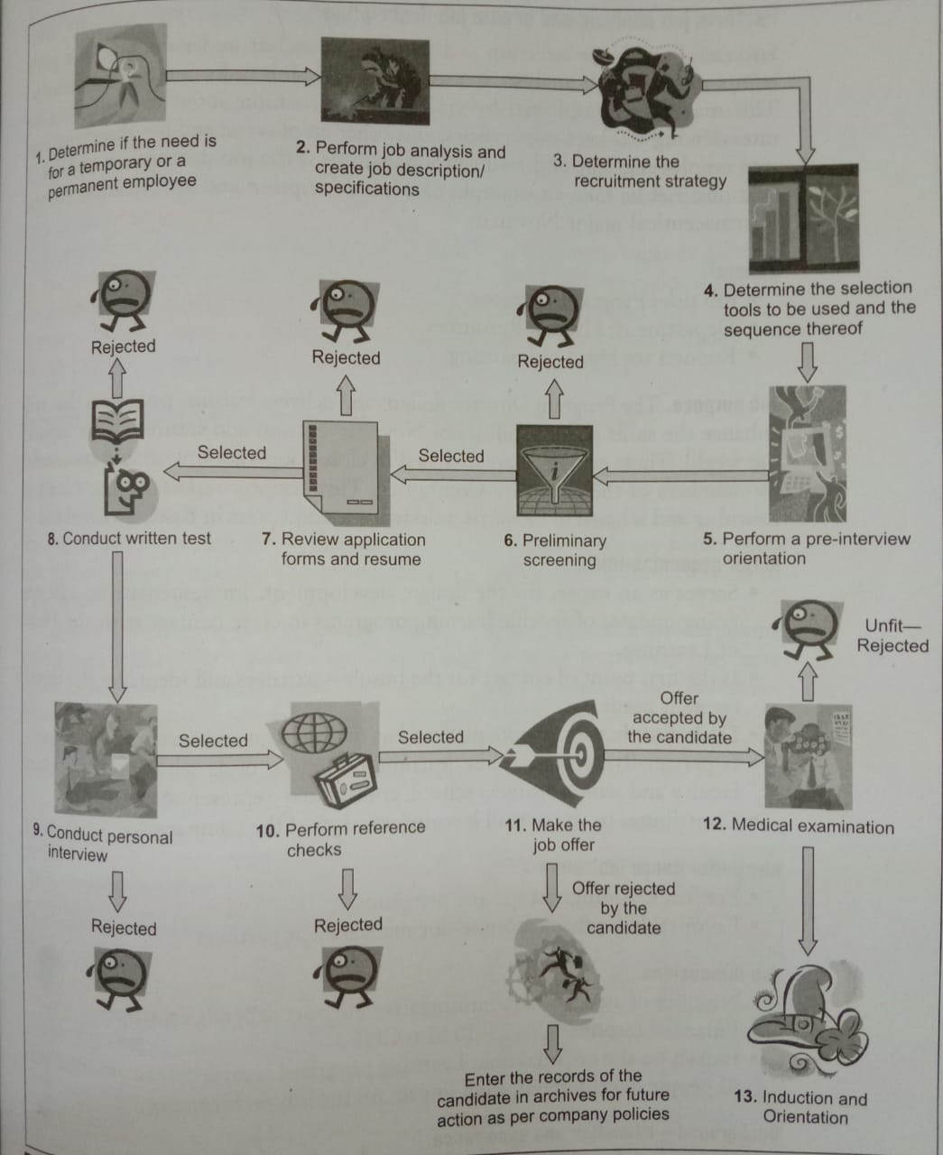

Slide 19
Team structures
In contemporary organizations, informal and formal teams have become commonplace. The phenomenon of quality circles and TPM(Total Productive Maintenance) circles were instrumental in the creation of informal voluntary teams of workers in organizations during the 1980s and 1990s. These teams were formed voluntarily by workers to find workable solutions to problems faced in their work domains/machinery or to find better ways of doing things.
Concurrent engineering: It is a product design approach in which the design team includes personnel from the marketing department(to specify customer requirements), engineering department(to look at the feasibility of the design), materials department(to give inputs about the materials availability according to design specifications), and finance department(to suggest financial feasibility of the design) in addition to the design department. Thus, concurrent engineering involves a team structure.
This approach is radically opposite to the classical sequential product design approach in which design process takes place in stages moving from one department to other. Thus, the interdepartmental concurrent engineering teams save a lot of time and effort unlike the sequential approach in which feedbacks between departments, at times leading to rejections of the suggested designs at later stages, results in wastage of a lot of time and effort.

Slide 20
Network Structures
Are relatively a new phenomenon whereby organizations have started making alliances and collaborations with their vendors, which extend beyond the conventional supplier-manufacturer relationships. The trust and confidence exhibited by organizations in treating their vendors as close partners has been the hallmark of recent times. Outsourcing is just one brick of this radical phenomenon.
With its Scorpio SUV, Mahindra & Mahindra has broken the unspoken rule that says automakers must design, engineer, and test their own vehicles while spending hundreds of millions of dollars in the process. Along the way, they can divvy up contracts to suppliers who will build the components for them. Mahindra, instead, tried something suppliers had been suggesting for years. The company built a brand-new vehicle with virtually 100 percent supplier involvement from concept to reality for $120 million, including improvements to the plant. The new Mahindra Scorpio SUV had all its major systems designed directly by suppliers with the only input from Mahindra being performance specifications and program cost. Design and engineering of systems was done by suppliers, as was testing, validation, and materials selection. Sourcing and engineering locations were also chosen by suppliers.

Slide 21
Tatas are trying to bring a new dimension to the network structure through their ambitious Nano car project. In view of socio-economic dimension in manufacturing the car, the company is looking at small satellite units, with very low break-even points, where the cars would be assembled, sold, and serviced. Tatas are planning to encourage local entrepreneurs to invest in these units, and to train these entrepreneurs to assemble the fully knocked-down or semi-knocked-down components that Tatas would send to them. These entrepreneurs would also sell the assembled vehicles and arrange for their servicing. This approach would replace the dealer, and, therefore, the dealer’s margin, with an assembly-cum-retail operation that would be combined with very low-cost service facilities.

Slide 22
Boundaryless organization
Leading-edge web-based technologies have brought radically new organization structures called virtual/boundaryless into existence. A typical example is that of “Wikipedia”(www.Wikipedia.org), which has become the world’s biggest online encyclopedia just within a short time span after its launch on 15 January 2001. Wikipedia is written collaboratively by volunteers from all around the world; anyone can edit it. Since its creation in 2001, Wikipedia has grown rapidly into one of the largest reference websites, attracting at least 684 million visitors yearly by 2008. there are more than 75000 active contributors working on more than 10,000,000 articles in more than 260 languages. As of December 2008, there are 2,677,698 articles in English. Wikimania is a conference for users of the wiki projects operated by the Wikimedia Foundation.

Slide 23
In the organizational structure of the State Bank of India, functional departmentation is evident with National Banking, Rural Business, Mid-Corporate, Corporate Banking, International Banking, Global Markets, and Associates & Subsidiaries. Under the National Banking functional unit, customer departmentation has been done with Personal Banking Business Unit, Government Business Unit, Small & Medium Enterprises Business Unit, Banking Operations, and Marketing-Cross Selling. Geographical departmentation has also been done for National Banking and Rural Business jointly in the form of Local Head Offices, Regional Offices and Branches.
In the organizational structure of Tata Tubes(a strategic business unit of Tata Steel), the functional departmentation is evident in the form of Financial Controller, Head(Strategy), Head(Tech group), Head(IT), Head(HR/IR), etc., while geographical departmentation has been done through Regional Sales Managers-North, East & Export, South, and West.

Slide 24
In the organizational structure of Infosys with functional departmentation on the top in the form of Chief Operating Officer, Chief Financial Officer, Director & Head(Administration, Education & Research, Human Resource Development & Infosys Leadership Institute), Director & Head(Delivery Excellence), etc. Customer departmentation has been achieved by its Industry Business Units like Banking & Capital Markets, Manufacturing, Insurance, Healthcare & Life Sciences, etc., while a product departmentation is there in the form of Horizontal Business Units like Enterprise Solutions, Consulting Solutions, Infrastructure Management Services, Product Engineering & Validation Services, and Systems Integration.

Slide 25
TYPES OF ORGANIZATION
Line, Military or Scaler Organization:
The line organization represents the structure in a direct vertical relationship through which authority flows. The line of authority flows vertically downward from top to bottom throughout the organization. The quantum of authority is highest at the top and reduces at each successive level.
Underline organization, each department is generally a complete self-contained unit. A separate person will look after the activity of the department and has full control over the department. The superior communicates his decision and orders to his subordinates.
The subordinates, in turn, can communicate them to those who are immediately under them. This type of organization is followed in military

Slide 26
The advantages of line organization are
(1) Simplicity
(2) Quick decision and speed of action.
(3) Unity of control.
(4) Clear division of authority and responsibility.
(5) Discipline and better coordination
(6) Direct communication.

Slide 27
Disadvantages
(1) The organization is rigid and inflexible
(2) Being an autocratic system, managers may become dictators and not leaders.
(3) There is scope of favor-ism and nepotism.
(4) Red-tape and bureaucracy.
(5) Lack of specialization.

Slide 28
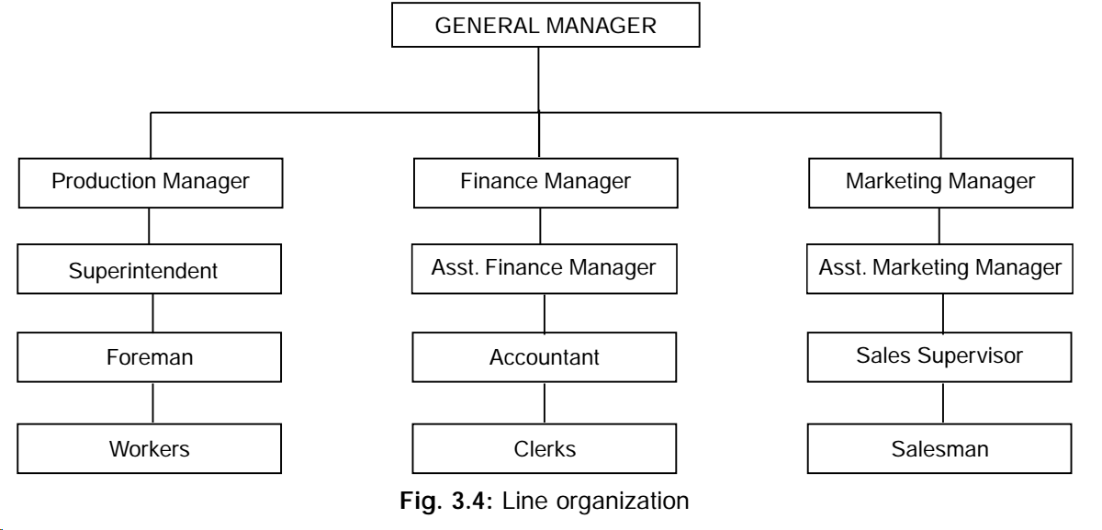

Slide 29
Functional Organization:
In functional organization the specialists are made available in the top positions throughout the enterprise. It confers upon the holder of a functional position, a limited power of command over the people of various departments concerning their function. Functional authority remains confined to functional guidance of different department.
Under functional organization, various activities of the enterprise are classified according to certain functions like production, marketing, finance, personnel etc., and are put under the charge of functional specialists. A functional incharge directs the subordinates throughout the organization in his particular area of business operation. That means that subordinates receives orders and instructions not from one superior but from several functional specialists.

Slide 30
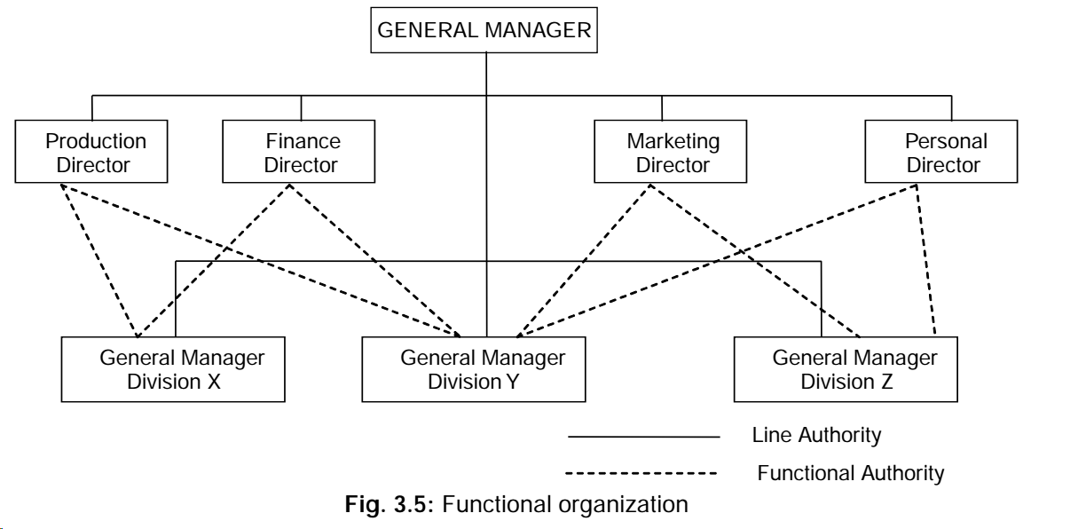

Slide 31
The advantages of functional organization
(1) Specialization.
(2) Reduces the burden on the top executives.
(3) Offers greater scope for expansion.
(4) A functional manager is required to have expertise in one function only. This makes it easy for executive development.

Slide 32
Disadvantages
(1) Violates principles of unity of command.
(2) The operation of functional organization is too complicated
(3) It develops specialists rather than generalists.
(4) Lack of coordination among functional executives which delays decision making.

Slide 33
Line and Staff Organization
In line and staff organization, the line authority remains the same as it does in the line organization. Authority flows from top to bottom.
In addition, the specialists are attached to line managers to advice them on important matters. These specialists stand ready with their speciality to serve line men as and when their services are called for to collect information and to give help which will enable the line officials to carryout their activity better.
The staff officials do not have any power of command in the organization as they are employed to provide expert advice to the line manager. In most of the organization, staff investigates and supplies information and recommendations to managers who takes decision. Specialized staff positions are created to give counsel and assistance in each specialized field of effort

Slide 34
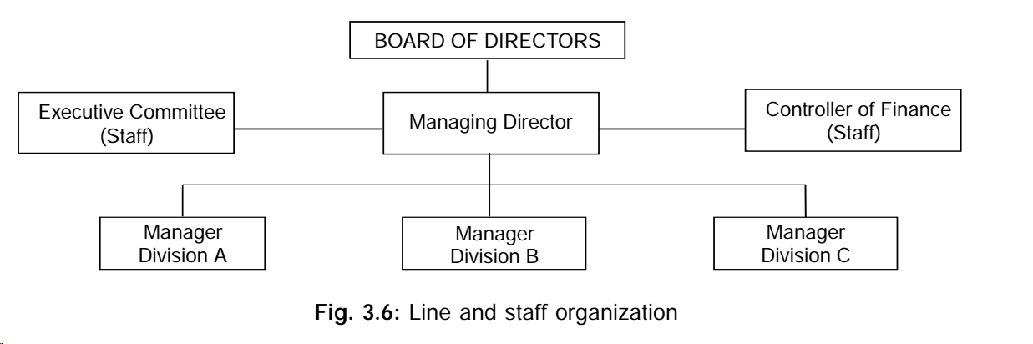

Slide 35
Advantages
(1) Specialized knowledge
(2) Reduction of burden on line managers.
(3) Better decisions, as staff specialists help the line managers
(4) Unity of command
(5) Flexible when compared to functional organization.

Slide 36
Disadvantages
(1) Allocation of duties between line and staff is not clear.
(2) There is generally conflict between line and staff executives.
(3) Since staff is not accountable, they may not be performing well.
(4) Difference between orientations of line and staff. Line executive’s deals with in problem in a more practical manner while staff, tend to be more theoretical.

Slide 37
Committee Organization /Committees
Are groups of two or more persons formed for the purpose of coordinating, advising, or decision-making. Committees are of two types: standing(or structural) and ad hoc. Standing committees are permanent in nature and are a part of the organizational structure, while ad hoc committees are dissolved after their intended purpose has been achieved.
Various committees in the governance structure of the Tubes SBU(Strategic Business Unit) of Tata Steel. Evidently, the audit committee, SHE(Safety, Health & Environment) committee, disaster management committee, general and central safety committees are all standing committees at the Tubes SBU. An e.g., of ad hoc committee can be the vigilance committee set-up to investigate the charges of corruption against an official in an organization. The committee is dissolved after it comes up with the report of its investigations to implicate or evict the concerned official.

Slide 38
Advantages of committees
Due to the involvement of many individuals in a committee, there is a generation of multiple ideas and alternative approaches to problem-solving. Thus, the likelihood of arriving at better solutions increases in a committee compared to an individual’s solution. The decisions taken by the committee are more acceptable to all due to “joint-ownership” of these decisions by the members.
By the virtue of many individuals involved in a committee, the possibility of corruption in its dealings or the abuse of power by an individual reduces considerably. If a vigilance committee implicates an official in a case of corruption, it is natural that this official would not be happy with such findings/decision of the committee. However, since such a decision is made by a group of people constituting the committee, any individual member would be saved of facing the brunt of this disgruntled official.

Slide 39
Disadvantages of Committees
In most instances, one or two individuals in a committee with an aggressive stance start dominating the group and may influence the decisions. If a decision proves out to be wrong, no particular individual in the committee can be made accountable for it. It has been observed that in most committees, the approach happens to be to arrive at a consensus. There are some merits of this approach, but the major disadvantage is that the best solutions may be overlooked at times in order to achieve a consensus.
Committees tie-up the time and effort of many individuals at the same time and hence, are expensive to the organization. In order to create a synergy out of the group, the coordination and leadership skills of the chairperson of the committee are of paramount importance.

Slide 40
Centralization Vs. Decentralization of Authority and Responsibility
Centralization and decentralization, just like delegation of authority, are also about the degree to which authority and responsibility is concentrated or dispersed.
Decentralization is a much broader concept and refers to the extent to which upper management delegates authority downward to divisions, branches, or lower-level organizational units, whereas delegation usually refers to the extent to which individual managers delegate authority and responsibility to the people reporting directly to them. The delegation of authority should allocate commensurate responsibility i.e. when one is given rights, one also assumes a corresponding obligation to perform. The decision of Alfred P Sloan to decentralize General Motors in 1921 is considered to be the first large-scale use of this approach.

Slide 41
The concept of centralization and decentralization has been defined from three perspectives: hierarchical, concentration, and participation. In Steer’s(1977) definition, centralization was viewed as the extent of power and authority held at the upper levels of the organization’s hierarchy. Decentralization referred to the extent of power and authority extended down through the hierarchy.
In contrast, the concentration approach is typified by the work of Hage and Aiken(1970) and views centralization as the concentration of power and decision-making in the hands of a small proportion of individuals, regardless of organization level.
The participation perspective is characterized by Hage’s(1980) assertion that the key to defining decentralization is the scope of actual participation or influence across hierarchical levels and substantive departments. In this approach, rather than the hierarchical position of the decision maker or dispersion of decisions across levels, the extent to which members participate in the decision process was viewed as the discriminator between centralization and decentralization.

Slide 42
Advantages of decentralization
In a decentralized organization, the performance of the managers is gauged on the basis of results achieved and objectives met rather than just their personality. Hence, the performance appraisal systems become more equitable.
The relatively liberal and open environment in decentralized organization leads to healthy competition amongst managers, who vie with each other to achieve more for the organization by using the authority and responsibility vested in them. Such an environment also nurtures creativity and ingenuity by allowing the managers to think rationally and act responsibly for best possible outcomes.
Decentralization at times means quick decision-making by managers on the site locally rather than to wait for decisions from the headquarters. This results in improved flexibility and responsiveness to the customer’s demands, which turns into a competitive advantage.

Slide 43
Disadvantages of decentralization
In order to make sure that the managers are well equipped with proper skills of decision-making, suitable training programmes have to be provided to them before passing on the authority and responsibility to them. This involves expenses in training and development.
If a centralized organization is transformed into a decentralized one, the initial resistance and discomfort on part of managers used to operating in the centralized way, is natural.
It is also expected that less experienced managers charged with the authority and responsibility in a decentralized organization may commit mistakes(especially in the beginning) which may prove costly for the organization.
The performance appraisal systems in a decentralized organization have to be refined and refurnished to capture the results achieved by managers with increased authority and responsibility.
Proper control mechanisms are a must for a decentralized organization so that top managers may have ready access to the real-time data and information about the key initiatives taken by the managers in the lower rungs.

Slide 44
Span of Control
Refers to the number of employees that report to a manager. When the span of control is relatively narrow(say 2-3 employees per manager), the organizational structure is taller(with 4 levels). On the other hand, a wider span of control(say 3-5 employees per manager) results in flatter organizational structure(with 3 levels) for the same overall number of employees(say N=19).
A manager may supervise even 20-30 employees under the effectively when the operations are simple and repetitive in nature(as in fast food restaurants like McDonald’s). At higher levels in the organization, however, it may be effective for only five to seven subordinates to report to a general manager. Recent studies show that the actual number for the span of control varies considerably-by industry, company size, and type of work being done.

Slide 45
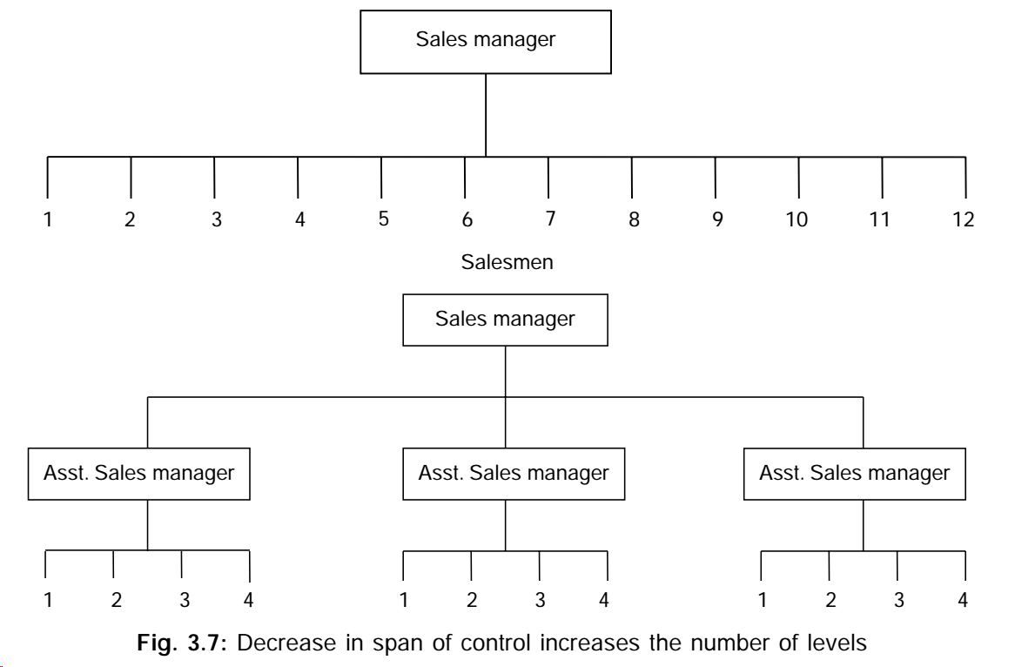

Slide 46
A median management ratio of 1 to 16 was found in the healthcare sector, but only 1 to 4 in information services. By company size, the median result also varies considerably-one manager to four employees in companies with 500 or less employees and one to nine in companies with 2000 to 5000 employees. Here, the management ratio can be calculated by:
Regular employees management ratio= Regular headcount/Management headcount
Regular headcount=Avg. no, of full-time and part-time regular employees
Management headcount= (Avg. no. of employees) – (officials and managers excluding project managers)

Slide 47
MBO and MBE
In his theory of Management by Objectives(MBO), Drucker(1954) emphasized the need for setting clearly spelled-out objectives for every manager at all levels of the hierarchy in an organization.
MBE stands for Management by Exception, a theory of management put forward by the father of scientific management, Fredrick W. Taylor. In Taylor’s view, routine decision-making should be handled by lower-level managers who report only exceptional cases to higher management.
MBE is an approach by which higher management devotes its time to investigating only those situations in which actual results differ significantly from planned results and leaves the routine decisions to lower level managers. The idea is that management should spend its valuable time concentrating on the more important items(such as shaping the company’s future strategic course). Thus, MBE is the delegation of authority and responsibility to the front-line supervisors. A typical e.g., is in quality control, when the supervisor is entrusted with the task of bringing back the process into control by finding an assignable cause for the variation going beyond the control limits set up for a particular parameter being measured.

Slide 48
Nature and importance of Staffing
The process of recruiting, retaining, developing, and nurturing the workforce is called staffing.
The staffing function in an organization has to recruit people with suitable qualifications, knowledge, and skills as per the current requirements of the organization. The workforce size may need to be increased at some point in time, while it may require curtailment at other times, in view of the overall business strategy.
Providing challenging and value-adding assignments to the existing talent in the organization helps in keeping them motivated and interested, while ensuring that the human resources are optimally utilized for the most value-adding activities for the organization. This requires meticulous performance appraisals of employees with well though of promotion procedures and career planning for employees. Training, education and job-related development not only help in retaining the employees, but also in enhancing their capabilities and capacities to work smartly and to be more productive for the organization. It is natural that over the period of time, some employee’s skills may need upgradation through re-training. Some employees may need to be shifted to other departments where their experience and skill may be utilized, while some others may have to be retrenched(laid-off) in a respectful manner, e.g., by way of voluntary retirement.

Slide 49
Process of Selection and Recruitment
Recruitment is a set of activities viz. advertising, establishing preliminary contacts and performing initial screening to create a qualified pool of job applicants for an organization. Selection involves choosing from a pool of applicants(created by the recruitment process) the person or persons who offer the greatest performance potential(Schermerhorn, 2005).
Temporary or permanent employee?
The first step in the selection and recruitment process is to determine if the job should be filled by employing a temporary or a permanent employee. When an employee suddenly exits from the organization leaving behind a vacancy to be filled urgently, it is worthwhile in most instances to find a temporary employee to fill the post to allow for suitable timeframe for formal selection and recruitment of a permanent employee. In other scenarios, a particular job may be seasonal in nature and thus, temporary employees would be more suitable for such a job. For e.g., retail stores usually increase the number of employees during the festival season like Deepawali, Christmas, and Eid, keeping in view the huge rush of customers during this time. Many of these employees are temporary and are laid-off after the season gets over. Temporary employment gives the opportunity to the employee to demonstrate his capabilities to the employer and also, to learn the skills typical of the organization.

Slide 50
Perform job analysis and create job description
A job analysis is used to identify job tasks and responsibilities. This may be accomplished by collecting information about the position; by interviewing workers, supervisors, and other employees; and by observing current employees. The end result of job analysis is the job description and specifications.
Let us take an example of a job description and specifications at the pharmaceutical major Novartis:
General:
-Job title: Program Director
-Department: Human Resources
-Reports to: Head of Learning
Job purpose: The Program Director designs and delivers learning programs that will enhance the skills and capabilities of Novartis’ current and future leaders around the world. These programs are designed in close cooperation with and sponsored by members of the Executive committee. This position reports to the Head of Learning and is based in Novartis worldwide headquarters in Basel, Switzerland.

Slide 51
Major accountabilities
-Serves as an expert for the design, development, implementation, and ongoing updates of specific learning programs in close contact with the Head of Learning.
-Is the first point of contact for the business partners and identifies the development needs
-Deals directly with all potential vendors in the design and development phase
-Is personally present in key learning programs, deals with internal senior faculty and senior business school, consultancy representatives
-Contributes to the overall learning strategy of the company
Key performance indicators
-Feedback/Ratings on specific programs
-Favourable feedback from senior management partners
Job dimensions
-Number of associates: Administrative support depends on scope
-Financial responsibility: 5-10 Mio CHF
-Impact on the organization: Learning programs regarded as an essential part of people development, high impact on the job performance
Background-education and experience
-University degree with a preference for MBA
-Strong business acumen
-Excellent people and communication skills
-6-10 years experience in an internationally operating company

Slide 52
Determine the recruitment strategy
The next step involves reaching out to the intended audience with the information that a vacancy exists for a particular position in the company. The objective here is to have as many applicants as possible for the vacancy so that the employer gets ample choice to find the best candidate for the job. Ways to advertise the position include: company website, present employees, previous applicants, trade journals, newspapers, vocational schools, universities, and employment agencies.
Many times, people come looking for work when there is no vacancy existing in the organization at that point in time. It is a good idea to make them fill up a simple form(requiring bare minimum information) so that they may be contacted when there is a relevant opening.
Determine the selection tools to be used and the sequence thereof
There are various tools to check the abilities, knowledge, and skills of the applicants. For e.g., preliminary screening(say by using group discussions), application forms/resumes, written tests, personal interviews, reference checks, letters of recommendations, medical check-up, etc. Some tools are better than the other in some respects. Therefore, it is best to use a combination of them in a predetermined sequence.
Factors reflecting worker motivation, such as punctuality and attendance, may be elicited within the interview, but contacting previous employees may give more reliable information. If possible, try to verify evidence of specific skills, knowledge, and abilities at more than one point in the selection process. Some of the tools like the preliminary screening and application forms may be used to eliminate a proportion of the applicants when the number of applicants is very large.
Inviting candidates to participate can include a description of the steps in the process, their sequence, and any required applicant preparation. The sequence of hurdles may be programmed to minimize travel and expense for both applicants and employer. A preliminary telephone interview with geographically distant applicants may eliminate unnecessary travel. Written tests can sometimes be mailed when they can be administered to applicants by a trusted, qualified third party(Billikopf,2003).

Slide 53
Perform a pre-interview orientation
This orientation should brief them of the company profile, its activities, and future outlook. It allows the candidates to clarify any doubts about the job and the company by asking questions. It also helps in arousing the interest of the potential candidates to apply for the job in the company.
Preliminary screening
When the number of applicants for a job is very large, preliminary screening can be performed to eliminate less worthy candidates. Group discussions have been found useful for screening candidates for managerial positions. The communication skills, listening skills, team skills, and leadership acumen of the candidates are tested through group discussions. Some organizations prefer to conduct objective-type tests to screen out candidates.
Review application forms and resumes
Well-drafted application forms aid in capturing the academic and employment history of candidates. The advantage of a standard application form vi-a-vis resume is that it facilitates easy comparison of the profile of two or more candidates on various parameters-gaps in employment, too short stints with organizations in the past, etc.-evident in the application form provide opportunity to the selection committee to seek clarifications later during the personal interview stage.

Slide 54
Conduct written test
There are various types of tests to measure knowledge, ability, skills, aptitude, attitude, honesty and personality. These are: power tests(to gauge the knowledge and analytical abilities), speed tests(to measure the ability to perform repetitive tasks in a set time frame), open-book-open-web exams(in which the candidates are allowed access to study material and the Internet), etc.
The formats of the tests can also be varied, e.g., multiple-choice, short-answer, fill-in-the-blank, and long-answer or essay questions. Essay questions provide better insights about the candidate’s written communication skills.
Conduct personal interview
Personal interview provides a perfect opportunity to the selection committee to check the personality, knowledge, verbal communication skills, etiquettes, dressing sense, and ability to respond to situations impromptu. Structured interviews require the questions and their sequence to be determined prior to the interview.

Slide 55
Perform reference checks
It provides various insights about the personality, academic and employment history of the candidate. The details of the people to be contacted for referencing are usually sought from the candidate in the application form/resume itself. Reference checks can be performed through email or by phone calls.
Make the job offer
If the reference checks result in good feedback about the candidate, an offer letter is sent to the candidate. Otherwise, it is customary to send a formal rejection letter. If no response is obtained from the candidate or a negative response about the offer is received, the records of the candidate are entered in archives for future action as per company policies. The policies of some organizations prohibit such an applicant from applying again for a job, while other organization have a lenient and open policy whereby the candidate gets an opportunity to apply again in future.
The offer letter should include a joining date after consultation with the candidate. Normally, there is a notice period varying from 1 month to 3 months, which has to be given by the candidate to his current employer before exiting. If the selected candidate requires relocation to a new place, some time period for transiting and settling down should be allowed. The relocation expenses are normally borne by the employer and all the modalities in this regard should be mentioned in the offer letter.

Slide 56
Medical examination
A post-offer pre-employment medical examination(of the candidate and dependent family members) is a must especially when the company has to cover the candidate and his dependent family members by medical insurance. The cost of such a medical examination is borne by the employer.
Induction and orientation
Help employees in understanding the various facets of the organization. Unwritten rules, traditions or informal perks should be discussed with employees as part of the orientation period.
The first day in office is always special for everybody. Therefore, proper arrangements have to be made before the joining date of the employee. This includes suitable workstation/room, stationary, computer hardware/software, and a welcome gathering(as per the traditions of the organization).

Slide 57
Identifying selection tools to measure skills/knowledge/abilities
Skills/knowledge/abilities X-Principal method for measuring skill O-Secondary method | Preliminary screening | Application form and resume | Written test | Personal interview | Reference checks
Educational qualifications |  | O |  |  | X
Subject knowledge |  |  | X | O
Oral communication skills | O |  |  | X
Written communication skills |  | O | X
Leadership skills | O |  |  |  | X
Team spirit | O |  |  |  | X
Analytical ability |  |  | X
Computer Skills |  | O |  | X
Dressing sense and physical appearance | O |  |  | X

Slide 58
Review Questions
Define organizing and organization.
Explain the nature and purpose of organization.
What is meant by division of labour?
What is delegation of authority and the scalar principle?
What is unity of command and why is it important?
Define departmentation and enumerate its various types.
Explain functional departmentation by taking a suitable example.
What is product departmentation? Give a major advantage and a major disadvantage of product departmentation.
Explain geographical departmentation by taking a suitable example of an Indian organization.
What is meant by customer departmentation? Explain it with an example of an Indian organization.
Explain process or equipment departmentation.

Slide 59
How does project/matrix organization violate the principle of unity of command?
Explain the contemporary organization structures-team, network, and boundaryless
What are committees? Explain their advantages and disadvantages.
What is decentralization? Explain its advantages and disadvantages.
How does the span of control impact the organizational structure? What is an ideal span of control?
What are the various reasons that put pressure upon organizations to overlook the recommended range of the span of control?
What is management by exception? How is it similar/different from management by objectives?
What is staffing? Highlight its nature and importance.
Make a schematic diagram to display various steps in the selection and recruitment process.

Slide 60
Explain the job description/specifications by taking a suitable example.
How are the selection tools to measure skills/knowledge/abilities identified?
Explain the various points to be taken care of while performing the steps of creating job offer letter, medical examination, and induction/orientation.
How are formal and informal organizations different from each other? Can both these co-exist at the same time?
Define recruitment. How is it different from selection?

