Slide 1
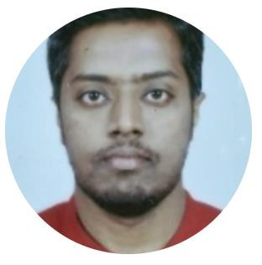

Name: Chethan M R
chethan.m@slkgroup.com
+91 – 8792382202
Specialized Skills
Background
CI CD pipelines using Jenkins and Harness, Source code tools like Git and Bitbucket.
Artifactory tools like Jfrog. Cloud- AWS EC2,EBS,IAM,
VPC, S3, ELB, Autoscaling.
Containerization using Docker and Orchestration using Kubernetes.
DevOps & DevSecOps Engineer with 5 year's experience in designing, testing and implementing infrastructure and applications. Consistent Team player with exemplary multitasking skills.
Setting up CI CD pipelines to automate deployments using
Jenkins and Harness, source code tools like git and bitbucket, Artifactory tools like Jfrog and Nexus.
Aws Cloud services like EC2,VPC, S3, Load Balancer, Autoscaling
Containerization using Docker and Orchestration using
Kubernetes.
Tools
Experience Summary
SLK Software(January 2024 – Present)
Linux,
Github, Bitbucket
AWS
Shell Script, Jenkins, SonarQube, Harness,
Docker, Kubernetes, OCP and Helm.
CD transformation for 10+ applications for java-based applications.
Designed and implemented end to end workflows and pipelines
for Lower and Higher Environments.
Setting up End to End CD pipelines on Harness to automate deployment to target server using helm chart on OCP cluster and VM based deployment using Templates.
Creating services, environments, connectors, secrets and
templates on harness.
Implemented rollback mechanism, created auto triggers,
minimize the manual intervention.
HCL Technologies - DevOps Engineer (Oct-2019-Oct 2013)
Executed DevOps functions for Insurance Group -UK based leading health life insurance, as well as for the property and casualty market.
Implemented a continuous delivery pipeline involving Jenkins & Docker to complete the automation from commit to deployment.
Implemented the setup for master slave architecture to
improve the performance of Jenkins.
Supported Dev team with troubleshooting build failures
artifactory repository maintenance in S3 Storage.
Monitor AWS resources, set a notification alarm in case of trouble through Cloud Watch.
LinkedIn profile :
www.linkedin.com/in/chethan-ramaiah
Certifications:
Harness Certified Expert – Continuous Delivery & GitOps Developer

