Slide 1
Clustering Indian Cities into Tiers based on Availability of Facilities
By
Chethan Kille

Slide 2
How is Clustering helpful?
The cities in India are clustered into multiple tiers based on availability of essential facilities like: health, education, food, services, transport, etc.
This clustering of the cities helps both private & public organizations who want to expand their business.
This helps in identifying cities that have yet to experience major growth. It is cheaper for the organizations to set up business here, due to comparatively lower initial cost & lesser competitors.
It also helps government to provide basic healthcare and public transport facilities in these cities.

Slide 3
Data Acquisition
The dataset of 212 Indian Cities is collected from https://simplemaps.com/data/in-cities. This contains basic information like population, state, latitude, longitude
Using Foursquare API we get a list of venues categories: Medical Center, College & University, Food, Shop & Service, Travel & Transport within a radius of 5km for each city
Both the dataframes are merged to get the complete dataframe.
Higher the number of venues for a city better the tier

Slide 4
K-Means Algorithm
We use K-Means to cluster the cities since we do not have pre defined categories.
Based on the distribution of features we select 4 clusters(tiers)
K-means predicts the labels for the cities as: 0,1,2,3
The face value of the label is not representative of the tier. We have to check the value of the features to assign a tier to a label. Higher the values better the tier.
Once we ascertain the values tiers are assigned to the labels.

Slide 5
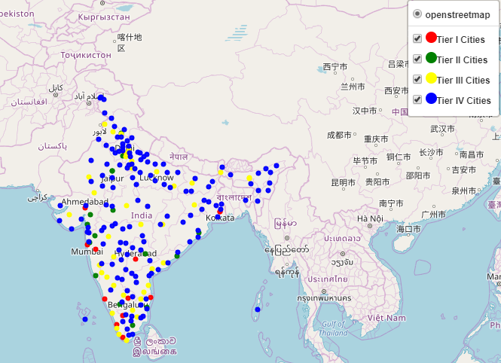
Result of K-Means

Slide 6
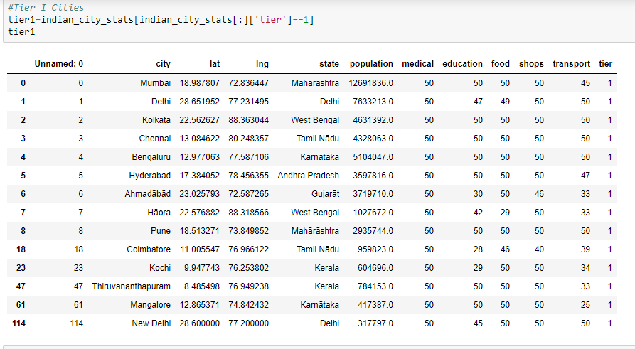
Tier I Cities

Slide 7
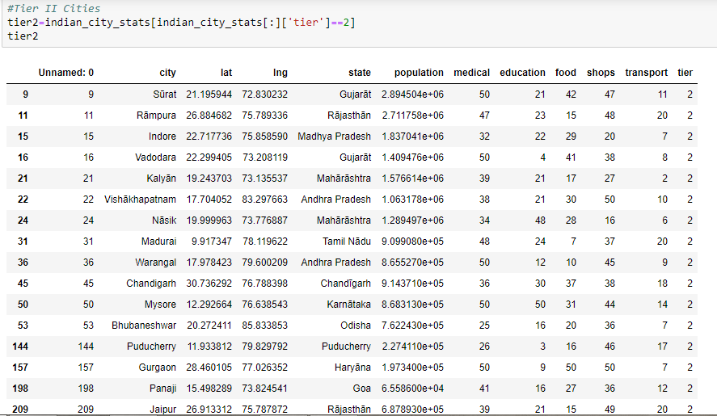
Tier II Cities

Slide 8
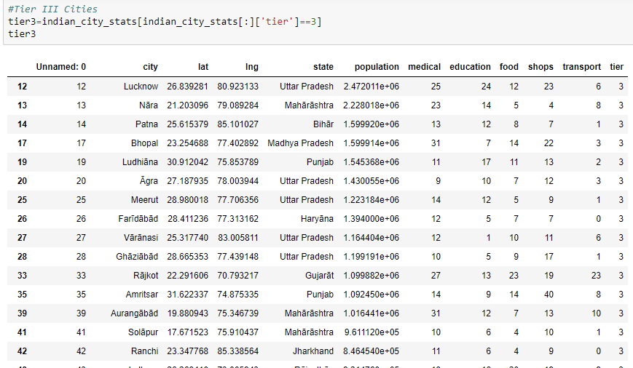
Tier III Cities

Slide 9

Tier IV Cities

Slide 10
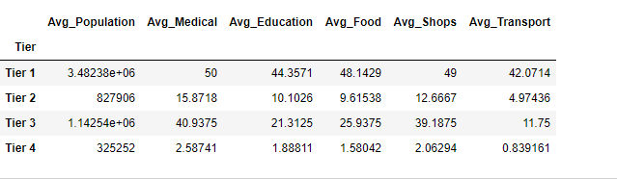
Statistics of the Tiers

Slide 11
Conclusion
Thus our idea to cluster cities reveals a major disparity in the availability of facilities across the tiers
Lower tiers have yet to experience growth which makes them potentially rewarding for setting up businesses since even these cities have a healthy population.

