Slide 1

Business Case – Data Used
Orion Star Sports & Outdoors is a fictitious global sports and outdoors retailer with traditional stores, an online store, and a large catalog business. The corporate headquarters is located in the United States with offices and stores in many countries throughout the world. Orion Star has about 1,000 employees and 90,000 customers, processes approximately 150,000 orders annually, and purchases products from 64 suppliers.

Slide 2
Orion Star Data
As is the case with most organizations, Orion Star has a large amount of data about its customers, suppliers, products, and employees. Much of this information is stored in transactional systems in various formats. Using applications and processes such as SAS Data Integration Studio, this transactional information was extracted, transformed, and loaded into a data warehouse. Data marts were created to meet the needs of specific departments such as Marketing.
libname orion '/tutorials/eg/data/ecprg1';

Slide 3
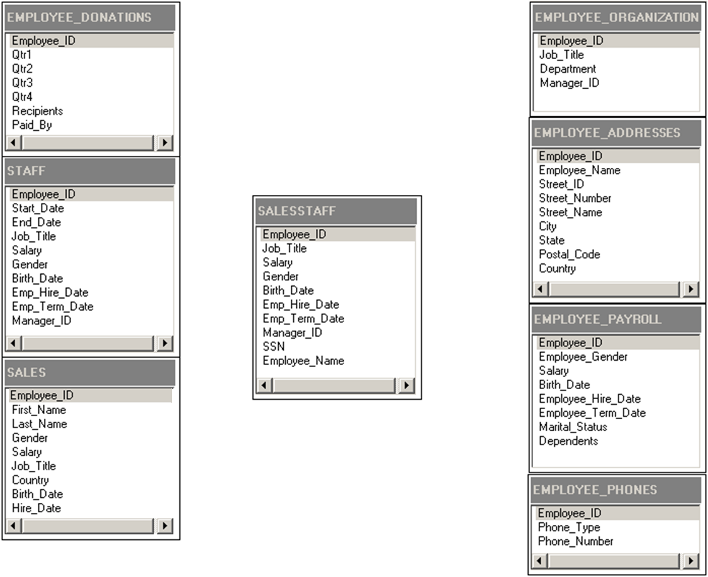
Orion Star Data Relationships
Employee Data
Employee_ID is the key column for HR data.

Slide 4
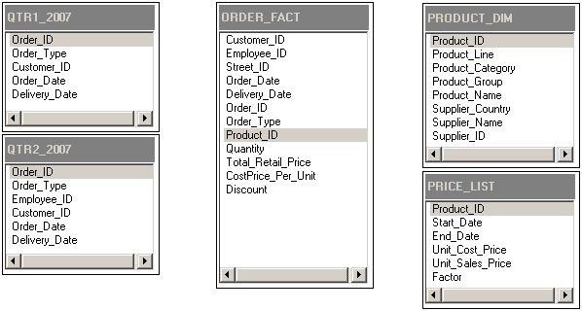
Orion Star Data Relationships
Order Data
Order_ID is the key column for Order data.
Product_ID is the key column for Product data.

Slide 5
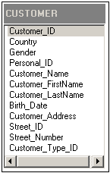
Orion Star Data Relationships
Customer Data
Customer_ID is the key column for Customer data.

Slide 6
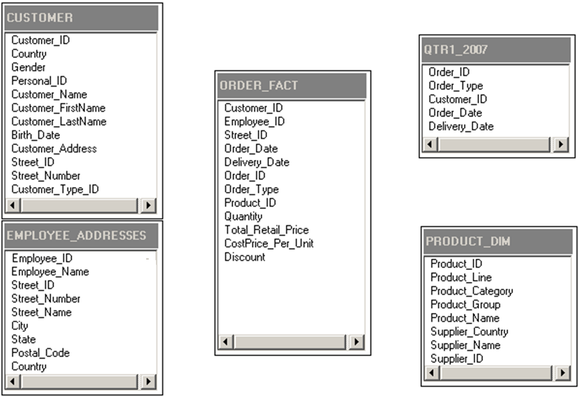
Orion Star Data Relationships
Relationships between Types of Data

