Slide 1



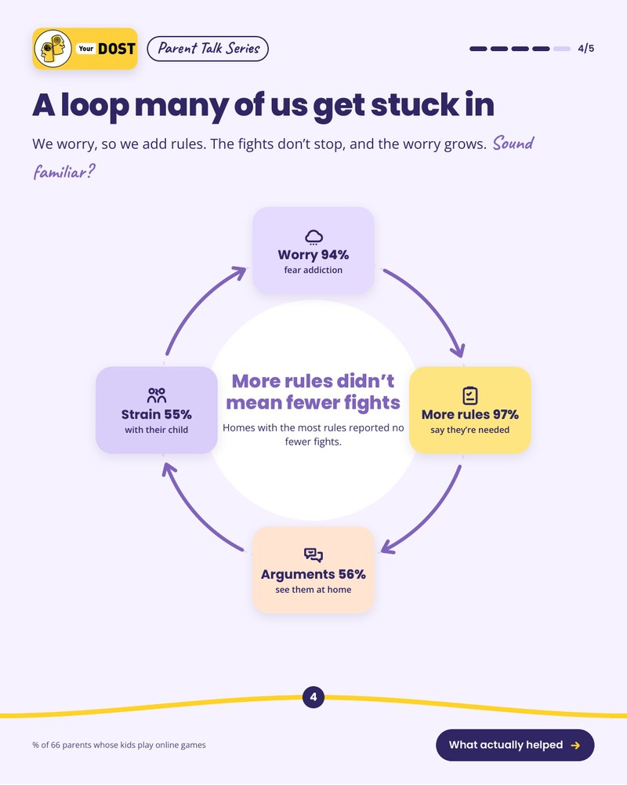

Click here: insights and the full analysis →
Open the carousel PDF →

Slide 2


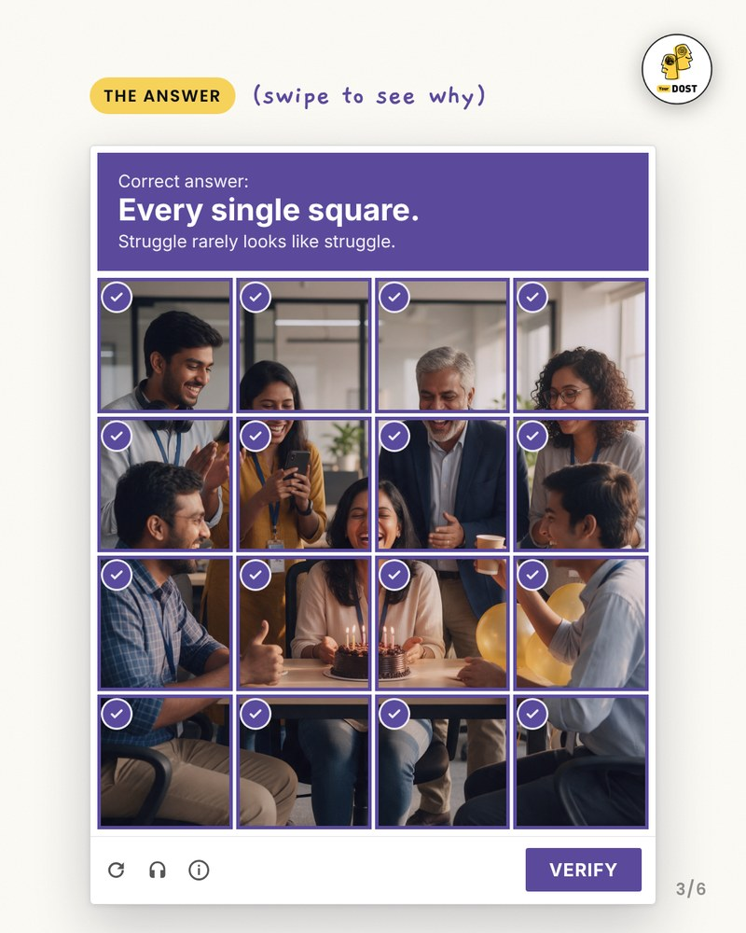




Slide 3







