Slide 1
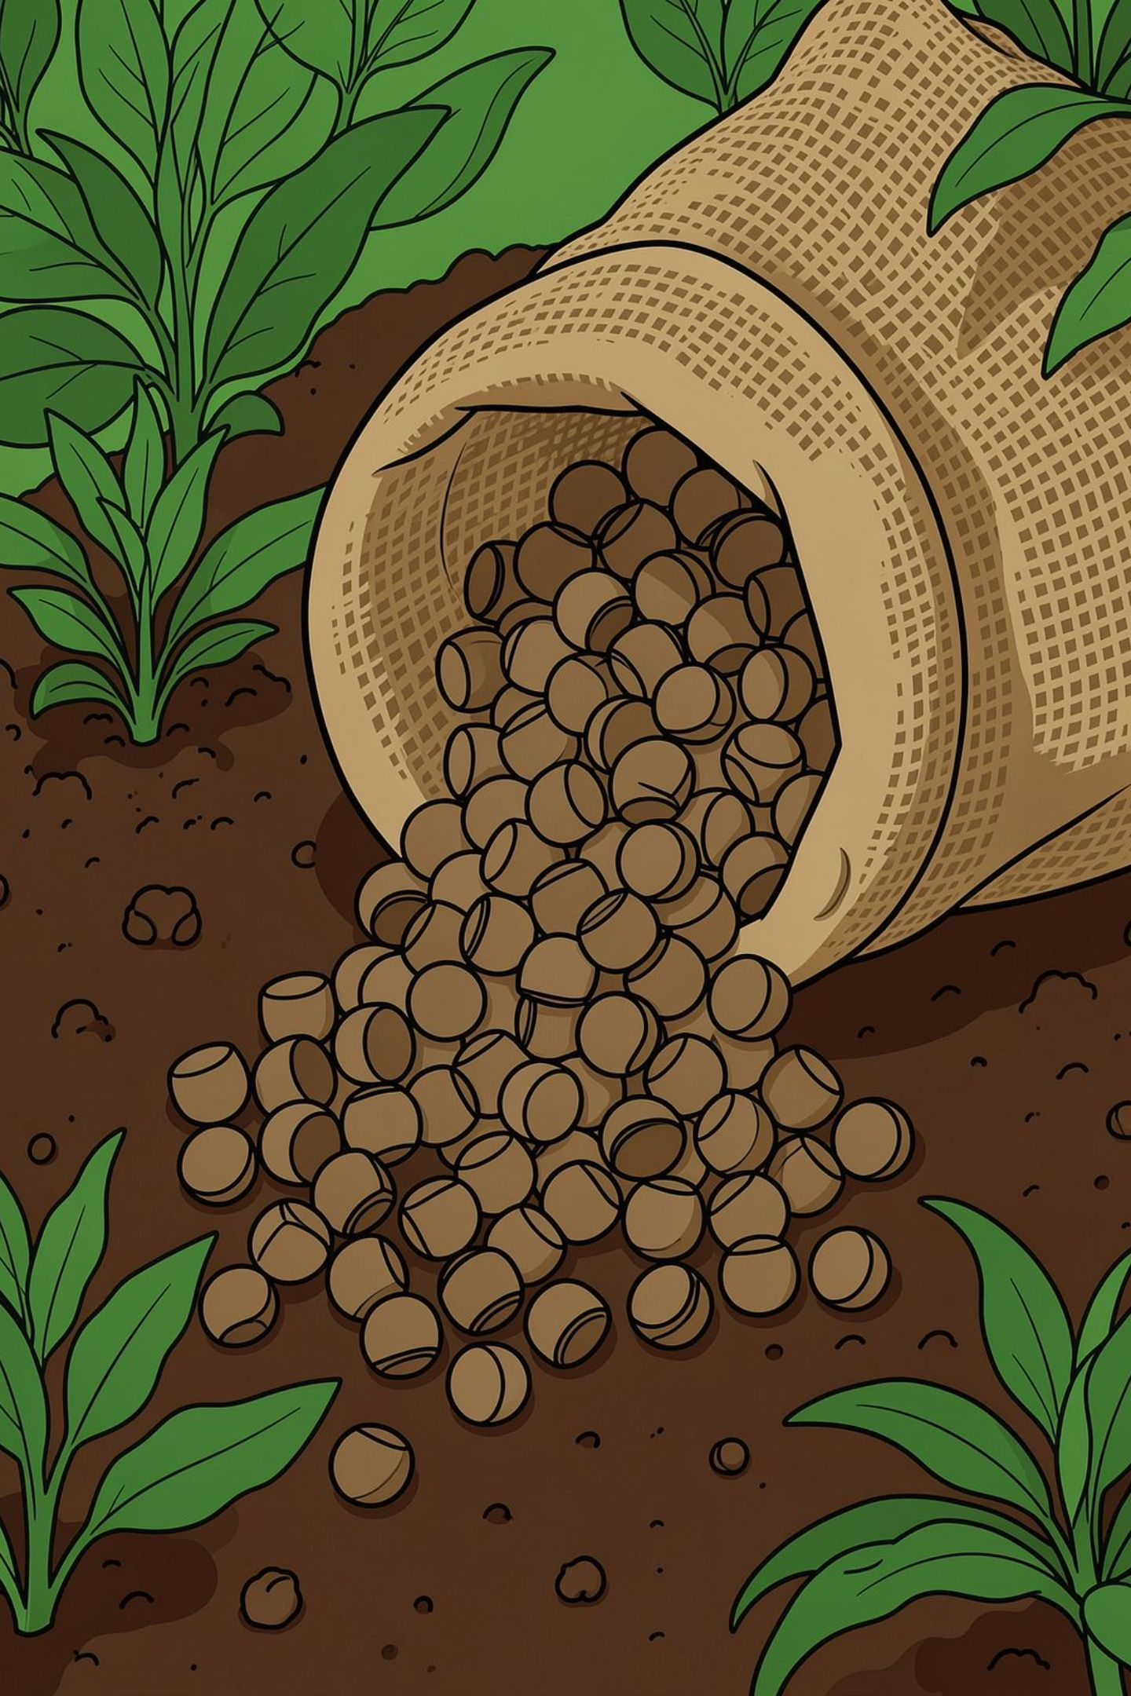

WASTE TO VALUE
Conversion of Vegetable Waste into Organic Plant Pellets
Turning vegetable waste into a stable, transportable, and high‑value agricultural input. A practical circular-economy model that reduces landfill loads, captures nutrients, and delivers affordable organic pellets for home gardeners, nurseries, and small farms.

Slide 2
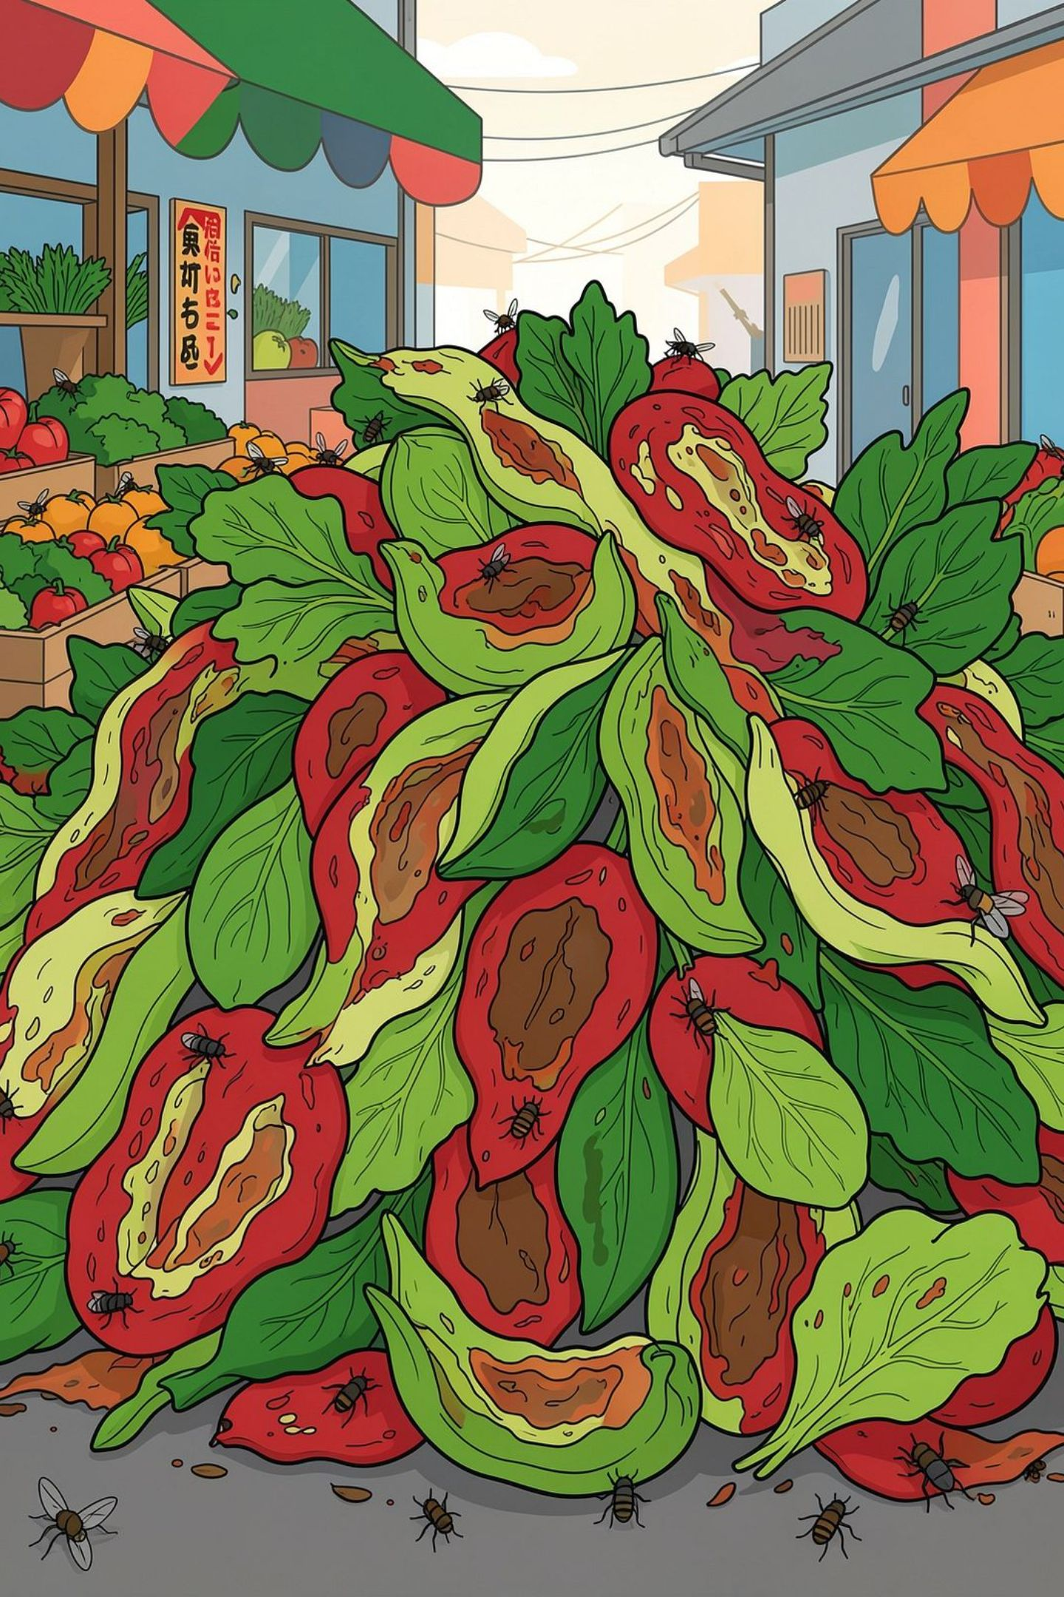

The Main Problem
Urban vegetable and food waste is frequently landfilled or mixed with general refuse, losing valuable organic matter and nutrients. High moisture content makes collection, transport, and storage costly; wet waste decomposes quickly, producing odors and pests. Meanwhile, many growers lack affordable, standardized organic inputs that are easy to store and apply.
Core Issue
Operational Challenges
Valuable nutrients from vegetable waste are discarded instead of recirculated to soil as usable inputs.
High moisture, transportation cost, pest attraction, and rapid spoilage make raw waste impractical for farmers.

Slide 3
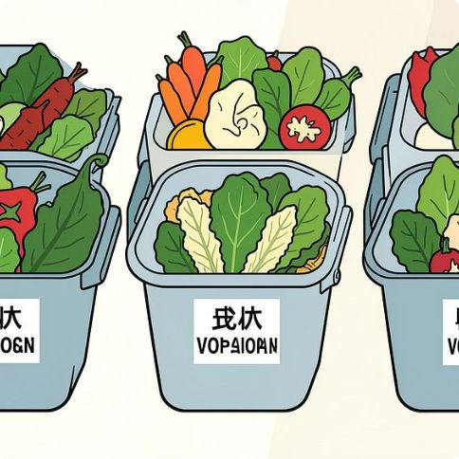
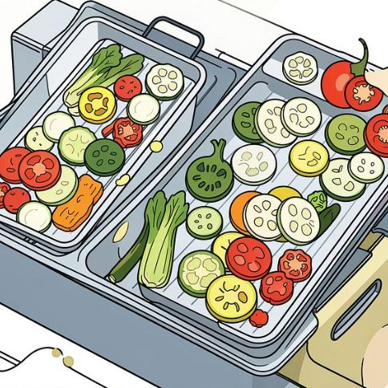
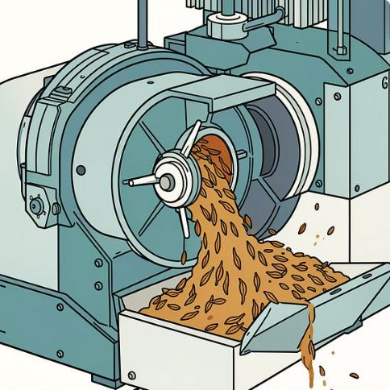
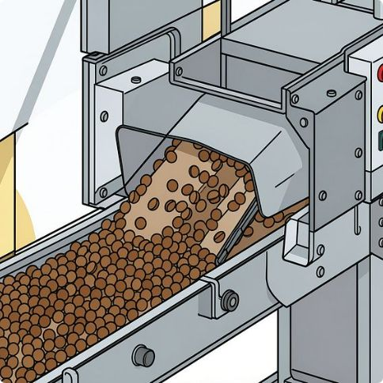

Our Solution — Process Overview
We convert segregated vegetable waste into dried, ground, formulated pellets through a simple modular process: Collection → Dehydration → Grinding → Formulation → Pelletization → Quality testing → Packaged product. The result: low-moisture, odor‑reduced pellets that are easy to transport, store, and apply.
Collection
Dehydration
Segregated streams from hotels, markets, and canteens reduce contamination risk and improve product consistency.
Removes moisture to cut transport weight and slow spoilage; enables safe storage before grinding.
Grinding & Mixing
Pelletization & Testing
Creates a uniform powder base that can be blended with additives for nutrient balance and pellet stability.
Produces consistent 3–6 mm pellets; follow with nutrient, safety, and physical testing prior to packaging.

Slide 4
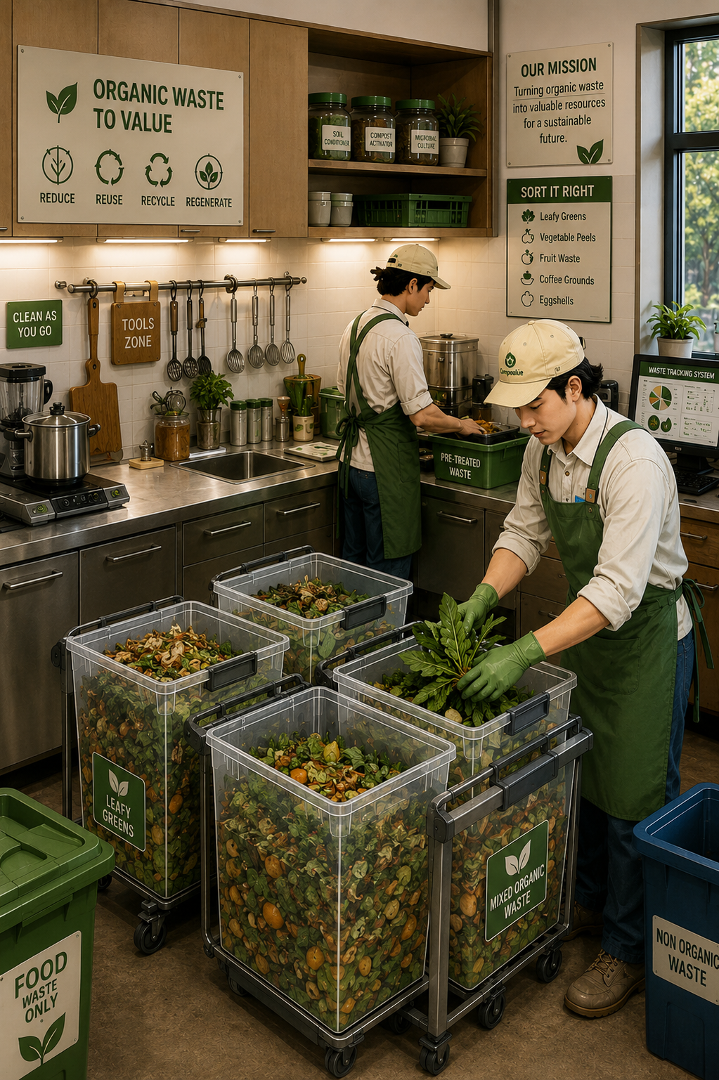

Collection & Segregation — Practical Guidance
Efficient upstream separation is critical. Target sources where segregation is practical: hotels, hostels, restaurants, college canteens, vegetable markets and catering services. Provide simple labeled bins and short training to reduce contaminants and ensure feedstock quality.
Suitable Materials
Do NOT Accept
Vegetable peels, trimmings, fruit residues, spoiled but uncontaminated vegetables, and plant-based kitchen wastes.
Plastics, glass, metals, chemicals, heavy oils, meat, bones, or highly contaminated streams — they compromise safety and testing.

Slide 5
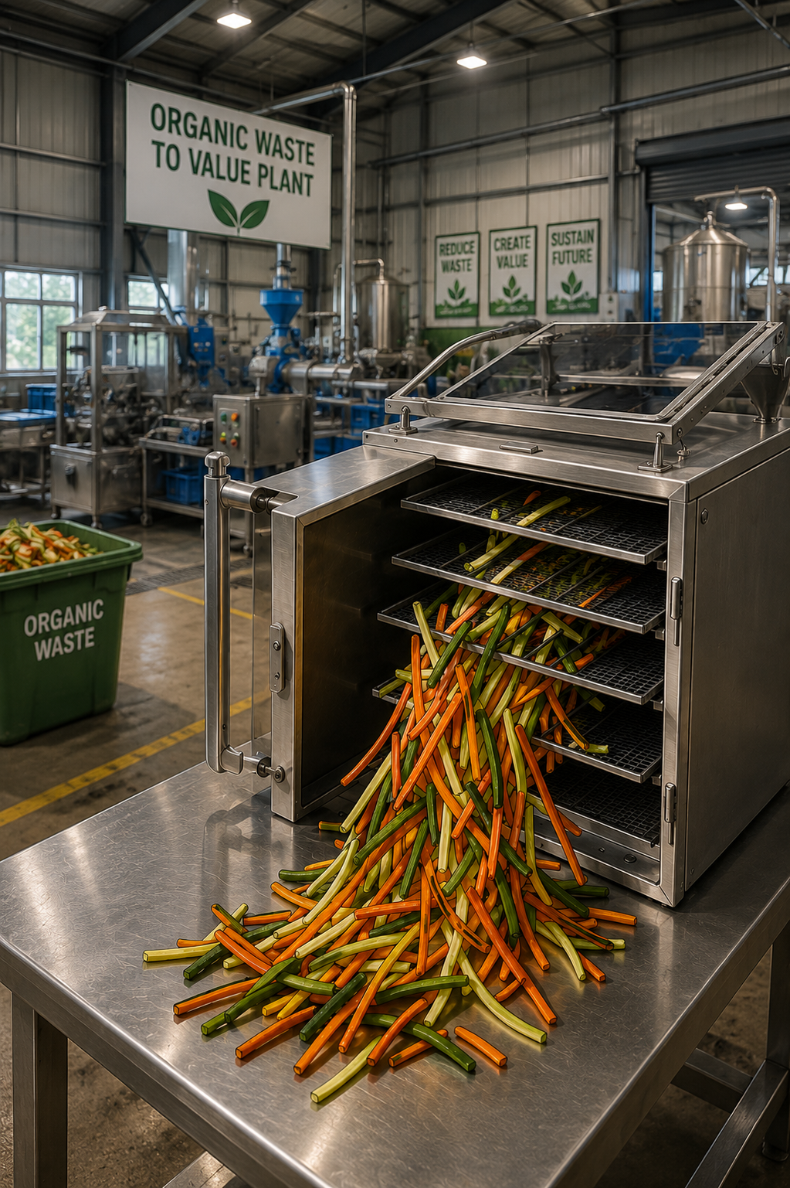
Size Reduction & Dehydration — Key Operational Steps
Shredding increases surface area and speeds drying. Dehydration (solar-assisted or low-cost electric) reduces moisture, weight, and microbial activity. Together they improve handling, reduce odors, and prepare material for efficient grinding and formulation.
01
02
Shredding
Dehydration Methods
Use a small shredder to create consistent small particles for faster, uniform drying.
Options: solar tunnel dryers, batch tray dryers, or low-temperature air dryers depending on budget and climate.
03
Benefits
Lower transport cost, reduced spoilage, and improved storage life before grinding.

Slide 6
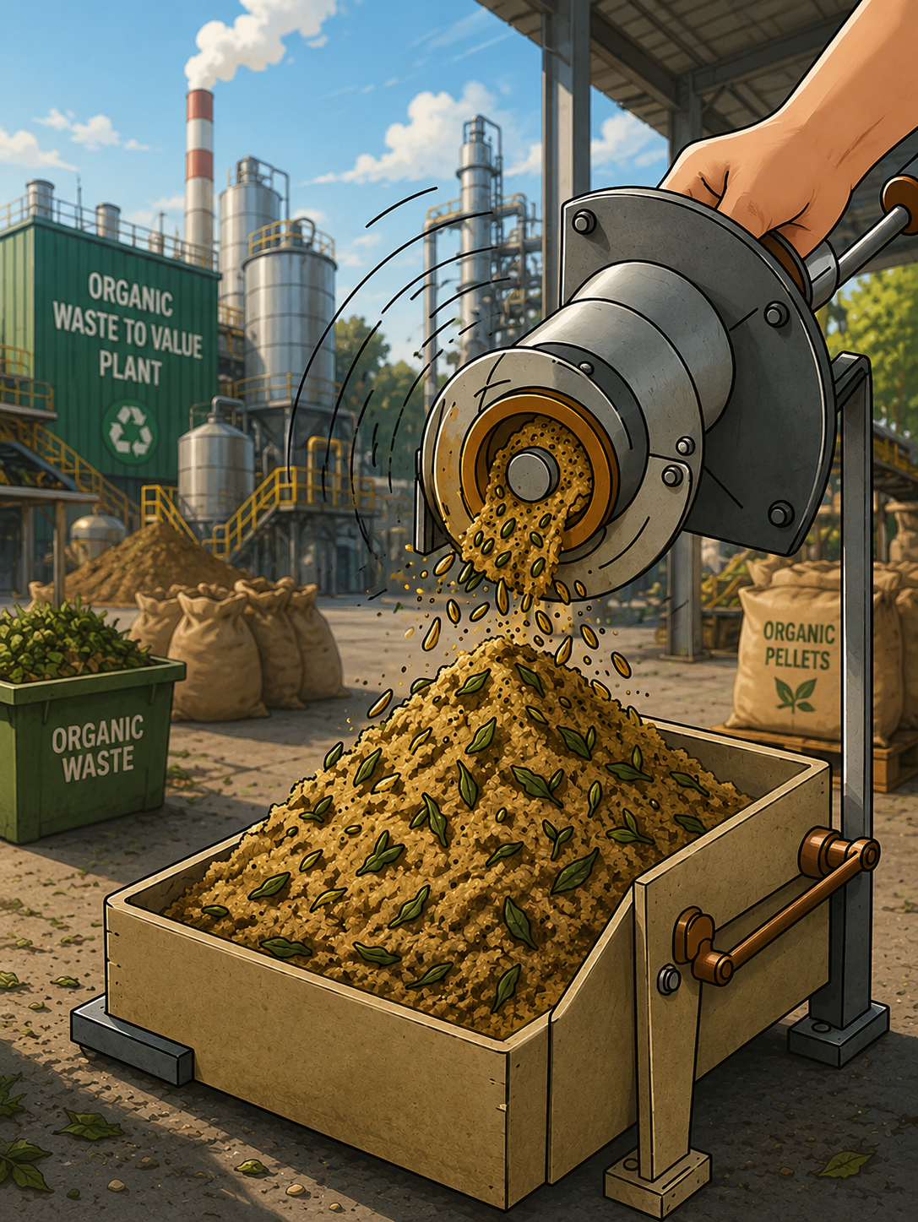


Grinding & Formulation — Making a Reliable Base
Crush dried material to a consistent powder (target particle sizing for uniform pelletization). Formulation may add stabilizers, binders, slow-release nutrient sources, or benign mineral supplements to ensure predictable performance and pellet strength.
Grinding Specs
Use a pulverizer or hammer mill; aim for uniform particle size to ensure consistent pellet formation.
Formulation Goals
Balance nutrients (NPK), improve bulk density, increase pellet durability, and maintain storage stability.

Slide 7

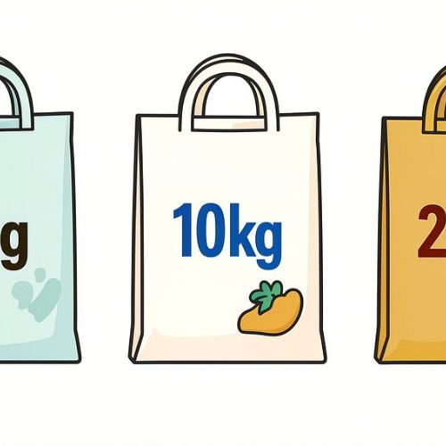
Pelletization, Sizes & Application
Pelletizers compress the formulated powder into dense pellets. Investigate a 3–6 mm diameter range for general-purpose soil amendment and nursery use. Pellet format reduces mess, improves dosing, and enables packaging at multiple scales from 1 kg to 25 kg.
3–6 mm Pellets
Packaging Tiers
Convenient for broadcasting, potting mixes, and seedbed incorporation; small size supports even distribution.
1 kg (home gardeners), 5 kg (terrace gardens, nurseries), 10 kg (larger users), 25 kg (farms & landscapers).

Slide 8

Quality Testing & Safety Protocols
Before sale, each batch should undergo nutrient (N, P, K, moisture, pH) and safety testing (heavy metals, pathogens, physical contaminants). Physical tests: pellet size distribution, strength, bulk density, moisture stability, and breakdown rate in soil to predict field performance.
Nutrient Testing
Safety Tests
Physical Integrity
Measure Nitrogen, Phosphorus, Potassium, moisture content, and pH to create a specification sheet for customers.
Screen for heavy metals and pathogens; ensure no physical contaminants remain from feedstock streams.
Assess pellet strength, bulk density, storage stability, and breakdown behavior in typical soils.

Slide 9

Target Market & Revenue Model
Primary customers: home gardeners, nurseries & landscapers, and small-to-medium farmers. Revenue streams: direct product sales (packaged pellets) and contracted waste-processing services (collection/processing fees from institutions). Position the product on ease-of-use, affordability, predictable specs, and environmental impact.
1
Home Gardeners
Small packs, low odor, user-friendly dosing — marketed as "easy-to-use organic pellets for kitchen gardens."
2
Nurseries & Landscapers
Bulk options, consistent quality, reliable supply for potting mixes and landscape projects.
3
Farmers
Competitive pricing per nutrient unit, soil health benefits, and bulk availability for field application.
4
Services
Offer waste-collection contracts to institutions as an additional revenue and feedstock security channel.

Slide 10
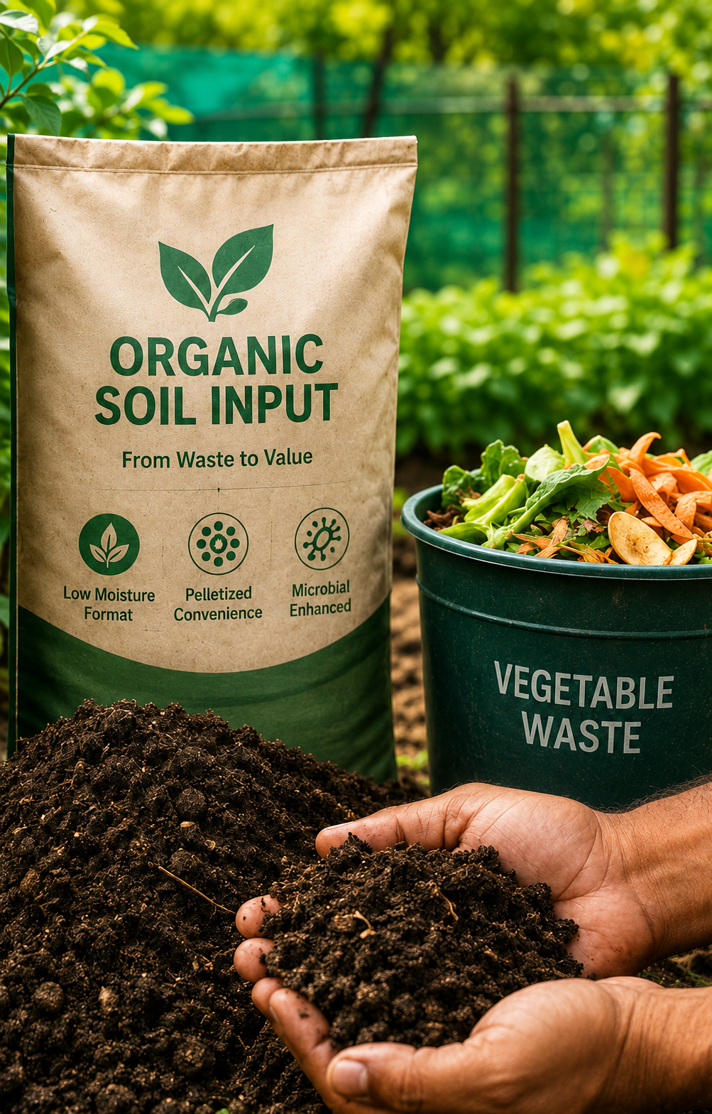

Competitive Advantages & Next Steps
Our product converts a local waste stream into a standardized, easy-to-apply organic soil input. Advantages include waste-to-value messaging, low‑moisture format for logistics, pelletized convenience, and the potential for lab-tested specifications and biological enhancements. Solar-assisted drying and microbial amendments offer future differentiation.
Value Propositions
Reduces landfill volumes and collection costs
Delivers affordable organic matter and slow-release nutrients
Cleaner, easier application than loose compost
Short-Term Roadmap
Pilot with 2–3 institutional feedstock partners
Establish basic dehydration and pelletization line
Set up simple lab testing and packaging
Call to Action
Partner with local waste generators, test product with target growers, and validate cost-per-nutrient to scale production. Let’s turn municipal vegetable waste into a practical soil solution.

