Slide 1

UE21CS320A – Capstone Project Phase-2
Project Title : Towards Safer Social Media: Real-Time Euphemism and Toxicity Detection in User Interactions
Project ID : 66
Project Guide : Dr. Kamatchi Priya L
Project Team :
Chethan V PES2UG21CS143
Darshan GN PES2UG21CS151
Harshini Murugan PES2UG21CS193
Janav Shetty PES2UG21CS210

Slide 2
Outline
Abstract
Summary of Requirements and Design ( Phase - 1)
Summary of Methodology / Approach (Phase - 1)
Design Description
Modules and Implementation Details
Project Demonstration and Walkthrough
Test Plan and Strategy
Results and Discussion
Lessons Learnt
Conclusion and Future Work
References

Slide 3
Abstract
This project presents a toxicity detection system designed to spot both direct and indirect harmful language in online messages. Unlike traditional approaches, our system can recognize euphemisms—words or phrases used to hide toxic intent—as well as sentiment to help identify truly harmful messages more accurately.
The system uses a client-server setup, where the server hosts models that analyze messages for toxicity. The main interface is a real-time chatroom, where user messages are checked for toxic content before they are shown.
Key features include:
Euphemism Detection: Finds indirect toxic language by identifying hidden or softened toxic words.
Sentiment Filtering: Uses sentiment analysis to avoid flagging positive messages as toxic.
Real-Time Feedback: Notifies users immediately if their message is flagged for toxicity, including warnings for repeated offenses.
This system aims to create safer online spaces by catching hidden toxic language and providing accurate, immediate feedback to users. The results show that this approach has potential for use in online platforms where respectful communication is important.

Slide 4
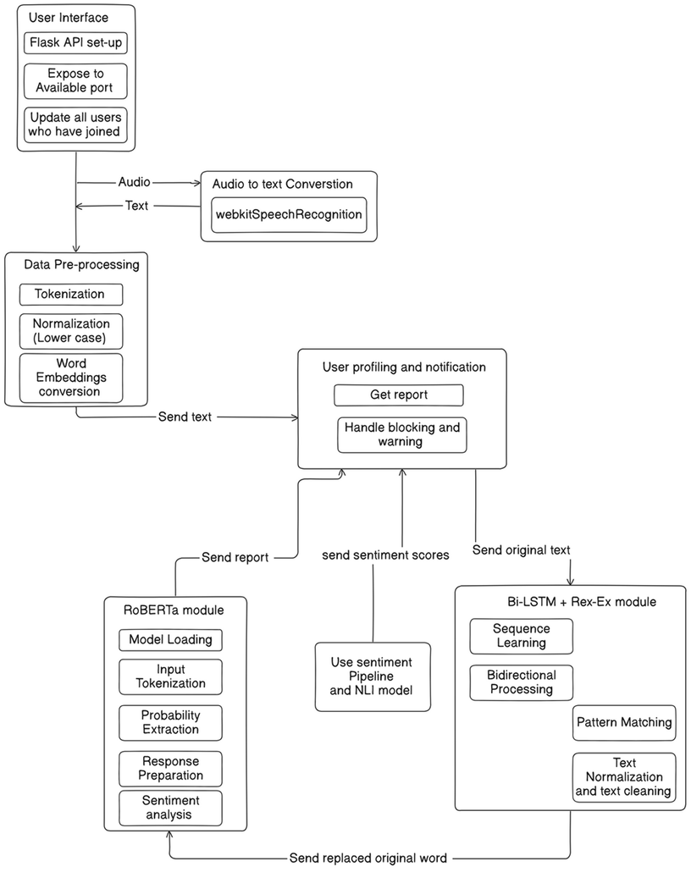
Summary of Requirements and Design

Slide 5
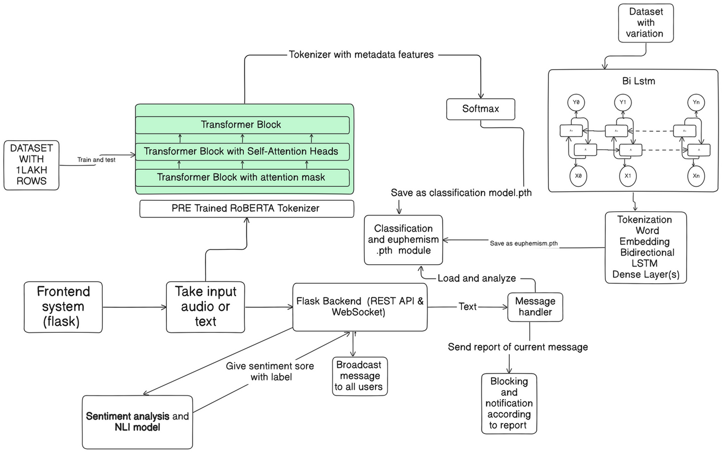
Summary of Methodology / Approach

Slide 6
Project Demonstration

Slide 7
Modules and Implementation Details
1. System Architecture Overview
• Components:
1. Frontend: HTML, CSS (Bootstrap), JavaScript
2. Backend: Flask with Flask-SocketIO
3. Machine Learning Models:
i) Toxicity Detection: RoBERTa-based classifier
ii) Euphemism Detection: Custom BiLSTM model
• Data Flow:
1. User sends a message via frontend
2. Backend processes the message for toxicity and euphemisms.
3. Responses or warnings are sent back to the user in real-time.
• Technologies Used:
1. Frontend: Bootstrap, Font Awesome, jQuery, Socket.IO
2. Backend: Flask, Flask-SocketIO, Transformers, PyTorch

Slide 8
Modules and Implementation Details
2.Backend with Flask and Socket.IO
• Flask Setup:
1. Initializes Flask app and integrates Socket.IO for real-time communication
2. Route / serves the main chat interface
• Real-Time Communication:
1. Events Handled:
join: User joins the chat
send_message: User sends a message
disconnect: User leaves the chat
• User Management:
1. Tracks online users and blocked users
2. Monitors user message toxicity counts to issue warnings or bans

Slide 9
Modules and Implementation Details
3.Toxicity Detection with RoBERTa
• Model Used:
1. RoBERTaForSequenceClassification: Pre-trained model from Hugging Face
• Setup:
1. Loads tokenizer and model, moves to GPU if available.
2. Loads trained weights from toxic_model.pth
• Processing Messages:
1. Steps:
i) Perform NLI to check message context
ii) Conduct sentiment analysis
iii) If necessary, classify message toxicity
2. Outcome:
i) Labels messages as toxic or non-toxic
ii) Triggers user warnings or blocks based on toxicity

Slide 10
Modules and Implementation Details
4.Euphemism Detection Module
• Purpose: Identifies and replaces euphemistic variations of toxic words
• Components:
1. CSV File: toxic_words_with_variations.csv maps euphemisms to original words
2. Model: Custom BiLSTM with Attention for detecting euphemisms
• Workflow:
1. Preprocess incoming messages
2. Detect euphemisms using the model
3. Replace euphemisms with original toxic words for accurate toxicity analysis

Slide 11
Modules and Implementation Details
5. Frontend Design
• Layout:
1. Sidebar: Displays online and blocked users
2. Main Chat Area: Shows messages and input controls
• Features:
1. User Authentication: Model prompts for username entry
2. Real-Time Messaging: Instant display of sent and received messages
3. Audio Messaging: Allows recording and sending voice messages
• Styling:
1. Uses Bootstrap for responsive design
2. Custom CSS for chat aesthetics and user experience

Slide 12
Modules and Implementation Details
6. Real-Time Messaging and User Interaction
• Socket.IO Events:
1. Sending Messages: Users send messages that are broadcasted to all.
2. Receiving Messages: Display messages in the chat window instantly.
• User Notifications:
1. Join/Leave Alerts: Inform users when someone joins or leaves.
2. Warnings and Blocks: Notify users about toxicity warnings or being blocked.
• User Interface Updates:
1. Dynamically updates online and blocked users lists.
2. Disables message input for blocked users.

Slide 13
Modules and Implementation Details
7. Audio Recording and Speech-to-Text
• Feature: Users can record audio messages which are converted to text.
• Implementation:
1. Utilizes Web Speech API (SpeechRecognition)
2. Process:
i) User clicks the microphone button to start recording.
ii) Audio is transcribed to text.
iii) Transcribed message is auto-sent to the chat.
• User Feedback:
1. Displays a recording indicator during audio capture.
2. Alerts if the browser does not support speech recognition.

Slide 14
Modules and Implementation Details
8.Model Training and Integration
• Toxicity Model:
1. Training: Fine-tuned RoBERTa on labeled toxic and non-toxic data.
2. Deployment: Loaded in Flask backend for real-time inference.
• Euphemism Detector:
1. Training: BiLSTM with Attention trained on euphemism datasets
2. Integration: Processes messages before toxicity classification
• Data Handling:
1. Preprocessing: Lowercasing, tokenization, and padding
2. Label Encoding: Translates labels for model compatibility

Slide 15
Modules and Implementation Details
9. User Management and Moderation
• Tracking Users:
1. Maintains lists of active and blocked users.
2. Monitors the number of toxic messages per user.
• Moderation Actions:
1. Warnings: After 3 toxic messages, users receive warnings.
2. Blocking: Users are blocked after 5 toxic messages.
• Feedback to Users:
1. Pop-up notifications for warnings and blocks.
2. Updates the UI to reflect user status changes.

Slide 16
Test Plan and Strategy
Unit Tests:
Toxicity Detection: Test the predict_toxicity function to ensure it identifies toxic and non-toxic messages correctly. Also, check the replace_euphemisms function to ensure euphemisms are replaced accurately. Test edge cases like empty or long messages.
Message Handling: Verify that messages are broadcast correctly to all users except the sender and that blocked users cannot send messages, with appropriate notifications.
Integration Tests:
Message Flow: Simulate a user sending a message to ensure it goes through toxicity detection, euphemism replacement, and the appropriate response (warning/block).
User Management: Ensure users can join/leave and that the online and blocked user lists are updated across all clients.

Slide 17
Test Plan and Strategy
End-to-End Tests:
Simulate User Interaction: Test the full flow of user actions: join → send toxic message → warning → repeat → block after 5 toxic messages.
Real-Time Interaction: Test simultaneous user interactions, ensuring messages are broadcast correctly and blocked users cannot send messages.
Load Testing:
Concurrency: Test the system under heavy load (many users sending messages) to ensure smooth operation.
Scalability: Simulate sending a large number of messages rapidly and verify that the system maintains performance and stability.

Slide 18
Test Plan and Strategy
Usability Testing:
UI/UX: Test the user interface for proper handling of messages, user names, and real-time updates of the user and blocked lists. Ensure notifications (e.g., for warnings/blocks) are displayed clearly.
Real-Time Notifications: Ensure all notifications (joining, leaving, warnings, and blocks) are correctly displayed in the UI.

Slide 19
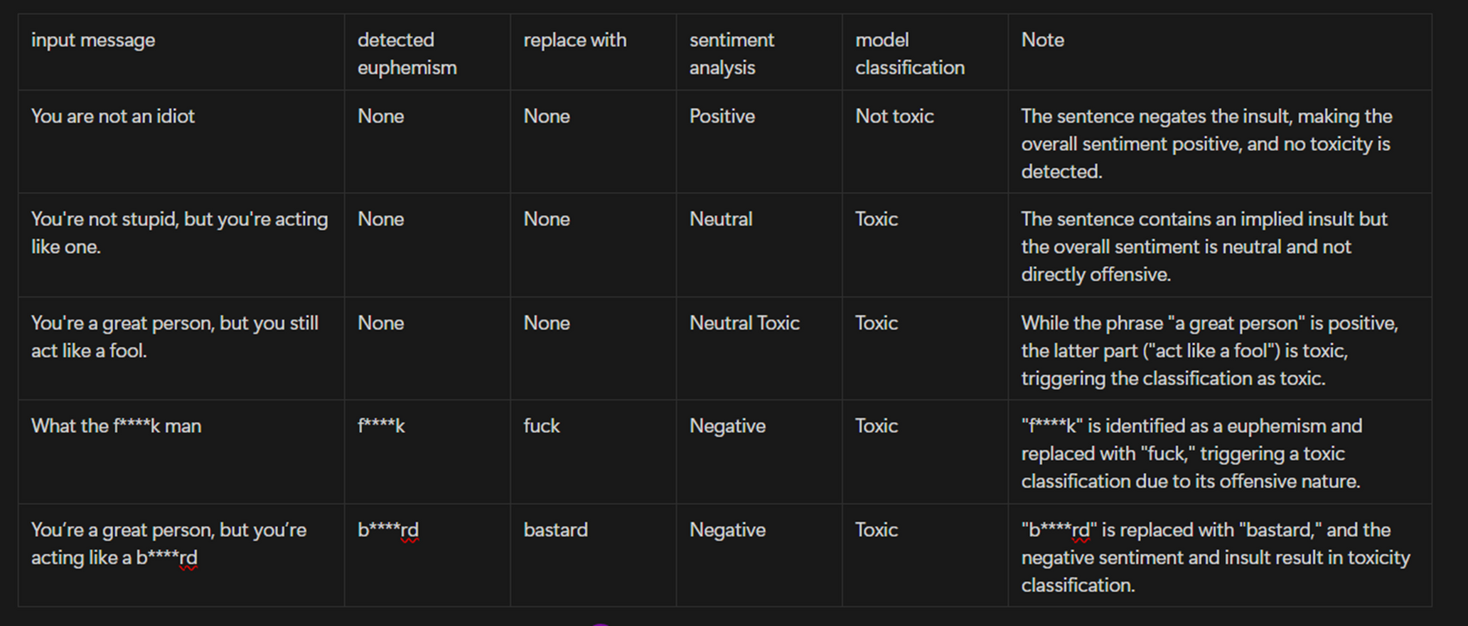
Results and Discussion

Slide 20
Lessons Learnt
Learnt in-depth about transformer architecture and various model built around it ( BERT, RoBerta)
Acquired knowledge around research papers that are trying to solve the same problem
Robustness about the various classification of toxicity
Learnt on how to handle cases of context and sentiment-analysis
Importance of iterative development

Slide 21
Conclusion
Our project provides an effective approach to detect toxicity and handle euphemisms, by combining a BILSTM model with attention mechanism for euphemism detection and replacement, DistilBERT model for sentiment analysis and a fine-tuned RoBERTa model for multi-label classification of toxicity.
The RoBERTa model accurately classifies toxic categories such as threat and identity hate, etc.
The BiLSTM model effectively identifies and replaces euphemisms, enhancing detection reliability.
DistilBERT is used to integrate sentiment analysis, which further enriches the model’s understanding by capturing the tone of messages.

Slide 22
Future work
Future work could focus on enhancing the project by enabling cross-language and cross-dialect toxicity detection, allowing for effective moderation in diverse linguistic contexts.
Expanding the euphemism detection model to suggest polite or neutral language replacements could help users reformulate messages in real-time, encouraging more respectful communication.
Analyzing user behavior trends over time could facilitate the development of profiles to identify recurring toxic patterns, enabling targeted interventions to promote healthier communication.

Slide 23
References
[1] Zhu, Wanzheng, and Suma Bhat. "Euphemistic phrase detection by masked language model." arXiv preprint arXiv:2109.04666 (2021).
[2] Kurita, Keita, Anna Belova, and Antonios Anastasopoulos. "Towards robust toxic content classification." arXiv preprint arXiv:1912.06872 (2019).
[3] Pavlopoulos, J., Sorensen, J., Dixon, L., Thain, N., & Androutsopoulos, I. (2020). “Toxicity detection: Does context really matter?”. arXiv preprint arXiv:2006.00998.
[4] Zhu, Wanzheng, et al. "Self-supervised euphemism detection and identification for content moderation." 2021 IEEE Symposium on Security and Privacy (SP). IEEE, 2021.

Slide 24
Thank You

