Slide 1

UE21CS320A – Capstone Project Phase-1
End Semester Assessment
Project Title : Detection of Euphemism using BERT Model
Project ID : 66
Project Guide : Dr. Kamatchi Priya L
Project Team :
Chethan V PES2UG21CS143
Darshan GN PES2UG21CS151
Harshini Murugan PES2UG21CS193
Janav Shetty PES2UG21CS210

Slide 2
Outline
Introduction and Motivation
Problem Statement
Abstract and Scope
Literature Survey / Existing System
Suggestions from Review – 3
Requirements Specification
Design Approach
Design Constraints, Assumptions & Dependencies
Proposed System / Approach
Architecture
Design Description
Project Report and Progress
References

Slide 3
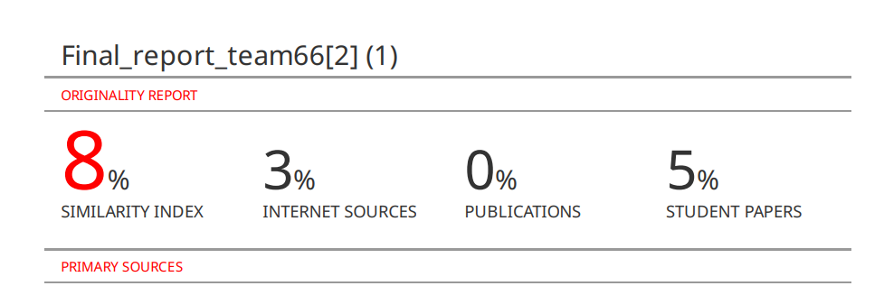
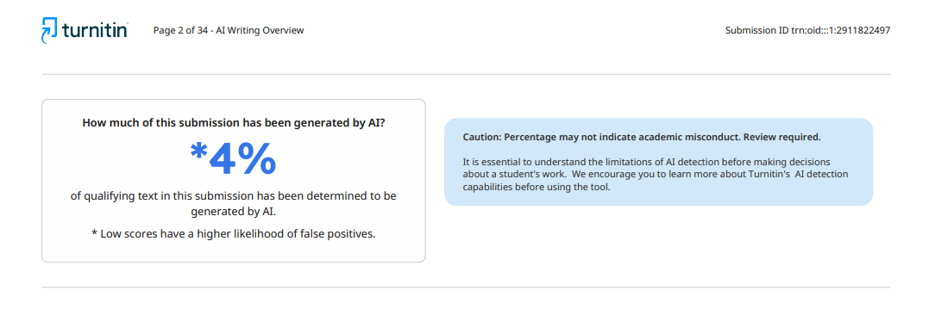
REPORT

Slide 4
Introduction and Motivation
In the expansive landscape of online communication, the issue of toxicity looms large, necessitating effective strategies for detection and mitigation. Within this realm, the identification of euphemistic language poses a significant challenge, as it often disguises harmful content behind seemingly innocuous phrases.
Our research "Detection of Euphemism using BERT Model " aims to address this by developing a computational solution for the automated detection of euphemistic language.
By harnessing the power of the BERT model, we aim to enhance our ability to identify and categorize euphemisms accurately, thus fostering a safer and more respectful online environment.

Slide 5
Problem Statement
WHY?
Rise of Hateful Content:
With the increasing popularity of social media, there has been a significant rise in the prevalence of toxic content, including hate speech, harassment, and offensive language.
Challenges in moderation:
Social media platforms struggle to effectively moderate and filter out toxic content due to the sheer volume of user-generated data and the evolving nature of online language.
Complexity of Toxicity:
Toxic content can manifest in various forms, including explicit language, subtle sarcasm, and cultural nuances, making it a complex challenge for automated systems to identify and classify accurately.

Slide 6
Abstract
Project targets automated detection of euphemistic language due to prevalent toxic behavior online, often masked by symbols and euphemisms.
Utilizes advanced NLP techniques, primarily BERT, for enhanced detection capabilities compared to existing models.
Project scope involves training the model with diverse datasets, implementing a real-time detection system, and designing a user-friendly interface for evaluation.
Addresses challenges such as language biases and continuous adaptation during model development.
Aims to promote respectful online conversations and lay groundwork for advanced toxicity detection methods.

Slide 7
Scope
Multimodal Toxicity Detection(audio , text)
Handling cases for euphemism
Real time processing
Enhanced User Experience

Slide 8
PAPER 1: Towards robust toxic content classification
The paper aims to study the impact of adversarial attacks on neural toxicity detectors and proposes methods to enhance model robustness for more accurate toxicity detection.
Methodology involves creating a lexicon of toxic tokens for realistic adversarial attacks, including character-level perturbations, injections, and non-toxic distractors to challenge toxicity classifiers.
Models such as ELMo and BERT for toxicity detection are utilized, alongside a contextual denoising autoencoder (CADE) to learn robust representations and improve resilience against adversarial attacks.
Two approaches are explored: training on synthetically noised data to enhance model ability and using CADE to denoise tokens and improve classification.
Results highlight significant reductions in detection performance due to adversarial attacks, with up to a 50% drop in recall performance, emphasizing the need for defenses that can withstand sophisticated attacks and enhance overall reliability in toxicity detection systems.

Slide 9
PAPER 2: Euphemistic phrase detection by masked language model
The paper introduces a method to automatically identify multiword euphemisms used by fringe groups in online forums, addressing challenges in content moderation on social media.
The research is divided into three stages: quality phrase extraction using Autophrase, preselection of euphemistic phrase candidates via cosine similarities with word2vec, and ranking of candidates using SpanBERT.
SpanBERT aids in predicting token spans in text, enabling effective analysis of long textual data for automated euphemism detection.
The study enables detection of both known and potential new euphemisms online, improving efficiency and accuracy in identifying hidden meanings in content.
The paper's methods, including phrase mining and SpanBERT, aim to enhance detection of toxic language phrases in online interactions, contributing to improved content moderation efforts on digital platforms.

Slide 10
PAPER 3: Toxicity detection: Does context really matter?
The paper investigates the impact of context on human judgment and the performance of toxicity detection systems, posing questions about context's influence on perceived toxicity and classifier efficacy.
Two datasets, CAT-SMALL and CAT-LARGE, were created with and without context annotations to analyze context's effect on toxicity assessment across different comment volumes.
Various techniques were explored, including RNN language models, contextual features for sentiment classification, and combining consecutive comments to assess context's influence on toxicity labels and classifier performance.
Results indicated a statistically significant effect of context on perceived toxicity, with approximately 5.2% of comments showing toxicity label changes. However, context did not lead to improved toxicity classifier performance.
The study concluded that while context can influence perceived toxicity, its impact on toxicity analysis requires larger datasets for better understanding, highlighting challenges in accurately assessing and automating toxicity detection in online comments.

Slide 11
PAPER 4: Self-supervised euphemism detection and identification for content moderation
The paper introduces a Masked Language Model (MLM) approach for Euphemism Detection, integrating self-supervision to reduce manual effort and address subjectivity in euphemism identification
It focuses on two main tasks: euphemism detection, where a set of forbidden words are used to generate euphemistic variations (Candidate set), and euphemism identification, determining the meaning of single euphemistic terms.
The MLM-based approach masks potential euphemisms in sentences and predicts their meanings based on context, using self-supervised techniques to filter and identify hidden meanings.
The model operates as a pipeline, first filtering masked sentences with a coarse classifier, then identifying euphemistic meanings with a multi-class classifier.
It can detect previously unknown euphemisms, aiding content moderation with less manual intervention, although domain-specific training is necessary for optimal performance.
Evaluation is based on precision at k, assessing the model's accuracy in identifying euphemisms and their meanings within a given context.

Slide 12
Requirements Specification
SOFTWARE REQUIREMENTS
Deployment
Streamlit
Large Language Model
BERT Large(LARGE , L-24,H-1024,16-LAYER,340M parameters)
Version Control
Git and Github
FUNCTIONAL REQUIREMENTS
Validity test on input
Validity check
user guidance
Sequence of operation
LLM
Classification algorithum
Error Handling and Recovery
Detection
Information
Detection
NON - FUNCTIONAL REQUIREMENTS
Performance requirement
Scalability
Reliability
Resource Utilization
Safety attributes
Availability

Slide 13
Design Constraints
Contextual Understanding: Nuanced context makes accurate detection challenging.
Algorithm Biases: Biases in models necessitate careful preprocessing and evaluation.
Privacy Concerns: Analyzing user data raises privacy issues, demanding stringent privacy measures.
Resource Limitations: Detection needs efficient algorithms to conserve resources.

Slide 14
Dependencies
•Standardized Data Format: Input data will be consistently formatted for analysis.
•Access to Training Data: Availability of diverse, labeled datasets for model training.
•Internet Connectivity: Users have reliable internet access for using the web application.
•User Engagement: Users will actively use the tool and provide feedback.
Regulatory Compliance: Adherence to legal regulations regarding data privacy and protection

Slide 15
Design Details
Platforms, Systems, and Processes Dependencies:
1.Novelty and Innovativeness:
Input format: The inclusion of audio data in addition to textual data
Handling euphemism: Our model focuses on detecting euphemistic language, which is a unique and challenging aspect of toxicity detection. This includes considering symbols (e.g., *, #, !), alternate words, and other subtle expressions that users may employ to convey toxicity indirectly.
Context of the conversation: Understanding the broader context of a conversation for accurately interpreting language and detecting toxicity.
2. Interoperability:
Ensures that our system can integrate with current moderation tools or content management systems which are used across different online platforms, like social media networks or forums.

Slide 16
Design Details
3. Performance:
Response Time: Generation of system output within a reasonable time frame
Scalability: Scaling effectively to accommodate increasing user demand without sacrificing performance or responsiveness
4. Maintainability:
Code Quality: Ensuring that our codebase is well-organized and is documented making it easier for us to understand and modify the code when needed.
Documentation: Providing comprehensive documentation that explains the project architecture, functionality, and usage instructions.
Modularity: Designing the model with modular components that can be easily modified or replaced without affecting other parts of the system.
5.Security:
Prioritizing data security and privacy, implementing robust measures to protect user inputs, analysis results, and any sensitive information.

Slide 17
Design Details
6.Portability:
Platform-independent application that is compatible with different operating systems and web browsers.
7.Reusability:
Components and protocols within the architecture are designed for reusability, allowing for flexible deployment in different network environments and scenarios.
The architecture can be adapted and scaled for use in various organizational settings.

Slide 18
Proposed System / Approach
Approach and Results:
Utilizing BERT and ELMO(embedding from model language)for toxicity analysis with high accuracy.
Achieved results showcase effectiveness across diverse datasets.
Need for Change:
Improve handling of hate speech.
Enhance detection of subtle toxicity cues for better performance.
New Benefits:
Enhanced Detection: Focus on subtleties in toxic content.
Advanced Context Awareness: Deeper text understanding for accuracy.
Targeted Model Fine-Tuning: Addressing gaps for nuanced detection.

Slide 19
Proposed System / Approach
Drawbacks of New Approach:
Increased Complexity: Advanced techniques may add complexity.
Data Requirements: Larger, diverse datasets for effective training.
Evaluation Challenges: Specialized metrics and validation needed.

Slide 20
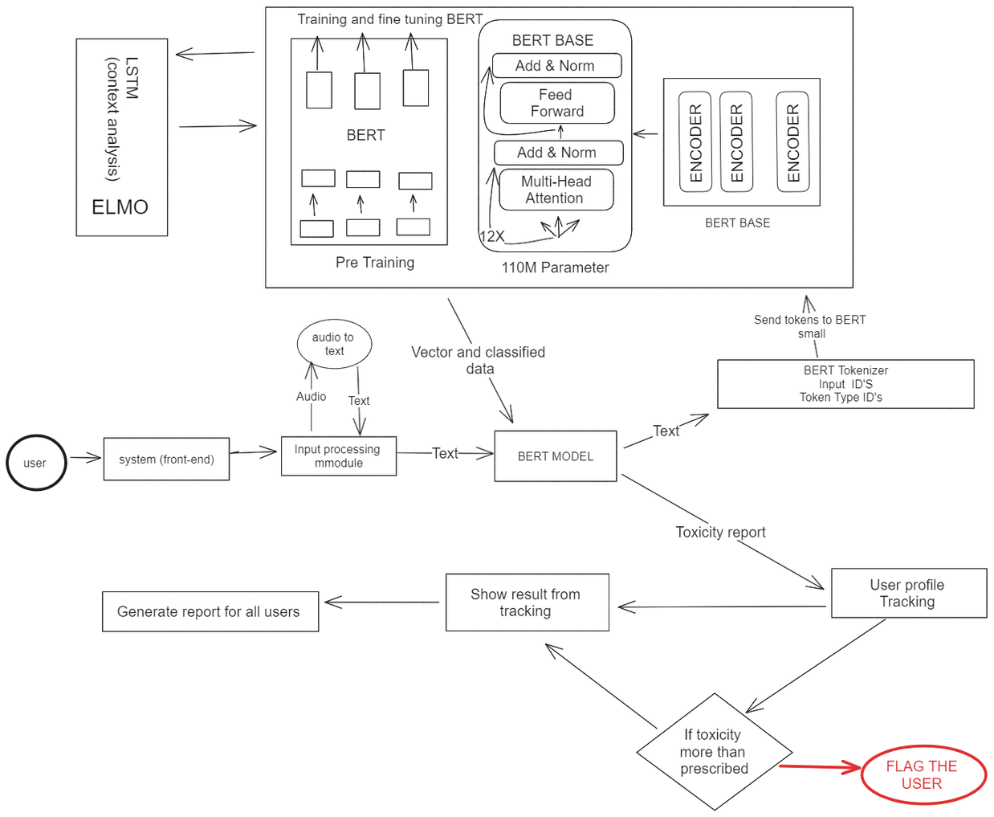
12 layers
Architecture

Slide 21
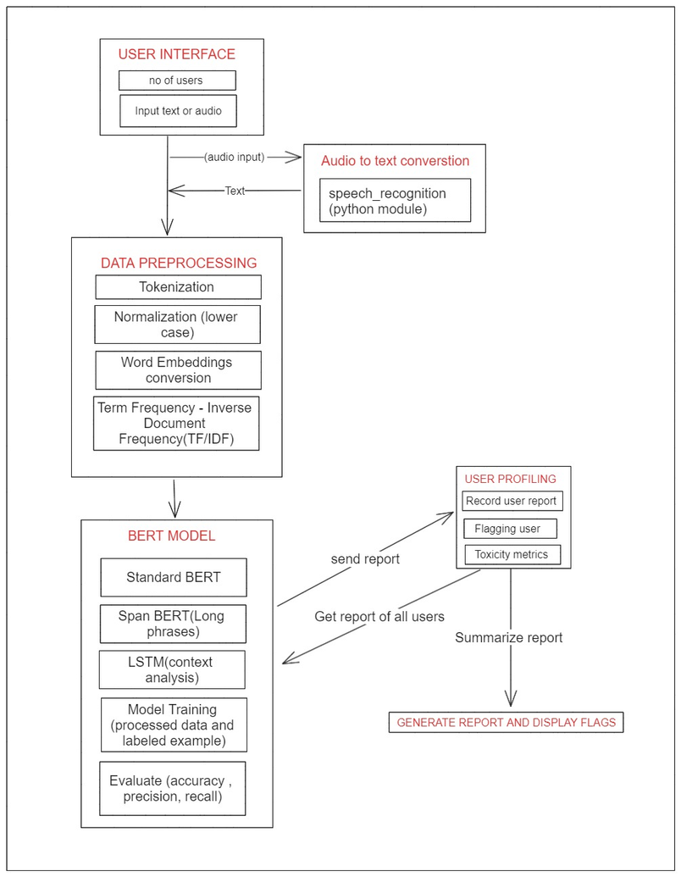
High Level System Design

Slide 22
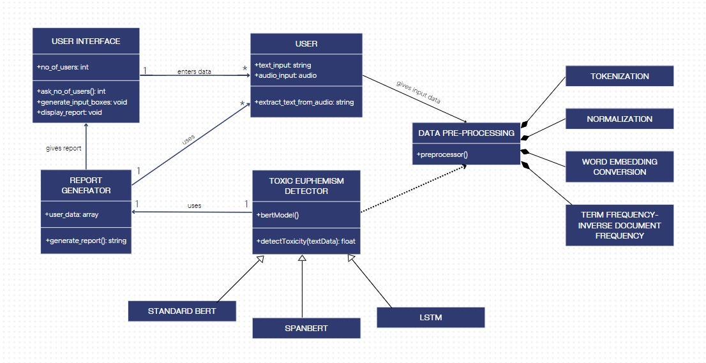
Design Description
Master class diagram

Slide 23
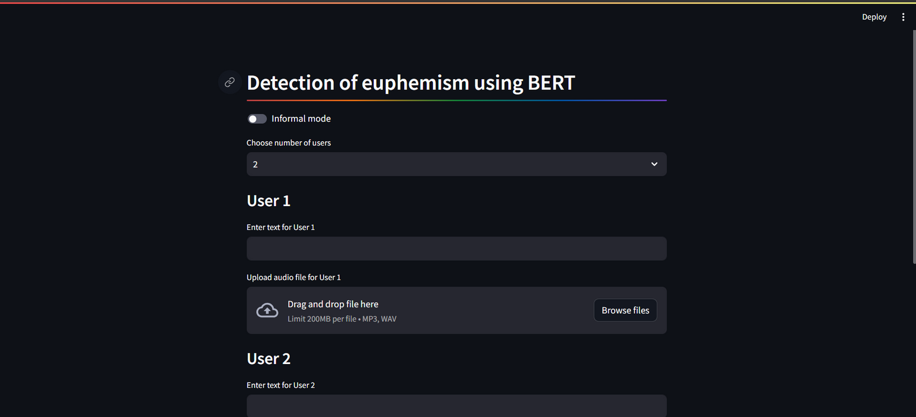
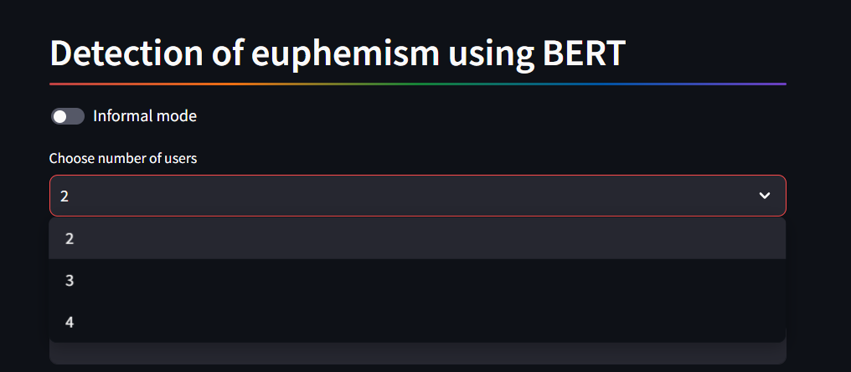
Design Description
User Interface
Main page
Selecting number of users

Slide 24
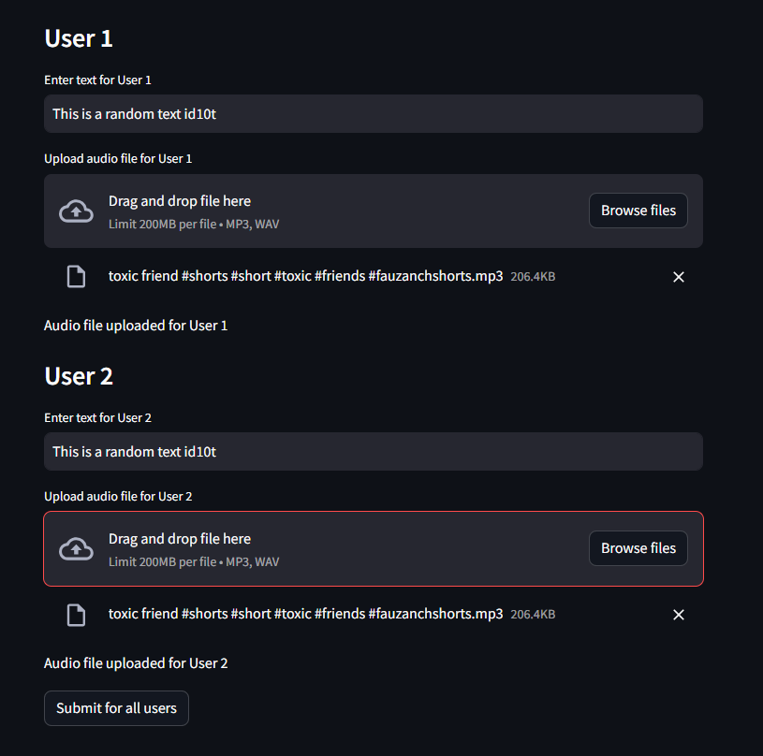

Design Description
User Interface
Test Report
User View

Slide 25
Project Progress
Exploration regarding various problem. statements.
Deciding of final problem statement.
Performed Feasibility Study.
Improvement and understanding of problem statement.
Started Literature Survey.
Deciding on architecture of the project and specifics of the model used

Slide 26
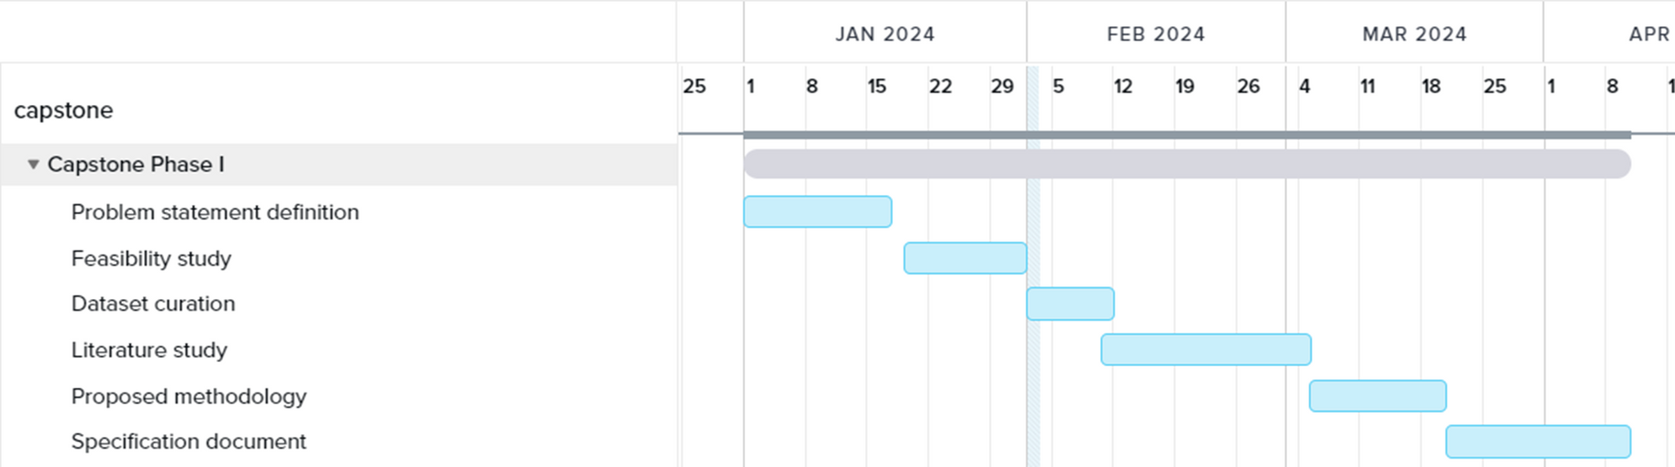
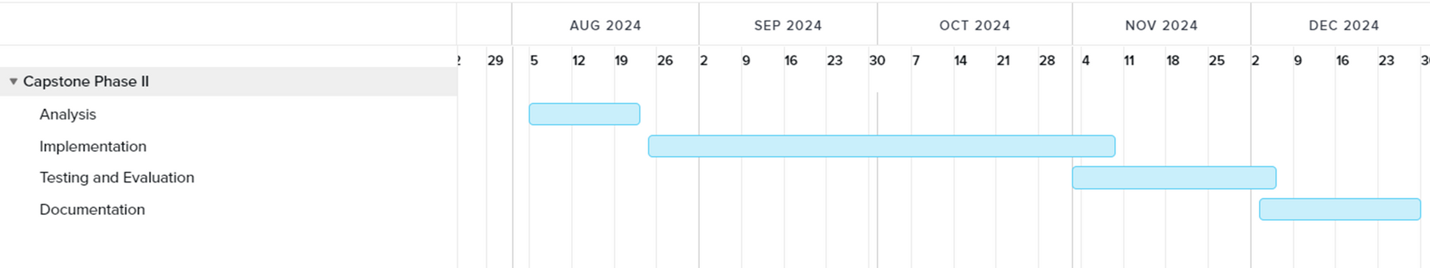
Capstone (Phase-I & Phase-II) Project Timeline

Slide 27
Conclusion
Explored models like BERT, SpanBERT, and LSTM for euphemism and toxic content detection, focusing on those best suited to the research goals.
Defined all necessary diagrams and system architecture in Phase 1, including a detailed view of BERT architecture.
Developed a prototype user interface using Streamlit, featuring input options for numbers, text, and audio, with flagged user outputs based on a threshold percentage.
Concluded Phase 1; next challenge is curating a suitable dataset containing euphemistic language from existing datasets for the project.
Emphasis on model enhancement, efficiency, and accuracy throughout the research process.

Slide 28
References
[1] Zhu, Wanzheng, and Suma Bhat. "Euphemistic phrase detection by masked language model." arXiv preprint arXiv:2109.04666 (2021).
[2] Kurita, Keita, Anna Belova, and Antonios Anastasopoulos. "Towards robust toxic content classification." arXiv preprint arXiv:1912.06872 (2019).
[3] Pavlopoulos, J., Sorensen, J., Dixon, L., Thain, N., & Androutsopoulos, I. (2020). “Toxicity detection: Does context really matter?”. arXiv preprint arXiv:2006.00998.
[4] Zhu, Wanzheng, et al. "Self-supervised euphemism detection and identification for content moderation." 2021 IEEE Symposium on Security and Privacy (SP). IEEE, 2021.

Slide 29
THANK YOU

