Slide 1
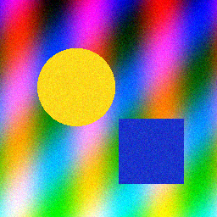
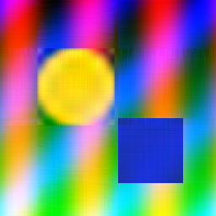
PYTHON · LINEAR ALGEBRA · IMAGE PROCESSING
Image Compression with Singular Value Decomposition
Keeping only the strongest k singular values to shrink an image while preserving what the eye sees
Original
256 × 256 RGB
Rank k = 5
25.6× smaller
python svd_compression.py --image test_image.png
Notes:
This project compresses an image by approximating each colour channel with a low-rank matrix built from its SVD. The small inset is the same image rebuilt from just 5 singular values per channel.

Slide 2
An image is a matrix, and SVD ranks what matters
Every channel is an m × n grid of pixel values.
SVD factors it into A = U Σ Vᵀ, where Σ holds singular values sorted from largest to smallest.
The first few values carry most of the structure; the rest are fine detail and noise.
Keep only the top k and the picture survives with far less data.
A
m × n
≈
U
Σ
Vᵀ
k × k
k × n
m × k
Storage per channel
m · n
original pixels
k (m + n + 1)
values kept at rank k
Notes:
The compression ratio is m*n divided by k(m+n+1). For a 256x256 image at k=5 that is 65,536 / 2,565, roughly 25.6 times smaller.

Slide 3
How the script works, in four steps
1
2
3
4
Load
Decompose
Rebuild
Measure & save
Read the image with Pillow and scale pixels to [0, 1]. Optional --gray. A synthetic test image is generated if the file is missing.
Run numpy.linalg.svd on each colour channel separately (full_matrices=False).
For every k in --ranks, multiply the first k columns of U, values of Σ and rows of Vᵀ; clip back to 0–1.
Report compression ratio, PSNR and energy kept; write rank_k.png, comparison.png and singular_values.png.
Dependencies: numpy · pillow · matplotlib | Outputs land in ./svd_output (change with --out)
Notes:
Each channel is handled independently, so an RGB image needs three SVDs. The decomposition is computed once and reused for every rank.

Slide 4
Quality climbs fast while size falls faster
25.6×
smaller at k = 5
98.5%
of the energy kept at k = 5
33.3 dB
PSNR at k = 100 (1.3× smaller)
Notes:
Results for the 256x256 synthetic test image. Above roughly 30 dB PSNR the differences are hard to see. Note the trade-off: by k=100 the 'compressed' form is barely smaller than the original.

Slide 5
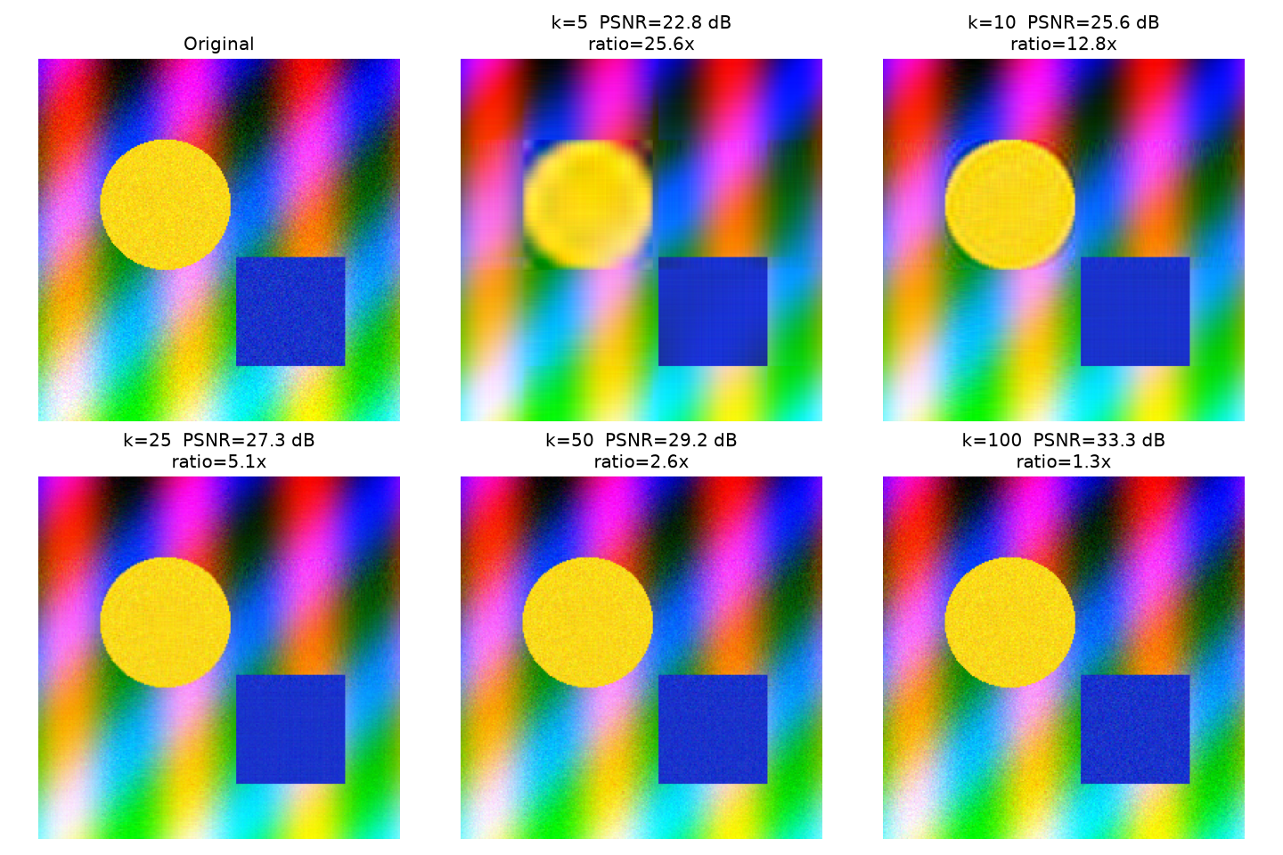
Seeing the trade-off side by side
1
k = 5
Shapes and colours are already recognisable; edges look streaky.
2
k = 25
Edges sharpen; the image reads as the original at a glance.
3
k = 100
Close to lossless, including the noise texture.
Notes:
This is comparison.png produced by the script: the original plus each rank, labelled with PSNR and compression ratio.

Slide 6
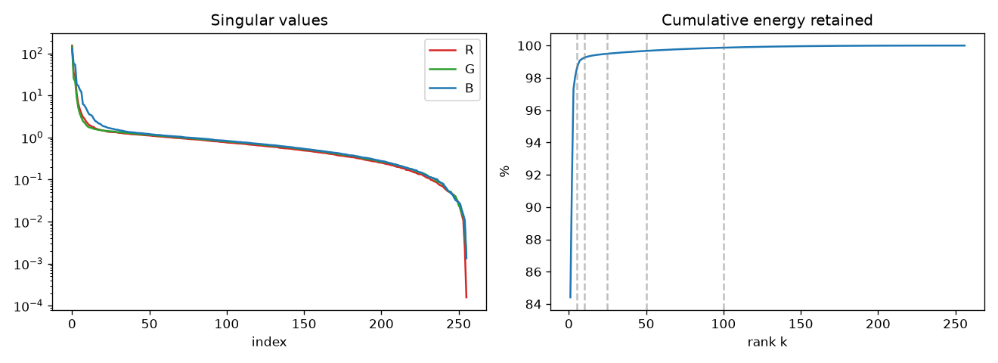
A few singular values hold almost all the energy
Steep drop
Energy curve
Choosing k
Values fall by orders of magnitude within the first few indices.
Cumulative Σσ² passes 98% by k = 5 for this image.
Pick the knee of the curve, or the smallest k above a target energy.
Notes:
Left: singular values per channel on a log scale. Right: cumulative energy, with dashed lines at each chosen rank. Real photos have a flatter tail than this synthetic image, so they need larger k for the same quality.

Slide 7
Takeaways and next steps
1
Low-rank SVD gives a tunable size–quality knob with a single parameter, k.
Try it
pip install numpy pillow matplotlib
python svd_compression.py --image test_image.png
python svd_compression.py --image photo.jpg --gray
2
Small k (5–25) already delivers 5–25× compression with a recognisable image.
Next steps
3
Beyond about k = n/2 the storage saving disappears: there SVD loses to JPEG.
Auto-select k from a target energy or PSNR
Compress in tiles to capture local detail
Benchmark against JPEG at equal file size
Notes:
SVD compression is a great teaching tool for low-rank approximation; practical codecs win at high quality, but the method shows clearly why so much of an image is redundant.

