Slide 1



Linux Kernel Hacking 101
#GHC14
Kelley Nielsen
Salticidoftheearth.com
For the Linux Foundation
Oct 8, 2014
2014

Slide 2


Slide 3

The process of kernel hacking is a
CYCLE

Slide 4
The Creative Cycle
Code your changes
Send in your patch
Gather feedback
Repeat

Slide 5
The Creative Cycle
Find a contribution to make
Read stored communications
Gain experience
Ask

Slide 6
The Creative Cycle
Find a contribution to make
Read stored communications
Gain experience
Ask

Slide 7
The Creative Cycle
Find a contribution to make
Read stored communications
Gain experience
Ask

Slide 8
The Creative Cycle
Find a contribution to make
Read stored communications
Gain experience
Ask

Slide 9
The Creative Cycle
Code your contribution
Prepare and send the patchset

Slide 10
The Creative Cycle
Gather feedback
Testing results
Mentoring and guidance
Discussion of strategies
General suggestions

Slide 11
The Creative Cycle
Gather feedback
Testing results
Mentoring and guidance
Discussion of strategies
General suggestions

Slide 12
The Creative Cycle
Gather feedback
Testing results
Mentoring and guidance
Discussion of strategies
General suggestions

Slide 13
The Creative Cycle
Gather feedback
Testing results
Mentoring and guidance
Discussion of strategies
General suggestions

Slide 14
The Creative Cycle
Gather feedback
Testing results
Mentoring and guidance
Discussion of strategies
General suggestions

Slide 15
The Creative Cycle
Incorporate changes
Use feedback to improve
If your contribution is rejected, find another
Regenerate and resend your patchset

Slide 16
Repeat the previous two slides until
Your patchset is accepted…
Then repeat with a new patchset…

Slide 17
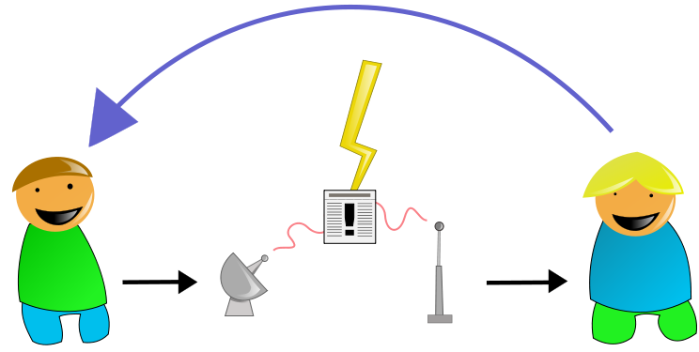
Communicating with team members
and community

Slide 18
Communicating
Mailing lists
Private email
Conferences
Linux Weekly News

Slide 19
Communicating
Mailing lists
Private email
Conferences
Linux Weekly News

Slide 20
Communicating
Mailing lists
Private email
Conferences
Linux Weekly News

Slide 21
Communicating
Mailing lists
Private email
Conferences
Linux Weekly News

Slide 22
Communicating
Internet Relay Chat (IRC)
Looks like multi-way text messaging
Use a dedicated client (not a web client)
Connect to a network
Once on the network, join a channel

Slide 23
Communicating
Internet Relay Chat (IRC)
Looks like multi-way text messaging
Use a dedicated client (not a web client)
Connect to a network
Once on the network, join a channel

Slide 24
Communicating
Internet Relay Chat (IRC)
Looks like multi-way text messaging
Use a dedicated client (not a web client)
Connect to a network
Once on the network, join a channel

Slide 25
Communicating
Internet Relay Chat (IRC)
Looks like multi-way text messaging
Use a dedicated client (not a web client)
Connect to a network
Once on the network, join a channel

Slide 26
Communicating
Internet Relay Chat (IRC)
Looks like multi-way text messaging
Use a dedicated client (not a web client)
Connect to a network
Once on the network, join a channel

Slide 27
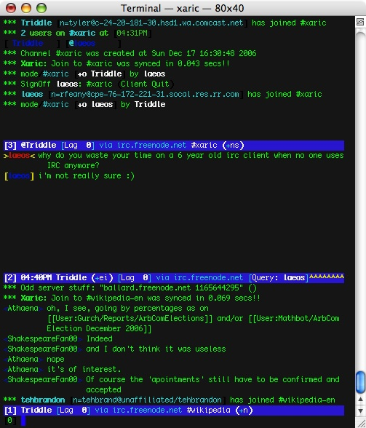

Slide 28
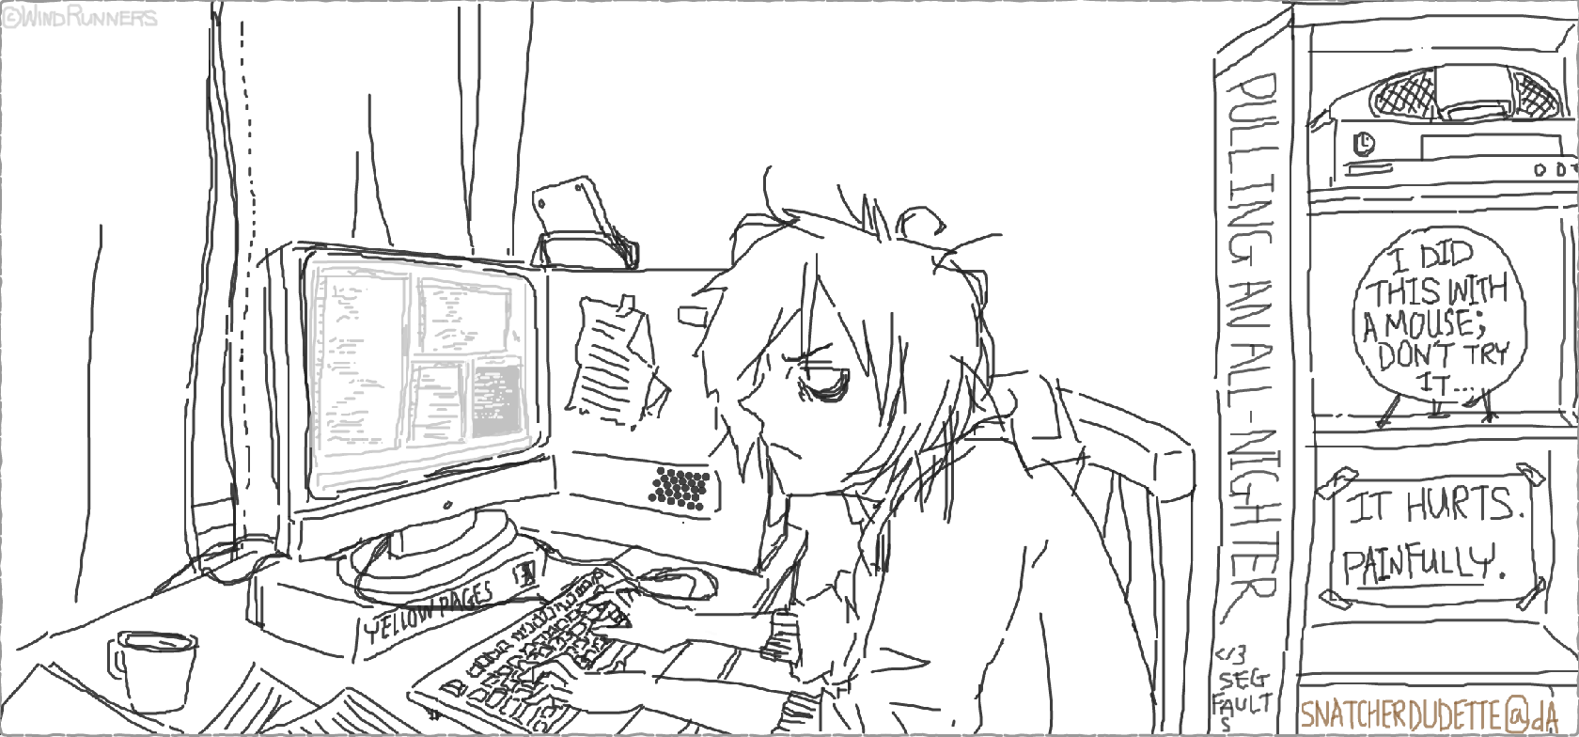
Coding your changes

Slide 29
Coding your changes
Plan
Code
Compile & run
Test & debug

Slide 30
Coding your changes
Plan
Trace existing paths of execution
Find examples similar to your goal
Learn which lines are relevant
Your friends are grep and the lxr ident search

Slide 31
Coding your changes
Plan
Trace existing paths of execution
Find examples similar to your goal
Learn which lines are relevant
Your friends are grep and the lxr ident search

Slide 32
Coding your changes
Plan
Trace existing paths of execution
Find examples similar to your goal
Learn which lines are relevant
Your friends are grep and the lxr ident search

Slide 33
Coding your changes
Plan
Trace existing paths of execution
Find examples similar to your goal
Learn which lines are relevant
Your friends are grep and the lxr ident search

Slide 34
Coding your changes
Hack your code
Language is C
Follow kernel coding style
Gain skill with your editor

Slide 35
Coding your changes
Compile and run
This involves installation and rebooting!
Use a virtual machine or dedicated machine
Maintain a known working and a test kernel

Slide 36
Coding your changes
Compile and run
This involves installation and rebooting!
Use a virtual machine or dedicated machine
Maintain a known working and a test kernel

Slide 37
Coding your changes
Compile and run
This involves installation and rebooting!
Use a virtual machine or dedicated machine
Maintain a known working and a test kernel

Slide 38
Coding your changes
Test and debug
Your friend is printk()
Find messages in /var/log/kern.log
Create testing scenarios

Slide 39
Coding your changes
Test and debug
Your friend is printk()
Find messages in /var/log/kern.log
Create testing scenarios

Slide 40
Coding your changes
Test and debug
Your friend is printk()
Find messages in /var/log/kern.log
Create testing scenarios

Slide 41

Generating and Delivering Your Patch

Slide 42
Delivering Your Patch
Git commit strategy
Git branching strategy
Composing the commit message
The patch

Slide 43
Delivering Your Patch
Git commit strategy
Make small incremental changes
Make changes in logical order
Each change should be encapsulated
Be prepared to alter previous commits
Be prepared for upstream changes as you update your sources

Slide 44
Delivering Your Patch
Git commit strategy
Make small incremental changes
Make changes in logical order
Each change should be encapsulated
Be prepared to alter previous commits
Be prepared for upstream changes as you update your sources

Slide 45
Delivering Your Patch
Git commit strategy
Make small incremental changes
Make changes in logical order
Each change should be encapsulated
Be prepared to alter previous commits
Be prepared for upstream changes as you update your sources

Slide 46
Delivering Your Patch
Git commit strategy
Make small incremental changes
Make changes in logical order
Each change should be encapsulated
Be prepared to alter previous commits
Be prepared for upstream changes as you update your sources

Slide 47
Delivering Your Patch
Git commit strategy
Make small incremental changes
Make changes in logical order
Each change should be encapsulated
Be prepared to alter previous commits
Be prepared for upstream changes as you update your sources

Slide 48
Delivering Your Patch
Git branching strategy
Keep master branch unmodified
Create a working branch
Use a throwaway branch to squash commits
If this method doesn’t work for you, try another

Slide 49
Delivering Your Patch
Git branching strategy
Keep master branch unmodified
Create a working branch
Use a throwaway branch to squash commits
If this method doesn’t work for you, try another

Slide 50
Delivering Your Patch
Git branching strategy
Keep master branch unmodified
Create a working branch
Use a throwaway branch to squash commits
If this method doesn’t work for you, try another

Slide 51
Delivering Your Patch
Git branching strategy
Keep master branch unmodified
Create a working branch
Use a throwaway branch to squash commits
If this method doesn’t work for you, try another

Slide 52
Delivering Your Patch
Composing the commit message
Work as hard on this as you do on coding!
Read existing examples
Be concise, yet thorough
Use imperative language

Slide 53
Delivering Your Patch
Composing the commit message
Work as hard on this as you do on coding!
Read existing examples
Be concise, yet thorough
Use imperative language

Slide 54
Delivering Your Patch
Composing the commit message
Work as hard on this as you do on coding!
Read existing examples
Be concise, yet thorough
Use imperative language

Slide 55
Delivering Your Patch
Composing the commit message
Work as hard on this as you do on coding!
Read existing examples
Be concise, yet thorough
Use imperative language

Slide 56
Delivering Your Patch
The patch itself
Run checkpatch.pl on the files you change
Generate patch with a git command
Cc everyone involved with the code
Send using plain text mail

Slide 57
Delivering Your Patch
The patch itself
Run checkpatch.pl on the files you change
Generate patch with a git command
Cc everyone involved with the code
Send using plain text mail

Slide 58
Delivering Your Patch
The patch itself
Run checkpatch.pl on the files you change
Generate patch with a git command
Cc everyone involved with the code
Send using plain text mail

Slide 59
Delivering Your Patch
The patch itself
Run checkpatch.pl on the files you change
Generate patch with a git command
Cc everyone involved with the code
Send using plain text mail

Slide 60
Delivering Your Patch
Why plain text?
Email formatting will break your code
Team members will apply your patch as is
Commit message will become subject line and content
Use a specific mail client such as mutt
(no gmail!)

Slide 61
Delivering Your Patch
Why plain text?
Email formatting will break your code
Team members will apply your patch as is
Commit message will become subject line and content
Use a specific mail client such as mutt
(no gmail!)

Slide 62
Delivering Your Patch
Why plain text?
Email formatting will break your code
Team members will apply your patch as is
Commit message will become subject line and content
Use a specific mail client such as mutt
(no gmail!)

Slide 63
Delivering Your Patch
Why plain text?
Email formatting will break your code
Team members will apply your patch as is
Commit message will become subject line and content
Use a specific mail client such as mutt
(no gmail!)

Slide 64
Now wait for your feedback,
And do it all again…

Slide 65


Happy Hacking!

Slide 66

Got Feedback?
Rate and Review the session using the GHC Mobile App
To download visit www.gracehopper.org
Notes:
This is the last slide and must be included in the slide deck

Slide 67
Resources
Gnome Outreach Program for Women https://wiki.gnome.org/OutreachProgramForWomen
Kernel.org git repositories https://git.kernel.org/cgit/
Linux Kernel Newbies http://kernelnewbies.org/
OPW Intro page http://kernelnewbies.org/OPWIntro
The Eudyptula Challenge http://eudyptula-challenge.org/
KVM Installation https://help.ubuntu.com/community/KVM/Installation
Linux Kernel Mailing List https://lkml.org/
Various Linux related mailing lists at Gmane http://gmane.org/find.php?list=kernel
Linux Foundation events http://events.linuxfoundation.org/
Linux Weekly News http://lwn.net/
#irchelp http://www.irchelp.org/
Irssi – The Client of the Future http://www.irssi.org/
Wikipedia entry for the grep command http://en.wikipedia.org/wiki/Grep
Linux Cross Reference at Free Electrons http://lxr.free-electrons.com/
Linux Kernel Coding Style (pdf) https://computing.llnl.gov/linux/slurm/coding_style.pdf
Vim the editor http://www.vim.org/
Pro Git http://git-scm.com/book https://www.gitbook.io/book/gitbookio/progit
The Mutt E-Mail Client http://www.mutt.org/

Slide 68
Image Credits
Arrows Circle by Freepik CC BY 3.0
Communication shannon-weaver2 by Einar Faanes CC BY-SA 3.0
Xaric screen shot by Triddle BSD License http://commons.wikimedia.org/wiki/File:Xaric_screen_shot.jpg
Coding All Night Long by Snatcherdudette http://snatcherdudette.deviantart.com/art/Coding-all-night-long-183815498
Music present by Marta Crowe Creative Commons Attribution 2.0 Generic
Linux Foundation Logo is in the public domain
Linux “Tux” Logo is in the public domain

Slide 71
Title Goes Here
The first point
Sub-points
Down one more
And again
Once more

Slide 72
Title Goes Here
The first point
Sub-points
Down one more
And again
Once more

