Slide 1


Chicago Crime Data Analysis
Cheta Ekweozoh
Cohort 9DA

Slide 2


Content:
Project Brief
Load and Prepare Data
Parsing data objects
Data Cleaning
Categorical Data Encoding
Clustering – Exploratory data analysis
Objective Analysis
Advise

Slide 3
Project Brief
Crime in Chicago has been worrisome to the Chicago PD. Reported crimes have been tracked on a daily basis since 2001 and have been provided in the project data file. The Chicago PD would like to drastically reduce the spate of violent crimes reported in the city. Being effective involves knowing crime patterns and where they are likely to occur. It also involves equipping the Police Department appropriately. They have recruited you to conduct full data analytics and uncover insights from the data that can be used to effectively prepare for and respond to crimes. They are interested in gleaning any insights that can help them determine What type of crimes to prepare for, Where these crimes are most likely to occur, What days of the week and periods to expect these crimes.
Conduct a complete data analytics study and from your analytics, advise the Chicago PD accordingly.

Slide 4
Load and Prepare Data
Firstly, you import necessary python libraries – Pandas(data manipulation package), NumPy( array-processing package), Matplotlib (visualization package), Seaborn(statistical plotting package), Pandas_profiling(generating basic report), scikit-learn(predictive data analysis), warnings module(to supress warnings).
Load and read data with pandas.read_csv function as the file is in csv format.
Use .shape, .head, .info and .describe functions to verify the size, eyeball, determine dimensions and distributions of the data, which gives us some insight to the data. This information can tell us how safe it is to load our data and show missing values as well.

Slide 5
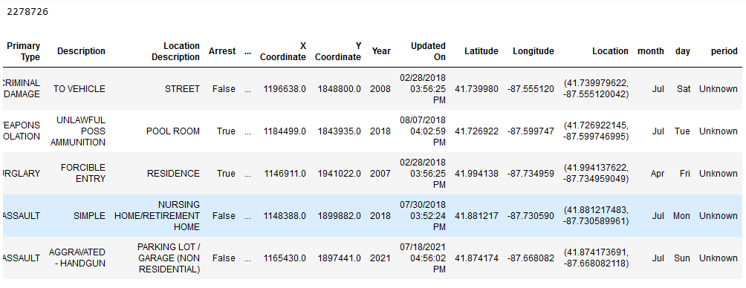
Parsing data objects
We will import Parse and Datetime modules, which supplies classes to work with date and time. The value of Date in the dataset will be converted to month, day and period.
dfSub.head()

Slide 6
Data Cleaning
Missing Values Analysis
We will use dfSub.isna.().sum() to determine the number of missing values of each feature. We can see the following missing values – Case Number(1), Location Description(2877), District(12), Ward(184695), Community Area(184267), X Coordinate(23985), Y Coordinate(23985), Latitude(23985), Longitude(23985), Location(23985).
We used dropna () method to treat missing values for Categorical features.
Used padding method to treat missing values for numerical features as the values don’t change much.

Slide 7
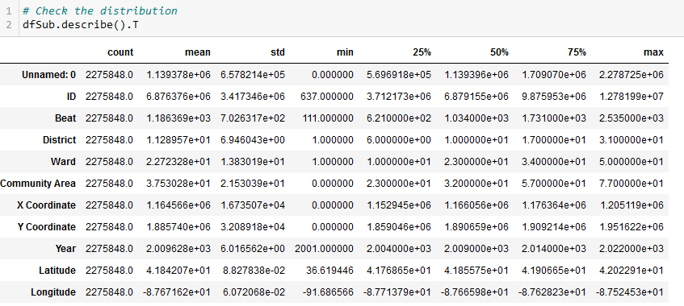
Duplication
Drop_duplicates () method was used to drop all duplicates.
Outlier
We will not check for outliers because there is no concept of outliers in categorical variables.
- dfSub.describe().T – we can see that the count values are same across all features, which shows that data cleaning was properly done. However there is need for standardization and rescaling.

Slide 8
Categorical Data Encoding
I employed Dummy Variable encoding technique. This technique transforms the categorical variable into a set of binary variables.
Significant features for exploratory analysis were been converted to Numerical variables.
Such as ; Arrest
Domestic
Primary Type
day

Slide 9
Clustering – Exploratory data analysis
K-means clustering is the clustering algorithm used.
Elbow method was used as a guide for selecting the optimum number of clusters.
K-means clustering was performed on each of the features.
Scatter plot was used to plot the selected features to uncover patterns and gain insights to the data.
From the clusters, we draw inference and advise Chicago Police Department.

Slide 10
Objective Analysis
I discovered that Year 2016 is a very peculiar year as it shows that crime incidence in 2016 was
higher than the other years. 2016 had a good number of arrests more than other years.
Beat number 1900 geographical area recorded in average more crime incidence than other areas.
At the District; out of the 22 police districts, district 19 recorded in average more crime incidence.
At the Ward, we can see that ward 34 recorded in average more crime incidence than the other wards.
Community Area - 22 out of the 77 areas had in average more recorded crime incidence.
We can see that about 9000000 incidents in average were recorded across the days of the week.

Slide 11
Advise
In regards to the provided crime dataset and inferences from the clusters we can say that the crime incidences on the primary type are likely to occur at BEAT number 1900 under DISTRICT number 19 at WARD 34 and Community Area 22. The Police department should expect crime at all the days of week
In order to prevent or reduce crime incidences to the above locations, we will suggest that a more detailed police investigation should be carried out on the factors that gave rise to crime and Arrests recorded in Year 2016.
This information will provide adequate intelligence to prevent further crime occurrence especially on the above stated locations.

Slide 12
Thanks

