Slide 1
CUSTOMIZED SEARCH ENGINE
(EXCLUSIVELY FOR PEC)
MENTOR:-
Dr. DIVYA BANSAL
TEAM MEMBERS:-
ADITYA SHARMA (16103050)
CHETNA GUPTA (16103040)
SHREYA (16103070)
SRISHTI (16103089)

Slide 2
ABOUT
ExpAll is a search engine meant to solve the queries related to students of PEC. Until now the google serve is hit for any query which leads to time delay as well as results are not centralised and informative.
The project is being developed on lines of search optimization techniques and the concept of Machine Learning.

Slide 3
Problem Statement
Design a search engine exclusively for PEC related queries.
Functionalities Supported:-
Response with valid links corresponding to the queries.
Send valid query to the authorized person if no link found
Autocompletion of queries using AI techniques.

Slide 4
OBJECTIVES
Ease the queries of students
Providing more relevant and centralise information
Diminishing the time delays by hitting our application instead of google server for such localised queries.
Minimizing the chances of error and providing authenticated and verified answers.
To build a crawler to extract information related to PEC from other search engines and incorporate it in our application.

Slide 5
SOLUTION PROPOSED
Predictive search techniques through autocompletion of queries based on frequency of searches.
Generation of keywords in query to provide appropriate results.
Display results comprising of webpages as well as personalized answers to the forum by authenticated users.
Recommendation of results based on most searched ones.
Redirection of new asked queries to the concerned person authorized to answer that query.

Slide 6
MOTIVATIONS
The students of PEC have a hard time searching for details specific to their college. The authentication of information they get is not guaranteed.
Currently, all queries related to PEC are fired to the google search engine. This is a localized search engine wherein the students shall get required information related to PEC only.
Details about campus, placement policies, day-to-day activities are not present anywhere till date
Some important information like policies, events, reports, locations,etc can be saved at a safe place unlike the present scenario wherein the WhatsApp is the place of such information and most likely to be lost.

Slide 7
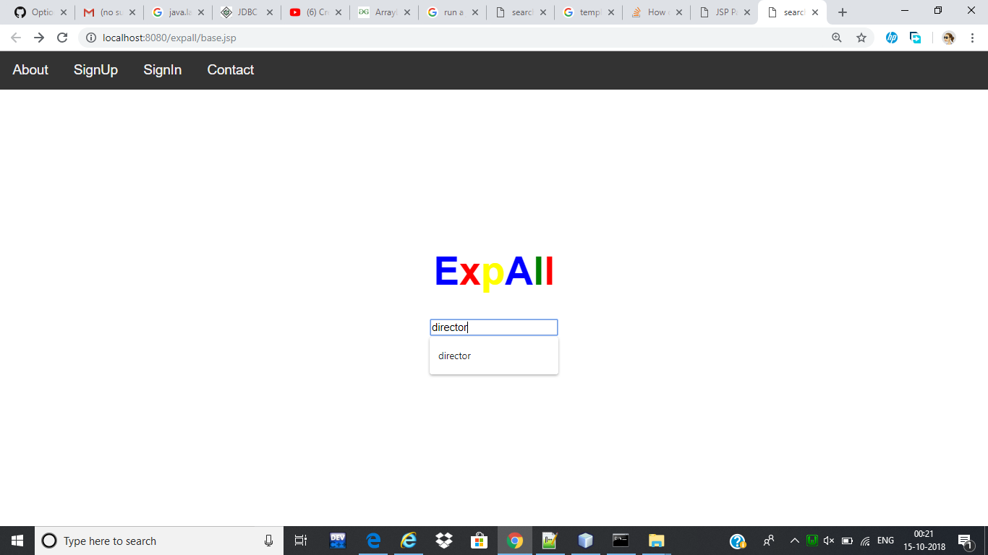
DESIGN/IMPLEMENTATION
HOME
PAGE

Slide 8
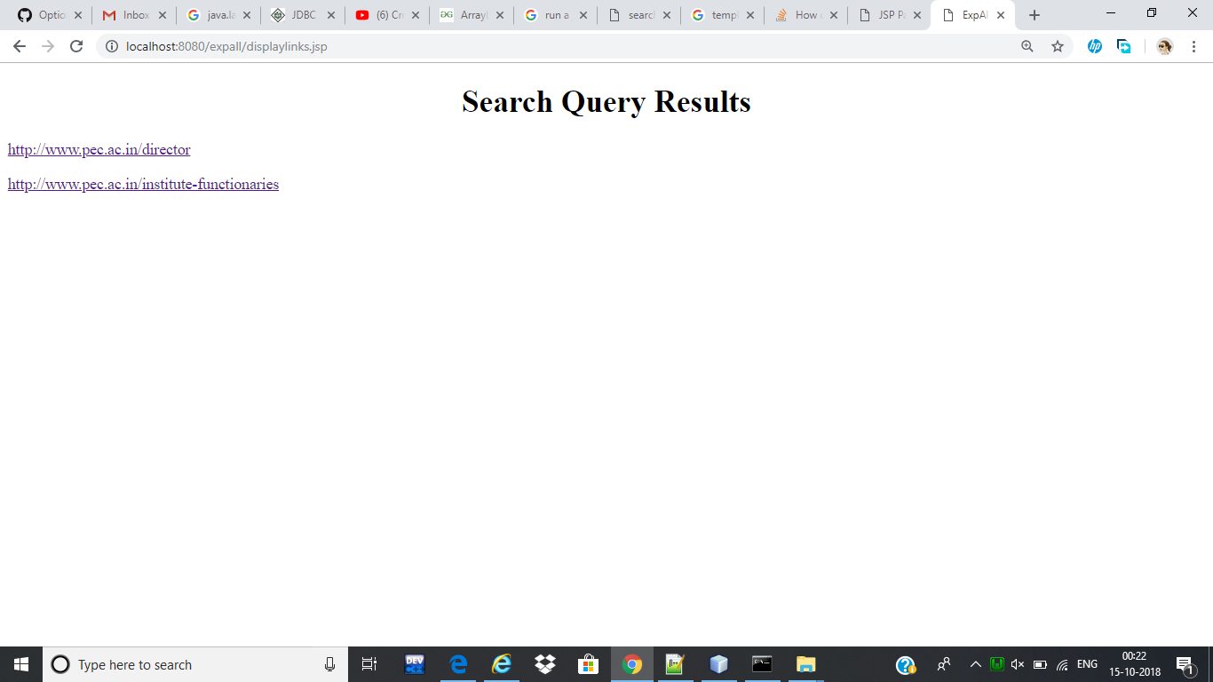
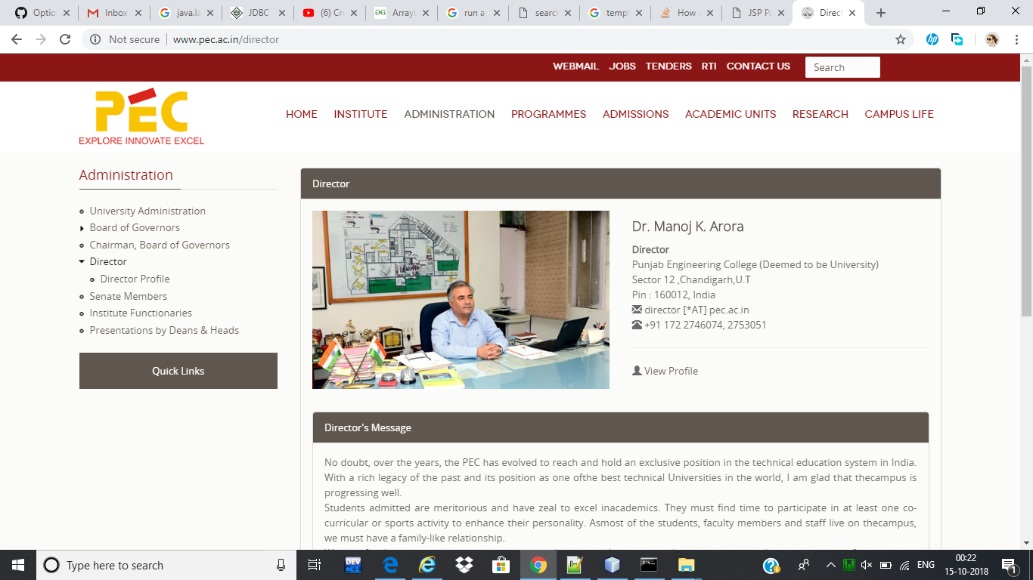
QUERY RESULTS
WEB PAGE DISPLAYED

Slide 9
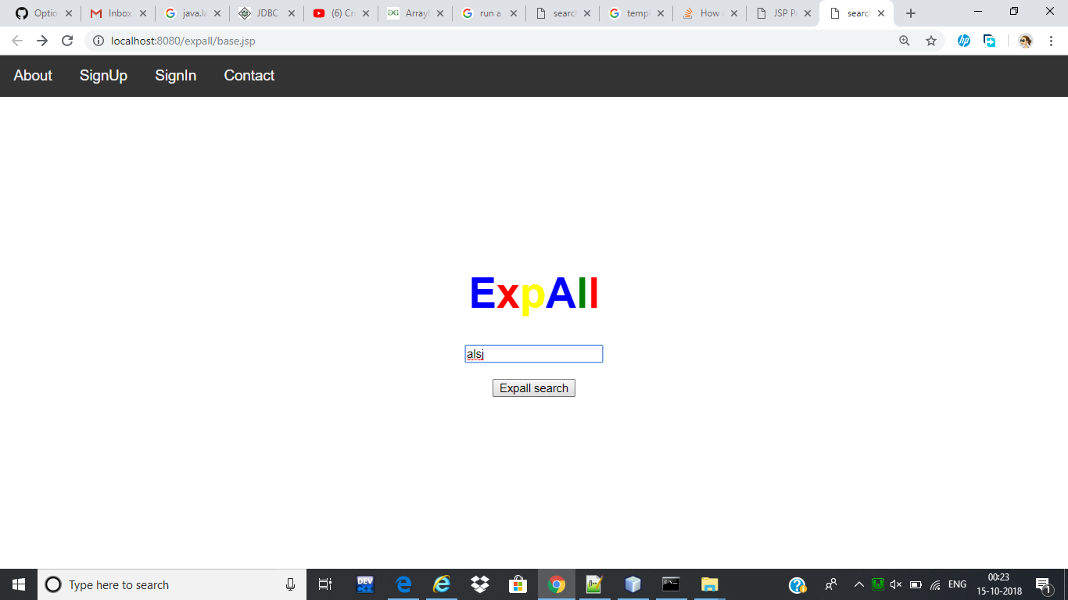
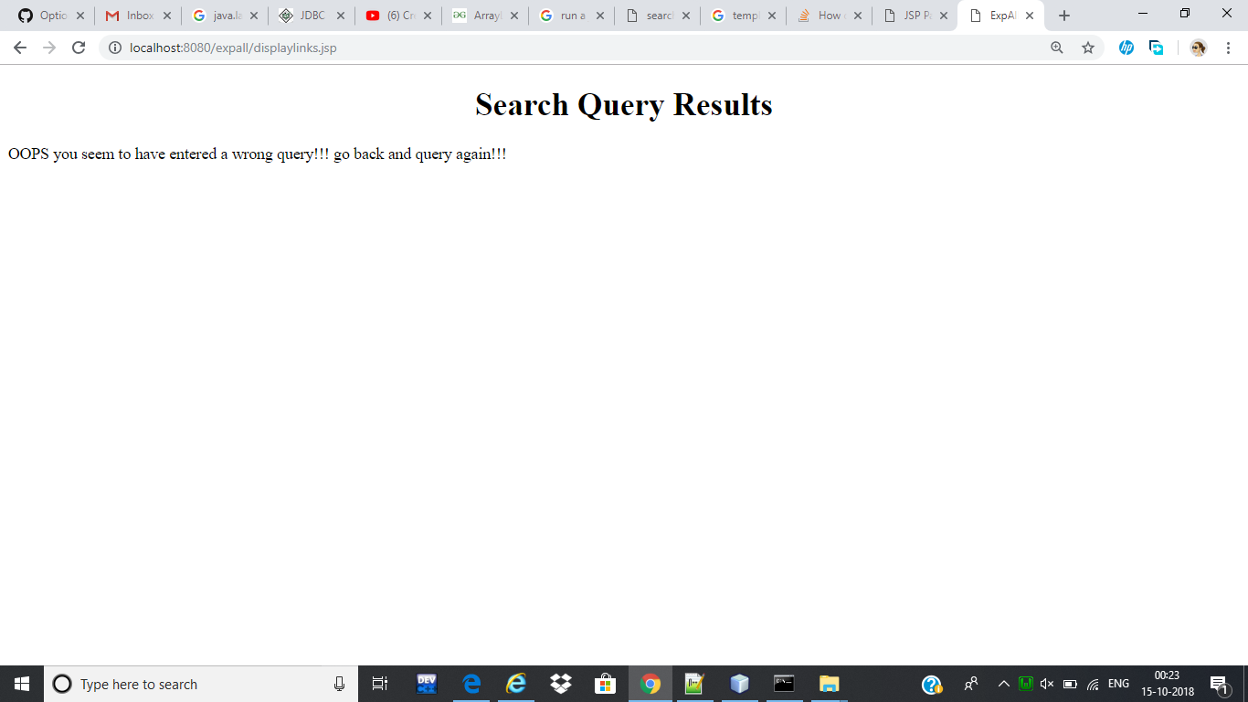
ANOTHER INVALID QUERY

Slide 10
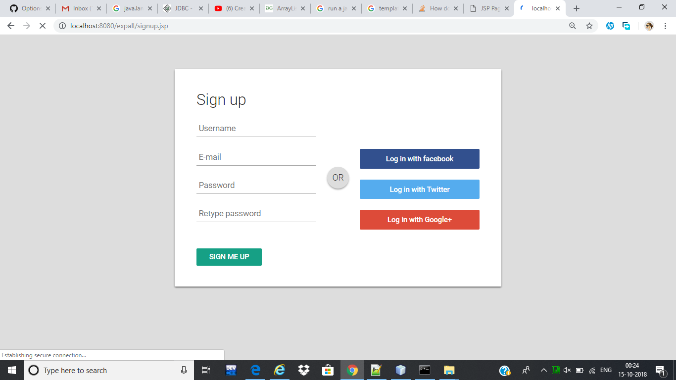
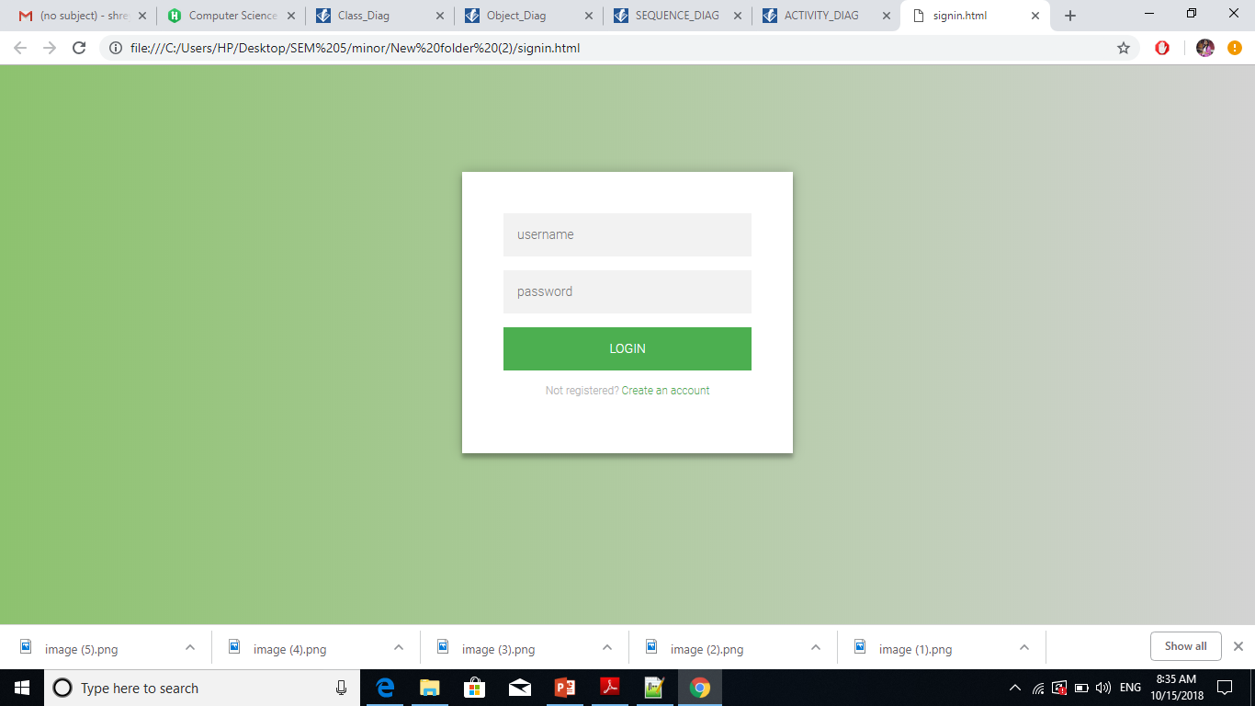
AUTHENTICATED USER PORTAL

Slide 11
RESULTS ACHEIVED
Collection of PEC dump from various websites.
Extraction of links after indexing various web pages and storing the links in front of keywords based on the frequency of their appearance in the webpage
Extraction of keywords on basis of stopwords.
Redirecting query asked by user to query the database and display appropriate relevant links in accordance to the query.

Slide 12
FUTURE TIMELINE
Adding Auto Completion of query feature –This feature is to be implemented using AI techniques.
Redirecting the queries to the authenticated users in case the query result is not found in database to get the appropriate result.
Redirecting only valid queries related to PEC to the authenticated user and discard all the invalid queries.

