Slide 1


Codergirl – WebDev Unit
Class 1
March 3, 2021

Slide 2
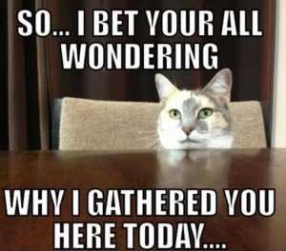

Agenda
Agenda
● Intros
● Course Overview
● Review
● Live coding
● Studio

Slide 3

Instructor Intros
Chetna Aggarwal
MS Computer Engineering
Missouri University of S&T - Rolla
Bayer
  Developer
  Technical Lead
  Agile Coach
Fun facts:
  Lives in St. Charles
  Husband's name is Jimmy
  Two children- Arianna and Miraya
  Strengths
    Developing others
    Valuing individuals
    Treating people consistently

Slide 4


Mentor Intros
Lucas
Katie
Tyler
Veleria
Sunita
Zach
Sam
Ted
Brit
Mary
Emma
Sidney
Pallavi
Olivia
Carrie
Notes:
Lucas Barker & Katie Blackstone
Tyler Kaelin & Veleria Boaten
Sunita Lanka & Zach Mirowitz
Sam Leonard & Ted Ryan
Brit Barrick & Mary Niederschmidt
Emma Troxell & Sidney Buckner
Pallavi Shah & Olivia Walls
floater mentor (will explain tomorrow) = Carrie Jones

Slide 5
Course Overview
Every Wednesday
  5:30-8:30pm
  Last class day: July 7th.
  Virtual
Pass/Don't pass
  Must complete all graded assignments
  Passing allows moving to Unit 2

Slide 6

Course Tools
Canvas
  Prep work, Assignments and grades
  Prep work posted roughly 2 weeks out
Slack
  Best communication method
  Announcements
  Don't be fooled by a green dot
repl.it
  Online Integrated Development Environment (IDE)
  Write your code here!

Slide 7
Course Expectations
You
  Do the prep work before class
  Come to class (virtually)
  Ask questions and participate
  Do the studios and assignments
  Don't cheat
Mentor Team
  Be available (within reason)
  Be patient and understanding
  Be prepared

Slide 8
Survival Tips
Find or form a study group
    #webdev_studygroups
Create a study schedule and stick to it
    Plan on 15-20 hours per week
Reach out when you're struggling
  Classmates, mentors, LC staff
  If something is unclear, ask
Stay focused on your goals
  Why are you here? Let that fuel you

Slide 9

Academic Honesty

Slide 10
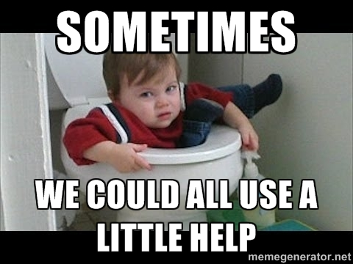
Sources for Help
Classmates
  If you can help, don't be afraid to answer
Group Mentor
  They are here to help YOU
  Be mindful of their schedules
Instructors
  More “I don't understand this”
  Less “my code doesn't work”
Google!

Slide 11
Class Overview
Questions?

Slide 12




Review – Values and Data Types
Programs are made of two things:
  Data
  Operations that manipulate data

Slide 13
Review – Values and Data Types
Value: Specific piece of data
  “Hello world”
  23
  animal_cross.jpeg
  true
Data Type: Category of data
String
Number
Object
Boolean

Slide 14



Review – Values and Data Types
Variable: Way to store values for use in a program.
  Declaration: Creating a new variable
  Initialization: Giving the variable a value to store

Slide 15
Review – Values and Data Types
Variable keywords
  let – used if the value will change
  const – used if the value is constant
    Trying to change a const variable will lead to errors
  Only use keywords when declaring a variable, never for reassignment
  Do not use var

Slide 16
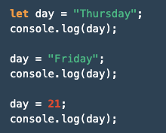
Review – Values and Data Types
Declaration and
Initialization
Reassignment
Reassignment

Slide 17
Review – Values and Data Types
Variable Naming
  Use camelCase
    thisIsVeryCoolCamelCase
    this_is_not_camel_case
No special characters or whitespace
Cannot start with a number
Use meaningful names
  x = “Hello, World!” (BAD)
  greeting = “Hello, World!” (GOOD!)

Slide 18
Review – Values and Data Types
Operator: Character that represents a computation to be made
    You likely know: +, -, *, /
    ** is exponent (5 ** 2 = 25)
    ++ is increment (if x = 2, x++ = 3)
    % is modulus
      Divide two numbers, return the remainder
      7 % 2 = 1

Slide 19
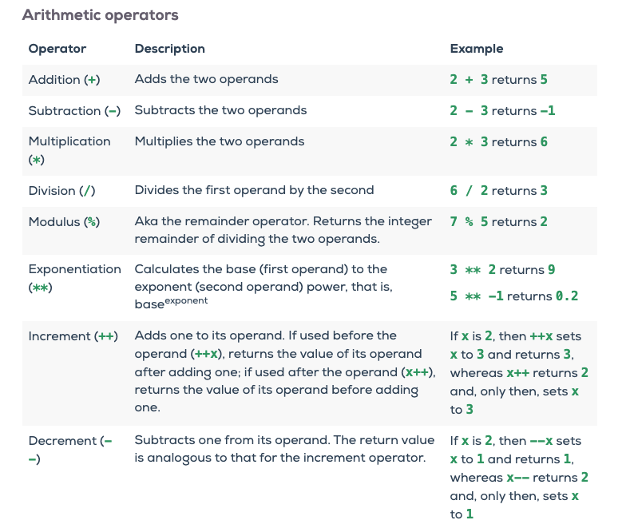

Slide 20
Review – Values and Data Types
Questions?

Slide 21
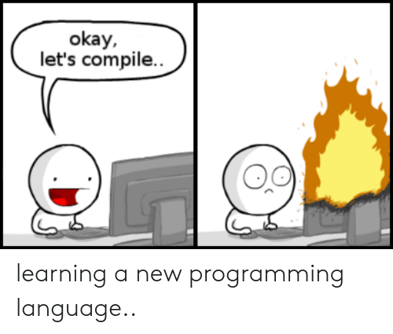
Live Coding

Slide 22
Live Coding
typeof
console.log
type conversion
Variables - creating, reassigning
let, const
naming
Expressions
Operations, compound assignments, reading input
Notes:
Why not use var, PEMDAS

Slide 23
Exercises
Notes:
Why not use var, PEMDAS

Slide 24
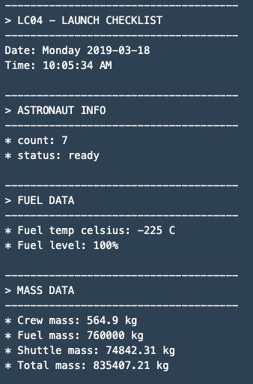
Studio – Data and Variables
Store data in variables
Print data back to the user
Format the output to look like the LC04 Form

Slide 25
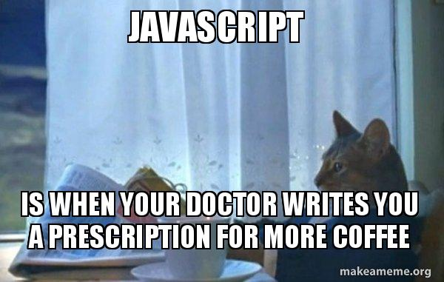
Now
Find your group Zoom
  Intros
  Studio
  Prep for next week
Studio Review
  next week

