Slide 1
JavaScript Object Notation

Slide 2
Overview
JSON or JavaScript Object Notation is a lightweight text-based open standard .
JSON is human-readable data interchange.
Conventions used by JSON are known to programmers, which include C, C++, Java, Python, Perl, etc.
The format was specified by Douglas Crockford.
It has been extended from the JavaScript scripting language.
The filename extension is .json.
JSON Internet Media type is application/json.
The Uniform Type Identifier is public.json

Slide 3
JSON Vs Xml
Similarities between JSON and XML
JSON and XML and human readable format and are language independent.
Both JSON and XML are hierarchical.
Both can be parsed and used by a lot of Programming language.
Both JSON and XML can be fetched with an XMLHttpRequest.
Difference between JSON and XML
JSON is shorter compare to Xml
JSON is quicker to read and write
JSON can use arrays but Xml does not.
XML requires a proper XML parse but JSON can be parsed by java script function.

Slide 4
JSON Vs Xml
JSON format
[“Employees”:
{“empid”:”E1001”,”empname”:”Sudhir”},
{“empid”:”E1002”,”empname”:”Vinod”},
]
XML Format
<Employees>
<Employee>
<empid>E1001</empid>
<empname>Sudhir</empname>
</Employee>
<Employee>
<empid>E1002</empid>
<empname>Vinod</empname>
</Employee>
</Employees>

Slide 5
Uses of JSON
It is used while writing JavaScript based applications that includes browser extensions and websites.
JSON format is used for serializing and transmitting structured data over network connection.
It is primarily used to transmit data between a server and web applications.
Web services and APIs use JSON format to provide public data.
It can be used with modern programming languages.

Slide 6
Characterstics of JSON
JSON is easy to read and write.
It is a lightweight text-based interchange format.
JSON is language independent.

Slide 7
JSON Syntax
In JSON the data will be stored in name and value pair wise.
Curly brace will store an object
Each name will followed with the “:” colon.
The name and value pair separated by comma.
Syntax below of a JSON values
{
"book":
[{"bookid":"1001","bookname":"core java"},
{"bookid":"1002","bookname":"Servlets"}
]
}

Slide 8
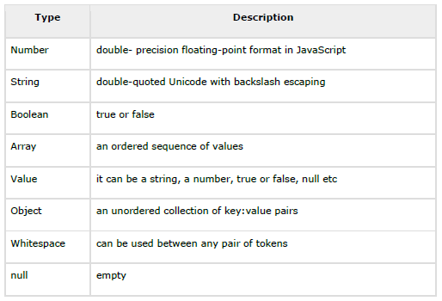
JSON DataType
In JSON these are the following datatypes supporting

Slide 9
JSON Objects
It is an unordered set of name and value pairs
Objects are enclosed with curly braces.
Each key or name must be strings and should be different from each other.
The following is the Syntax for the JSON.
var json_obj={};
var json_obj=new Object();
var json_obj={"bookname":"Core java","bookid" :"1001"}

Slide 10
JSON Array Objects
Using JSON we can implement the array.
Array can store number of Objects.
var books =
{ "CoreJava" :
[ { "bookname" : "Java 2 Edition", "price" : 700 },
{ "bookname" : "21 Days JAVA SE 6", "price" : 400 } ]
};
Here books is the array object.
Array name is CoreJava and elements are bookname and price.

