Slide 1

Lending Club Case Study
Nitish Sharma
Chetna Priyadarshini

Slide 2

Problem Statement
Help a finance company identify risky loan applicants
Understand consumer attributes and loan attributes that are likely to cause the account to be defaulted
To serve above
Clean data removing null columns, replace NA with 0 where applicable, identify and remove rows that do not have any important information
Study distribution of data on various rows and perform outlier treatment
Understand corelation between different variables in people who defaulted on the loan and identify a common pattern
Combine the rows together to arrive at a conclusion on risk factors for loan defaulters

Slide 3
Data Cleaning
Initial data: 39717 rows and 111 columns
Removed null columns: 39717 rows and 57 columns
Removed columns with only one value: 39717 rows and 51 columns
Removed columns which have more than 20% null values: 39717 rows and 47 columns
Removed columns with id/membership_id(all unique vals): 39717 rows and 45 columns
Removing columns not interesting for analysis: 39717 rows, 23 columns
Replace remaining null values with 0
Standardize column values removing trailing string of %, months, x, converting to numeric where possible
Remove outliers from Loan Amount, Annual Income, Debt to Income ratio columns

Slide 4
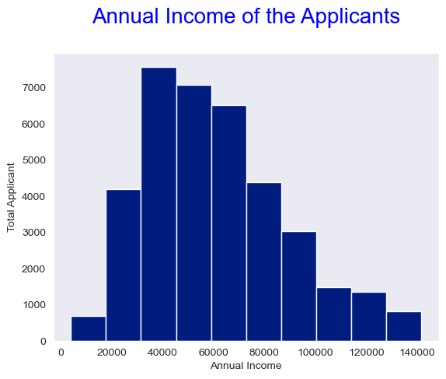
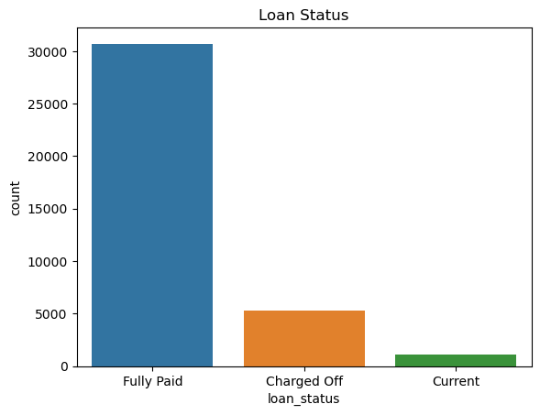
Univariate Analysis: Loan Status & Annual Income
We can see that most of the users are in Fully paid category
maximum number of loan applicants have annual income of 30000 - 40000.
4500 people have salary less than 30000.

Slide 5
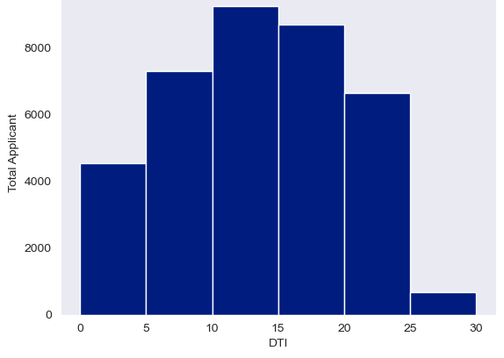
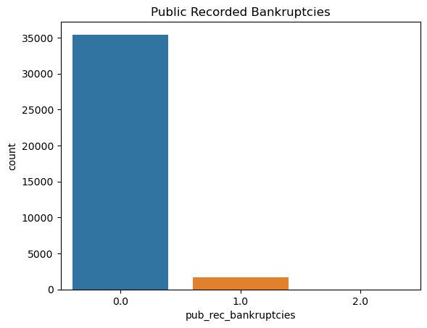
Univariate Analysis: Debt to Income & Public recorded bankruptcies
Composition of highest applicants with top 3 DTI falls under the categories as 10-15, 15-20 and 5-10
1634 applicants with public recorded bankruptcies

Slide 6
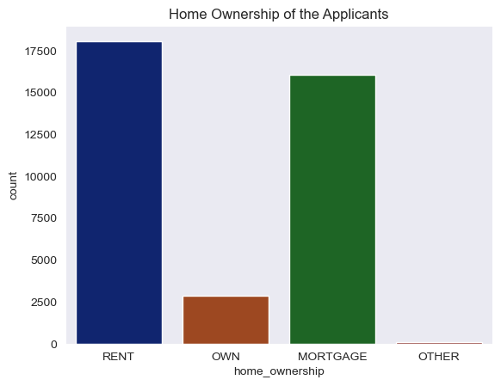
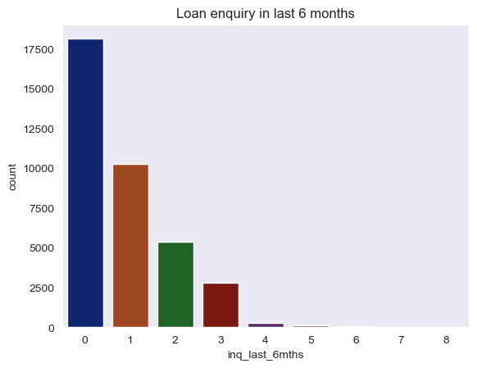
Univariate Analysis: Home Ownership & Loan enquiry in last 6 months
Most of the applicants are either living on rent or property is mortgage.
Most of the applicants have 0 to 3 enquiries.
Some applicants with enquiry between 4 to 8

Slide 7
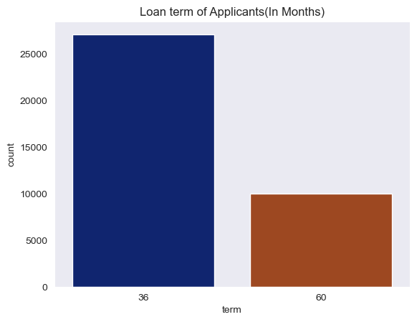
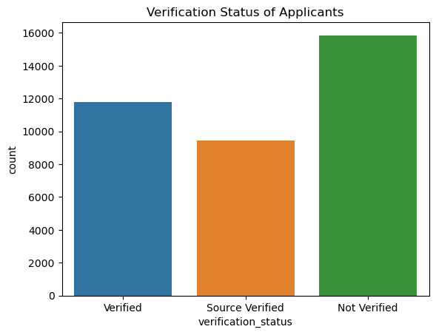
Univariate Analysis : Loan Term & Verification Status
maximum applicants have a Loan term of 36 months.
This represents high number of applicants as not verified. This is followed by the count of source verified and verified are nearly same.

Slide 8
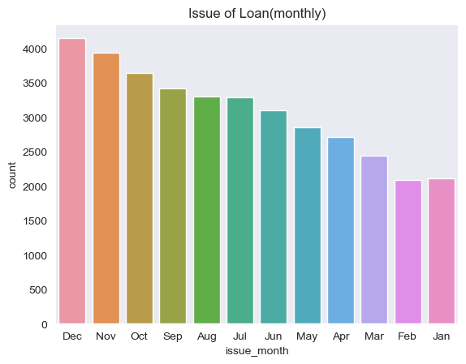
Univariate Analysis: Issue of Loan(Month)
Maximum number of loans were issued in December

Slide 9
Segmented Analysis
Break down loan amount data in 0k-7k, 7k-14k, 14k-21k, 21k-28k, 28k +
1
Break down annual income data 0k-2k, 20k-40k, 40k-60k, 60k-80k, 80k+
2
Break down interest rate in group 0-10, 10-13, 13-16, 16+
3
Break down debt to income ration in groups 0-5, 5-10, 10-15, 15-20, 20+
4

Slide 10
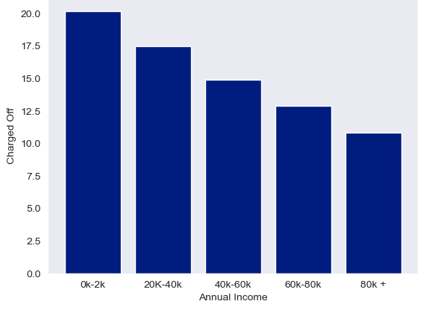
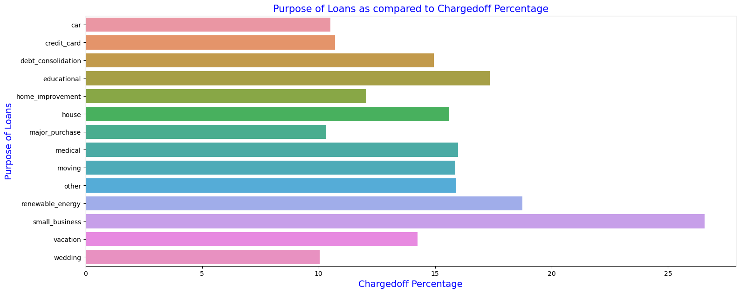
Bivariate Analysis: Annual Inc & Purpose of Loan vs Charged Off Percentage
Income range 0-20000 has high chances of charged off.
Income 80000+ has less chances of charged off.
Notice that with increase in annual income, the charged off percentage is decreasing.
Small Business applicants have high chances of getting charged off.
Major purchase has charged off percentage is better compared to other categories.

Slide 11
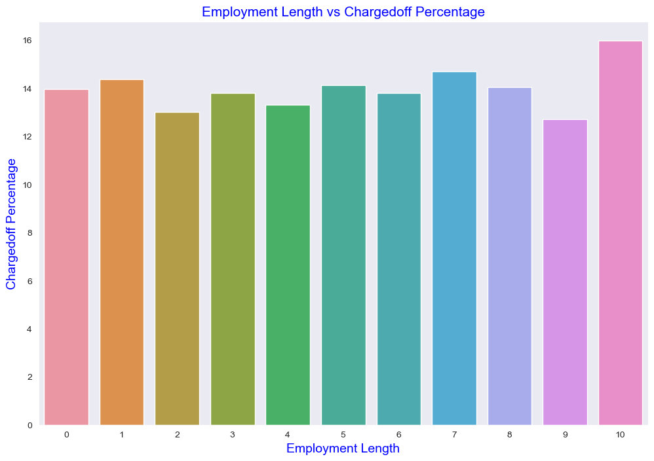
Bivariate Analysis: Employment Length vs Charged Off
Those who have employment length more than 10 years have the highest chance of charge off.
People with employment might have higher debts leading to higher rates of charge off
Those with work experience less than 1 year have high chances of getting charged off.
It makes sense as with less or no experience they don't have source of income to repay loan.

Slide 12
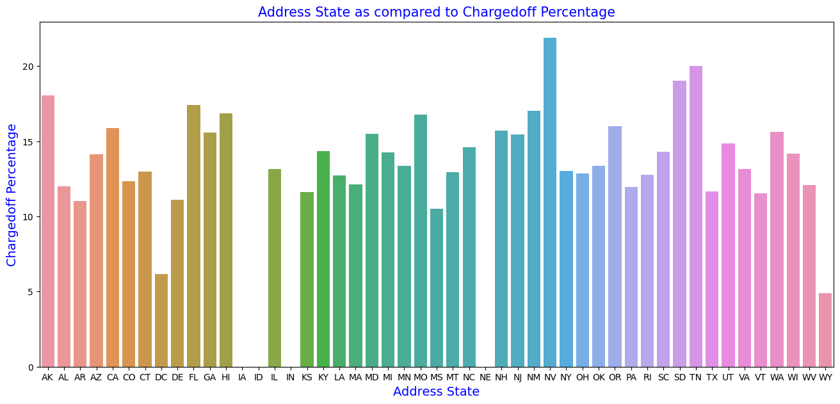
Bivariate Analysis: Address state vs Charged Off Percentage
-The State Address 'NV' has the highest rate of charge off. -This is followed by 'TN' and 'SD' respectively. -Seems like 'IA' and 'IN' has no charge off(maybe there is no data from that place) -'WY' and 'DC' has the lowest rate of charge off.

Slide 13
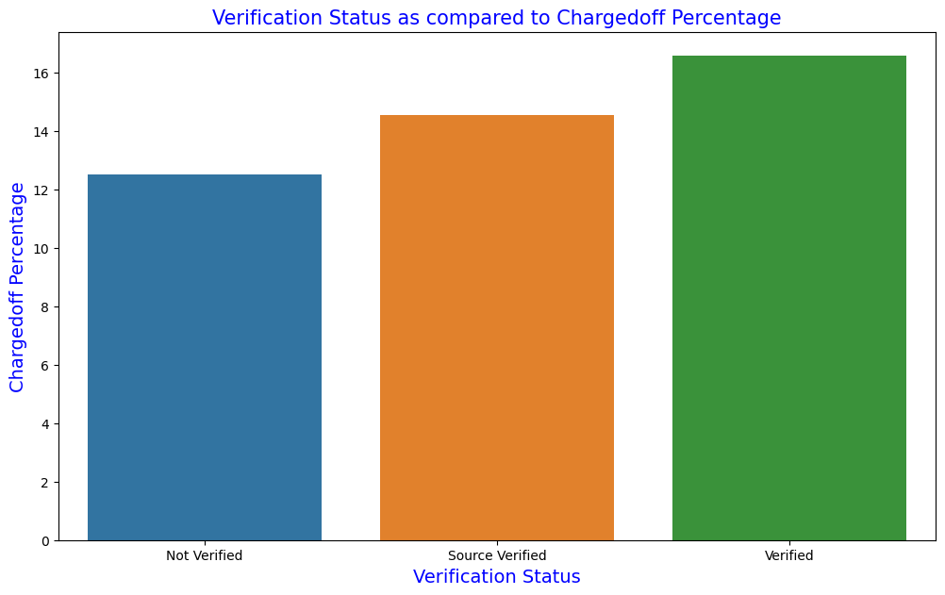
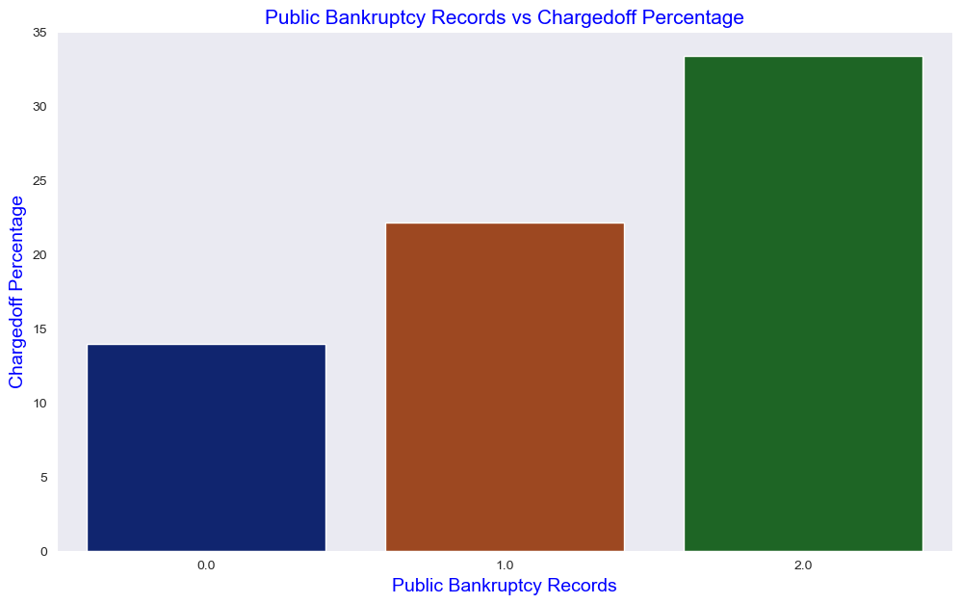
Bivariate Analysis: Public bankruptcy records & Verification vs Charged off percentage
The highest rate of charge off is with Bankruptcies as 2.
Charge off rate is directly proportional to the rise in Public bankruptcies records.
There is not much difference in charged off proportion for verification status

Slide 14
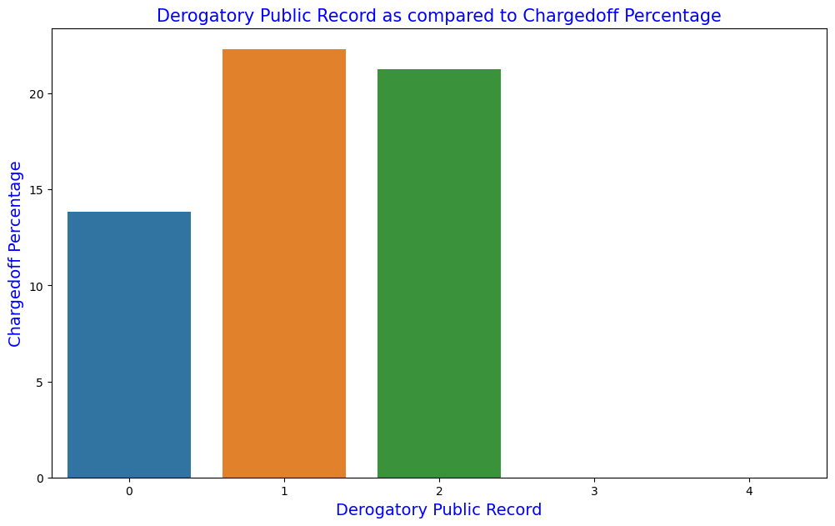
Bivariate Analysis: Derogatory public record vs Charged off percentage
The highest rate of charge off is with Bankruptcies as 2.
Charge off rate is directly proportional to the rise in Public bankruptcies records.

Slide 15
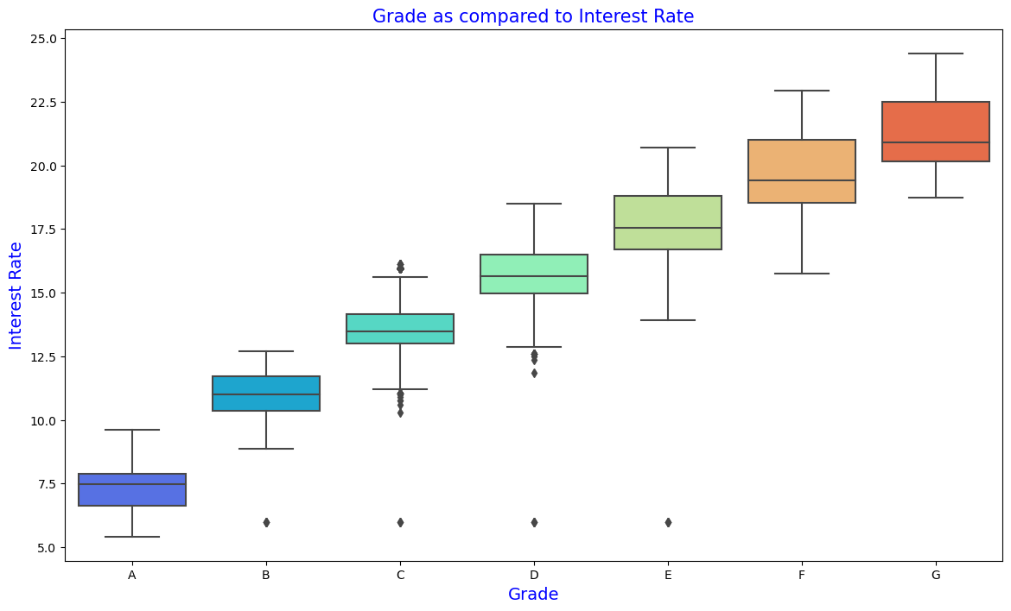
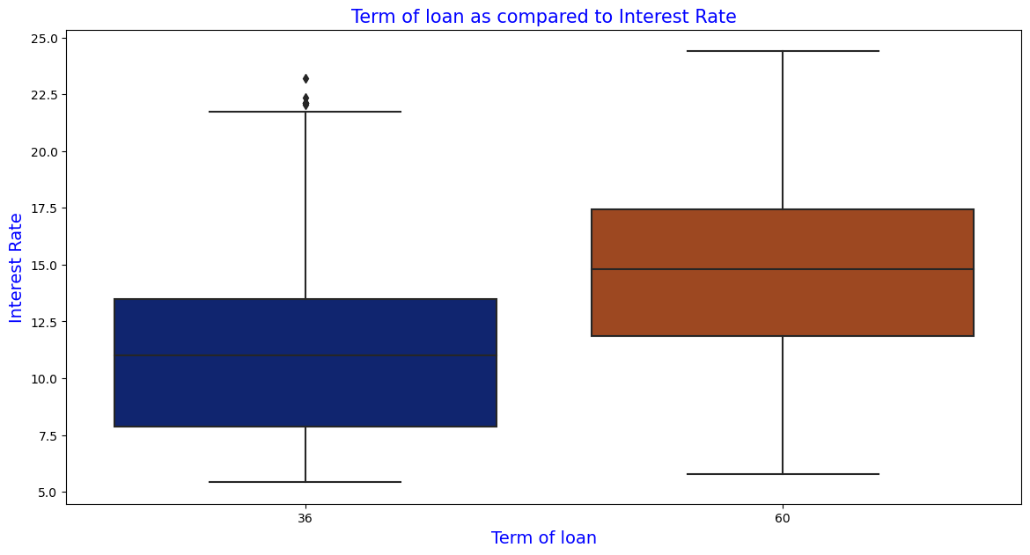
Term of loan & Grade vs Interest Rate
Average interest rate is higher for loan term of 60 months.
Median of applicants with term 36 months pay less, around 11% compared to median of ones with 60 months term of around 15% .
-Grade A has the lowest interest rates. -Grade G has the highest interest rates. -Interest rates are increments in propotion to growth of grades in ascending order

Slide 16
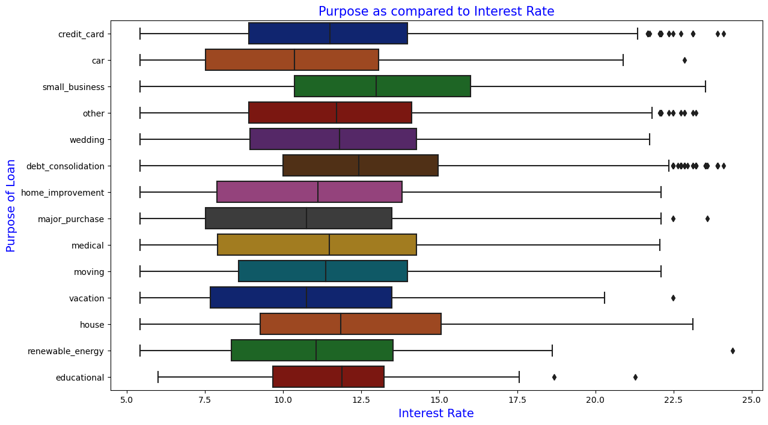
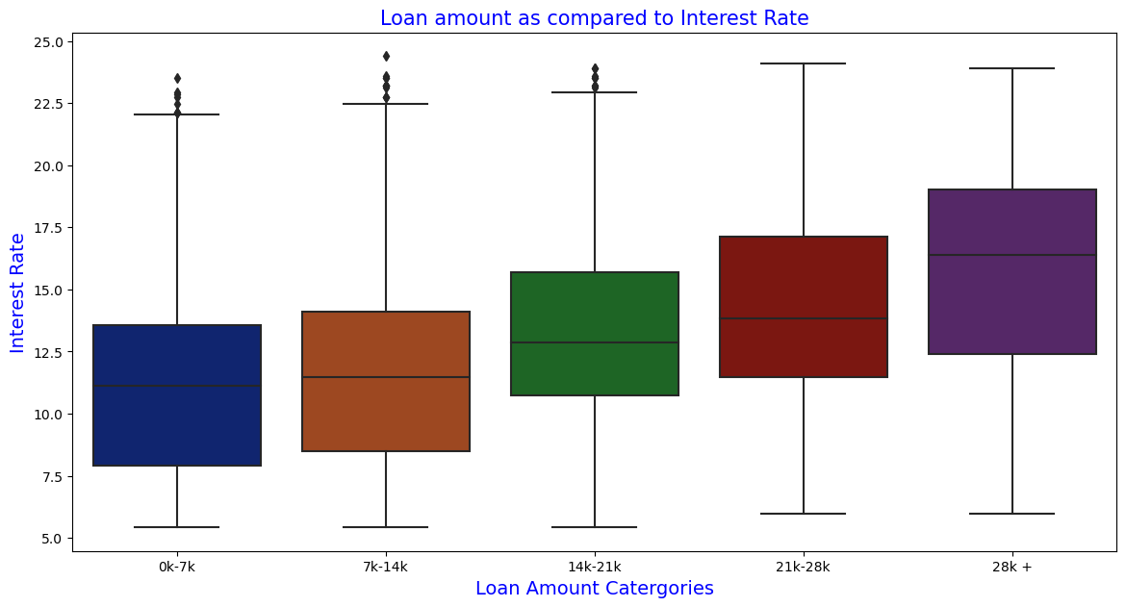
Purpose of loan & Loan Amount vs Interest Rate
-Increase in Loan amount is directly proportional to increase in interest rates. -Interest rat is highest for loan amounting to 28K+, whereas its the lowest for loan amount below 14K[0-7K, 7K-14K
Average interest rate is highest for small business purpose. -Loans taken for small business purposes had to repay the loan with more interest rate as compared to other.
Debt consolidation is 2nd where borrowers had to pay more interest rate.

Slide 17
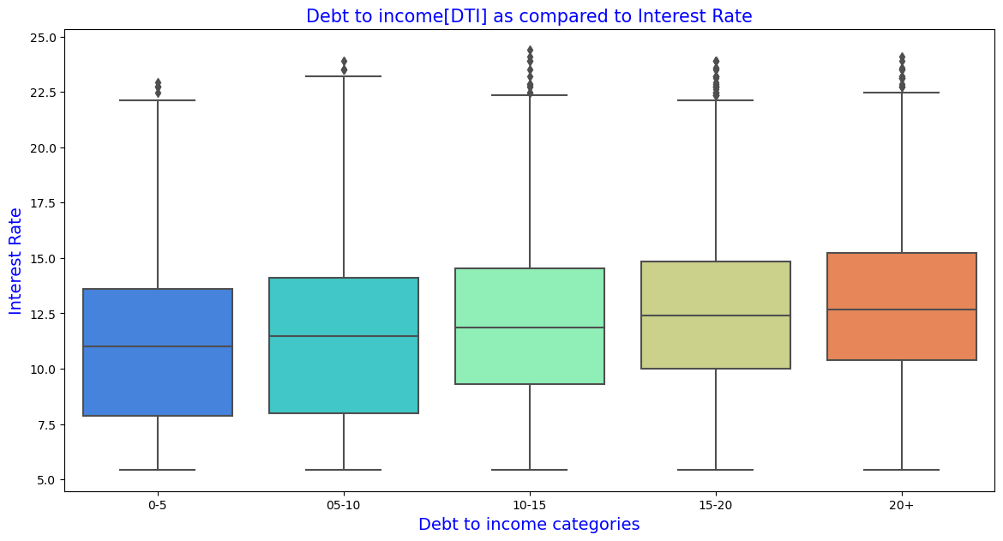
Debt to income[DTI] vs Interest Rate
There seems to be no or negligible difference in interest rates on loan as compared to DTI

Slide 18
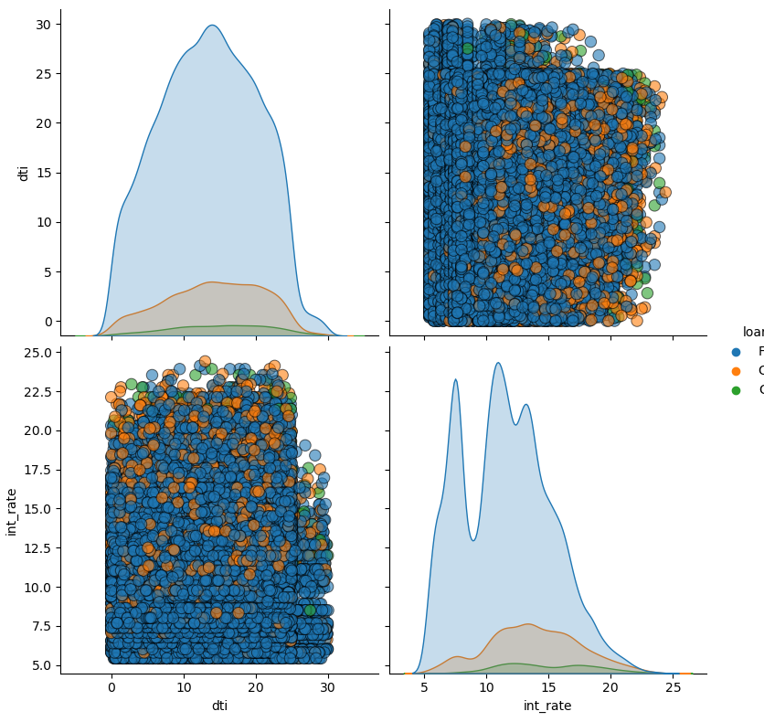
Multivariate Analysis: Loan Amt, Annual Income, Interest Rate, Loan Status

Slide 19
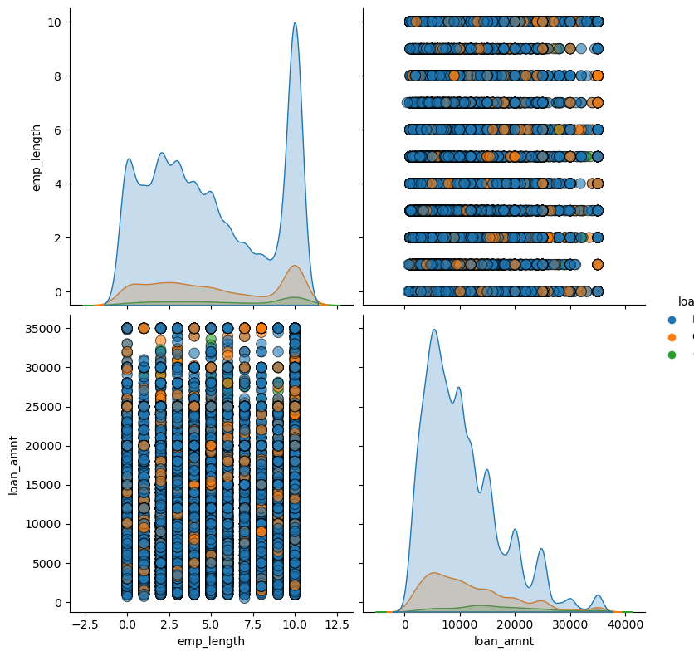
Multivariate Analysis: Loan Amount, Employment Length, Loan Status

Slide 20
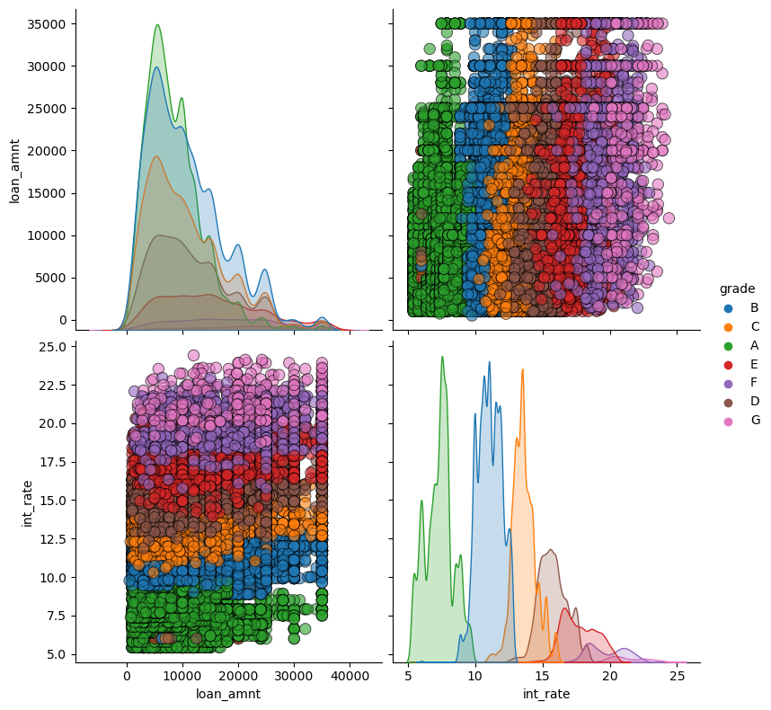
Multivariate Analysis: Loan Amount, Loan Grade, Interest Rate

Slide 21
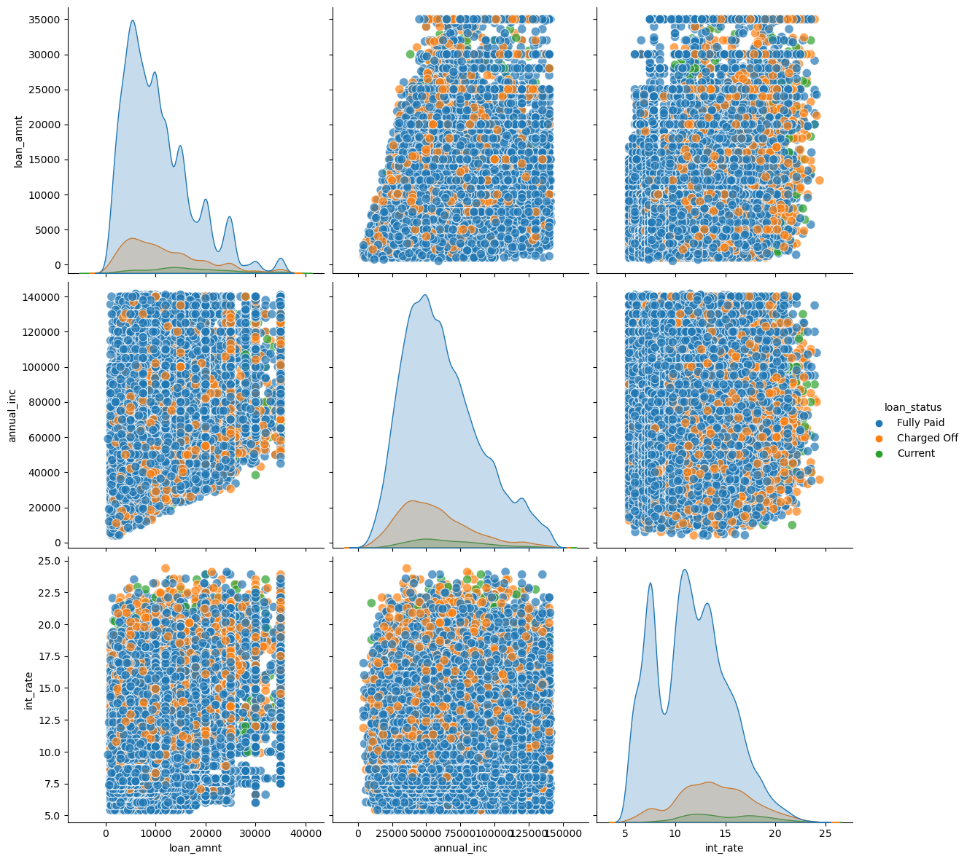
Multivariate Analysis: Loan Amount, Annual Income, Interest Rate, Loan Status

Slide 22
Multivariate Analysis: Loan Amount, Annual Income, Interest Rate, DTI, Loan Status

Slide 23
Conclusion

