Slide 1

Lending Club Case Study
Nitish Sharma
Chetna Priyadarshini

Slide 2

Problem Statement
Help a finance company identify risky loan applicants
Understand consumer attributes and loan attributes that are likely to cause the account to be defaulted
To serve above
Clean data removing null columns, replace NA with 0 where applicable, identify and remove rows that do not have any important information
Study distribution of data on various rows and perform outlier treatment
Understand corelation between different variables in people who defaulted on the loan and identify a common pattern
Combine the rows together to arrive at a conclusion on risk factors for loan defaulters

Slide 3
Data Cleaning
Initial data: 39717 rows and 111 columns
Removed null columns: 39717 rows and 57 columns
Removed columns with only one value: 39717 rows and 51 columns
Removed columns which have more than 20% null values: 39717 rows and 47 columns
Removed columns with id/membership_id(all unique vals): 39717 rows and 45 columns
Removing columns not interesting for analysis: 39717 rows, 23 columns
Replace remaining null values with 0
Standardize column values removing trailing string of %, months, x, converting to numeric where possible
Remove outliers from Loan Amount, Annual Income, Debt to Income ratio columns

Slide 4
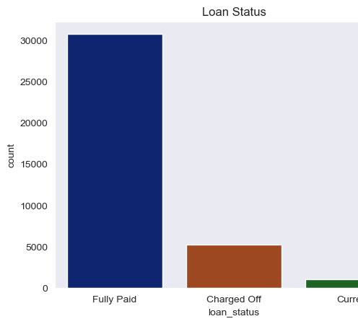
Univariate Analysis: Loan Status
We can see that most of the users in Fully paid category

Slide 5
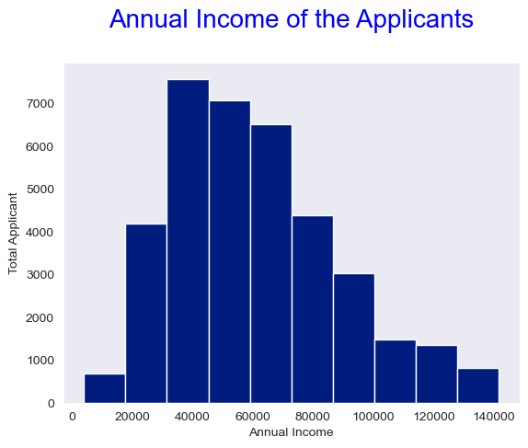
Univariate Analysis: Annual Income
maximum number of loan applicants are having a annual income of 30000 - 40000.
4500 people have salary less than 30000.

Slide 6
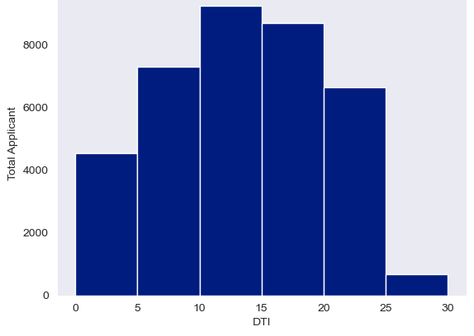
Univariate Analysis: Debt to Income
Composition of highest applicants with top 3 DTI falls under the categories as 10-15, 15-20 and 5-10 respectively.

Slide 7
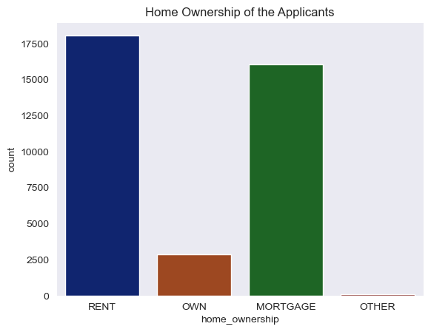
Univariate Analysis: Home Ownership
most of the applicants are either living on rent or property is mortgage.

Slide 8
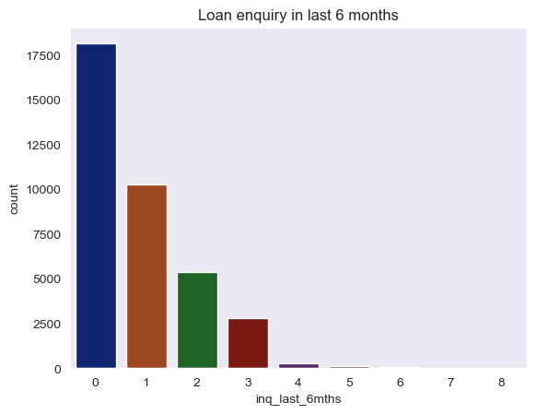
Univariate Analysis: Loan enquiry in last 6 months
most of the applicants have 0 to 3 enquiries.
some applicants with enquiry between 4 to 8

Slide 9
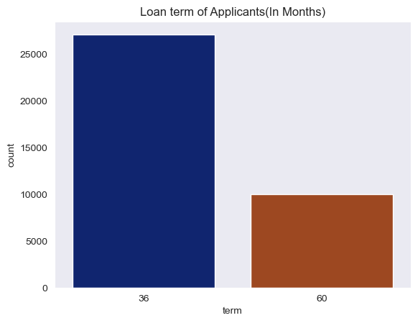
Univariate Analysis : Loan Term
maximum applicants have a Loan term of 36 months.

Slide 10
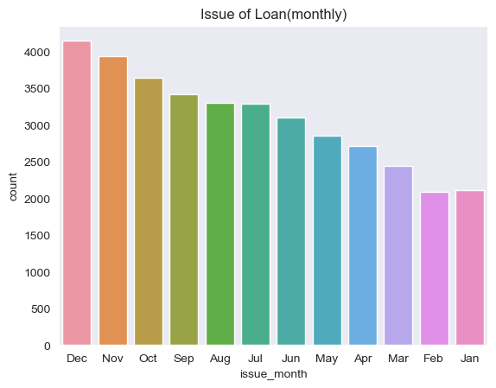
Univariate Analysis: Issue of Loan(Month)
This represents the maximum loan being issued in December

Slide 11
Segmented Analysis
Break down loan amount data in 0k-7k, 7k-14k, 14k-21k, 21k-28k, 28k +
1
Break down annual income data 0k-2k, 20k-40k, 40k-60k, 60k-80k, 80k+
2
Break down interest rate in group 0-10, 10-13, 13-16, 16+
3
Break down debt to income ration in groups 0-5, 5-10, 10-15, 15-20, 20+
4

Slide 12
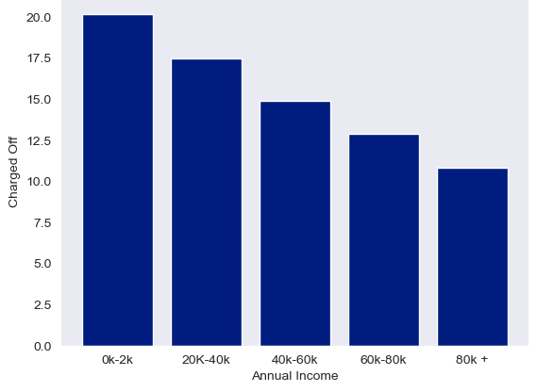
Bivariate Analysis: Annual Inc vs Charged Off Percentage
-Income range 0-20000 has high chances of charged off. -Income 80000+ has less chances of charged off. -Notice that with increase in annual income, the charged off percentage is decreasing.

Slide 13
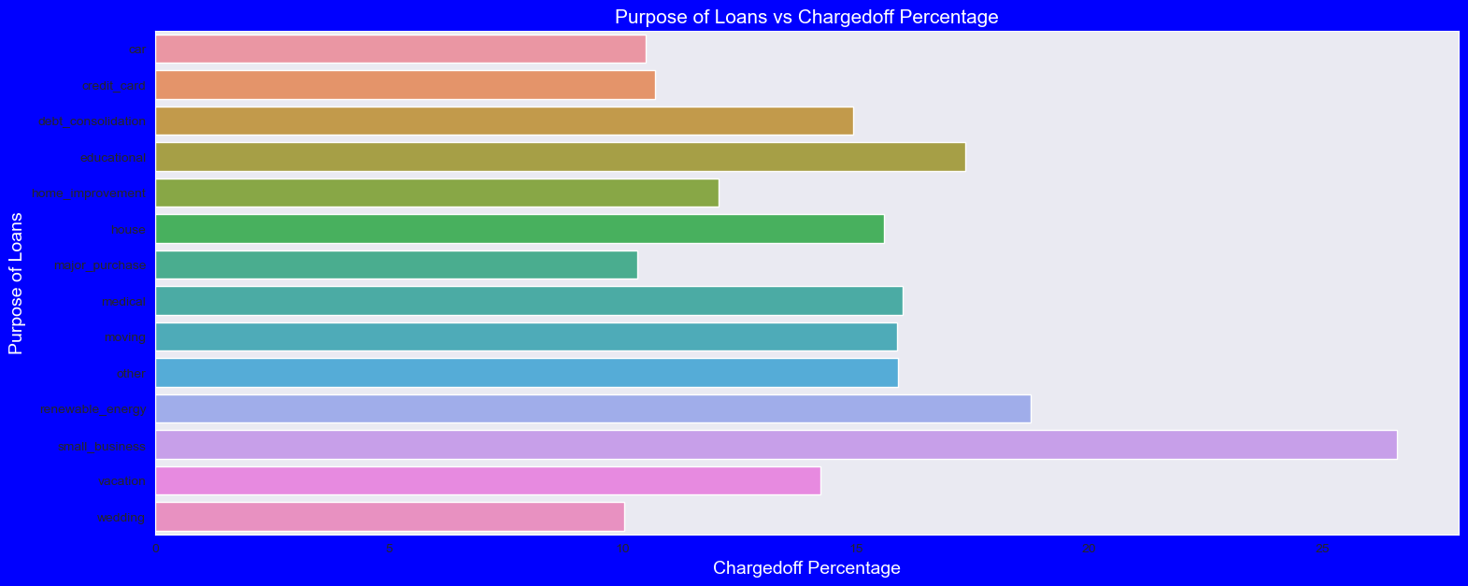
Bivariate Analysis: Purpose of loan vs charged off percentage
small Business applicants have high chances of getting charged off.
major_purchase where charged off percentage is better as compare to other categories.

Slide 14
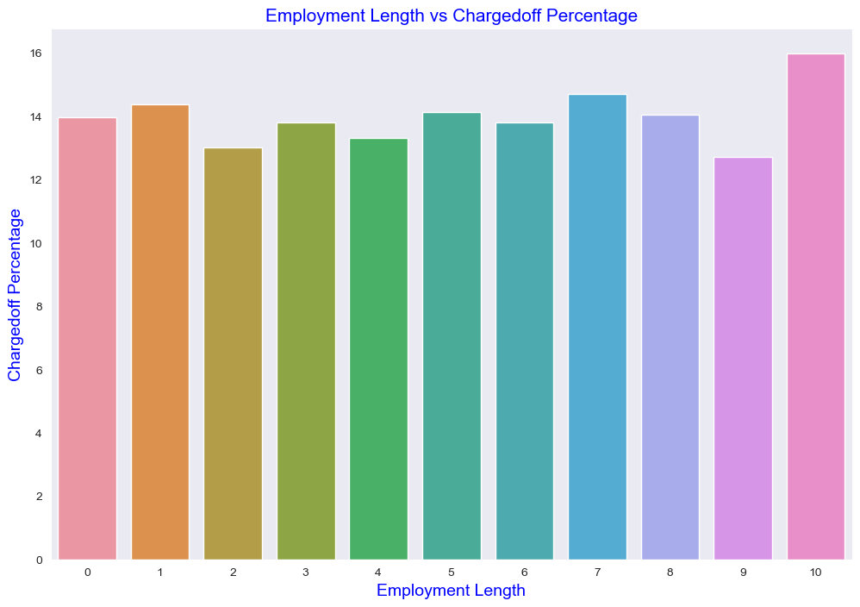
Bivariate Analysis: Employment Length vs Charged Off
Those who have employment length more than 10 years have the highest chance of charge off.
People with employment might have higher debts leading to higher rates of charge off
Those with work experience less than 1 year have high chances of getting charged off.
It makes sense as with less or no experience they don't have source of income to repay loan.

Slide 15
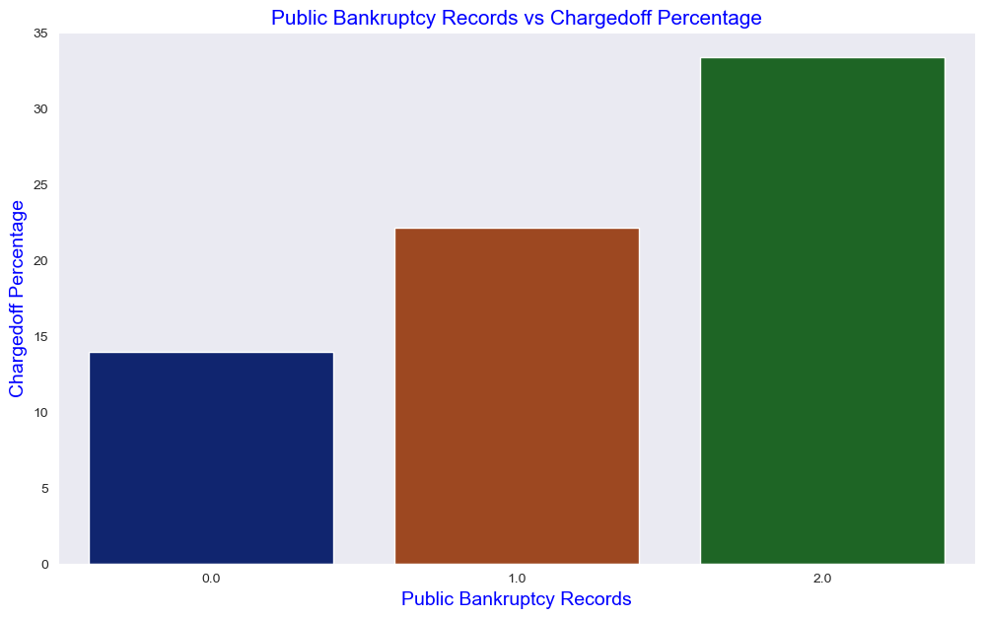
Bivariate Analysis: Public bankruptcy records vs Charged off percentage
The highest rate of charge off is with Bankruptcies as 2.
Charge off rate is directly proportional to the rise in Public bankruptcies records.

Slide 16
Conclusion

