Slide 1

MACHINE LEARNING
Summer Internship- 2026
Name: Chetna Saharan
Supervisor: Prof. Millie Pant
Mentor: Ms. Riya & Mr. Harjeet Singh Applied Mathematics & Scientific Computing
Indian Institute of Technology Roorkee

Slide 2

Table of Content
1
INTRODUCTION TO MACHINE LEARNING
DATA PREPROCESSING AND EDA
LINEAR AND LOGISTIC REGRESSION
DECISION TREES AND RANDOM FORESTS
SVM AND K-NEAREST NEIGHBORS
CLUSTERING AND DIMENSIONALITY REDUCTION
MODEL EVALUATION AND HYPERPARAMETER TUNING
FEATURE ENGINEERING AND PIPELINES
INTRODUCTION TO NLP

Slide 3
Introduction
2
MACHINE LEARNING: ML is the process of training a piece of software, called a model, to make useful predictions or generate content (like text, images, audio, or video) from data. ML is the way of teaching computer to learn from data – just like we human learn from experience.
EXAMPLE: Real-Life Applications of ML Netflix & YouTube: Recommend movies and videos.
Amazon & Flipkart: Recommend products based on previous purchases.
The Core Types of Machine Learning
Supervised Learning: The algorithm is trained on "labeled" data, meaning the input data already has the correct answer attached to it.
Example: Teaching a system to recognize tumors by showing it thousands of MRI scans labeled "benign" or "malignant."
Unsupervised Learning: The algorithm is given "unlabeled" data and must find patterns, structures, or anomalies on its own.
Example: Grouping e-commerce customers into distinct segments based on their purchasing habits for targeted marketing.
Reinforcement Learning: The algorithm learns by trial and error within a specific environment, receiving "rewards" for correct actions and "penalties" for wrong ones.
Example: A robot learns to navigate a maze by receiving rewards for reaching the exit and penalties for hitting walls.*
Key Terminology in Machine Learning
Features(Input)
Labels(Output)
Training(Teaching Model)
Testing(Accuracy)

Slide 4
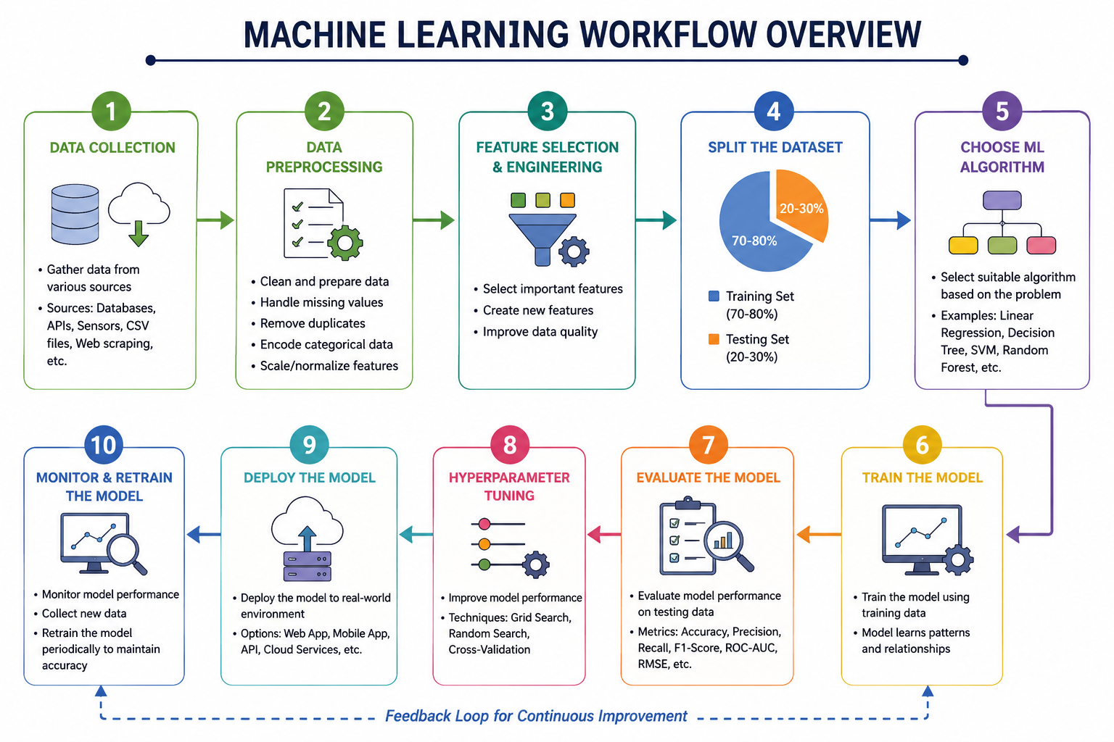
ML Workflow Overview
3

Slide 5
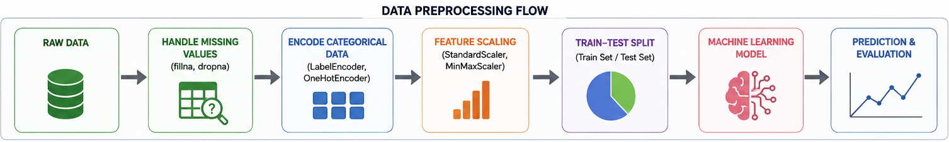
DATA PREPROCESSING
4
Handling Missing Values(Fill or drop the gaps)
fillna() → Replaces missing values with mean, median, mode, or another value.
dropna() → Removes rows or columns containing missing values.
Encoding Categorical Variables(Turning categories into numbers)
LabelEncoder → Converts categories into numerical labels (0, 1, 2, ...).
OneHotEncoder → Creates separate binary columns for each category.
Feature Scaling(Leveling the playing field for different units)
StandardScaler → Transforms data to have mean = 0 and standard deviation = 1.
MinMaxScaler → Scales data to a range between 0 and 1.
Train-Test Split(Separating the practice quiz from the final exam)
Divides the dataset into:
Training Set: Used to train the model.
Testing Set: Used to evaluate the model's performance

Slide 6
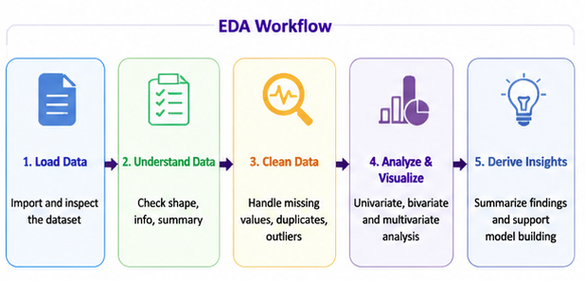
Exploratory Data Analysis
5
Exploratory Data Analysis (EDA) is the process of examining, cleaning, and understanding a dataset before building a machine learning model. It helps identify patterns, relationships, outliers, and errors in the data.
Matplotlib (Python library for creating static, animated, and interactive visualizations) is the foundational, low-level plotting engine.
Example:
Seaborn is built on top of Matplotlib and makes beautiful, complex statistical plots with very little code. It provides a high-level interface for creating attractive and informative statistical graphics.
Line plots ,Scatter plots ,Bar charts ,Histograms & Pie charts

Slide 7
Supervised Machine Learning
6
The algorithm learns the relationship between inputs and outputs and then predicts the output for new data.
Algorithm | Description
Linear Regression | A supervised learning algorithm used to predict continuous values by fitting a straight line to the data. Cost function:measures how far the model's predictions are from the actual values. Gradient descent:Gradient Descent is an optimization algorithm used to minimize the cost function by updating the model parameters step by step.
Logistic Regression | Predicts the probability that an input belongs to a particular class(Output between 0 and 1)
Decision Tree | Decision trees are non-parametric supervised learning models that partition the feature space into local regions through a sequence of recursive binary splits.
Random Forest | Random Forest is a supervised ensemble machine learning algorithm that combines multiple decision trees and uses their collective predictions to improve accuracy and reduce overfitting. Bagging (Bootstrap Aggregating)
SVM | Support Vector Machine (SVM) is a supervised machine learning algorithm that finds the optimal boundary (hyperplane) to separate different classes with the maximum margin. Hyperplane, Margin, Support Vectors, Kernel Trick
KNN | KNN predicts a new data point by looking at the labels of its nearest neighbors. Distance Metrics, Choosing K

Slide 8
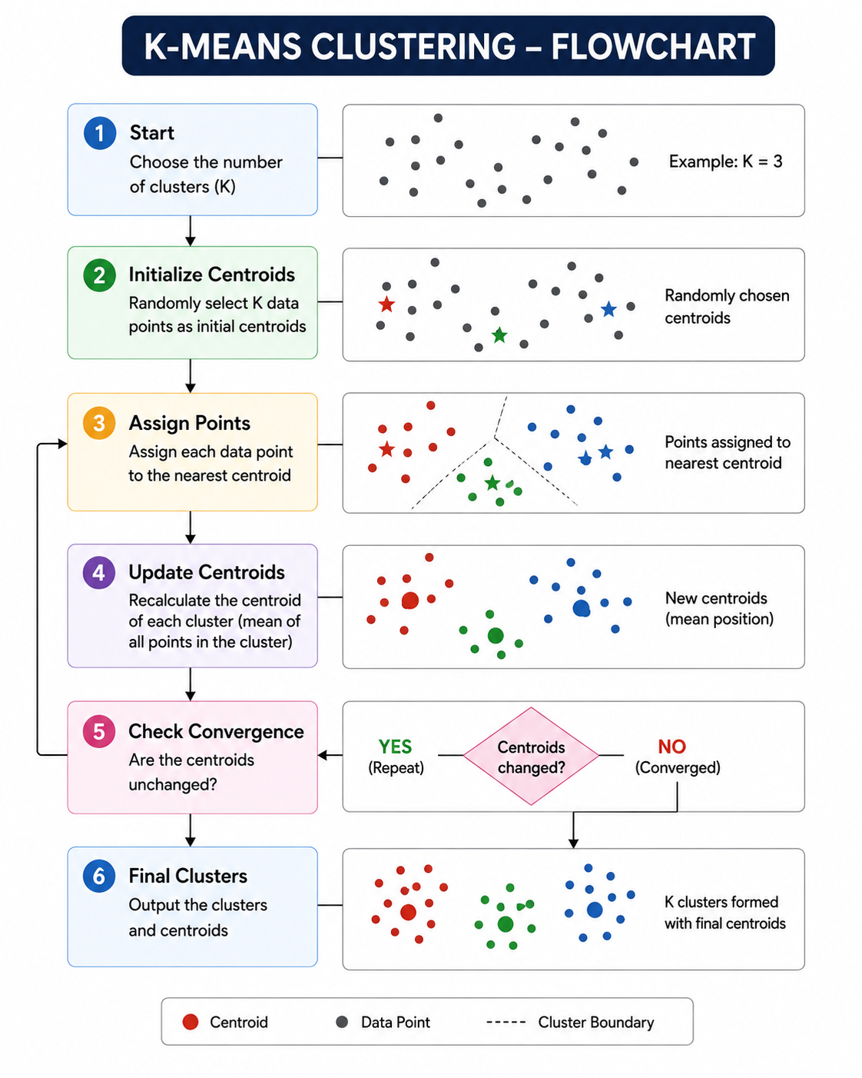
Unsupervised Machine Learning
7
Unsupervised Machine Learning is a type of machine learning in which the algorithm learns patterns and relationships from unlabeled data without knowing the correct output in advance.
Algorithm | Description
K Means Clustering | K-Means is an unsupervised machine learning algorithm that groups similar data points into K clusters based on their similarity. Centroids, Inertia, Elbow Method
DBSCAN | DBSCAN is an unsupervised clustering algorithm that groups closely packed data points and identifies isolated points as outliers (noise). Epsilon (ε), Core Point, outlier, MinPts (Minimum Points)
PCA | PCA is an unsupervised dimensionality reduction technique that transforms data into a smaller set of principal components while preserving most of the information (variance).

Slide 9
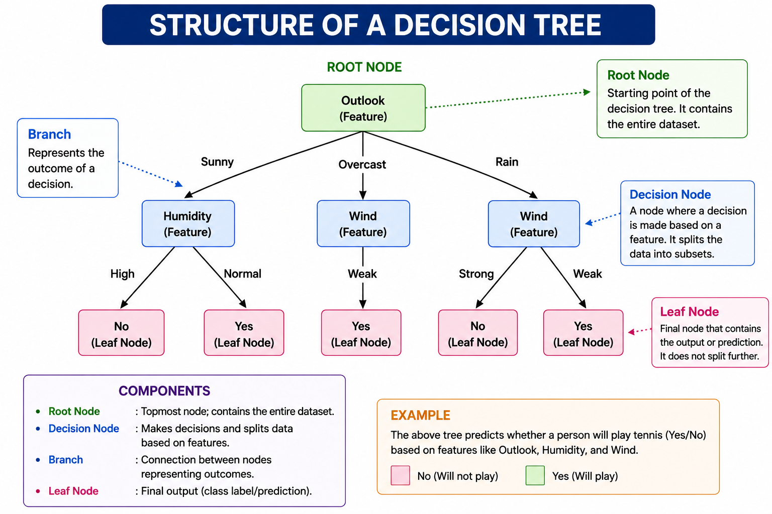
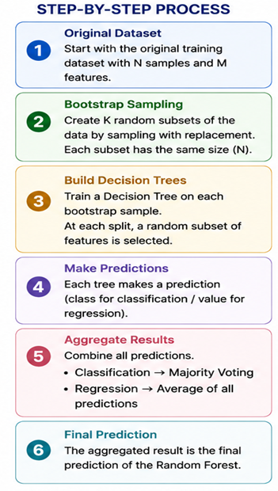
Decision trees & Random Forest
8
RANOM FOREST

Slide 10
Model Evaluation & Hyperparameter Tuning
9
Model Evaluation is the process of assessing how well a machine learning model performs on a task, typically using data that was not used during training.
Hyperparameter tuning is the process of finding the best values of a machine learning model's hyperparameters to improve its performance.
Classification Matrices | Description
Precision | Precision answers the question : “When the model predicts Positive, how often is it correct?"
Recall | Recall answers: “Out of all actual positive cases, how many did the model detect?"
F1 Score | F1-Score is the harmonic mean of Precision and Recall. It balances both metrics.
ROC-AUC | ROC stands for “Receiver Operating Characteristic”. It is a graph used to evaluate binary classification models. AUC measures the overall performance of the classifier.
Cross-Validation Strategies | Cross-Validation Strategies are techniques used to evaluate a machine learning model's performance by dividing the dataset into training and testing sets in different ways. K-Fold Cross-Validation , Stratified K-Fold &Leave-One-Out Cross Validation (LOOCV)
GridSearchCV | GridSearchCV is used to find the best combination of hyperparameters by testing every possible combination
RandomizedSearchCV | RandomizedSearchCV tests only a random subset of parameter combinations instead of all combinations.
Bias-Variance Tradeoff | The Bias-Variance Tradeoff explains the balance between : Bias (Underfitting) Variance (Overfitting) A good model achieves a balance between both.

Slide 11
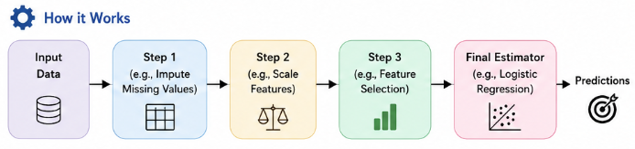
Feature Engineering & Pipelines
10
Feature Selection: Feature selection is the process of choosing the most relevant input features (variables) for building a machine learning model. It improves model performance, reduces overfitting, and decreases training time.
SelectKBest: SelectKBest selects the top K features based on a statistical test.
Recursive Feature Elimination (RFE) RFE recursively removes the least important features until the desired number of features remains.
Correlation-Based Feature Selection : Correlation measures how strongly two variables are related.
Creating New Features (Polynomial and Interaction Features)
Feature engineering is the process of creating new features (variables) from existing data to improve the performance of a machine learning model. Well-designed features help models capture patterns that may not be apparent from the original data.
Scikit-learn Pipeline to Chain Steps
A Pipeline in scikit-learn is a utility that allows you to combine multiple preprocessing steps and a machine learning model into a single object

Slide 12
INTRODUCTION TO NLP
11
Natural Language Processing (NLP) is a branch of Artificial Intelligence that enables computers to understand, interpret, process, and generate human language in both text and speech forms.
Text Preprocessing Text preprocessing is the process of cleaning and transforming raw text into a format suitable for machine learning models.
Steps in Text Preprocessing
A. Tokenization
Definition: Breaking text into smaller units called tokens (words or sentences).
Example:
Sentence: "I love Machine Learning!"
Tokens:
["I", "love", "Machine", "Learning"]
C. Stemming
Definition: Reduces words to their root (stem) form.
Examples:
B. Stopwords Removal
Definition: Stopwords are commonly used words that usually do not add much meaning.
Example:
Original:
The cat is sleeping on the mat.
After removing stopwords:
cat sleeping mat
Original Word | Stem
Playing | Play
Played | Play
Playing | Play
Studies | Studi
Running | Run

Slide 13
Introduction to NLP
12
Vectorization is the technique of representing data as numerical vectors for mathematical and machine learning operations.
Terms | Description
Bag of Words (BoW) vectorization | Bag of Words (BoW) is a text vectorization technique that converts text into numerical feature vectors by counting how many times each word appears in a document. It ignores grammar and word order but preserves word frequency.
TF-IDF Vectorization | TF-IDF (Term Frequency–Inverse Document Frequency) is a feature extraction technique that measures the importance of a word in a document relative to a collection of documents.
Naive Bayes Text Classifier | A Naive Bayes classifier is a probabilistic machine learning algorithm based on Bayes' Theorem. It is widely used for text classification because it is fast, simple, and effective.
Sentiment Analysis Basics | Sentiment Analysis is an NLP technique used to determine the emotional tone or opinion expressed in text.

Slide 14
References
13
Google ML Crash Course
Scikit-learn
Kaggle
StatQuest
NLTK Official Docs
Towards Data Science – ML Projects

